Slide 1
Technology Frameworks
The When and Why of Using Tech
Notes:
Opening slide. Facilitator might have this opening slide showing 15 minutes prior to the start of the session as participants join the virtual room. A few minutes before the start of the session, move to slide 2.

Slide 2



Technology Should Foster Collaboration, Critical Thinking and Creativity
Notes:
Think about why you use technology in your classrooms.

Slide 3

Technology Should Foster Learning

Slide 4
Why Use Technology in the Classroom?
Padlet

Slide 5
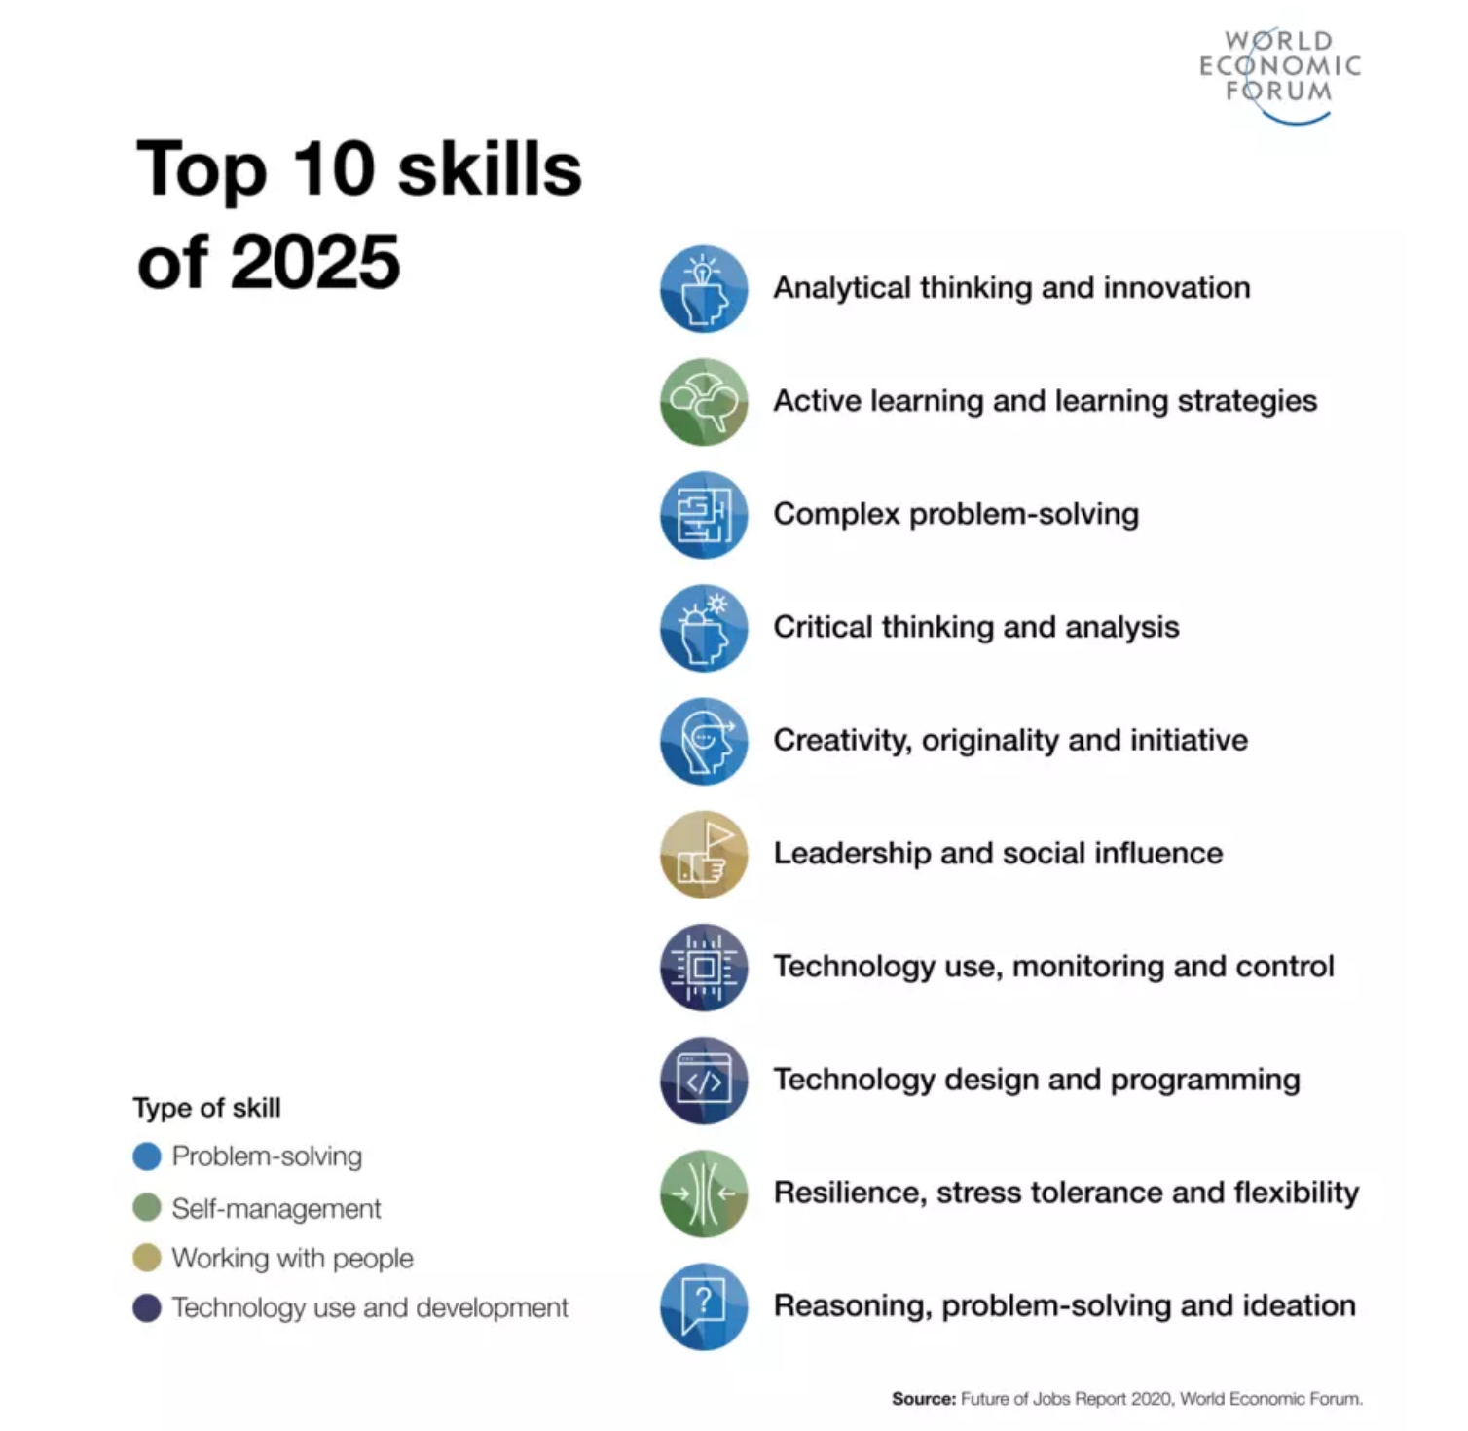
Top 10
Skills of 2025
Source: Future of Jobs Report 2020, World Economic Forum

Slide 6
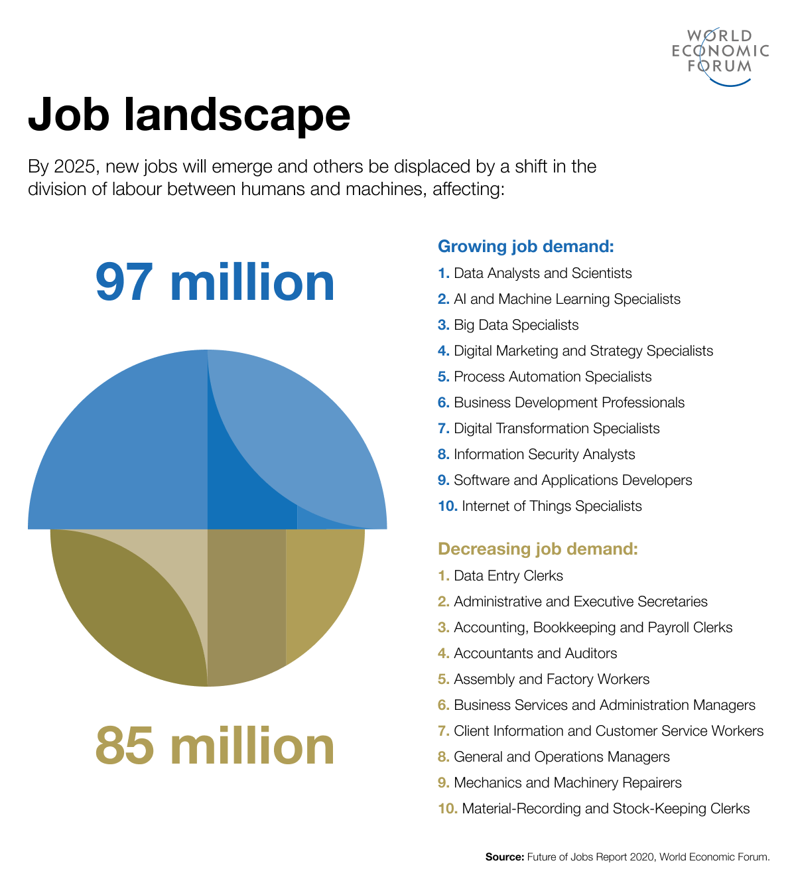
Job Landscape
By 2025, new jobs will emerge and others be displaced by a shift in the division of labor between humans and machines affecting:
Growing Job Demand
Decreasing Job Demand
Data Analysts & Scientists
Al & Machine Learning Specialists
Big Data Specialists
Digital Marketing & Strategy Specialists
Process Automation Specialists
Business Development Professionals
Digital Transformation Specialists
Informational Security Analysts
Software & Applications Developers
Internet of Things Specialists
Data Entry Clerks
Administrative & Executive Secretaries
Accounting, Bookkeeping & Payroll Clerks
Accountants and Auditors
Assembly and Factory Workers
Business Services & Administrative Managers
Client Information & Customer Service Workers
General & Operations Managers
Mechanics & Machinery Repairers
Material Recording & Stock-Keeping Clerks
Source: Future of Jobs Report 2020, World Economic Forum

Slide 7
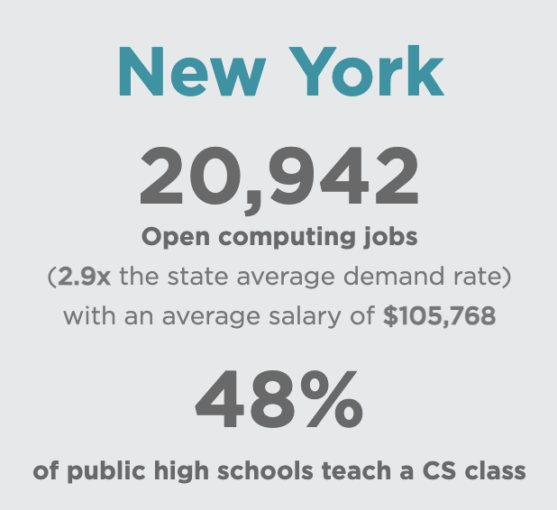
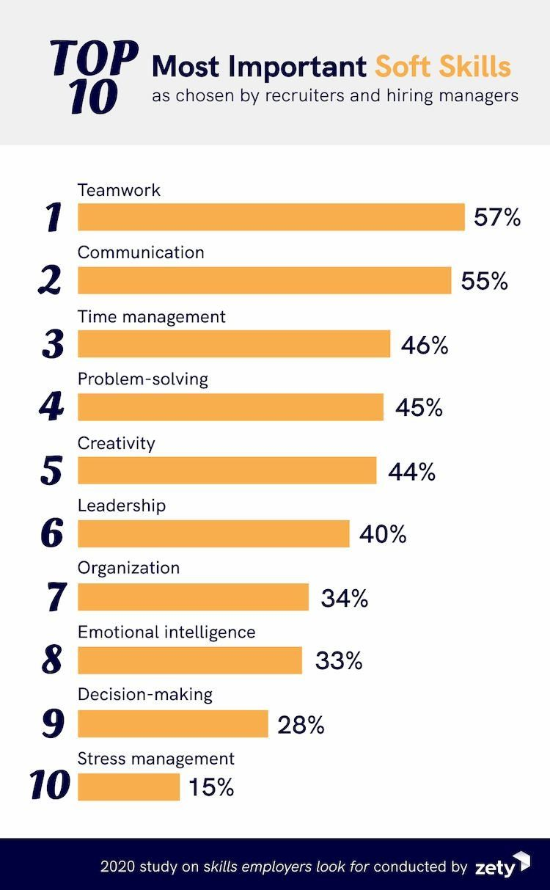
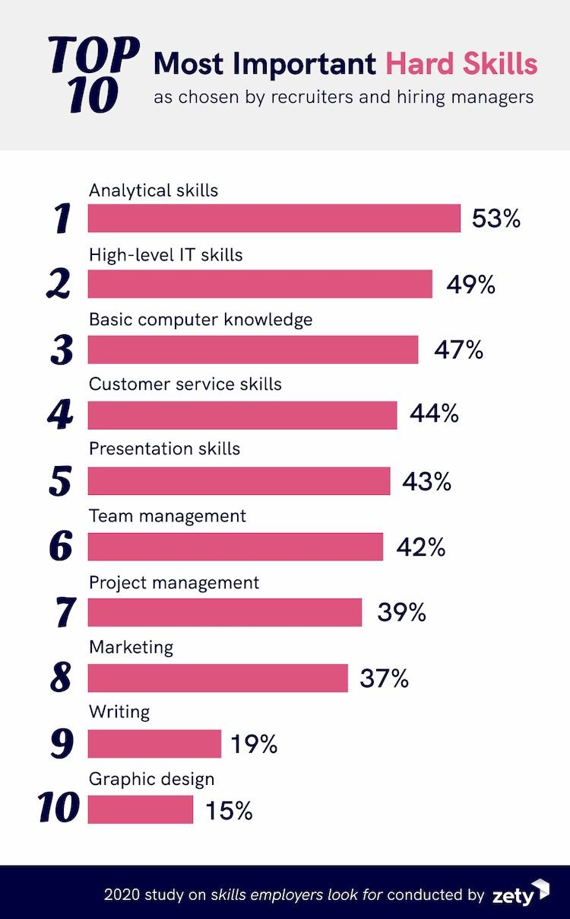
More reasons why…

Slide 8
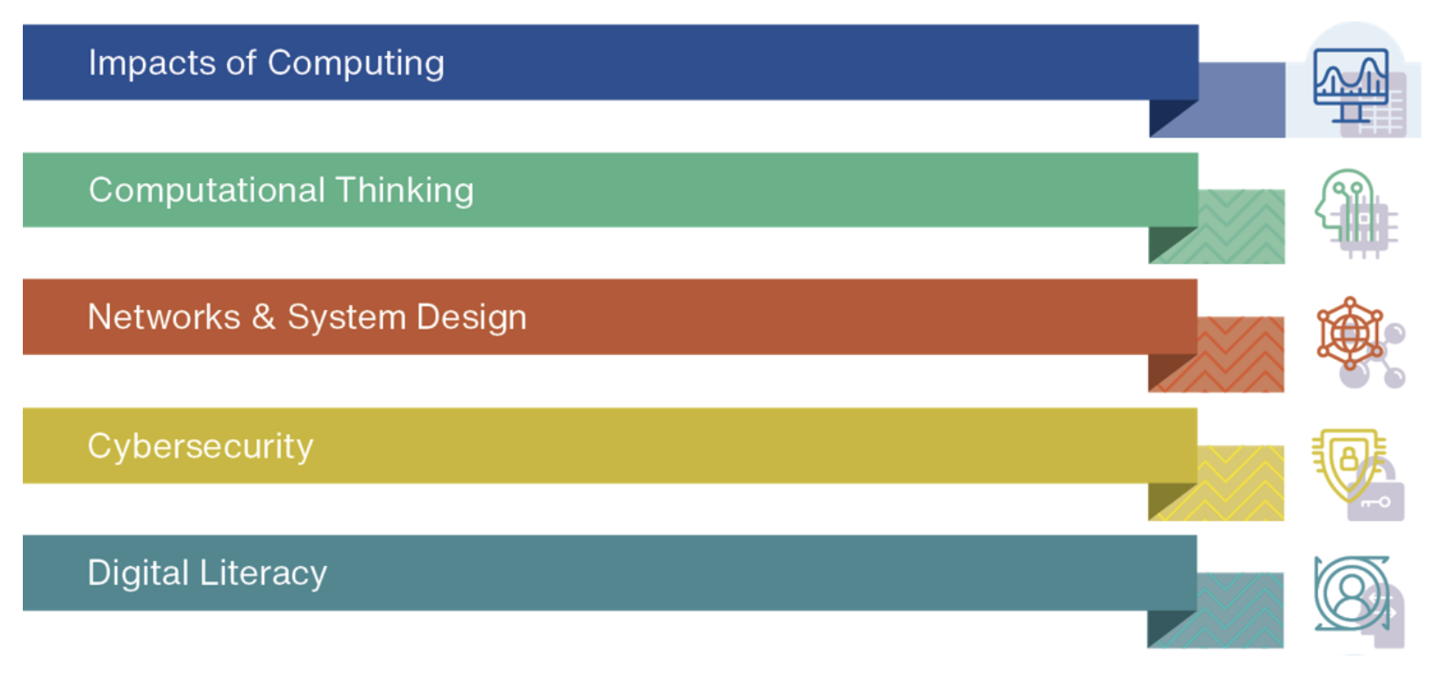
NYSED Computer Science and Digital Fluency Standards

Slide 9
How do you know when to use technology?
Padlet

Slide 10
When to use technology…
It enhances the learning experience
It engages the learning process
It allows for things that would otherwise not be possible
It gives students responsibility for their learning
It allows for student agency
It allows for feedback
It allows for interaction
It allows for creativity
It connects students to the world around them
It offers positive effects to student achievement
It offers access
It helps with problem solving and critical thinking

Slide 11
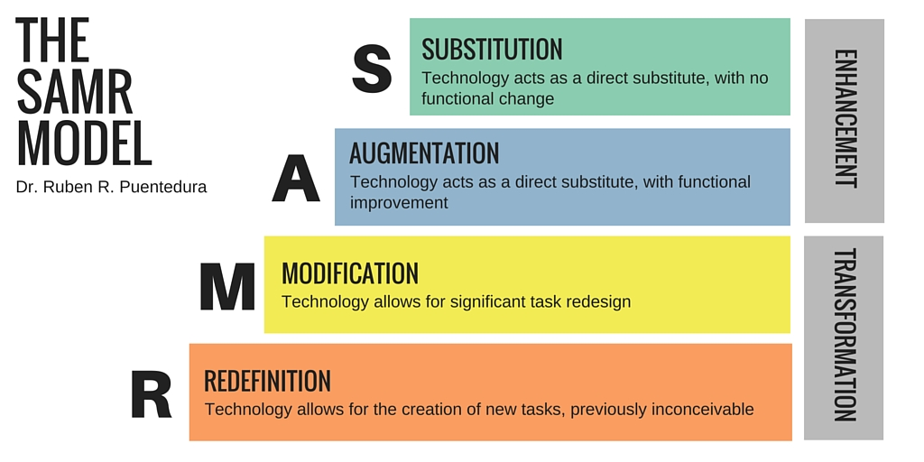
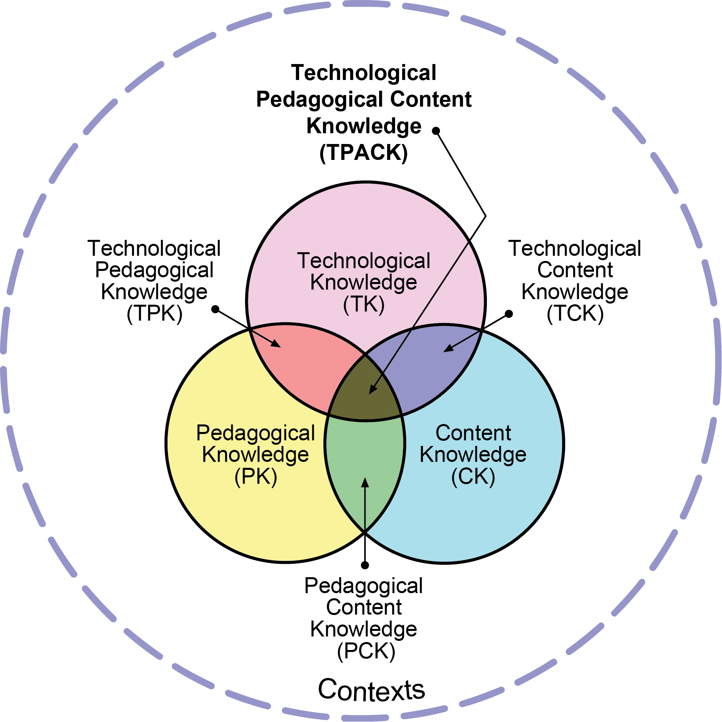

Frameworks to assess the use of technology

Slide 12
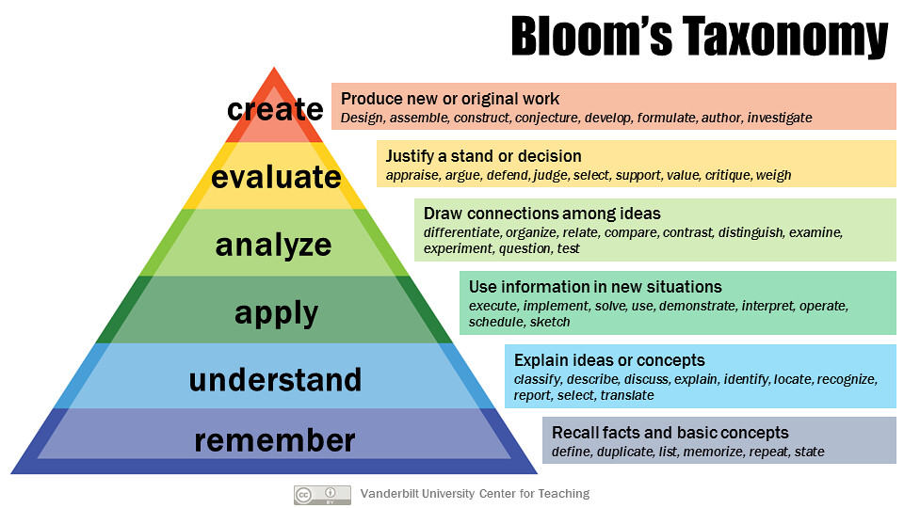
Bloom’s Taxonomy Reminder
Source: Vanderbilt University Center for Teaching

Slide 13
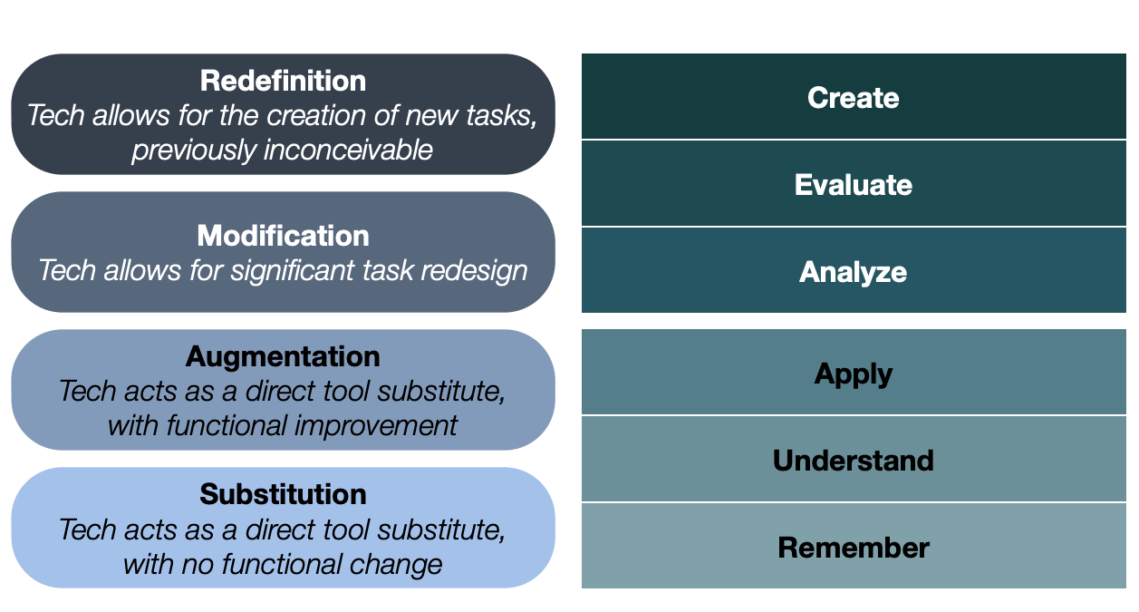
SAMR

Slide 14
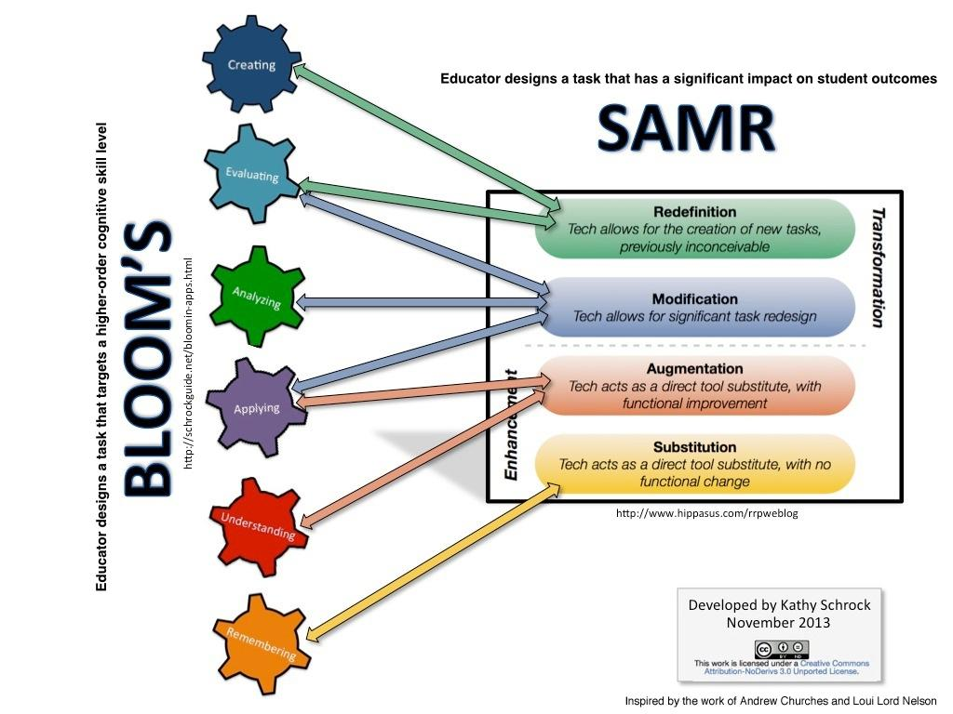
SAMR continued…

Slide 15
SAMR Levels
Substitution | Augmentation | Modification | Redefinition
what will be gained by replacing traditional tools with technology | Does the technology augment or increase student productivity | Is the task significantly altered by technology | Does using the tech make the task possible where it would not be before.
Example
Video
Let’s Try

Slide 16
Where does it fit on SAMR
Substitution | Augmentation
Modification | Redefinition
Task:
Using the sample lessons described, determine where you think it falls.
Original Assignment: Writing a Paper
Using a Chromebook to write the paper
Using Speech to Text to write the paper
Putting the paper on a shared blog
Student opts instead to use multimedia tools and analytics to prove the topic of the paper.

Slide 17
TPack Framework
7 Layers that build from the first three:
  Content
  Pedagogy
  Technology
The ‘sweet spot’ is where they come together

Slide 18
SAMR and TPack
Substitution | Augmentation | Modification | Redefinition
Does not fit anywhere in TPack | Only touches the outer 3 (content, pedagogy, technology) | Touches the inner 3 (TPK, PCK,TCK) | The “sweet spot”

Slide 19
Let’s look at the same tasks on TPack
Task:
Using the sample lessons described, determine where you think it falls on TPACK.
Original Assignment: Writing a Paper
Using a Chromebook to write the paper
Using Speech to Text to write the paper
Putting the paper on a shared blog
Student opts instead to use multimedia tools and analytics to prove the topic of the paper.

Slide 20
Let’s look at the same tasks on Tpack continued…
Task:
Using the sample lessons described, determine where you think it falls.
Original Assignment: Fractions Exam
Students complete a ‘mystery picture’ in
Google Sheets
Teacher gives feedback and links to supplemental work
Uses an app to practice
Teacher gives feedback on the colored in spreadsheet

Slide 21

Triple E

Slide 22
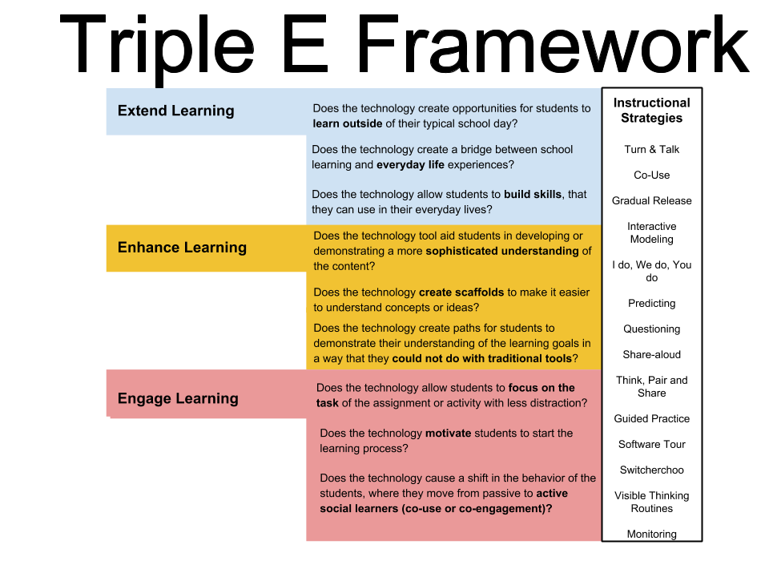
Triple E Framework

Slide 23
Needs Title
TPack Framework
chatzke, S. (2019). A Validation Study of the Triple E Rubric for Lesson Design: A Measurement Tool for Technology Use in the Classroom https://digital.library.unt.edu/ark:/67531/metadc1505198/

Slide 24
Let’s try Triple E
Take one of the activities we looked at for SAMR and TPACK
Use the evaluation tool
Determine the strengths and drawbacks of the lesson
Discuss how the lesson can be improved
Triple E Online Tool
BLOG

Slide 25
Debrief
What are your biggest takeaways?
Padlet

Slide 26
Thank you
Laurie Guyon
lguyon@wswheboces.org
@wswhebocesms
@smilelearning

