Slide 1
CULTURALLY RESPONSIVE– SUSTAINING EDUCATION IN REMOTE AND HYBRID ENVIRONMENTS
Module 6 – The How: Intention and Impact
Notes:
Hello everyone! Welcome to our final module turnkey presentation. I’m excited to join you all as we reflect upon CR-SE framework in remote and hybrid environments. This final module is the how: intention and impact.

Slide 2
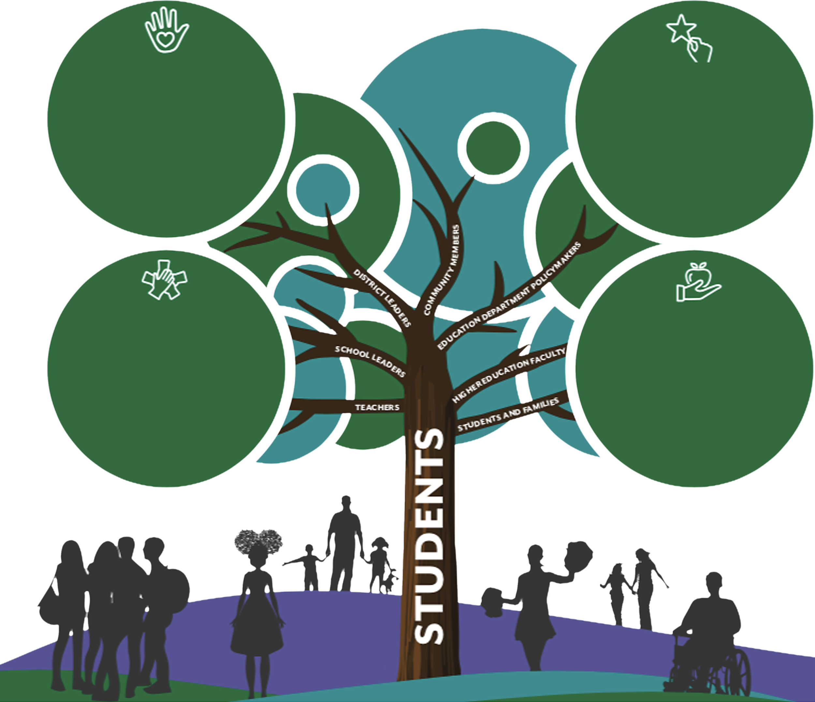
CR-SE Framework
Welcoming and Affirming Environment
Collective responsibility to learn about student cultures and communities.
Close relationships with Students & Families.
Social-Emotional Learning Programs.
Materials that represent and affirm student identities.
High Expectations and Rigorous Instruction
Student-Led Civic Engagement.
Critical Examination of Power Structures.
Project-Based Learning on Social Justice Issues.
Student Leadership Opportunities.
Inclusive Curriculum and Assessment
Current events incorporated into instruction.
Students as co-designers of curriculum.
Resources written and developed by racially, culturally, and linguistically diverse perspectives.
Instructional strategies that adapt to diverse learning styles.
Ongoing Professional Learning and Support
Diversity, Equity, and Inclusion Training, examining implicit bias and interrogation of beliefs and assumptions.
Support in aligning curriculum and instruction to the histories, languages, and experiences of traditionally marginalized voices.
Notes:
Through the course of the last four modules, we have started the work of deconstructing each of the 4 principles of the NYSED CR-SE framework through the lens of remote and hybrid learning.

Slide 3
The Golden Circle
Notes:
You may be familiar with the golden circle from Simon Sinek. We started this journey with the why in our first module. After the first module, the 4 principles were explored to define the what. At the beginning of each module, we started off with an immersive scenario in order to continuously frame the why throughout the modules. It has to be central to the work around being culturally responsive. This module, module 6, is now dedicated to the how through intention and impact.

Slide 4
Our Goal
“And it’s those who start with why, that have the ability to inspire those around them or find others who inspire them.”
Simon Sinek
Notes:
The ultimate goal is to be reflective practitioners in this work and to inspire the need to lead with equity to those around you. What will be the lasting positive impact on students across the state and nation when we each commit to being intentional about culturally responsive pedagogy? How will we each continue to lead with intention?

Slide 5
The Efficacy Notebook
Notes:
The efficacy notebook was introduced in module 5 and it is the medium that will be used through this final reflective module.

Slide 6
A Welcoming and Affirming Environment
A welcoming and affirming environment feels safe. It is a space where people can find themselves represented and reflected, and where they understand that all people are treated with respect and dignity. The environment ensures all cultural identities (i.e. race, ethnicity, age, gender, sexual orientation, disability, language, religion, socioeconomic background) are affirmed, valued, and used as vehicles for teaching and learning.
Notes:
The first principle of CR-SE is to have a welcoming and affirming environment. Notice the key terms and phrases from this description that are pulled from the framework. You must first start with a safe environment for students where they feel positively represented and reflected in the space. Also, make sure that a plethora of cultural identities are affirmed and valued in the space.

Slide 7
Module 2 Objectives
“The Voice of Your Classroom” — Design a physical and virtual learning environment that presents a welcoming and affirming message.
“A Community of Learners” — Implement norms, protocols, and achievable expectations for individual success and mutual support, whether students are learning in school or at home.
“A Family Gathering” — Honor and leverage parents/caregivers as powerful partners in developing a welcoming and affirming environment for learning in school and at home.
“Failing Forward Is What Matters” — Establish structures and strategies that allow students to take learning risks without fear of failure, seeing failure as a step in the learning process.
Notes:
The activities for principle 1 which was module 2 come from each of the 4 objectives for the module. One activity per objective is used for a deeper dive and new reflective lens to ensure that students are entering a welcoming and affirming remote and hybrid learning environment.

Slide 8
Module 2 Objectives, cont.
“The Voice of Your Classroom” — Design a physical and virtual learning environment that presents a welcoming and affirming message.
“A Community of Learners” — Implement norms, protocols, and achievable expectations for individual success and mutual support, whether students are learning in school or at home.
“A Family Gathering” — Honor and leverage parents/caregivers as powerful partners in developing a welcoming and affirming environment for learning in school and at home.
“Failing Forward Is What Matters” — Establish structures and strategies that allow students to take learning risks without fear of failure, seeing failure as a step in the learning process.
Notes:
Let’s take a look at Failing Forward is What Matters. https://www.eteachny.org/culturally-responsive-education/

Slide 9
High Expectations and Rigorous Instruction
High expectations and rigorous instruction prepare the community for rigor and independent learning. The environment is academically rigorous and intellectually challenging, while also considering the different ways students learn. Instruction includes opportunities to use critical reasoning, take academic risks, and leverage a growth mindset to learn from mistakes. Messages encourage positive self-image and empower others to succeed.
Notes:
The second principle of the framework is high expectations and rigorous instruction. We want to make sure that the learning environment is intellectually challenging and consider various ways that students can learn. How are students able to critically reason, take risks and learn from their mistakes in a safe environment? In our remote and learning environments, we want to design a space that allows each student to have a positive self-image.

Slide 10
Module 3 Objectives
“The Expectations-Support Connection” — Setting high expectations for all students is important but requires providing support to ensure all have the resources and learning opportunities to succeed. How do you create a classroom climate of high expectations in a remote learning environment?
“Opportunity and Access” — It is important to provide students with opportunities to learn that are accessible in terms of cognitive levels, learning styles, language, and cultural relevance. How do you ensure differentiated support in a remote learning environment?
“The Power of Language and Feedback” — Supporting students to achieve at high levels involves personalized facilitation through the use of language and feedback in terms of both academics and the learning process. How do you provide powerful facilitation and feedback in a remote learning environment?
Notes:
The activities for principle 2 which was module 3 come from each of the 3 objectives for the module. One activity per objective is used for a deeper dive and new reflective lens to ensure that students are entering a remote and hybrid learning environment that has high expectations and rigorous learning experiences. https://www.eteachny.org/module-6-the-how-intention-and-impact/

Slide 11
Breakout Room Discussion (10 minutes)
In your Breakout Room, choose an objective from Module 3/Principle 2: High Expectations and Rigorous Instruction (1 min.)
Take 3-4 minutes to review the objective and corresponding activity.
Use the remaining time to choose at least one reflection question to discuss from that objective.
Notes:
Take a moment to review one of the objectives in High Expectations and Rigorous Instruction. When you are ready, join your breakout room and discuss one of the reflection questions for the objective you looked at.

Slide 12
Inclusive Curriculum and Assessments
Inclusive curriculum and assessment elevate historically marginalized voices. It includes opportunities to learn about power and privilege in the context of various communities and empowers learners to be agents of positive social change. It provides the opportunity to learn about perspectives beyond one’s own scope. It works toward dismantling systems of biases and inequities, and decentering dominant ideologies in education.
Notes:
The third principle is an inclusive curriculum and assessments. We know that historically there are many voices that have been marginalized by the system so how can we be intentional about elevating the voices that sometimes go unheard? This requires the examination of power and privilege in our nation and how we, as educators, can be agents of positive change and set up the structures in our learning environments for students to be the same. There are more perspectives to be considered over the dominant culture and our role as educators is exposure for our students so that they, along with us, can dismantle the biases and inequities that exist in education.

Slide 13
Module 4 Objectives
“Student Advocates” — Our learning environments should build up efficacious students who are agents of change for their communities. How are we positioning students to achieve this in our remote and hybrid learning environments?
“Self-Identity” — In order for our remote and hybrid learning environments to build up efficacious students, we must first empower them. How are students positively represented in curriculum and assessments? How are students learning more about who they are as remote learners?
“Risk-Taking and Change” — For our students to be advocates for change, they need to be engaged not only with the curriculum but with their communities. Teaching through PBLs, integrating service learning, and more allows students to feel a greater connection to the content presented.
Notes:
The activities for principle 3 which was module 4 come from each of the 3 objectives for the module. One activity per objective is used for a deeper dive and new reflective lens to ensure that students are entering a remote and hybrid learning environment that contains inclusive curriculum and assessments. https://www.eteachny.org/module-6-the-how-intention-and-impact/

Slide 14
Breakout Room Discussion (15 minutes)
How will elevating historically marginalized voices build up efficacious students who are agents of change?
Do all learners see themselves in your curriculum and assessments? How can we empower them if they don’t?
How has your understanding of inclusive curriculum and assessment changed, or been affirmed by, Module 4/Principle 3?
Notes:
Take a moment to review one of the objectives in High Expectations and Rigorous Instruction. When you are ready, join your breakout room and discuss one of the reflection questions for the objective you looked at.

Slide 15
Ongoing Professional Learning
Ongoing professional learning is rooted in the idea that teaching and learning is an adaptive process needing constant reexamination (Moll, et al., 1992; Gay, 2010). It allows learners to develop and sharpen a critically conscious lens toward instruction, curriculum, assessment, history, culture, and institutions. Learners must be self-directed and take on opportunities that directly impact learning outcomes.
Notes:
The fourth principle is ongoing professional learning. Teaching and learning requires us to be reflective practitioners as we should always continue to grow in our understanding of instructional pedagogy and sharpen our skill set. Take time to be self-directed in sharpen your knowledge.

Slide 16
Module 5 Objectives
“Holding Ourselves Accountable” — Maya Angelou said, “Do the best you can until you know better. Then when you know better, do better.” This was a personal insight that she made about her circumstances and it still rings true today. The keyword in this fourth principle is ongoing. The more we learn, explore, ask questions, and reflect, the more confident we are to implement necessary and lasting change.
“Continuously Educating Ourselves” — Being a learning educator means that we each need to put in the work to stay current on educational trends, research, and more. Many vision and mission statements include the term lifelong learning. As educators, we need to have that same mindset. What new learning did you attain today?
“Intentionally Growing Our PLN” — In this digital age of social media, it is easy to access and grow your professional learning network. Not only that, but it can expand across the globe! How are you leveraging social media to grow your network? How does expanding your PLN support you in continuously educating yourself?
Notes:
The activities for principle 4 which was module 5 come from each of the 3 objectives for the module. One activity per objective is used for a deeper dive and new reflective lens to ensure that we, as educators, are continuing our own learning growth around culturally responsive pedagogy. https://www.eteachny.org/module-6-the-how-intention-and-impact/

Slide 17
Thank you for attending
CULTURALLY RESPONSIVE-SUSTAINING EDUCATION IN REMOTE AND HYBRID ENVIRONMENTS
Module 6 – The How: Intention and Impact
Notes:
Thank you for joining us for this brief exploration of the module 6. There are two videos and 4 activities that are on the website that reflects deeply on each of the principles presented through the past modules.

