Slide 1
Literacy Assessment for Targeted Instruction
Notes:
Welcome participants
Inform that we will be discussing quick assessments that can be used to quickly identify students’ skill gaps at the beginning of of the school year

Slide 2
Outcomes
Today we will...
Explain essential understandings guiding targeted ELA assessment
Explain how to use the Literacy Assessment Map to guide targeted instructional decisions
Identify specific assessment tools for screening and diagnostic assessment in literacy and how they assess essential components of the foundational skills continuum.
Notes:
Briefly Describe outcomes to participants

Slide 3
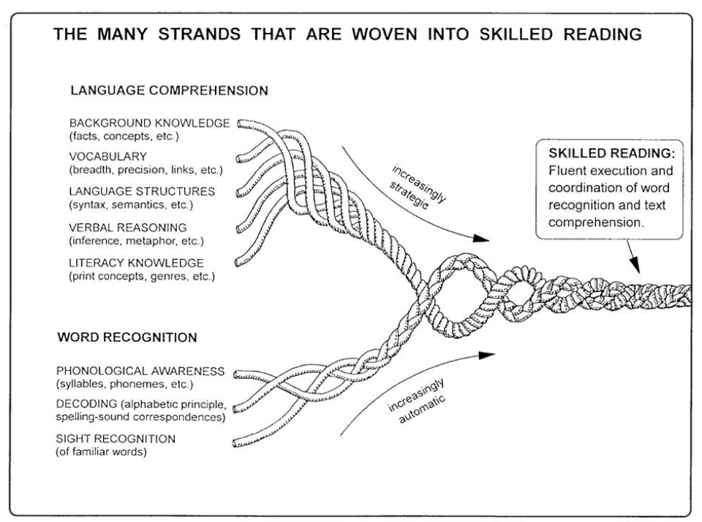
“The Reading Rope”:
A theoretical model for understanding reading
Scarborough, H. S. (2001). Connecting early language and literacy to later reading (dis)abilities: Evidence, theory, and practice. In S. Neuman & D. Dickinson (Eds.), Handbook for research in early literacy (pp. 97–110). New York, NY: Guilford Press.
Notes:
-Scarborough’s Rope is a graphic intended to capture the complexity of learning to read.
-It is comprised of upper and lower strands:
-the upper strands represent the comprehension aspects of learning to read such as vocabulary and background knowledge
-the lower strands represent the aspects that comprise the ability to accurately decode the words on the page.
-Together, the strands intertwine resulting in skilled reading

Slide 4
Sequence of Assessment
Elementary Model
Secondary Model
Comprehension
Vocabulary
Fluency
Word recognition/decoding
Phonemic Awareness
Comprehension
Vocabulary
Fluency
Word recognition/decoding
Phonemic Awareness
Notes:
“In the primary grades, teachers typically use assessments that will measure a student’s knowledge and skills in phonological awareness, the alphabetic principle, letter-sound correspondence, and word reading. Educators tend to assess young students in a sequence that starts with beginning skills such as letter recognition, sound recognition, and word reading and then progresses along a continuum to more complex skills such as fluency and comprehension (see Figure 5). For example, in kindergarten and first grade, teachers may assess letter-naming ability and phonemic awareness. Being able to rapidly name letters is highly correlated with future reading success (Wagner et al., 1997). Phonemic awareness, including the ability to orally segment a word into individual phonemes (i.e., saying the sounds in the word cat one at a time: /c/ /a/ /t/), is also important for reading progress National Institute of Child Health and Human Development [NICHD], 2000). As students begin to read connected text, primary-grade teachers begin to assess oral reading fluency, vocabulary, and comprehension. It is important to realize, however, that even though more complex reading behaviors such as comprehension come later in the reading continuum, instruction in these areas is not delayed until students are proficient readers. For example, listening comprehension strategies can be taught very early as precursors to later reading comprehension strategies.” Taken from The Reading Teacher’s Sourcebook, (2007). University of Texas System/Texas Education Agency, pp. 19-20. Authors: Carolyn Denton, Deanna Bryan, Jade Wexler, Deborah Reed, and Sharon Vaughn.

Slide 5
A Word About Foundational Skills….
The foundational skills included in these standards are an essential component of early and intermediate literacy learning. They provide a foundation upon which students build as they develop increasingly deeper proficiency with advanced literacy skills. As such, mastery of these components is vital to further learning. It is important to note, however, that foundational skills are built simultaneously with comprehension, vocabulary, and oral language skills and are therefore only a part of a comprehensive and effective reading program in which children also read a variety of texts accurately and automatically. Because many of these early literacy skills develop along a continuum from simpler to more complex, it is important that instruction be differentiated according to what students are already able to do and not do. That is, proficient readers will need less instruction and practice with these skills and concepts than those who are struggling. It is necessary to identify where students are in these progressions and employ targeted instruction, focusing on what students need to learn and not on what they already know.
From the Introduction to the NYS Next Generation ELA Learning Standards, 2017, p.12
From the Introduction to the NYS Next Generation ELA Learning Standards, 2017, p.12
Notes:
Notes:
Ask participants to take 1 minute to read this quote from the Introduction to the NYS Next Generation ELA Learning Standards. Prompt them to share out a reflection in the chat. After, make sure to highlight:
-The foundational skills must all be mastered, they can not be prioritized
-the foundational skills are cumulative and build upon one another.
These skills are essential-students must master them in a relatively short period of time (2-3 years ish).
Scott Paris, 2005 as referenced in K. Stahl 2011 “Applying new visions of reading development in today’s classroom”, The Reading Teacher v.65, issue 1, pp. 52-56.
Constrained skills theory (paris, 2005) is a reconceptualization of reading development that has important implications for classroom practice, curricula, and assessment… Constrained abilities consist of a limited number of items and thus can be mastered within a relatively short time frame... Name writing, alphabet knowledge, concepts about print, high-frequency word lists, and phonics can be considered highly constrained abilities. First, they each consist of a finite number of items to be learned, so mastery occurs within a short time span.”

Slide 6
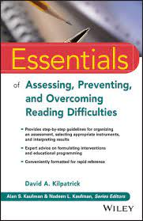
Phonological & Phonemic Awareness
...are the foundation upon which all the other layers are built and, unless it is solid, the other layers will most definitely suffer, and the student will struggle to read.
-Kilpatrick, D. (2015). Essentials of Assessing, Preventing and Overcoming Reading Difficulties
Notes:
Phonological Awareness and Phonemic Awareness are necessary prerequisites for reading success.

Slide 7
Phonological Awareness Continuum
Notes:
Image from 2013, Texas Education Agency/The University of Texas System https://images.slideplayer.com/20/5927556/slides/slide_16.jpg

Slide 8
Continuum of Phonics Skills*
Multisyllable
R Controlled & Variant Vowels
Vowel Teams
Final e Patterns
Blends & Digraphs
CVC Patterns
Letter-Sound Correspondence
Notes:
*Note: There are some slight differences in this progressions, depending upon which source you reference. The concept of movement from simpler to more complex is true for graphic representations of this skill progression, regardless of the nuance of order.
Staircase image taken from unspash; photographer Denys Sudilkovsky

Slide 9
Assessment Across the Year
Beginning of the Year
Throughout the Year
End of the Year
Torgesen and Miller (2009)
Torgesen & Miller (2009)
Screening
diagnostic measures
Benchmark/
Progress Monitoring
Classroom-based Formative assessments
Standards-based State-level Outcome tests
To identify students
who meet developmental benchmarks or who need supplemental instruction
To pinpoint student needs for instruction and/or supplemental instruction
To monitor the progress of all students & monitor progress of students in supplemental instruction
To make adjustments to classroom instruction
To determine the extent all students can meet or exceed
state-level standards
Notes:
Based on the research of Torgesen and Miller, 2009, image courtesy of Dr. Erin Washburn, used with permission
-Take 1 minute to read through this graphic
-Focus on just the beginning of the year columns (screener and diagnostic)--take one minute to make a personal connection. 2 minute pause, set a timer and ask participants to to jot down for themselves, what specific tools are used in their own districts for Screening and (d)iagnostic purposes. Add your notes to the chat. Facilitator reads a few of the responses and notes any overlap.
-When giving any type of assessment, we want to be aware of its purpose.
-A screener can alert us that a student may need supplemental instruction, but will not necessarily tell us exactly which skills our instruction needs to focus on
-(d)iagnostic measures which are the focus of today’s session is to help identify diagnostic assessments that will give us clues as to exactly what skills we need to focus on in our small group instruction.
-benchmarks are given to all students, and give us an indication of whether or not our core and/or supplemental instruction is effective
-classroom formative assessments help us determine whether students have mastered Tier 1, classroom instruction.
-lastly, standards-based/State assessments help paint a picture of where students are in relation to the standards.

Slide 10
Beginning of the Year Assessment
Screener
(d)iagnostic
Notes:
When we start the year, all students take a screener, which after first-grade is often computer based and is normed and reliable. The results of that screener will help teachers identify which students may be performing below grade level and may indicate a need for additional first line (d)iagnostic assessments which we also want to give early in the school year so that we can quickly begin targeted instruction.

Slide 11
Beginning of the Year Assessment (cont.)
Screener
(d)iagnostic
Purpose: To identify students who meet developmental benchmarks or who need supplemental instruction
They are:
Quick and easy to administer
Administered to all students
Predictive of overall reading achievement
They are not
For the purpose of identifying first steps of instruction
Purpose: To pinpoint student needs for instruction and/or supplemental instruction
They are:
More specific in content to show where students are ready for instruction
Administered to specific students as needed
They are not
The WISC, Woodcock Johnson, WIAT, etc.
Notes:
Each of these assessments serve different purposes
Read slide to participants making sure to highlight that a (d)iagnostic is not a formal Diagnostic measure like a WIAT or WISC.

Slide 12
Literacy Assessment Guidance & Resources
Grades K-5

Slide 13
The Literacy Assessment Sequence Maps
These are created for each grade level, K-5 and are banded:
K-1
2-3
4-5
They are structured to identify screening tools and possible follow up diagnostic assessments for beginning, middle, & end of year
They contain hyperlinks to free assessments for all tools

Slide 14
Targeted Literacy Assessment Resources
Navigating the eTeachNY website
Start here to access the targeted literacy assessment landing page.
Notes:
Briefly Describe outcomes to participants
Literacy Assessment landing page URL: https://www.eteachny.org/targeted-assessments-module-6/

Slide 15
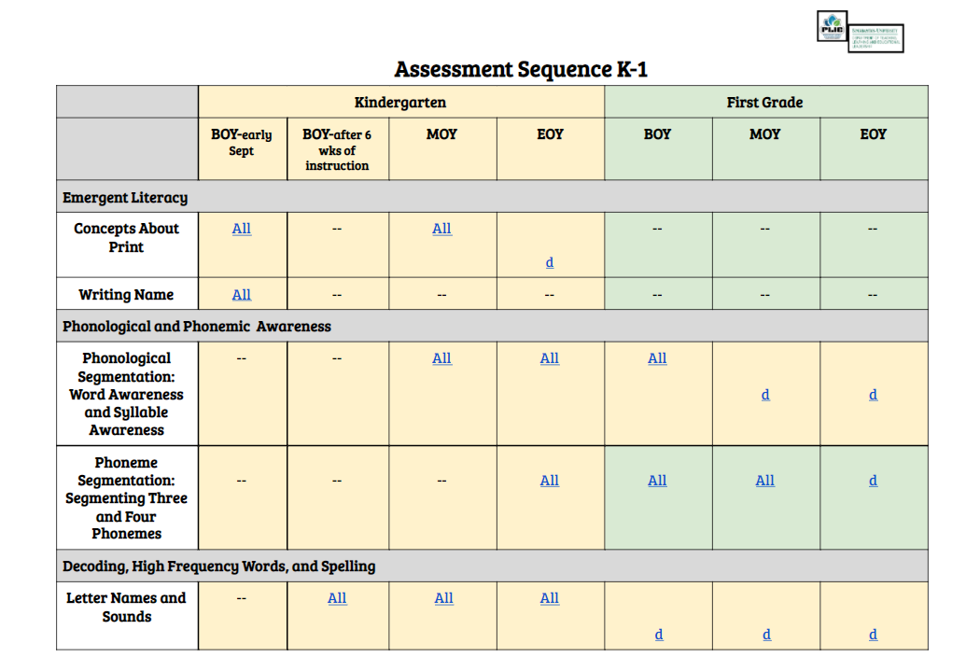
Pause & Examine a Map
Sample Map
Choose a literacy sequence map from a grade level band
Explore, clicking on the hyperlinks
What do you notice?
What questions do you have?

Slide 16
Thank you

