Slide 1
CULTURALLY RESPONSIVE– SUSTAINING EDUCATION IN REMOTE AND HYBRID ENVIRONMENTS
Module 5 – Ongoing Professional Learning

Slide 2
Immersive Scenario Part 1
Imagine that you need to have major surgery. Your primary care physician has provided you the option of two surgeons. Both have been in their field for over twenty years.

Slide 3
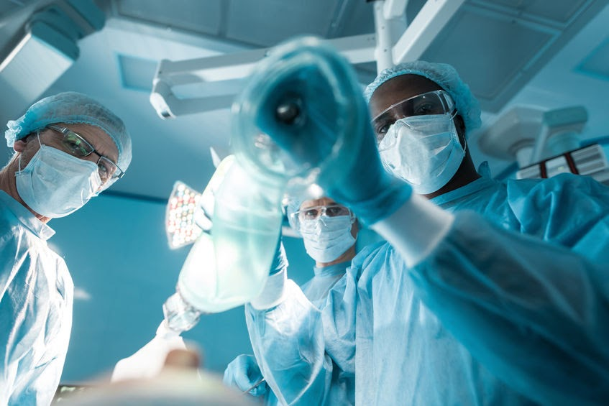
Immersive Scenario Part 2
Surgeon A has a comprehensive curriculum vitae (CV) — a list of information that includes academic background, teaching experience, degrees, research, awards, publications, presentations, and other achievements. From this CV, you are able to see Surgeon A’s current and past research, read up on their publications, see what they have accomplished, find out how they have advanced their knowledge to keep current with research, and learn where they have presented over the past twenty years.
Surgeon B has a less comprehensive CV. Upon further searching, you find no evidence that this surgeon has engaged in professional learning or research in the past twenty years since receiving their medical degree.
Which surgeon would you want to pursue? Why?

Slide 4
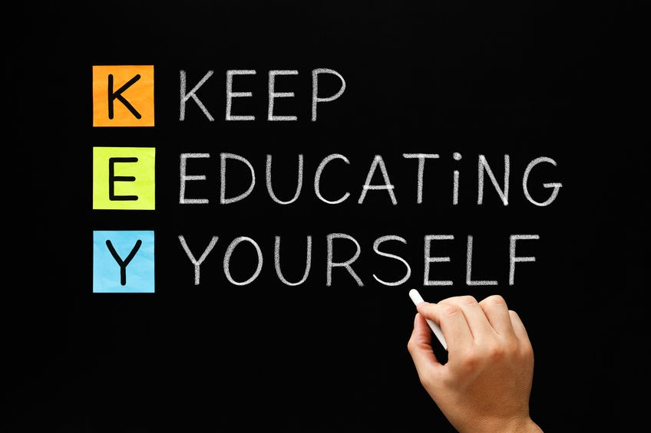
Immersive Scenario Part 3
Professional learning is important, no matter what your career is. As educators, we are in charge of taking care of students’ minds, so being a learning teacher is essential. Keeping abreast of current educational trends and research, new resources and tools, and more is a critical part of furthering your own knowledge. Although this is the final module for engaging with Culturally Responsive Teaching, it should not be the final time that you further your learning on this topic. This module will provide you with some final nuggets of information about equity and cultural responsiveness, and highlight some ways you can continue to extend your professional learning network (PLN). How will you continue to be a learning teacher?

Slide 5
BOR Reflection (7 minutes)
In your breakout rooms….
Quickly introduce yourself and your role to the group
Discuss the question, “How will you continue to be a learning teacher?”

Slide 6
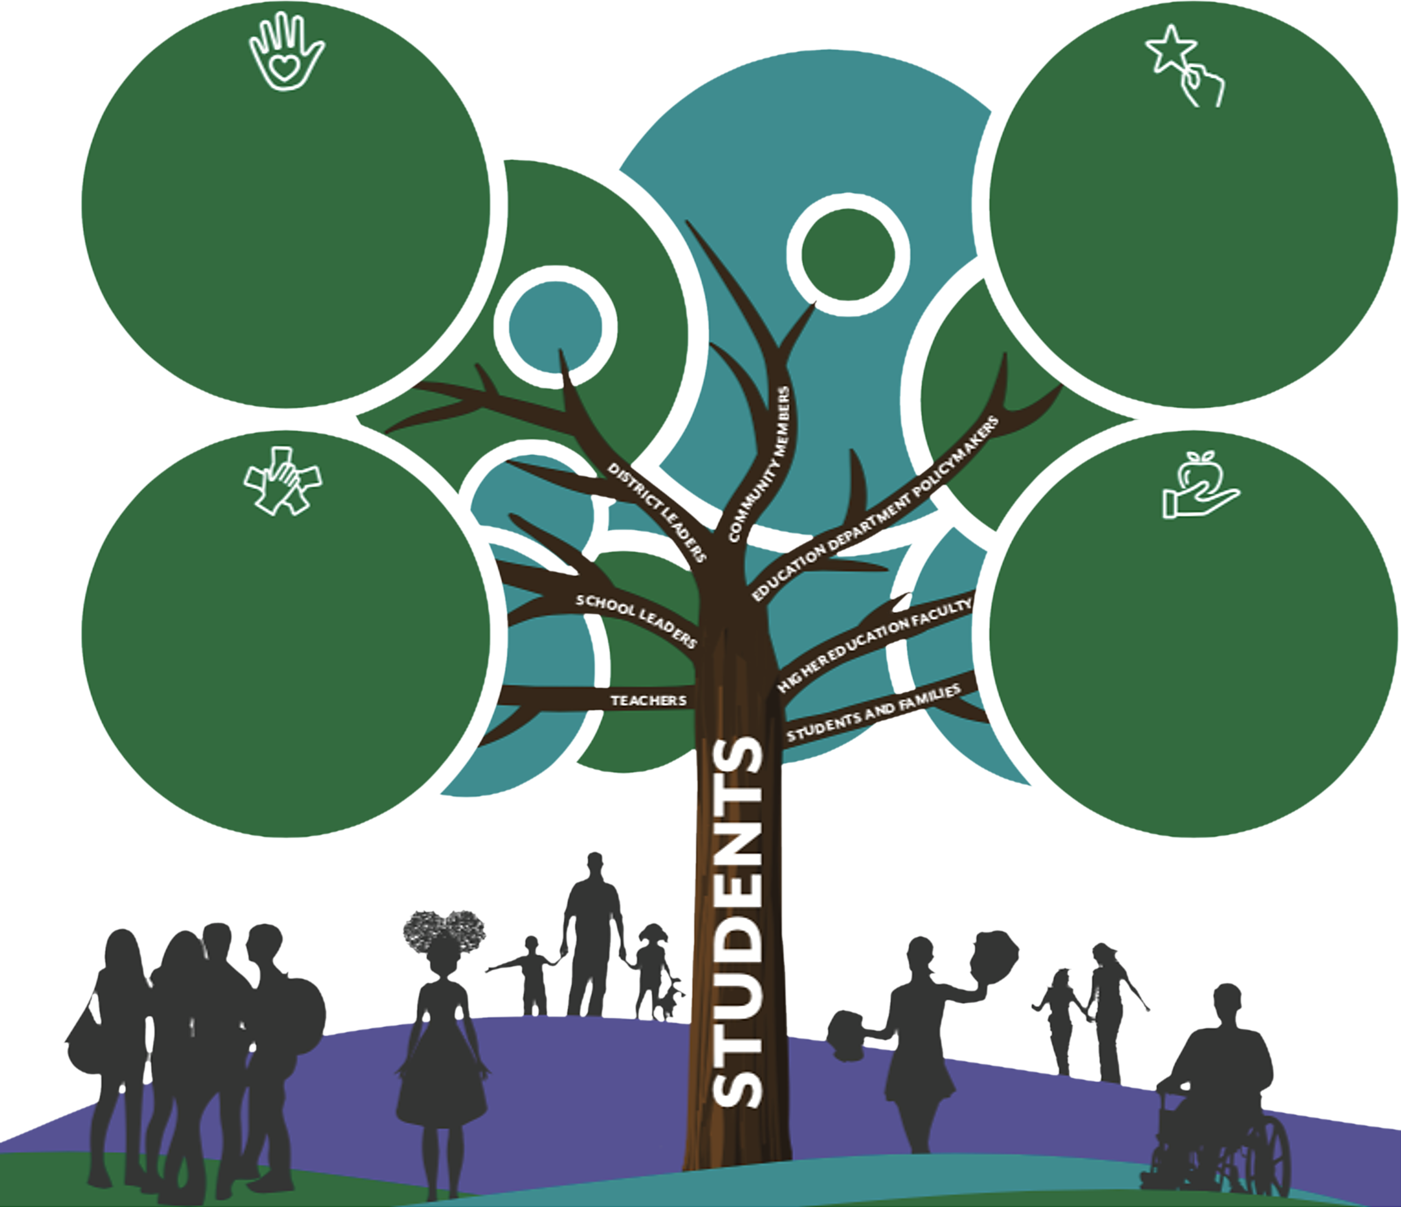
Ongoing Professional Learning
Welcoming and Affirming Environment
Collective responsibility to learn about student cultures and communities.
Close relationships with Students & Families.
Social-Emotional Learning Programs.
Materials that represent and affirm student identities.
High Expectations and Rigorous Instruction
Student-Led Civic Engagement.
Critical Examination of Power Structures.
Project-Based Learning on Social Justice Issues.
Student Leadership Opportunities.
Inclusive Curriculum and Assessment
Current events incorporated into instruction.
Students as co-designers of curriculum.
Resources written and developed by racially, culturally, and linguistically diverse perspectives.
Instructional strategies that adapt to diverse learning styles.
Ongoing Professional Learning and Support
Diversity, Equity, and Inclusion Training, examining implicit bias and interrogation of beliefs and assumptions.
Support in aligning curriculum and instruction to the histories, languages, and experiences of traditionally marginalized voices.

Slide 7
Learning Objectives
“Holding Ourselves Accountable” — Maya Angelou said, “Do the best you can until you know better. Then when you know better, do better.” This was a personal insight that she made about her circumstances and it still rings true today. The keyword in this fourth principle is ongoing. The more we learn, explore, ask questions, and reflect, the more confident we are to implement necessary and lasting change.
“Continuously Educating Ourselves” — Being a learning educator means that we each need to put in the work to stay current on educational trends, research, and more. Many vision and mission statements include the term lifelong learning. As educators, we need to have that same mindset. What new learning did you attain today?
“Intentionally Growing Our PLN” — In this digital age of social media, it is easy to access and grow your professional learning network. Not only that, but it can expand across the globe! How are you leveraging social media to grow your network? How does expanding your PLN support you in continuously educating yourself?

Slide 8
Holding Ourselves Accountable

Slide 9
Holding Ourselves Accountable– Definitions
The Problem with that Equity vs. Equality Graphic You’re Using - To define the terms of equity and equality in the context of education to understand the intention of cultural responsiveness. This activity includes an etext, reflection questions and collaborative activity.
Understanding Your Biases to Address Stereotype Threats in Your Learning Environment - To explore and reflect on strategies to use in your remote and hybrid learning environment that address stereotype threats by understanding our own biases. This includes an etext and take action activity.
Potential Biases That Impact the Educational System - To identify the biases that impact our educational system and synthesize strategies for creating a safe and just remote and hybrid learning environment. This includes reflection questions, a collaborative activity, and brainstorming and design.
Using an Efficacy Notebook for Reflection and Connection - You will design and learn to use a Digital Efficacy Notebook (from www.myqportal.com) to capture your ideas, questions, insights, and connections as you continue to engage in work around equity-related topics in education. This includes a video and take action activity.

Slide 10
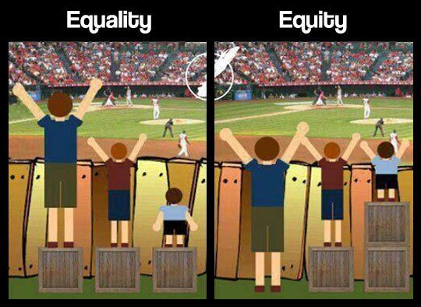
The Problem with That Equity vs. Equality Graphic You’re Using (20 – 30 min)
Goal:
To define the terms equity and equality in the context of education to understand the intention of cultural responsiveness.
Image from - https://culturalorganizing.org/the-problem-with-that-equity-vs-equality-graphic/

Slide 11
BOR Discussion 10 minutes
Access the link the chat that is a shorten version of the actual activity on the website.
View the images and discuss the reflection question at the bottom.
When we come back, be prepared to share a headline of your group’s conversation.
Notes:
https://docs.google.com/document/d/1zZfSNQKyNDmPJyYYGS1Lhw-jv_rwDJLXH0tgL8BR6uA/edit#heading=h.ubxydv70z3jn

Slide 12
Continuously Educating Ourselves

Slide 13
Continuously Educating Ourselves – Definitions
Unmasking the Myth of the Model Minority in Remote and Hybrid Learning Environments - To build awareness of how the “model minority” myth impacts students of Asian communities and identify ways to demystify common beliefs that create inequalities within remote and hybrid classrooms. This includes an etext, reflection questions, and a take action activity.
Empowering Teachers to Support Effective and Equitable Family Engagement - To explore professional learning opportunities that will support family and community involvement to sustain a culturally responsive environment for all learners. This includes a website exploration, reflection questions and a take action activity.
Addressing Bias in Data Analysis - To determine trends across sub-groups or bias toward students by analyzing student data in order to set and meet professional goals related to Culturally Responsive-Sustaining practices. This includes a website exploration, reflection questions and a take action activity.
Learning About Diverse Communities In Which We Teach Or Are Near To Us - To learn about the diverse communities present in our remote and hybrid learning environments and strategize ways to provide culturally competent teaching. This includes a video, reflection questions, a brainstorm and design, and collaborative activity.
Leveraging Podcasts for Professional Learning - To identify podcasts that can be leveraged as tools for ongoing professional development and continuous education. This includes a website exploration, reflection questions and a collaborative activity.
More on CRSE from NYU - an additional resource

Slide 14
Addressing Bias in Data Analysis (40 – 45 min)
Goal:
To determine trends across subgroups or bias towards students by analyzing student data in order to set and meet professional goals related to CR-SE practices.

Slide 15
6 Steps to Equitable Data Analysis
Research Identity
Preempt Implicit Bias
Frame and Challenge
Set Intentions
Pick the Right Data
Strategically Sort
Notes:
author Andrew Knips recognizes that “for teachers and administrators, it’s easy to overlook culture and identity when analyzing data. However, ignoring students’ diversity markers means pretending that their identity doesn’t matter. In order to close gaps in student outcomes, we must name equity as an essential component to data analysis.”

Slide 16
Breakout Room Discussion (10 minutes)
What assessments do you use to collect data? What metrics do you consider other than standardized tests? (T, SL, DL)
What intentions do you have for analyzing data regularly? How will your intentions affect student achievement? (T, SL, DL)

Slide 17
Intentionally Growing Our PLN

Slide 18
Intentionally Growing Our PLN– Definitions
Using Twitter to Extend Your PLN - Learn and explore the social media application, Twitter, to extend your professional learning network. This includes a website exploration and take action activity.
What’s a PLN and Why is it Important? - To explore professional learning networks for educators and their role in sustaining ongoing professional learning for teachers, school leaders, and district leaders. This includes a video, reflection questions, a brainstorm and design, and additional resources.

Slide 19
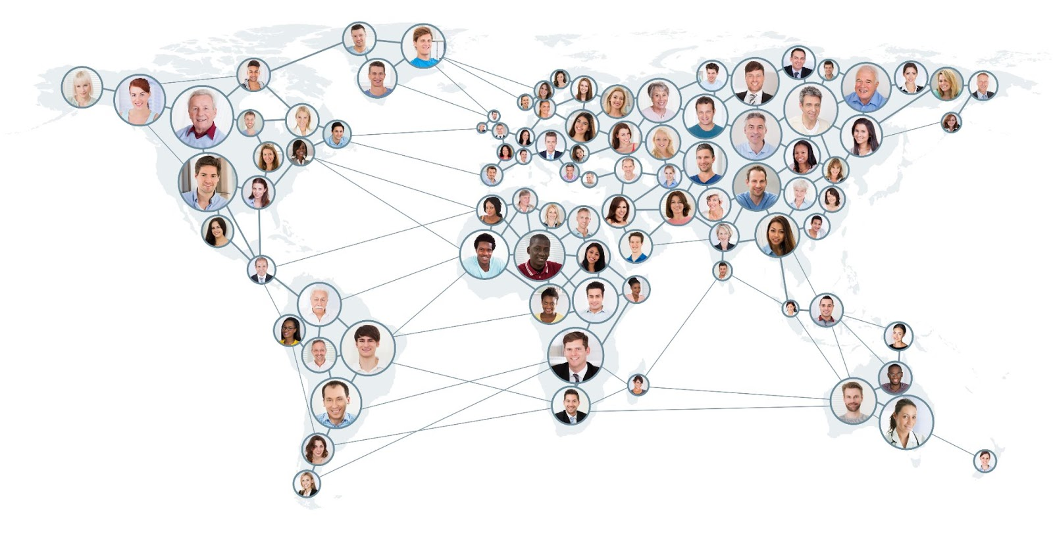
What’s a PLN and Why is it Important? (20 – 25 min)
Goal:
To explore professional learning networks for educators and their role in sustaining ongoing professional learning for teachers, school leaders, and district leaders.

Slide 20
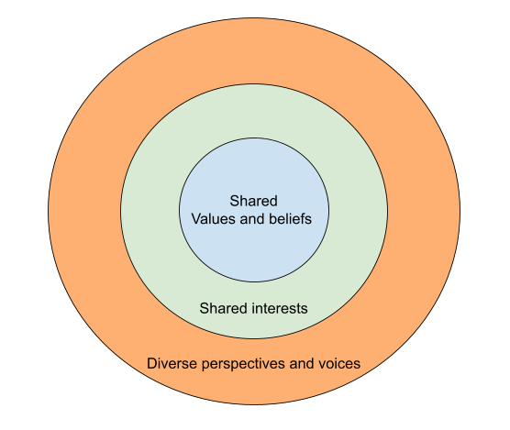
Professional Learning Network
Your professional learning network should reflect your values, passions, and area(s) of expertise. Identify organizations and individuals whose mission statements and resources align with your personal beliefs about teaching and learning. For many organizations, you can subscribe to their email list, bookmark their blog, follow them on social media, or sign up for in-person or virtual events.

Slide 21
Silent Chat Discussion
Who is currently in your professional learning network?
How will a diverse PLN support your CR-SE learning environment?
Notes:
Silent Discussion Document - https://docs.google.com/document/d/1DjwXpkVrOaSRHPhsLc6co0Lj7aqDVC0kSyJMQ8gg_Ko/edit

Slide 22
Learning Objectives Recap
“Holding Ourselves Accountable” — Maya Angelou said, “Do the best you can until you know better. Then when you know better, do better.” This was a personal insight that she made about her circumstances and it still rings true today. The keyword in this fourth principle is ongoing. The more we learn, explore, ask questions, and reflect, the more confident we are to implement necessary and lasting change.
“Continuously Educating Ourselves” — Being a learning educator means that we each need to put in the work to stay current on educational trends, research, and more. Many vision and mission statements include the term lifelong learning. As educators, we need to have that same mindset. What new learning did you attain today?
“Intentionally Growing Our PLN” — In this digital age of social media, it is easy to access and grow your professional learning network. Not only that, but it can expand across the globe! How are you leveraging social media to grow your network? How does expanding your PLN support you in continuously educating yourself?

Slide 23
Thank you for attending
CULTURALLY RESPONSIVE-SUSTAINING EDUCATION IN REMOTE AND HYBRID ENVIRONMENTS
Module 5 – Ongoing Professional Learning

