Slide 1
SEL in Leadership
TRLE Unit #5

Slide 2
Norms: General best practices of all productive groups
We agree…
To proactively see and consider diverse voices, ideas, and perspectives
Pausing, Paraphrasing, Asking Questions, Listening
To embrace a mindset that promotes my own and other’s learning
Be Present, Listen, Put Ideas on the Table, Presume Positive Intentions
To see opportunities to show gratitude and celebrate with colleagues
Be Present, Presume Positive Intentions, Ask Questions, Offer Support, Thank One Another
Notes:
Establishing norms for online learning experiences reinforces different behaviors, but also can improve the virtual meeting by providing participants with anticipated processes.
Norms can be written to reflect the needs and dynamics of the group.
Suggestion: If using Zoom or an online platform that includes a polling feature, participants can vote on which norms they agree. This allows participants to have voice and choice in the selection of norms for interaction.
The norms written for this slide are more specifically crafted for an audience of professional developers, and suggest strategies to assist participants in adhering to the norms for interaction.

Slide 3
Long Term Learning Target
To build the capacity of teachers and educational leaders to effectively integrate SEL in remote learning environments for all students.
Notes:
Review of the long term learning target related to the TRLE Grant work and Social Emotional Learning (SEL)
Facilitator's Pause Point: The learning target indicates for “all students”, and the language is specifically designed for inclusivity. Consider linking to the Culturally Responsive-Sustaining (CR-S) Education Framework. “The framework was designed to support education stakeholders in developing and implementing policies that educate all students effectively and equitably, as well as provide appropriate support and services to promote positive student outcomes.”
The 4 principles of CR-S Education are supported in this presentation…
Welcoming and affirming environment
High expectations and rigorous instruction
Inclusive curriculum and assessment
Ongoing professional learning

Slide 4
e-Learning Series
Notes:
Steph - 2 minutes
Outline of the session in this e-Learning Series with representation of resources and contributing partners.
Note: In several of the sessions for TRLE SEL trainings, materials are sourced from CASEL - https://casel.org and OSPI Student Support Website - https://www.k12.wa.us/student-success/health-safety/mental-social-behavioral-health/social-and-emotional-learning-sel/sel-online-education-module.
OSPI Usage Statement: “This resource was adapted from SEL Online Education Modules developed by the Office of Superintendent of Public Instruction. Access the original work on the OSPI Student Support website.”
CASEL Usage Statement: “Subject to the terms and conditions contained in this Agreement, CASEL hereby grants Licensee a limited, non-exclusive, non-transferable, non-sublicensable and royalty-free, right and license, during the Term, to use, reproduce, publish, broadcast, distribute, disseminate, publicly display, and otherwise exploit the CASEL Materials, and to modify, alter, edit, and create derivative works of the CASEL Materials (“Licensee Derivative Works”, included in the definition of CASEL Materials), in all media, whether now known or later developed, solely in the Territory and in connection with the Purpose. Notwithstanding anything to the contrary contained in this Agreement, Licensee may not use, reproduce, publish, broadcast, distribute, disseminate, publicly display, or otherwise exploit any CASEL Materials with the intent of earning a profit or for commercial purposes.”

Slide 5
Participants will be able to...
Participants will be able to:
Develop strategies to enhance effective leadership by supporting school leaders to deepen their social and emotional competencies, which set the foundation for staff and student success.
Define prosocial leadership, and examine the prosocial leader’s responsibility to ensure that all staff, students, parents, and community members feel safe, cared for, respected, and valued.
Participate in activities for school leadership that models good and best practices in SEL
Notes:
Facilitator’s Pause Point: Objectives are developed and arranged to promote a deeper understanding, connection, and suggestion of actions to participants.

Slide 6
Leadership Circles & Welcoming Ritual
Leadership Circles Jamboard - Group Activity & Welcoming Ritual
Honoring the perspective of Indigenous People - School Leader Community Circle
When we think of the Earth and utilize its power we are drawing on the Wisdom of the Indigenous People - also known as first peoples, aboriginal peoples or native peoples, are ethnic groups who are the original inhabitants of a given region, in contrast to groups that have settled, occupied or colonized the area.
Indigenous People are known for Restorative Practices/Healing Circles which aims at developing a consensus on how to repair relationships while healing people. Groups are usually described as indigenous when they maintain traditions or other aspects of an early culture that is associated with a given region.
Notes:
Community Circles use ritual and structures that can achieve a multitude of outcomes including:
Conflict mediation
Community building
To think through questions and issues
To de-escalate or resolve conflicts that involve or affect multiple people.
The Jamboard is set up for smaller group interaction in the virtual environment and in consideration of time.. In an in-person setting, the circle activity could be done in a large group.
CPS Circle Guide - Provides “The Talking Circle Process” and template on page 67-68, and .
Facilitator’s Pause Point: The choice of Welcoming Ritual should be intentional to the group and the purpose of the activity see CASEL 3 Signature Practices Playbook (pg 10 - 18) for ideas and definition of a Welcoming Activity/Ritual.

Slide 7
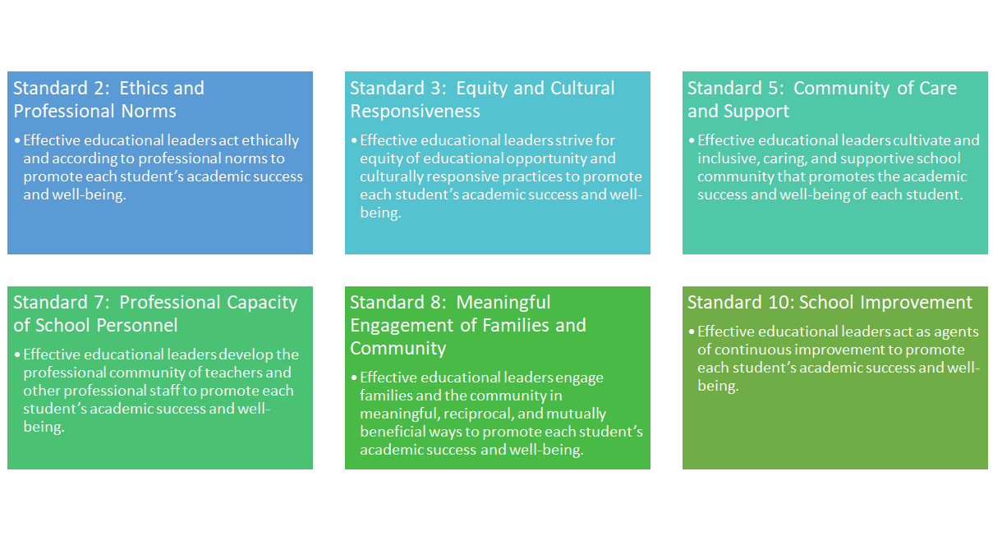
Aligning SEL in Leadership with the Professional Standards for Educational Leadership (PSEL)
(Previously the ISLLC Standards)
Notes:
New Standards for Administrators - 2017 Update on NYSED Board of Regents Actions - including phasing the PSEL standards into school building leader preparation programs and 2022 for evaluation principals. Also, highlights the “themes of equity and cultural responsiveness are an appropriate emphasis for the PSEL standards.”
Professional Standards for Educational Leaders - full description of all PSEL Standards
Facilitator’s Pause Point: Consider your group’s familiarity with the PSEL standards and the changes from the ISLLC standards. Is there an opportunity to provide further professional development on this topic?

Slide 8
The members of school leadership are responsible for helping to articulate the “big idea” of SEL to the entire school community and supporting SEL as a priority.
Notes:
Illinois Principals Association, The Illinois Social and Emotional Learning (SEL) Standards; Leading the way for School and Student Success. April 2009.

Slide 9
Exploring the CASEL FOCUS Areas & Exploring a Resource
Notes:
El Paso Independent School District - Social Emotional Learning Resource Guide
This resource provides a comprehensive look at the timelines of implementation for SEL and also the major Focus Areas.

Slide 10
Virtual Jigsaw Style Activity
Break Out Room 1 | Focus Area 1A - Building Awareness, Commitment and Ownership (page 12 & 13 and rubric on page 27)
Break Out Room 2 | Focus Area 1B - Create a Shared Plan (page 15 & 16 and rubric on page 28)
Break Out Room 3 | Focus Area 2 - Cultivate Adult SEL (page 18-20 and rubric on page 29)
Break Out Room 4 | Focus Area 3 - Promote SEL for Students (page 22 & 23 and rubric on page 30)
Break Out Room 5 | Focus Area 4 - Practice Continuous Improvement (Page 25 and rubric on page 34)
Virtual Jigsaw Style Activity
Introduce yourself in your group, and the person with the closest birthday date (day and month) is your group spokesperson
In your group review the information presented in each section. Interact with the links (at least 3 links) and explore the resources.
Review the Administrator Action Checklist
Spokesperson please provide a summary of your group work and major takeaways.

Slide 11
Break time 1

Slide 12
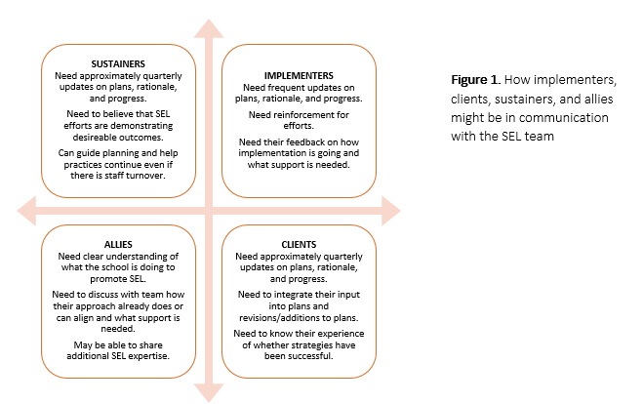
CASEL’s Creating an SEL Communication Strategy
Part 1 - Identifying Stakeholders - Identify key stakeholders to include when preparing a communication strategy for schoolwide SEL implementation and programming.
Part 2 - A Differentiated Plan to Communicate with Stakeholders- Provides an example to create a differentiated plant to reach stakeholders both the share important information and to invite and include their prospectuses and ideas to improve SEL implementation over time (download the document and you will be able to edit and tailor to meet your district).
Notes:
Facilitator’s Pause Point: Consider having participants complete a whip-around to discuss their thoughts about the tool and the usability of the tool by district and school leadership. The first 3 columns of Part 2 - A Differentiated Plan to Communicate with Stakeholders - could remain static with school leadership editing the Schedule of Communication Modes, and Team Member Responsible sections to tailor to the district.

Slide 13
Social Emotional Learning Vision Activity
Social Emotional Learning Vision Activity
“Imagine that it’s the year 2025. As you are traveling to NYC, you make a stop in Times Square. You see a copy of the NY Times and on the cover you notice a big headline about BOCES and its pledge to supporting Social Emotional Learning.
In Breakout Rooms -
Using the post-it notes develop some ideas of what would make great stories or ideas to help fill in the template.
Greece CSD Completed Example
Notes:
Facilitator’s Pause Point: Think about how you might guide this work in your turn-key trainings. Knowing the districts you support the best, what could be some of the main stories for the districts to develop?

Slide 14
Active, visible leadership support is crucial to successful implementation and long-term sustainability of SEL programming in a school.

Slide 15
Assemble Your SEL Team
Leadership is not about titles or the corner office. It’s about the willingness to step up, put yourself out there, and lean into courage. The work is desperate for braver leaders. It’s time for all of us to step up. ~ Brene Brown
Directions:
Review Assembling an SEL Team and look at the Roles and Considerations for Selection
In your small group break out rooms, discuss how you could use this document in your turn-key experiences.
What strategies might you use? Place your thoughts and ideas on the Jamboard.
Notes:
Assemble Your SEL Team
“Leadership is not about titles or the corner office. It’s about the willingness to step up, put yourself out there, and lean into courage. The work is desperate for braver leaders. It’s time for all of us to step up. ~ Brene Brown
Directions:
Review Assembling an SEL Team and look at the Roles and Considerations for Selection
In your small group break out rooms, discuss how you could use this document in your turn-key experiences.
What strategies might you use? Place your thoughts and ideas on the Jamboard.

Slide 16
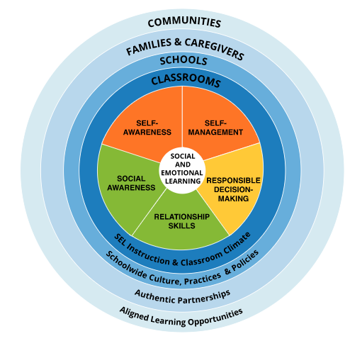
Free two birds with one key...
As a leader look for opportunities that are already part of your practice like unannounced observations or walkthroughs to focus on observing lessons and activities related to SEL.
Capitalizing on a requirement of APPR and focusing on providing feedback on SEL lessons and supporting teachers.
Provides the leader with an overview of SEL lesson delivery and the impact on students.
Brainstorm: What are some other similar opportunities?
Notes:
Brainstorm: What are some other similar opportunities?
The example provided is school principals using unannounced observations or walkthroughs during SEL lesson times as opportunities to focus on providing feedback with a specific focus on SEL. During these types of layered opportunities, principals and school leaders can capitalize on time and intent.

Slide 17
School leadership works in collaboration with staff, students, and parents to nurture change and be supportive throughout the process.
Notes:
Illinois Principals Association, The Illinois Social and Emotional Learning (SEL) Standards; Leading the way for School and Student Success. April 2009.

Slide 18
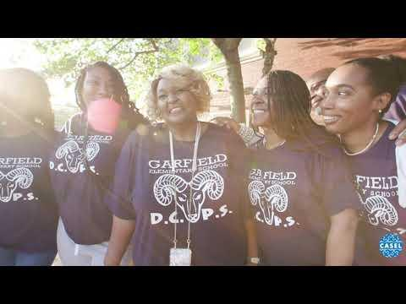
School Leadership Supporting SEL during COVID 19
https://drc.casel.org/how-it-works/
Notes:
2 minutes 38 seconds video
5 Ways Superintendents are Promoting SEL during COVID-19
CASEL District Resource Center
The manner in which this information is arranged compliments the materials from the El Paso resource from slide 9.

Slide 19
Adult Survey Question Bank
Panorama Adult SEL Measures - Individual Learning Time
Review the Panorama survey materials…
Which do you think you might utilize in your next turnkey training?
Consider sections like Well-being (pg 3), Professional Learning About Equity (pg 10), Feedback and Coaching (pg 13).
Create a Google Form or Microsoft 365 Form to use to gather data from participants regarding - minimum of 3 questions.
Notes:
This is a free resource from Panorama and the survey questions are broken into categories that allow for ease of use. The categories are inclusive of faculty and staff well-being, perceptions on the amount and quality of professional learning related to SEL, how well a school supports faculty and staff in learning about cultural awareness, and staff-leadership relationships.
The activity selected with this information is for participants of the initial training to determine which of the questions, choosing a minimum of 3, that they could utilize in their next turn-key training.
Facilitator’s Pause Point: During the turn-key training, consider providing school leaders and principals with an opportunity to develop a Google Form, Microsoft 365 Form, Metimeter, Zoom poll, to use during a staff meeting or any opportunity to check-in with faculty and staff. Additionally, encouraging school leaders and principals to reflect on the data collected and to help inform their practice related to SEL.

Slide 20
Break time 2

Slide 21
School leadership should model the social and emotional competencies they expect students to learn and teachers to teach.
Notes:
Illinois Principals Association, The Illinois Social and Emotional Learning (SEL) Standards; Leading the way for School and Student Success. April 2009.

Slide 22
SEL 3 Signature Practices
Promote Equitable Learning and Working Environments
Equity of Voice: All participants are encouraged to speak and are respectfully heard.
Inclusion: All degrees of participation are welcomed and acknowledged
Collectivism: All engage in and contribute to a “for the good of the group” experience
CASEL SEL 3 Signature Practices Playbook
Notes:
Facilitator Pause Point: Included in this slide is a link to the CASEL SEL 3 Signature Practices Playbook. The last unit in TRLE for SALE, Practical and Achievable SEL Practices in the Classroom, specifically examined the use of the CASTLE 3 SEL Signature Practices and how to use them with intentionality with choosing practices and purpose, and the thoughtful application to enhance adult and student SEL skill building.

Slide 23
Model SEL for Staff - Focus Area 2
SEL practices can be modeled and embedded into any meeting where staff comes together.
Practices may include intentional opportunities to connect personally, interact in meaningful ways, share appreciations, or take time for reflection.
The 3 Signature Practices provide one concrete example of how SEL can be embedded throughout the day—in classrooms, staff meetings, and professional learning—and set the tone for our learning and interactions.
Principal Facilitation Strategies Guide: Large Group SEL Activities for Staff
Notes:
Principal Facilitation Strategies Guide: Large Group SEL Activities for Staff
The attached resource provides a “collection of activities to energize, build community, and practice social and emotional skills during professional development.”
Facilitator’s Pause Point: Consider asking participants if they have used any of these activities, and to what degree of success have they experienced? Additionally, in turn-key trainings, provide time to review the 6 activities and determine if there is one that a school leader or principal would consider using in their next staff meeting or staff engagement opportunity.

Slide 24
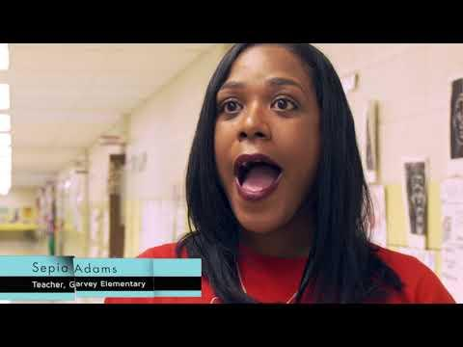
Marcus Garvey Case Study
Video Note Catcher

Slide 25
Together in SEL - Pledge
Catalyze Your Commitment to Youth
Commitment to SEL from Superintendents Nationwide
The “Together for SEL” Pledge
Notes:
The Greater Southern Tier BOCES SEL Implementation Team committed to leading with SEL in mind. Members of the team are from across the organization, and members are from across all departments.
Catalyze Your Commitment to Youth
Video - 3 minutes 7 seconds - Commitment to SEL from Superintendents Nationwide
Video - 3 minutes 16 seconds - The “Together for SEL” Pledge
Facilitator’s Pause Point - What could be the impact in an organization if the school leadership and/or faculty took the SEL pledge?

Slide 26
The leader must be an advocate and visible and vocal supporter of SEL, particularly to staff and parents, in order to generate and maintain enthusiasm.
Notes:
Illinois Principals Association, The Illinois Social and Emotional Learning (SEL) Standards; Leading the way for School and Student Success. April 2009.

Slide 27
Principal SEL Article Review Activity
Article Review Activity
Identify the article corresponding with your breakout room.
Take 3-5 minutes to skim/read the article
Consider what your major takeaways are, and discuss them with your group.
Access the SCRUMBLR
Use the post-its or 3x5 in Scrumblr cards to capture your thoughts or key ideas from the article.
Ask if someone is willing to share the group’s thoughts about the article
Return to the main room and share learning with the larger group.
Breakout Room 1 - The Importance of Self-Care for Administrators
Breakout Room 2 - Principals, please take care of yourselves
Breakout Room 3 - SEL Needs Principals
Breakout Room 4 - The Importance of Self-Care for Administrators
Breakout Room 5- Principals, please take care of yourselves
Breakout Room 6 - SEL Needs Principals
Notes:
Facilitator’s Pause Point: There are many articles available with similar messages and themes regarding the necessity of school leadership and principals to practice self-care. The articles suggested can be switched out for other readings.
Additionally, if time allows consider exploring a deeper reading with participants - Principal’s Social and Emotional Competence: A Key Factor for Creating Caring Schools. This document is also used to help define ‘Prosocial School Leadership’ in the next slide.
Scrumblr is another tool, free to use, that allows for thought catching and organization, however, a Padlet or similar technology tool could be used.

Slide 28
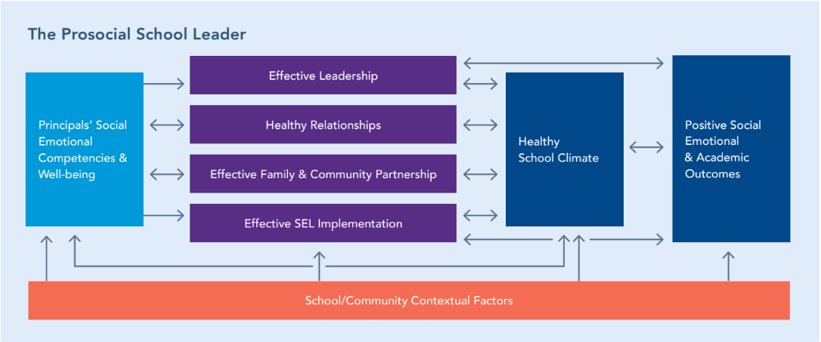
The Prosocial School Leader
Notes:
Principal’s Social and Emotional Competence: A Key Factor for Creating Caring Schools.

Slide 29
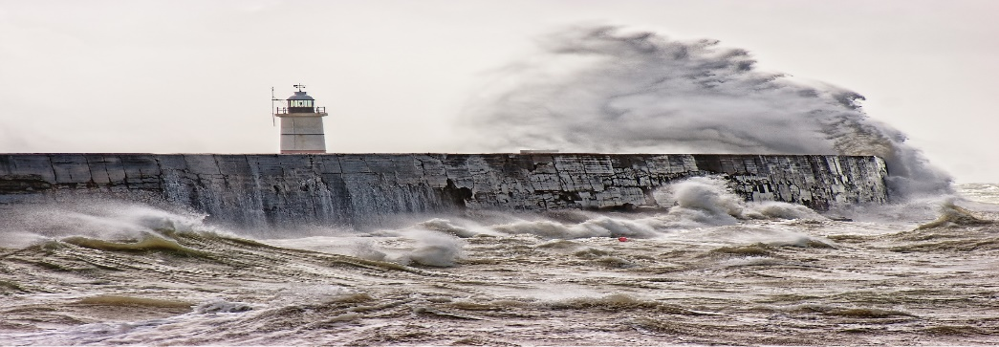
“In order to realize the worth of the anchor, we need to feel the stress of the storm.”
— Corrie ten Boom
Notes:
Principal’s Social and Emotional Competence: A Key Factor for Creating Caring Schools.
Today we all feel the stress of the storm. But, as educators, what is our anchor? The prosocial skills that we are working to foster in our students and adults —skills that will steady and serve them in life’s inevitable storms.

Slide 30
5 Minute Chats with the Principal
5 Minute Chats with the Principal
What do you notice?
What do you wonder?
What phrase/sentence/group of words stands out for you?
What complications or obstacles might be present to prevent effectively implementing this strategy?
What if every student had at least one adult engaging them in this type of conversation? 5 Minute Chat with Students

Slide 31
Additional Opportunities
Check-Ins: Begin all conversations, visits, and meetings with a brief personal check-in. For example, with staff you might ask that they “Share a rose and a thorn of this past week/month” (good/bad). Keep track of what is shared to check-in later; e.g., “Last time we talked you mentioned that your son was ill—how is he feeling?” With families and students, before addressing the issue at hand, take the time to ask how they are doing and listen actively to their answers.
Staff meetings can begin with a quick whip-around question to share out loud or in small groups for large meetings. For example, “Each person describe your weekend in five words” or “In groups of three, share what percentage of your attention is on this meeting and where the other percentage is focused.”
Check-in calendar: Place a staff/administrator name on each day/week of your calendar. On that day, check in with the assigned person to see how they are doing by visiting the classroom, calling, or emailing. Try to limit conversations to good news and personal check-ins; don’t use them to share work reminders. Use the same strategy for students and families, noting students who have recently undergone major changes or life events, or those who have been having challenging interactions with classmates or teachers. Take a few minutes to check in with the student and/or family.
Verbal appreciation for time: Thank administrators/staff/parents for taking the time to meet with you (even if it was ‘mandatory’). Let them know that their time is appreciated.
Be visible out of your office: The more time spent positively interacting with staff and students, the more influence you will have on the climate and relational trust in your building.
Notice what’s going well: Ensure that staff and students hear from you more often about what they are doing right than about what’s wrong. Highlighting best practices is a great way to influence others, and when individuals believe their school leader has a positive opinion of them, they are better able to receive and use critical feedback.
Show staff that you value their perspectives: Invite and use input from staff in decision-making, ask teacher leaders to pilot or discuss new ideas in a focus group, and acknowledge the experience and institutional knowledge of veteran staff members.

Slide 32
Optimistic Closure
30 Day Self-Care Should be...A Principal Priority
Notes:
Optimistic Closure
Image is of a ‘cenote’ - https://en.wikipedia.org/wiki/Cenote. The metaphorical idea is that there is a continuous spring of water that keeps the pool filled. How are you refilling your ‘cenote’?

Slide 33
Thank you for your time today and for learning with us. Please take a moment to provide us with feedback and complete this short form.

