Slide 1
As You Arrive:
Prepare any materials that support your learning
Introduce yourself in the Zoom Chat
Name
School or organization, and role
Notes:
Provide time for participants to gather materials they might need for the learning.
Suggestion: Use the chat function to have participants sign in indicating their name, position/role, and what educational organization they are representing.

Slide 2
Practical & Achievable SEL Practices in the Classroom
TRLE SEL Unit #4

Slide 3
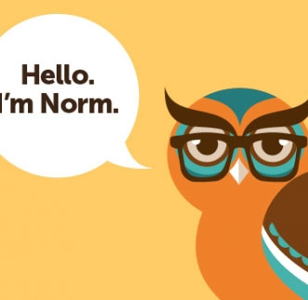
Norms: General best practices of all productive groups
We agree…
To proactively see and consider diverse voices, ideas, and perspectives
Pausing, Paraphrasing, Asking Questions, Listening
To embrace a mindset that promotes my own and other’s learning
Be Present, Listen, Put Ideas on the Table, Presume Positive Intentions
To see opportunities to show gratitude and celebrate with colleagues
Be Present, Presume Positive Intentions, Ask Questions, Offer Support, Thank One Another
Notes:
Establishing norms for online learning experiences reinforces different behaviors, but also can improve the virtual meeting by providing participants with anticipated processes.
Norms can be written to reflect the needs and dynamics of the group.
Suggestion: If using Zoom or an online platform that includes a polling feature, participants can vote on which norms they agree. This allows participants to have voice and choice in the selection of norms for interaction.
The norms written for this slide are more specifically crafted for an audience of professional developers, and suggest strategies to assist participants in adhering to the norms for interaction.

Slide 4
Long Term Learning Target
To build the capacity of teachers and educational leaders to effectively integrate SEL in remote learning environments for all students.
Notes:
Review of the long term learning target related to the TRLE Grant work and Social Emotional Learning (SEL)
Facilitator's Pause Point: The learning target indicates for “all students”, and the language is specifically designed for inclusivity. Consider linking to the Culturally Responsive-Sustaining (CR-S) Education Framework. “The framework was designed to support education stakeholders in developing and implementing policies that educate all students effectively and equitably, as well as provide appropriate support and services to promote positive student outcomes.”
The 4 principles of CR-S Education are supported in this presentation…
Welcoming and affirming environment
High expectations and rigorous instruction
Inclusive curriculum and assessment
Ongoing professional learning

Slide 5
e-Learning Series
Session # | Topic | Date
1 | Introduction to SEL | 2/11/21
2 | Embedding SEL Schoolwide | 3/18/21
3 | Creating a PL Culture Based on SEL | 4/22/21
4 | Practical & Achievable SEL Practices in the Classroom | 5/13/21
5 | Identifying and Selecting Evidence Based SEL Programs | 6/22/21
6 | Classroom-based SEL Activities to Support Student Development of the 5 Core Competencies | 7/26/21
“This resource was adapted from SEL Online Education Modules developed by the Office of Superintendent of Public Instruction. Access the original work on the OSPI Student Support website.”
Additional resources sourced from CASEL - https://casel.org/.
Notes:
Outline of the session in this e-Learning Series with representation of resources and contributing partners.
Note: In several of the sessions for TRLE SEL trainings, materials are sourced from CASEL - https://casel.org and OSPI Student Support Website - https://www.k12.wa.us/student-success/health-safety/mental-social-behavioral-health/social-and-emotional-learning-sel/sel-online-education-module.
OSPI Usage Statement: “This resource was adapted from SEL Online Education Modules developed by the Office of Superintendent of Public Instruction. Access the original work on the OSPI Student Support website.”
CASEL Usage Statement: “Subject to the terms and conditions contained in this Agreement, CASEL hereby grants Licensee a limited, non-exclusive, non-transferable, non-sublicensable and royalty-free, right and license, during the Term, to use, reproduce, publish, broadcast, distribute, disseminate, publicly display, and otherwise exploit the CASEL Materials, and to modify, alter, edit, and create derivative works of the CASEL Materials (“Licensee Derivative Works”, included in the definition of CASEL Materials), in all media, whether now known or later developed, solely in the Territory and in connection with the Purpose. Notwithstanding anything to the contrary contained in this Agreement, Licensee may not use, reproduce, publish, broadcast, distribute, disseminate, publicly display, or otherwise exploit any CASEL Materials with the intent of earning a profit or for commercial purposes.”

Slide 6
Participants will be able to...
Identify the CASEL 3 SEL Signature Practices and demonstrate intentionality with choosing practices and the purposes there of
Use the SEL Signature Practices to develop proficiency in the thoughtful application to enhance adult and student SEL skill building
Develop a plan to implement SEL Signature Practices into a future teaching opportunity
Notes:
The focus of the first objective is to ensure participants’ familiarity with each of the CASEL 3 Signature SEL practices, and how to choose which practice with intentionality for the situation and learners.
Facilitator’s Pause Point: Objectives are developed and arranged to promote a deeper understanding, connection, and suggestion of actions to participants.

Slide 7
Self-awareness check
Celebrate Unique Potential ~Within each of us lies our unique true nature, aching to express its unique potential. Celebrate diversity in others.
Go Deep ~ There is more going on than what we can see. Stay open to the unexpected, lean into the unknown, and embrace paradox.
Bring Your Whole Self ~ Notice the roles we play, the personas we wear, and the parts of ourselves we’re afraid to show. Share your dreams and fears.
Practice Authentic Curiosity ~ No judging, fixing, blaming or rescuing. Realize how little you really know. Instead, ask open, honest questions and listen deeply.
Be Kind ~ Practice compassion. See the best in all beings, the story behind their mask, and speak your truth with love.
Seek Connection ~ Notice the interconnection of all things. Each event affects another, so see the whole and honor multiple perspectives.
Be Here Now ~ Be in your body. Observe your thoughts, feelings and sensations…and what distracts you from the present moment. Try to stay engaged, even when uncomfortable.
100% Integrity ~ Trust is earned by what you say and what you do. Own your thoughts, words and actions.
Notes:
The purpose of rationale for the Self-Awareness Check is for participants to identify which of these elements they will bring to their learning today. This self awareness focuses on their learning and providing a focus for their learning. Participants can be instructed to unmute and share responses, place their responses in Zoom chat, or silently reflect.
Facilitator’s Pause Point: Consider reviewing each of the descriptors with participants, or paraphrasing to deepen their knowledge and understanding.
Self-awareness is the ability to accurately recognize one’s own emotions, thoughts, and values, and how they influence behavior. It is the ability to accurately assess one’s strengths and limitations, with a well-grounded sense of confidence, optimism, and a “growth mindset.” In short, self-awareness is the ability to understand one’s self.
What Skills are Associated with Self-Awareness? In order to be self-aware, one must be able to do the following:
Identify emotions – It is important that students be able to recognize and identify emotions. In order to be aware of their own emotions and participate in activities that address those emotions, they must first be able to label them.
Have an accurate self-perception – Because self-awareness is based on an awareness of the “self,” it is necessary for one’s perception of self to match reality. In order to have accurate self-awareness, it is important for students to be reflective and open to feedback in order to develop a true sense of self. A realistic understanding of themselves will allow students to better manage their behavior.
Recognize strengths – We each have unique strengths, and it is vital that we each recognize and build on them. An important piece of social emotional health is a focus on positive attributes.
Possess self-confidence – When students are able to recognize their strengths, their self-confidence grows. Again, self-confidence is an integral piece of a healthy social emotional state.
Demonstrate self-efficacy – Self-efficacy is an individual’s belief in their ability to achieve a goal. Recent research suggests that by believing you are capable of something, you help yourself on the path to achieving it.

Slide 8
How familiar are you with CASEL’s Playbook- 3 Signature Practices
First time learning about it
I have some knowledge and try to incorporate into my teaching
I’m an SEL Guru
Notes:
This check-in specifically focuses on the participant’s current knowledge around the CASEL SEL 3 Signature Practices Playbook. Participants are asked to identify on the continuum how familiar they are with the practices.
Facilitator’s Pause Point: If presenting in Zoom, have participants use the “Annotate” function and then they can choose a “Stamp” to indicate their response. Consider modeling this for participants. Turn-key presenters can use this data collected to tailor their training.
Possible topic of discussion: How do the two check-ins differ? What information is each seeking? Why are both needed?
Facilitator’s Pause Point: If presenting in Zoom, have participants use the “Annotate” function and then they can choose a “Stamp” to indicate their response. Consider modeling this for participants. Turn-key presenters can use this data collected to tailor their training.
Possible topic of discussion: How do the two check-ins differ? What information is each seeking? Why are both needed?

Slide 9
SEL 3 Signature Practices
Promote Equitable Learning and Working Environments
Equity of Voice: All participants are encouraged to speak and are respectfully heard.
Inclusion: All degrees of participation are welcomed and acknowledged
Collectivism: All engage in and contribute to a “for the good of the group” experience
CASEL SEL 3 Signature Practices Playbook

Slide 10
ABCs of Equitable Practices
The synergy of intentionally practicing SEL skills within academic and social situations provides opportunities to develop them as well-ingrained habits that are transferable to situations beyond the classroom walls.
The SEL 3 Signature Practices support the ABCs of an effective learning environment.
A - Autonomy: The need to be in control of oneself and empowered to make decisions. Participants make personal choices about what they say and do in each of the activities.
B - Belonging: The need to be accepted and valued by others. The activities are designed so that every person can be heard and seen without judgement and help build relationships with others and with content.
C - Competence: The need to be effective or to accomplish things. The Signature Practices give opportunities to be effective across a variety of contexts and strengthen intra- and inter- personal skills during the school day, in out-of-school-time experiences, or at work.

Slide 11
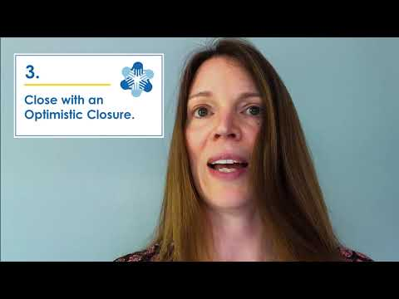
CASEL SEL 3 Signature Practices Playbook
Video Overview
Notes:
3 Signature Practices with Karen VanAusdal - Video 2 minutes and 57 seconds: https://youtu.be/mCwGp-CHg7E
CASEL SEL 3 Signatures Practices Playbook: https://casel.org/sel-3-signature-practices/

Slide 12
3 Signature Practices as a Tool
Why? Set the tone for our learning and interactions as our strengths, challenges, goodwill, implicit biases and circumstances contribute to how we face the day
What? Intentionally chosen strategies, activities, and protocols that model SEL in action and create an equitable experience.
Who? Everyone- students and adults are a part of the lifelong learning process for developing strong SEL skills.
When? Build the practices throughout the day as a regular part of daily lesson planning, meeting agendas and professional learning to create strong effective learning environments.
Notes:
Review of the why, what, who, and when to use the 3 signature SEL practices as a tool for adult and student learning.

Slide 13
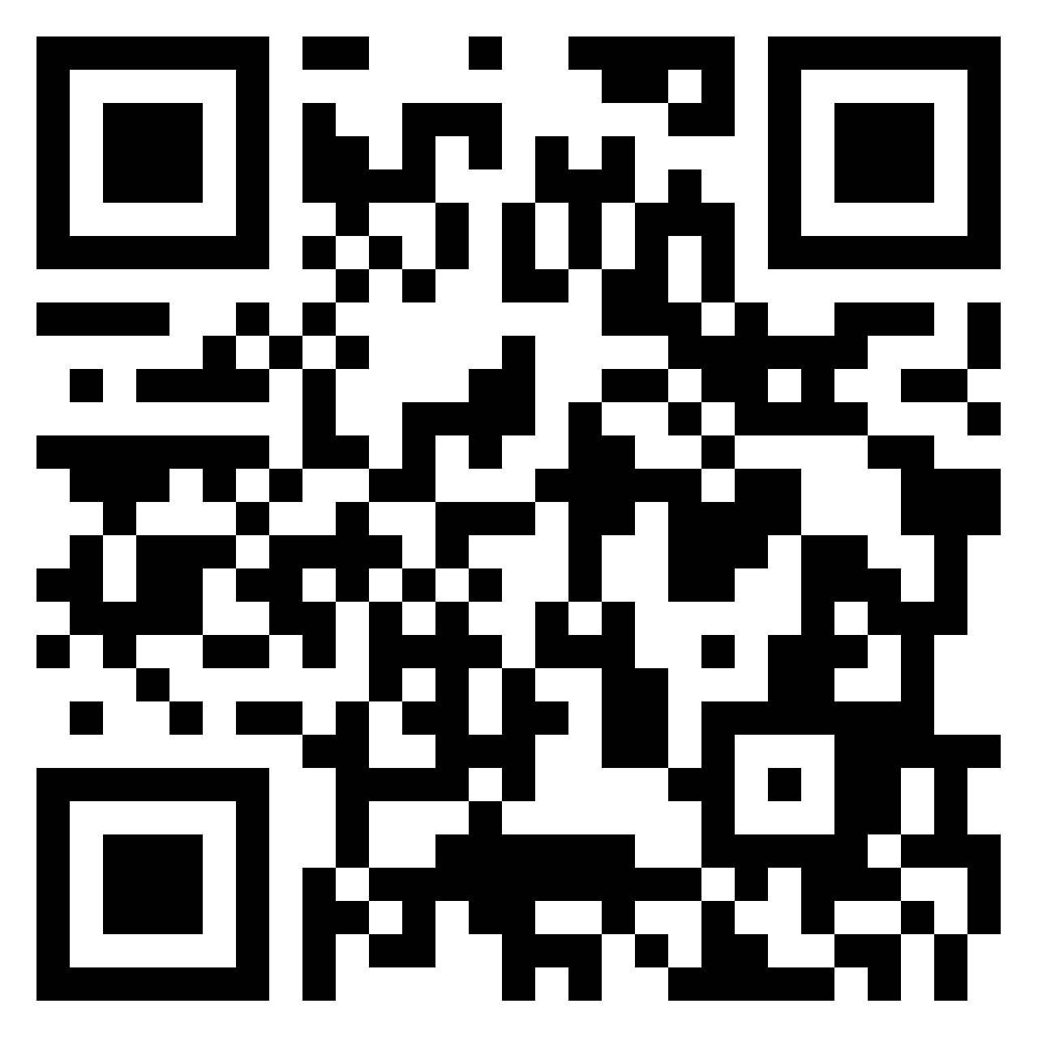
Using the CASEL 3 Signature Practices Playbook 1
Complete the following...
On page 10 read the information on Welcoming/Inclusion Activities
What are your I notice?, I wonder? Considerations for using these activities in a virtual environments? Place your responses on the PADLET
Notes:
Using the CASEL SEL 3 Signatures Practices Playbook (https://casel.org/sel-3-signature-practices/) page 10, participants are asked to read the materials, and then record their “I notice… I wonder” statements on the provided Padlet (https://padlet.com/sstephensselgst/jr5t9vx2dl634jxm). A QR Code is also on the slide so that participants can access the Padlet through an alternative resource.
Facilitator’s Pause Point: While Padlet is being used in this example, other technology tools can be utilized including; Jamboard, Google Slides, Mentimeter.

Slide 14
Purposeful and practical check-ins
Student well- being
Potential for teachers and counselors to review responses to better understand student well-being and supports, and then follow up with individual students.
SEL skills and competition
Educators have an opportunity reflect on trends in student social-emotional growth, and conduct interim SEL check-ins and use the information to plan or adjust Tier 1 programming, and plan action or interventions for individual or groups of students
Classroom Feedback
Classroom teachers can gather feedback on how class went "today" and understand how each student learns best, then use the information to plan the next day's lesson, reflect on teaching practices and follow-up with specific students
Notes:
The Panorama resource (https://go.panoramaed.com/hubfs/Check-Ins-Question-Bank.pdf?hsCtaTracking=7170e658-4dcf-43d1-a16d-09ba5e5c364f%7C9a9428dd-0626-4e77-b9bc-42a1a3e9871e) provides a question bank that supports the three possible purposes of the check-ins. In each case, the check-ins provide an opportunity for educators to collect data on student well-being and understanding of content, and then follow up with students or use it to plan for learning. Presenting as an example of how to specifically align the SEL practice with the desired purpose.

Slide 15
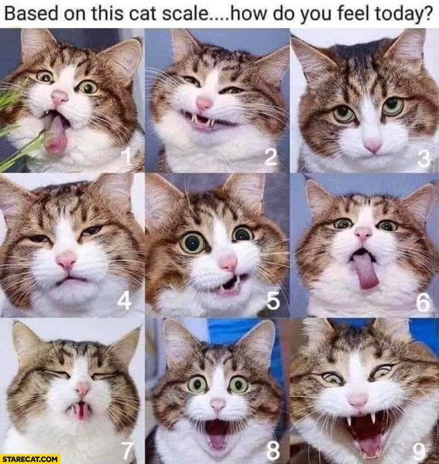
Meme Check- In Examples
Based on this guinea pig scale, how are you feeling today?
Based on this cat scale, how are you feeling today?

Slide 16
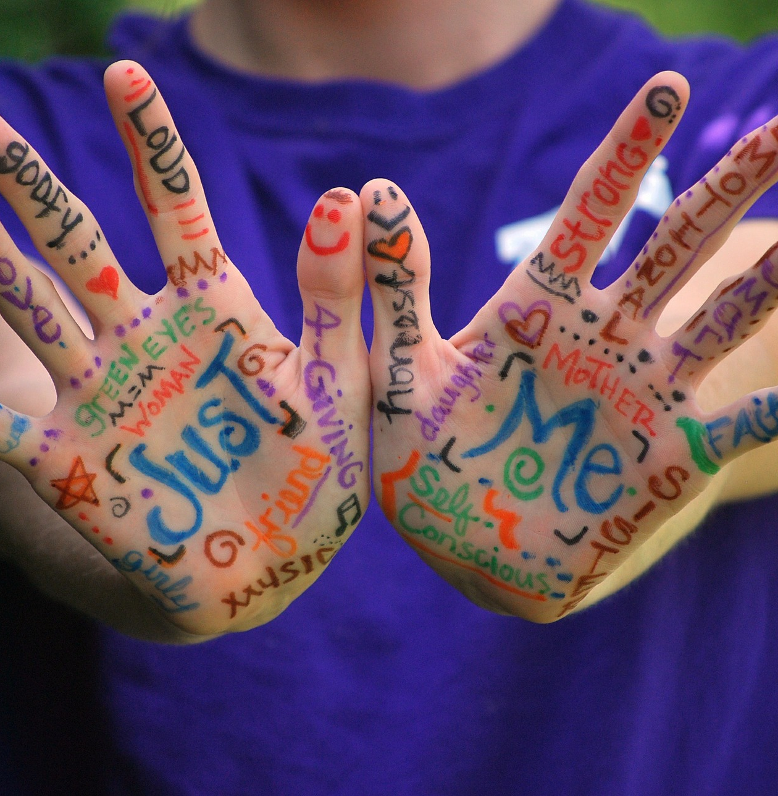
How do I know what emotion I am feeling?
Notes:
Image from Pixabay

Slide 17
Defining emotional intelligence
Process emotions in yourself and others
Notes:
Video - 3 minutes 42 seconds: https://www.youtube.com/watch?v=n9h8fG1DKhA

Slide 18
Emotional intelligence
Children with higher emotional intelligence are better able to pay attention, are more engaged in school, have more positive relationships, and are more empathic.
Raver, Garner, & Smith-Donald 2007; Eggum et al. 2011
Recognizing emotions in oneself and others
R U L E R
Understanding the causes and consequences of emotions
Labeling emotions correctly
Expressing emotions in a way that are appropriate for the time, place, and culture
Regulating emotions
Notes:
Prior to introducing the Mood Meter on slide 20, the concept of emotional intelligence is defined, and the RULER method on how to practice emotional intelligence with adults and students is explored. The linked article, Teaching Emotional Intelligence in Early Childhood (https://www.naeyc.org/resources/pubs/yc/mar2017/teaching-emotional-intelligence), provides additional explanations of RULER and using the mood meter to practice emotional intelligence as well as how to integrate into classroom management practices and in read-alouds.

Slide 19
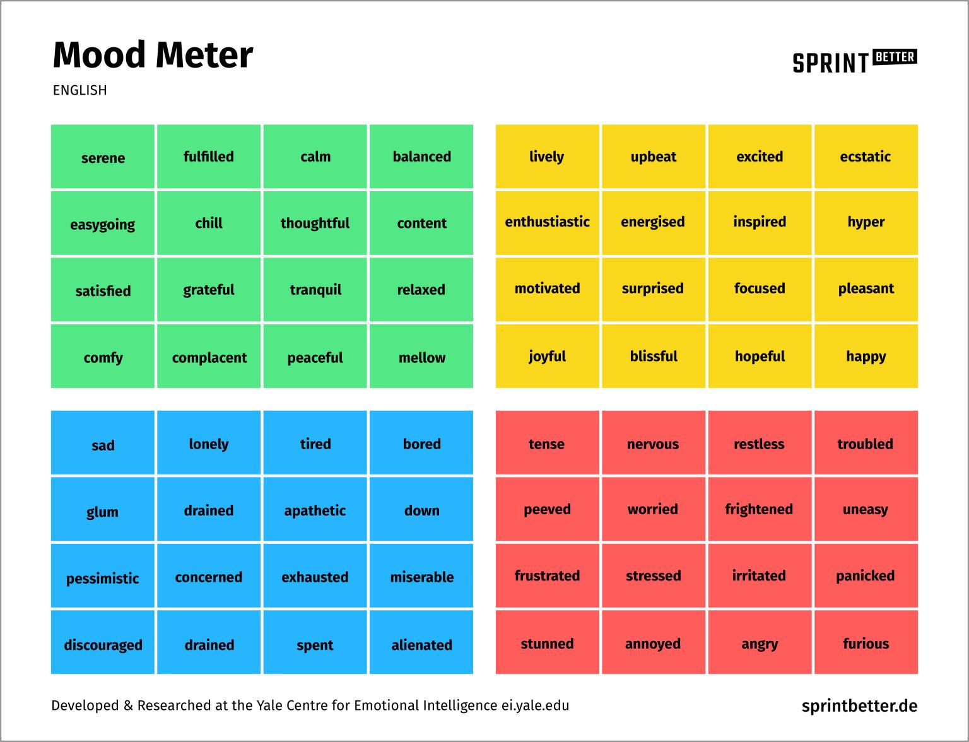
Mood meter
This Photo by Unknown author is licensed under CC BY-SA-NC.
Notes:
The Mood Meter assists students with identifying emotions and increasing student emotional vocabulary. The first video on the slide, Yale Center for Emotional Intelligence: Mood Meter Overview (https://youtu.be/qj6AIczvDhg), is a brief overview of how the emotions in each quadrant can influence or affect student learning and the energy for that learning.
Facilitator’s Pause Point: Consider viewing Marc Brackett on Emotional Intelligence and the Mood Meter, Part 1 (https://youtu.be/d36ksgP72Z4), is a more in depth explanation of the Mood Meter from the co-creator of the RULER Approach to Social Emotional Learning, Marc Brackett.

Slide 20
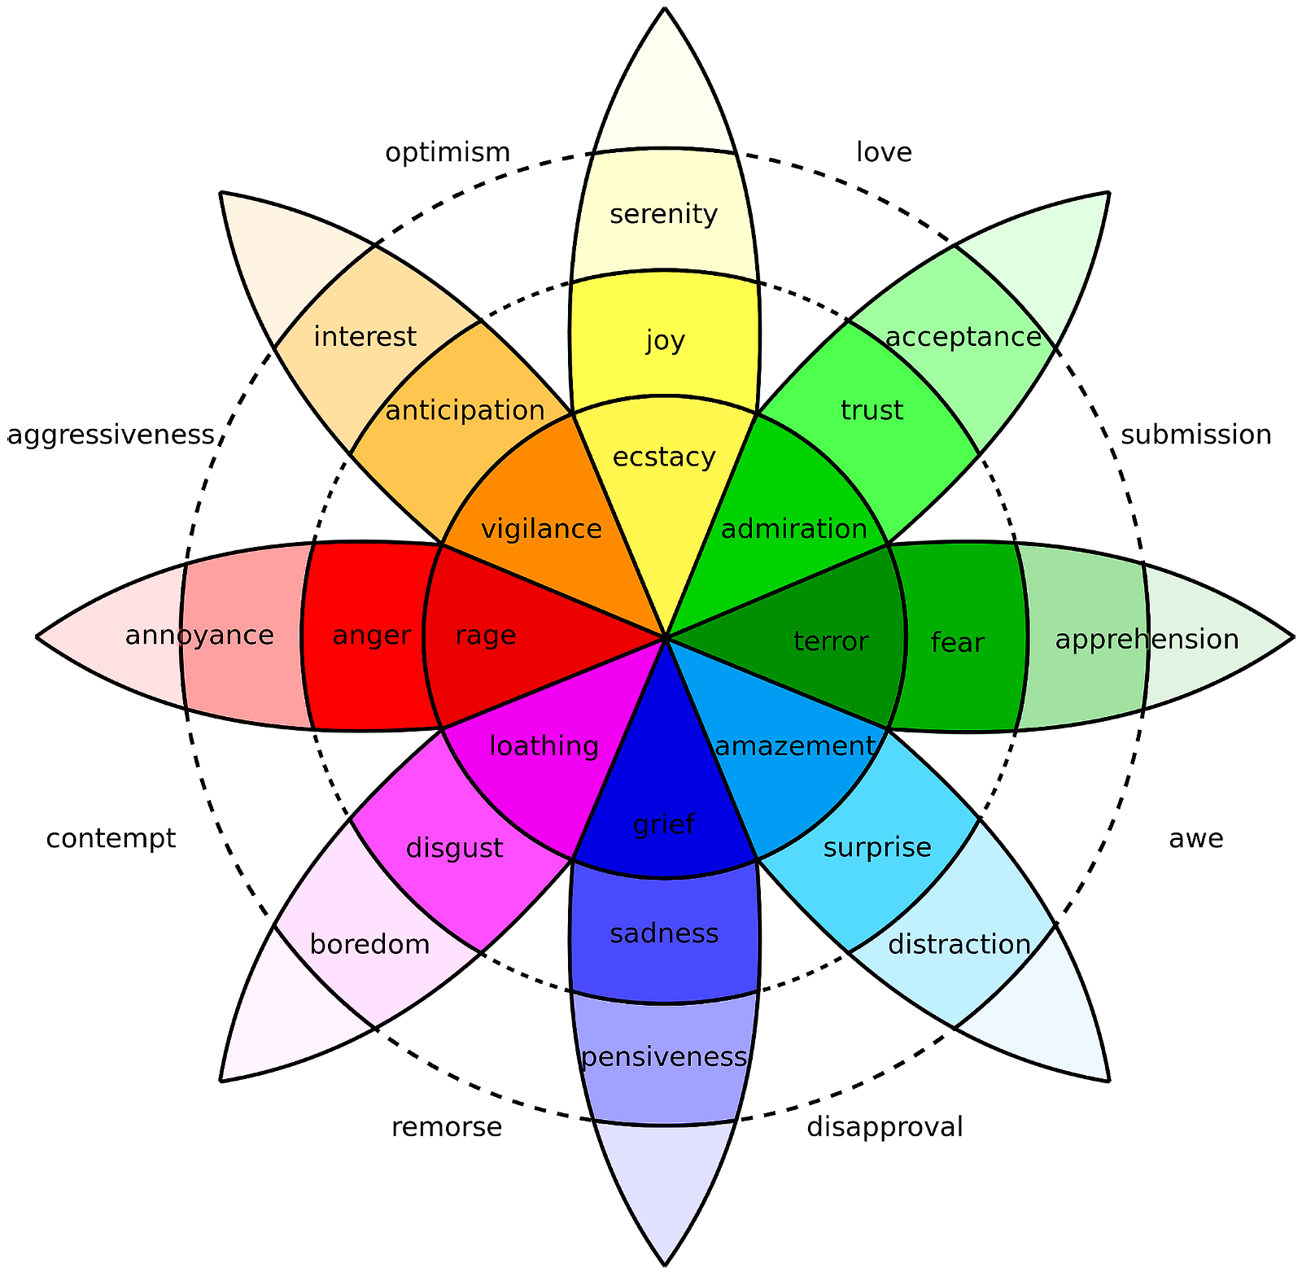
Emotional intelligence for adults
https://www.6seconds.org/2020/08/11/plutchik-wheel-emotions/
https://www.healthline.com/health/emotion-wheel#variations
Notes:
These additional resources explore the Plutchik Wheel of Emotions, and emotion wheel variations.
Facilitator’s Pause Point: Explore the resources of Plutchick’s Wheel of Emotions, including What’s new in emotional intelligence.
Additional possible enrichment activity: Using How to Use an Emotion Wheel to Get in Touch with All Your Feels, assign participants to a breakout room. Each breakout room explores each of the different wheels (Plutchik, Geneva Wheel, Junto Wheel - links are provided in the article), and have participants evaluate the pros and cons of each wheel.

Slide 21
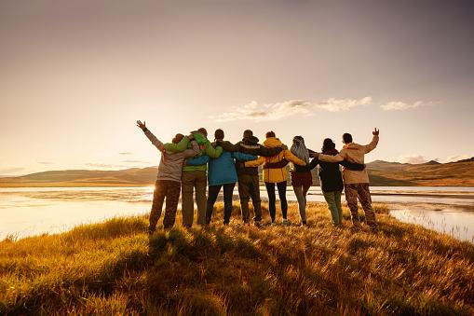
Welcoming activities for hybrid learning
Linked in
ID Numbers
Have you ever
Notes:
Pixabay image
Each link to its own slide deck

Slide 22
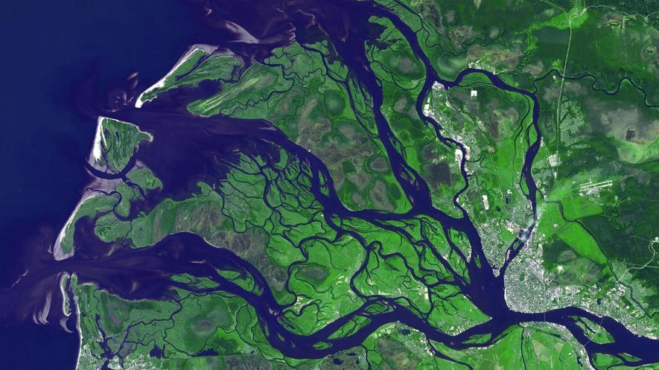
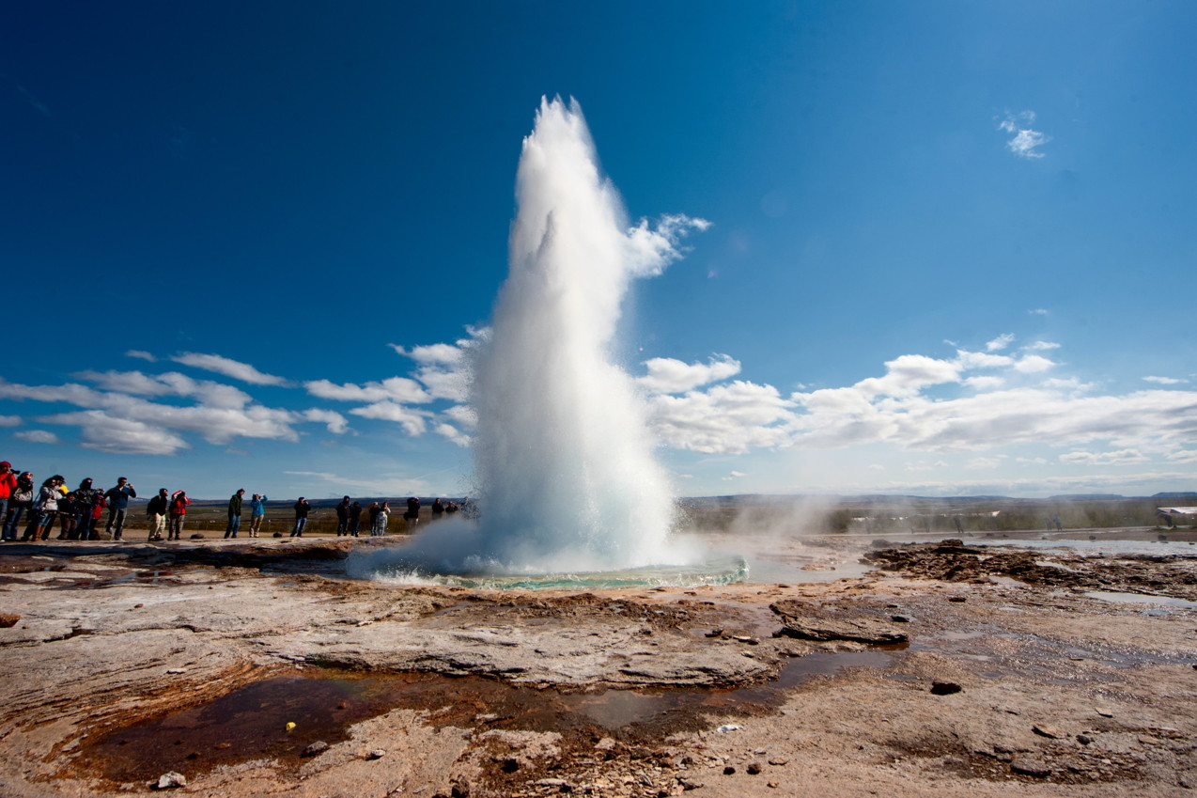
Highly effective teaching and learning is like …
Notes:
Highly effective teaching and learning is like....
...because _____________________________________________________.
Participants can share their ideas in chat and then also in large group discussion.

Slide 23
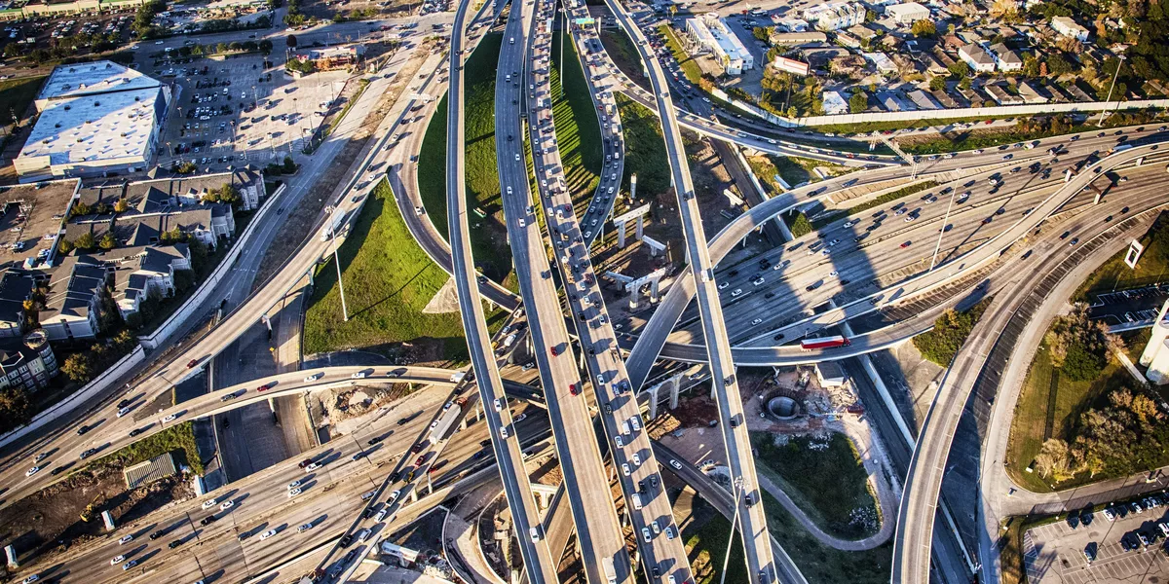
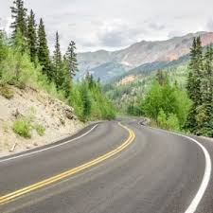
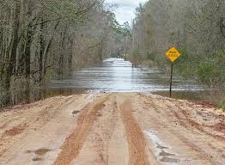
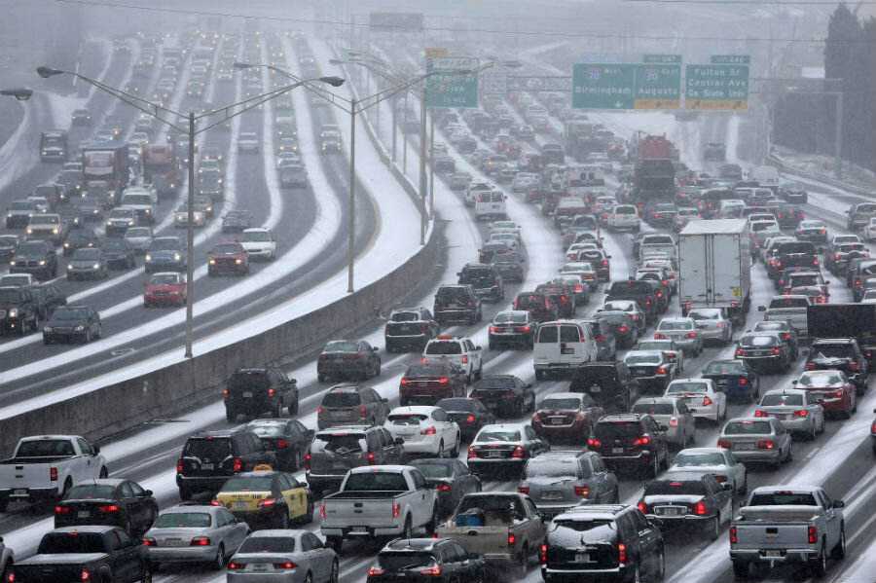
Which road best represents your current emotional state?
1
2
3
4
5
6
Notes:
Invite participants to answer the question and respond in the chat box with the number and a word that might represent the picture in relation to their current emotional state. Other welcoming strategies can be found in CASEL’s 3 Signature Practices Playbook https://schoolguide.casel.org/uploads/2018/12/CASEL_SEL-3-Signature-Practices-Playbook-V3.pdf
5 min

Slide 24
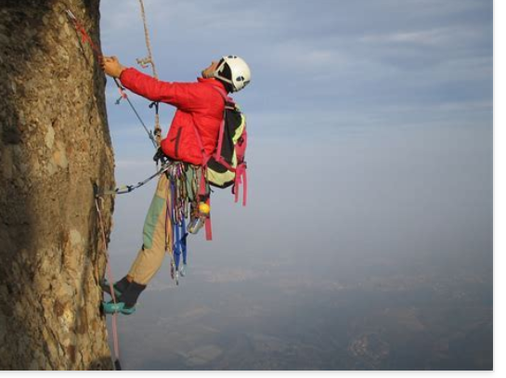
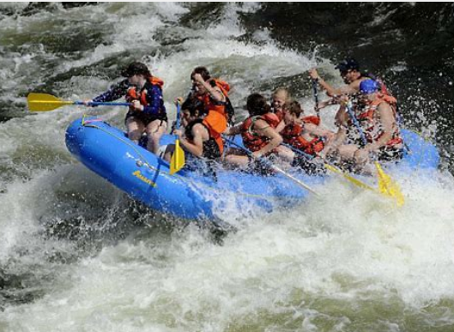
Virtual teaching is like …
Notes:
Example of welcoming activity
Virtual teaching is like....
...because _____________________________________________________.
Participants can share their ideas in chat and then also in large group discussion.

Slide 25
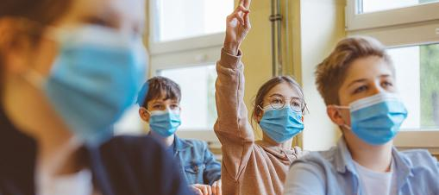
What made you smile in the past two weeks
Notes:
Open-ended question that can be modified to say "today" or any length of time. Personal or Professional. Positive, typically student focused.

Slide 26
Morning check-in
https://bit.ly/3qmmmxg
Notes:
An example of a Morning Check-In designed with low-risk and engaging questions, but with some embedded content. This example was built in Microsoft forms.

Slide 27
Reflection
What was it like for you to participate in these activities?
What were some things that you appreciated about the activities? Challenges?
What SEL skills did you use?
Notes:
What was it like for you to participate in these activities?
What were some things that you appreciated about the activities? What did you find challenging?
What SEL skills did you use to participate in the activities?

Slide 28
Break time 1
Notes:
5 min Break

Slide 29
Using the CASEL 3 Signature Practices Playbook 2
Complete the following...
On page 10 read the information on Welcoming/Inclusion Activities
What are your I notice?, I wonder? Considerations for using these activities in a virtual environments? Place your responses on the PADLET
Notes:
Using the CASEL SEL 3 Signatures Practices Playbook (https://casel.org/sel-3-signature-practices/) page 19, participants are asked to read the materials, and then record their “I notice… I wonder” statements on the provided Padlet (https://padlet.com/sstephensselgst/6g7to5igf12z3y5a). A QR Code is also on the slide so that participants can access the Padlet through an alternative resource.

Slide 30
Instructional models for remote instruction
Notes:
Student engagement: All models of Instruction must attend to creating experiences that will engage and stimulate student learning and include substantive interactions with teachers.

Slide 31
Why students don’t turn on their video cameras during online classes
…and an equitable and inclusive plan to encourage them to do so
Directions:
Review the Discussion Overview (Section 4.1) - whole group activity
In breakout room, choose a spokesperson for your group or someone who is willing to share.
In your breakout room, skim your assigned section of the discussion (4.2, 4.3, 4.4, 4.5, 4.6).
What are your summary/major takeaway from that section. In the schools/classrooms your support or work with would this strategy work? Has it been tried? To what degree of success? Evaluate the recommendations of the article. Support the spokesperson to share the group's learning.
Spokesperson shares group's learning in large group.
https://onlinelibrary.wiley.com/doi/full/10.1002/ece3.7123
Notes:
Using Why students do not turn on their video cameras during online classes and an equitable and inclusive plan to encourage them to do so, complete the following activity (https://onlinelibrary.wiley.com/doi/full/10.1002/ece3.7123)
Directions:​
​
Review the Discussion Overview (Section 4.1) - whole group activity​
In breakout room, choose a spokesperson for your group or someone who is willing to share.​
In your breakout room, skim your assigned section of the discussion (4.2, 4.3, 4.4, 4.5, 4.6).​
What are your summary/major takeaways from that section. In the schools/classrooms your support or work with would this strategy work? Has it been tried? To what degree of success? Evaluate the recommendations of the article. Support the spokesperson to share the group's learning.​
Spokesperson shares the group's learning in a large group.
Note: This is an open access article under the terms of the Creative Commons Attribution License, which permits use, distribution and reproduction in any medium, provided the original work is properly cited. Copyright 2021 The Authors. Ecology and Evolution published by John Wiley & Sons Ltd.

Slide 32
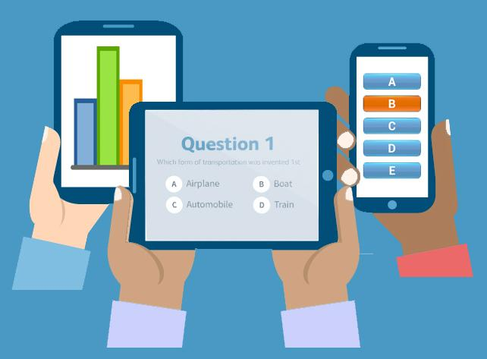
Polling students to check understanding
https://www.edutopia.org/article/polling-students-check-understanding
This Photo by Unknown author is licensed under CC BY-NC.
Notes:
To assist with gaging your audience’s level of familiarity and comfort with educational technology tools. Consider asking questions similar to...
How often do you use technology tools to enhance engagement in your teaching?
Which educational technology tool do you feel most comfortable using?
Which education technology tool do you still feel unsure using?

Slide 33
Engagement Examples for Hybrid Learning Environments
Scavenger Hunt
Jamboard Engagement Templates
One Word

Slide 34
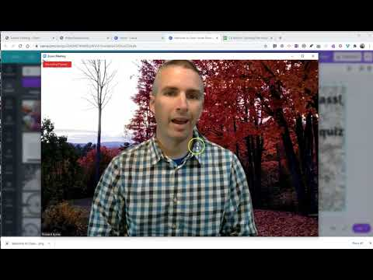
Virtual Backgrounds for Student and Teacher Engagement
5 Free Zoom Virtual Backgrounds for Teachers in 2020
https://www.kapwing.com/resources/5-free-zoom-virtual-backgrounds-for-teachers-in-2020/
5 Free Zoom Virtual Backgrounds for Students
https://www.kapwing.com/resources/5-free-zoom-virtual-backgrounds-for-students/
Notes:
Facilitator’s Pause Point: Having teachers and students design their own individualized Zoom or Microsoft Teams backgrounds allows students and teachers to demonstrate self-awareness and communicate their interest and for peers to learn about each other.
Depending on the time you have with your turn-key groups, consider having participants design their own virtual backgrounds.

Slide 35
Break time 2
Notes:
5 min Break

Slide 36
Mindfulness Activity/Brain Break
Notes:
https://youtu.be/kWjzgSncMrI
https://youtu.be/c1Ndym-IsQg
22 Powerful Closure Activities | Edutopia (https://www.edutopia.org/blog/22-powerful-closure-activities-todd-finley)
https://www.centervention.com/morning-affirmations-for-kids/

Slide 37
Using the CASEL 3 Signature Practices Playbook 3
Complete the following...
On page 10 read the information on Welcoming/Inclusion Activities
What are your I notice?, I wonder? Considerations for using these activities in a virtual environments? Place your responses on the PADLET
Notes:
Using the CASEL SEL 3 Signatures Practices Playbook page 36 (https://casel.org/sel-3-signature-practices/), participants are asked to read the materials, and then record their “I notice… I wonder” statements on the provided Padlet (https://padlet.com/sstephensselgst/76x8c99jmtggtke0. A QR Code is also on the slide so that participants can access the Padlet through an alternative resource.

Slide 38
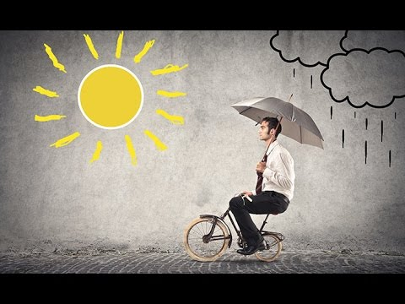
Video: Be Optimistic
Notes:
Video - 1 minute 34 seconds (https://youtu.be/NDr0EWc3VP0)
Facilitator’s Pause Point: Sometimes there is an assumption that optimistic means that everything is rainbows and unicorns. However, a better understanding of optimism is related to the understanding that adversity can be faced with positivity or that resilience is a better path than resistance.

Slide 39
What are your next steps for SEL practices in the classroom?
Traffic Light
Toy Reflection
Human Bar Graph
Comfort Circle

Slide 40
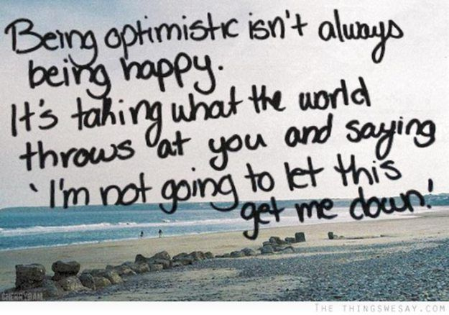
Being optimistic
Notes:
​1 minute to reflect one of the following...building resiliency​
Something you appreciated today
Something you are looking forward to​
Something you learned​
Something you want to thank someone for​

Slide 41
Planning time – Getting it Down PATT
Notes:
Review the Getting it Down PATT! Planning template on page 61 in the SEL Playbook (https://schoolguide.casel.org/resource/three-signature-sel-practices-for-adult-learning/). Give participants time (10-15 minutes) to begin planning a lesson.
Image from Pixabay

Slide 42
What are the next steps for SEL practices in the classroom?
How can we bring what we have learned in the remote learning environment to the classroom?
Notes:
Facilitator’s Pause Point: This activity has been modified from the SEL Playbook page 43.

Slide 43
Thank you!
Thank you for your participation and for learning with us! Would you mind completing this short feedback form for us?

