Slide 1
Round Table for Applying Key Instructional Strategies for ELLs/MLs
Session 4
Notes:
Welcome to the 4th Session of The TRLE Turnkey training.
In today’s training, we will review some of the key concepts that were presented in the first three sessions. In addition to the review, you will have an opportunity to see an example and identify implementation of strategies that were presented in the first three sessions.

Slide 2
Why have a round table now?
Notes:
The goal of this session is to allow each group to go a little deeper into the information presented and to allow participants time for interaction and questions from material presented previously in asynchronous and synchronous trainings.
Take a moment to reflect on how many people have attended sessions 1 2 and 3…Have they had an opportunity to interact with others around these topics?
As we learn from Leo Vygotsky, social interaction plays a critical role in learning. His theory was based on researching children., but it can easily apply to adults. We welcome the opportunity in this session to delve more into the topics and support teacher’s understanding of how best to apply the concepts in teaching ELLs/MLs.

Slide 3
Session 1
What is comprehensible input?
How to convey context & meaning without ‘explaining’?
Notes:
Starting with Session 1, What is Comprehensible Input?
Please put some answers in the chat.
In the chat, there should be things like, “helping children understand through pictures, gestures, repetition, rephrasing, etc… “
“making meaning for students to participate in learning”
There might also be things such as, “showing students, not telling them”
When students are in remote environments, this presents a layer of challenge since pictures and gestures need to be conveyed online. Videos can also be used to help convey meaning and build background.

Slide 4
Session 2
Best way to use home language supports?
https://www.youtube.com/watch?v=8b7EJmS9A0g
Notes:
Session 2 addressed use of home language supports. In this session we learned about some right ways and not so helpful ways to use the home language.
We learned that using the home language strategically, targeted to main ideas and concepts that allow students to engage in the lesson are best.
We learned that translating all the information is not necessary, nor is it preferred. Students learn academic language and key concepts by providing supports in home lamaguage via mini webinettes and bilingual glossaries.
Let’s take a closer look at the Chinese webinette for Modeling in Science.
(Pause to show the webinette)
Ask: What do you notice about the webinette?
Did the time seem longer than 3 minutes to you?
If you share the webinette with a parent and/or student that speaks Chinese, please share the response and any effects with the group.

Slide 5
What are some of the challenges regarding home language support?
Notes:
What have participants expressed as most challenging about home language supports?
We often hear that finding accurate translations is difficult. We also hear that it is not easy to find videos or texts in different languages. Session 3, shows some home language libraries that may help teachers find home language texts…see the Padlet link in Session 3 for those resources.
Another challenge we hear is that teachers don’t have the time to have students access materials and information in their home language. In remote and hybrid environments, is this something easier or more challenging during classroom instruction?
(Pause and let participants respond, either in the chat or verbally)
We look forward to offering additional webinettes on this site, and hosting a session to teach teachers how to create a webinette of their own for their students.

Slide 6
Session 3: Scaffolding
What is scaffolding?
Notes:
Now let’s take a moment to review Session 3. Were you able to watch the webinar for Session 3?
(Pause to check your responses either in the chat or ask for thumbs up)
What is Scaffolding in terms of instruction for ELLs?
(Pause. You should get answers like, “supports, accommodations, adapted materials, small group assignments, individualized and differentiated assignments”
I will remind you that scaffolds are temporary. They are not intended to be permanent or long term. Let’s take a look at some of the things we learned in Session 3 about Scaffolds for ELLs.
STOP and SHARE slides 39-47 from the presentation in Session 3 as a review

Slide 7
Materials and Resources Scaffolds
Graphic organizers
English and/or bilingual glossaries
English and/or bilingual dictionaries
Home language materials
Sentence frames, sentence stems, and paragraph frames
Visuals
Word banks or word walls
Notes:
This list gives visual examples of some common scaffolds used. Ask: Are there other scaffolds that you have seen?
What about using actual items/real objects?
For virtual learning, the use of videos and demonstrations online.

Slide 8
Instructional Scaffolds
Preidentified and pretaught vocabulary
Concise instruction of background knowledge
Reduced linguistic load, repetition, paraphrasing, and modeling
Notes:
These instructional scaffolds are used during teaching, and lessons. Having students identify and practice key vocabulary.
Providing chunked text and “reader’s digest” versions of or lists for students.
Creating shortened texts, with vocabulary that is more understandable, less confusing to ELLs.
These scaffolds can be noticed in the English versions of the webinettes from Session 2.

Slide 9
Grouping Scaffolds
Structured pair work
Structured small-group work
Teacher-led small-group work
Notes:
Finally, scaffolds can be in the form of grouping with students.
In remote and hybrid learning, break out rooms are often strategically planned for meeting the different needs and strengths of students.

Slide 10
What does a teacher need to know in order to scaffold appropriately?
Revisit Tools #3 and #7 from Module 3
Notes:
Let’s take a look at two tools from Session 3:
Tool #3 reviews what teachers need to know about their ELLs.
(show tool #3)
Tool #7 has a checklist for teachers to review as they plan for their ELLs
(show tool #7)
https://www.eteachny.org/ells-and-mlls/ells-in-distance-learning-or-hybrid-settings/scaffolded-lesson-planning-checklist/
Read through the checklist. Ask: Is there anything on this checklist that presents a challenge for classroom teachers? How can they find out the information?
It is so important that teachers know the levels of their students to provide the appropriate scaffolds. As students advance in English proficiency, scaffolds can be removed strategically.

Slide 11
Elevator Pitch
Can you create an elevator speech or statement to describe Scaffolding for ELLs?
Notes:
Let’s take a moment and see if we can synthesize or summarize what we know about scaffolding for ELLs.
Pause for 3-4 minutes. Ask: can anyone please share something in the chat or unmute? Take 3 examples…Or move participants to break out rooms and have each break out room create a unified statement.
Share the statements.

Slide 12
Example: Video
Let’s look at an example:
https://www.teachingchannel.org/videos/multi-language-classroom
Notes:
We are going to watch a classroom teacher provide some strategies that have been presented in sessions 1, 2, and 3.
As you watch the video, please take notes on what you see. We will debrief in break out rooms and then together as a whole group at the end.

Slide 13
Small Group Discussion
What did you notice about Ms. Yurkavetsky’s classroom?
What ways were home language and culture used?
What scaffolds did you see?
How can these be used in hybrid & remote instruction?
Notes:
In break out rooms or in small groups, please answer these questions. You will have 15 minutes to talk about what you saw, and identify any questions you have.
Please choose one person who will be the reporter for the group and one person who will keep track of the time and encourage everyone to participate.

Slide 14
Debrief
What were the big takeaways in your small group?
What are some things that your group wonders about?
Notes:
After the small group discussion, bring each group back to have a whole group debrief about what they noticed. Each group will share some noticings and wonderings.

Slide 15
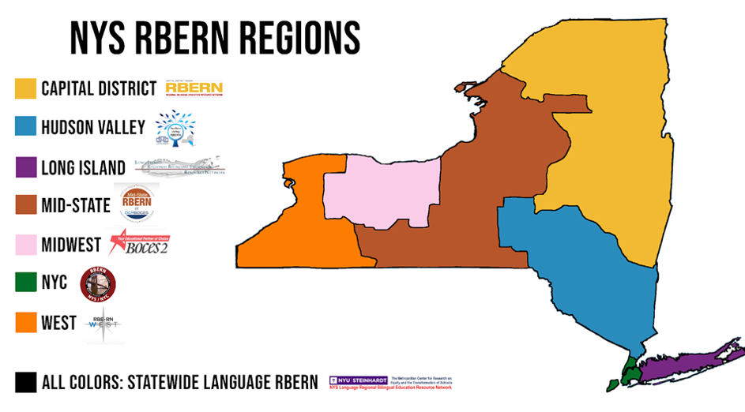
For more information
Please check with your local RBERN
Notes:
There are many other resources out there for supporting content area instruction for ELLs. Please check with your local RBERN for details.

