Slide 1
Providing Remote Specially Designed Instruction for Students with Severe Disabilities
Parents & Families as Instructional Partners
Notes:
Opening slide. Facilitator might have this opening slide showing 15 minutes prior to the start of the session as participants join the virtual room. A few minutes before the start of the session, move to slide 2.

Slide 2
Objectives
Identify what elements of instruction may be adapted when specially designing instruction including content, methodology and delivery of instruction.
Prioritize standards-aligned content for students with severe disabilities
Explore 3 instructional methodologies to support for students with severe disabilities
Inspect 6 approaches to delivering specially designed instruction
Discuss how to monitoring progress, collecting data to use as a basis for adjusting instruction

Slide 3
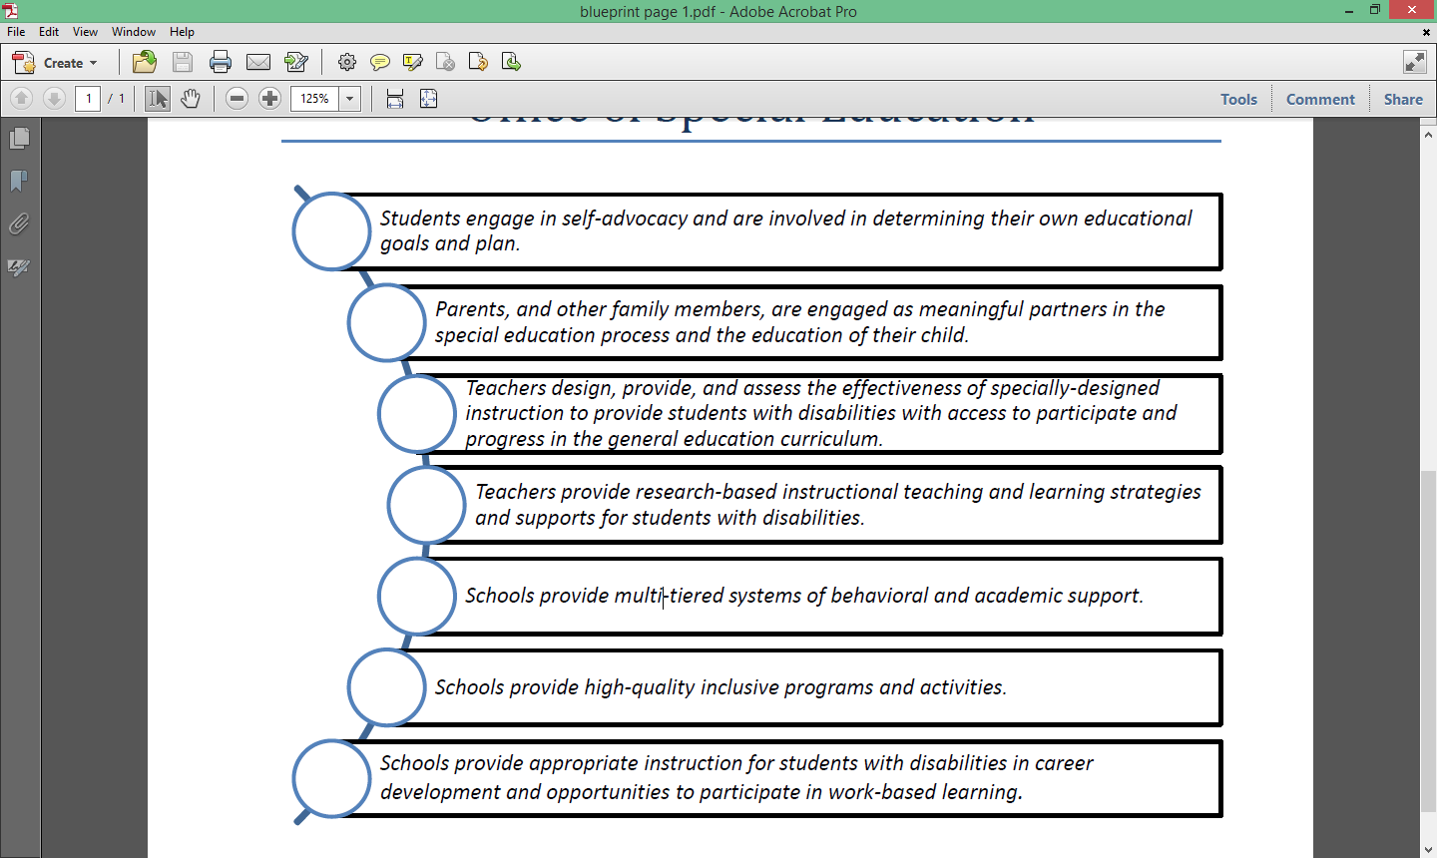
The NYS Blueprint for Improved Results for Students with Disabilities

Slide 4
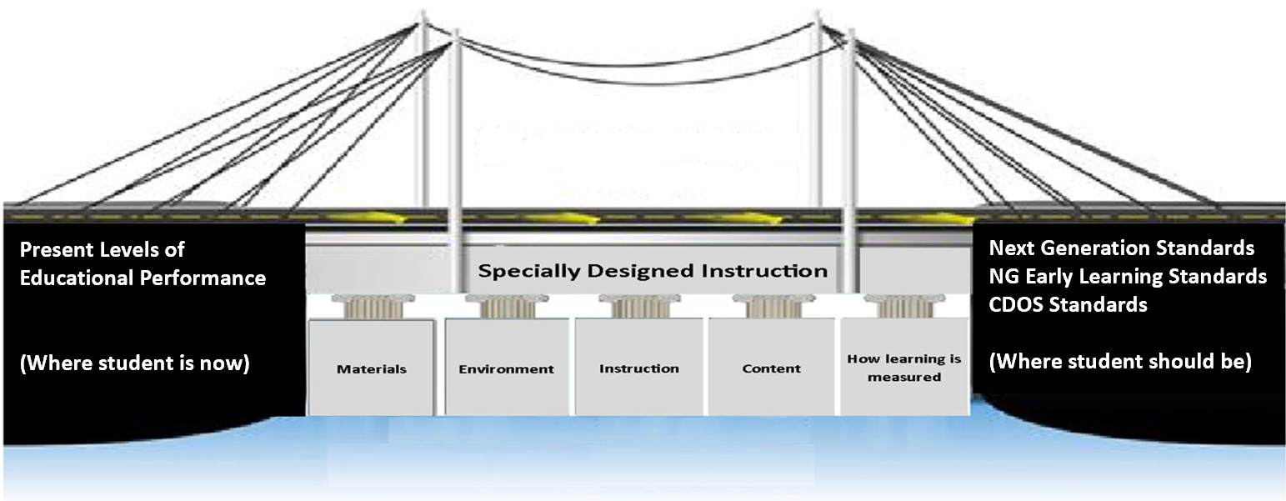
SDI: Crossing the Bridge

Slide 5
Specially Designed Instruction
Current IDEA (2006) regulations define specially designed instruction as:
“… adapting, as appropriate to the needs of an eligible child under this part, the content, methodology or delivery of instruction (i) to address the unique needs of the child that result from the child’s disability; and (ii) to ensure access of the child to the general curriculum, so that the child can meet the educational standards within the jurisdiction of the public agency that apply to all children.”
[34 C.F.R. §300.39(b)(3)]

Slide 6
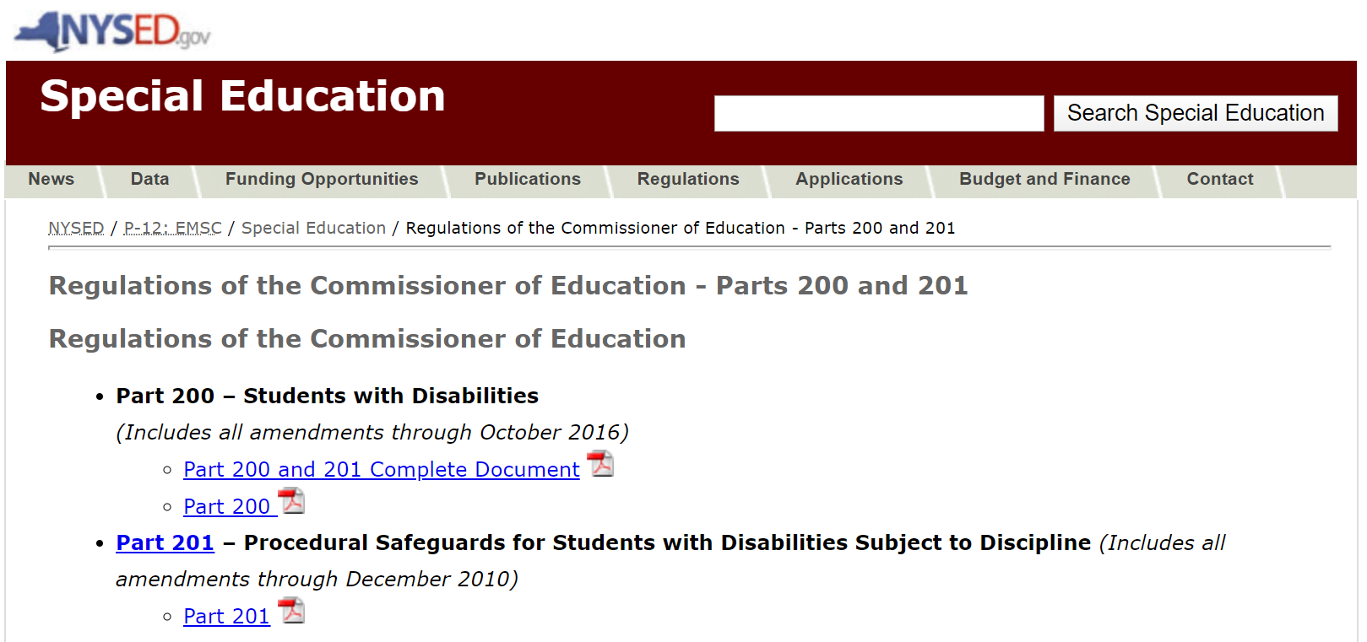
Specially Designed Instruction continued…
New York State regulations also define specially designed instruction in a similar manner:
“…adapting, as appropriate to the needs of an eligible student, the content, methodology, or delivery of instruction to address the unique needs that result from the student’s disability; and to ensure access of the student to the general curriculum, so that he or she can meet the education standards that apply to all students”

Slide 7
Defining Specially Designed Instruction
Content: Knowledge & skills being taught
Methodology: Instructional strategies or programs
Delivery: The way instruction is delivered to the student
Specially designed instruction means adapting, as appropriate to the needs of a student, the content, methodology, or delivery of instruction.

Slide 8
Examples of Adaptations for Students with Severe Disabilities
Content Adaptations
Methodology Adaptations
Delivery Adaptations
Non-verbal high schooler learning community safety skills
4th grade student learning toilet training skills
7th grade student learning to transition from activity to activity
3rd grade student learning to identify his name
Non-verbal student learning to use technology to communicate
Student learning to regulate his emotions
Applied Behavior Analysis
Social Narratives
Video Modeling
Checklists
Picture Exchange
Sticker charts
Manipulatives
Reinforcement
Peer Assisted Learning
Graphics
First-Then chart
Token economy system
Reciprocal teaching
Cooperative learning
Flow charts & organizers
EXPLICIT DIRECT INSTRUCTION
Repetition
Demonstrating & Modeling
Think Aloud
Scaffolding
Task analysis
Chunking
Fading Supports
Prompting
Corrective feedback
Verbal & visual pairing
Generalization
Checks for Understanding
Distributed practice
Maintenance of skills

Slide 9
Remote learning for students with mild disabilities should be viewed as a REAL opportunity for individualized learning and meeting IEP goals. However, this is not the case for students with severe disabilities as they lack the necessary skills and abilities to engage in online learning.

Slide 10
Shifting to Remote Learning
THEN
NOW

Slide 11
6 Steps for Moving Forward
Step 6: Remote progress monitoring
Step 5: Remote Specially Designed Instruction
Step 4: Parent collaboration
Step 3: Team collaboration
Step 2: Identify SDI
Step1: Embrace the challenge

Slide 12
Moving Forward: Step 1
Step 6: Remote progress monitoring
Step 5: Remote Specially Designed Instruction
Step 4: Parent collaboration
Step 3: Team collaboration
Step 2: Identify SDI
Step1: Embrace the challenge

Slide 13
Step 1: Embrace the Challenge
Acknowledge that this is a difficult situation for your students.
Keep focus on what you and your students stand to gain through this experience
Embrace the challenge
Identify and then accept those things that you can’t change.
Identify those things that you CAN do to support your students.

Slide 14
Moving Forward: Step 2
Step 6: Remote progress monitoring
Step 5: Remote Specially Designed Instruction
Step 4: Parent collaboration
Step 3: Team collaboration
Step 2: Identify SDI
Step1: Embrace the challenge

Slide 15
Step 2: Identify SDI
IEP Annual Goals
Additional needs due to remote learning environment
Identify SDI
IEP Supplemental Aids & Services
IEP Assistive Technology, Accommodations & Modifications
IEP Services

Slide 16
Moving Forward: Step 3
Step 6: Remote progress monitoring
Step 5: Remote Specially Designed Instruction
Step 4: Parent collaboration
Step 3: Team collaboration
Step 2: Identify SDI
Step1: Embrace the challenge

Slide 17
Step 3: Team Collaboration
Share & Discuss each other’s plans to service student
Agree on an action plan/roadmap for services
Team Collaboration
Discuss role contributions & expectations
Establish a reasonable intervention schedule

Slide 18
Moving Forward: Step 4
Step 6: Remote progress monitoring
Step 5: Remote Specially Designed Instruction
Step 4: Parent collaboration
Step 3: Team collaboration
Step 2: Identify SDI
Step1: Embrace the challenge

Slide 19
Step 4: Parent Collaboration
Share & Discuss the team’s plans & backup plans
Agree on an action plan
Parent Collaboration
Collect parent input & agree upon adaptations
Discuss skills needed and the role parent will take in instruction
Distance Learning and Deafblindness: Learning From Parents: https://publications.ici.umn.edu/ties/building-engagement-with-distance-learning/dl21-distance-learning-and-deafblindness-learning-from-parents

Slide 20
Moving Forward: Step 5
Step 6: Remote progress monitoring
Step 5: Remote Specially Designed Instruction
Step 4: Parent collaboration
Step 3: Team collaboration
Step 2: Identify SDI
Step1: Embrace the challenge

Slide 21
Step 5: Remote Specially Designed Instruction
Content: What to teach
Remote Specially Designed Instruction
Teaching parents & families how to deliver instruction
Methodology: Instructional strategies to meet student needs
Delivery of Instruction: The way instruction is delivered

Slide 22
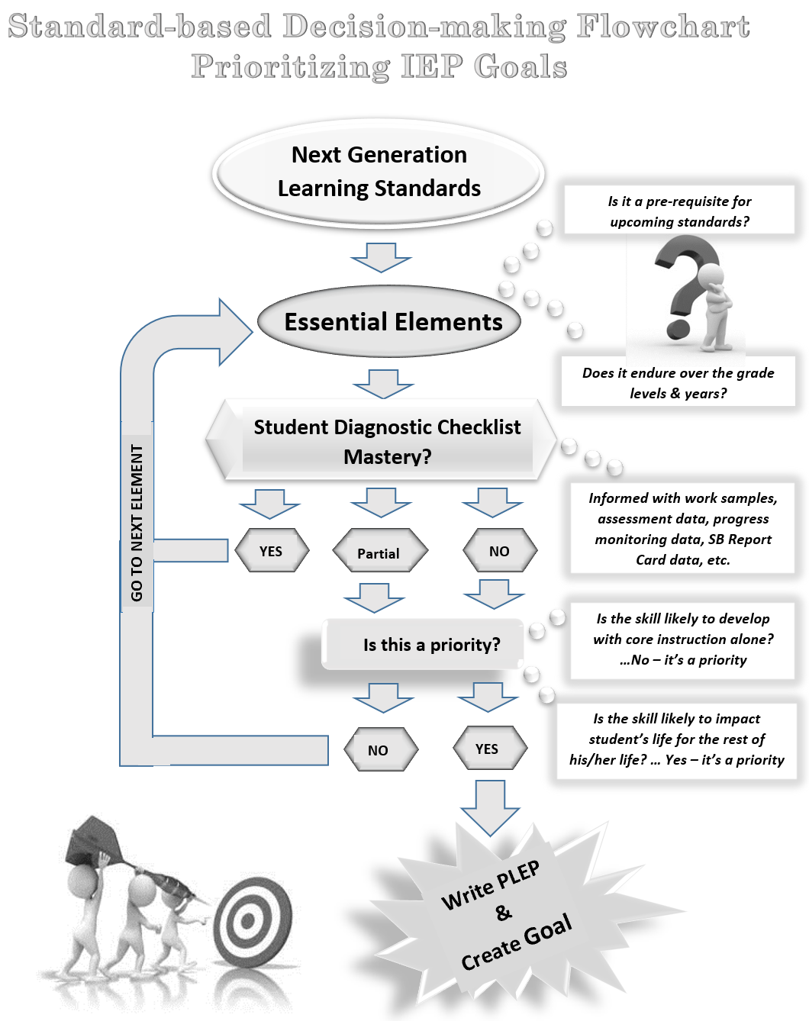
Content: What to teach Next Generation Learning Standards

Slide 23
Using the Standards to Prioritize Intervention
Next Generation Standards
Anchor Standards
Math Coherence Map
ELA & Math Standards at a Glance
Essential Elements

Slide 24
Content: What to teach Essential Elements

Slide 25
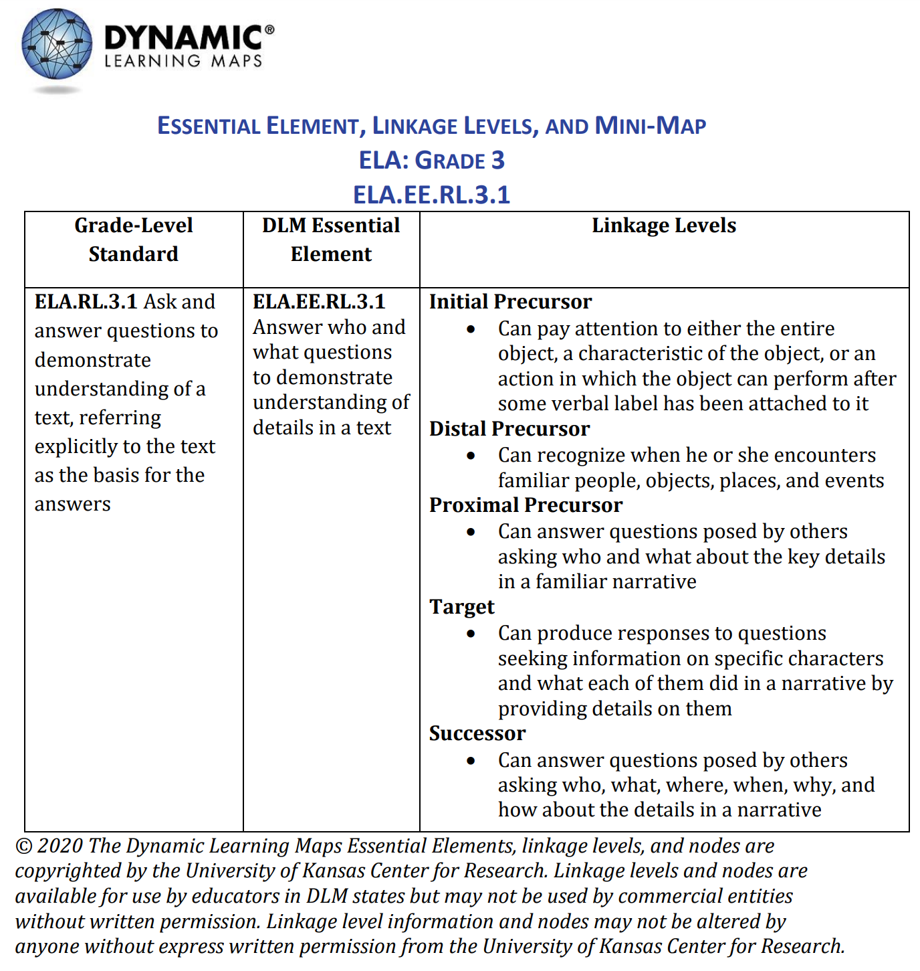
Essential Elements to Prioritize Intervention

Slide 26
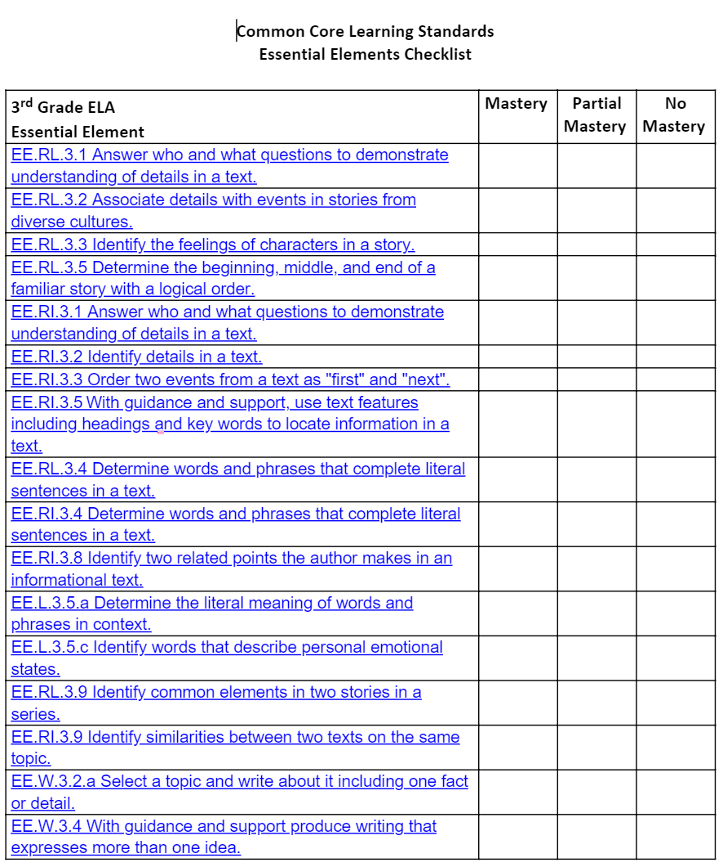
Student Diagnostic Checklist Mastery

Slide 27
Content: What to teach
Jamboard Activity
How might you use the Essential Elements in the Dynamic Learning Maps site in your practice?
Click here for link to the Jamboard.
Prioritize for Instruction

Slide 28
Methodology: Instructional strategies to meet student needs
EXPLICIT DIRECT INSTRUCTION:
structured, systematic, unambiguous, and scaffolded (Archer & Hughes, 2011)
identified as a “High-Leverage Practice” in special education by the Council for Exceptional Children (McLeskey et al., 2017)

Slide 29
Methodology: Instructional strategies to meet student needs - slide 2
3 EDI Practices for Students with Severe Disabilities:
Structured Teaching
Video Modeling
Social Narratives

Slide 30
Methodology: Instructional strategies to meet student needs - slide 4
STRUCTURED TEACHING: Creating a highly visually based structured environment that promotes an understanding of schedules, activities and expectations. This allows students to understand and act appropriately within their environment.
Making sense of an environment that seems overstimulating or chaotic
Helping students understand what activities occur in what parts of the classroom
Providing predictability and flexibility
Helps students create work stamina and independence.
Teach complex skills
Teach them to focus on specific details
Visual instructions, visual clarity and visual organization in the student’s environment and within work or tasks

Slide 31
Methodology: Instructional strategies to meet student needs - slide 5
4 STRUCTURED TEACHING STRATEGIES:
Picture Communication
Checklists for Task-Analysis
First-Then Board
Visual Schedules

Slide 32
Structured Teaching: Picture Communication
What it is…
Used by people with no or limited verbal abilities to express themselves through pictures.
Facilitates the development of expressive language
Used by parents, teachers, therapists or anyone wishing to communicate with people with limited understanding of the spoken word.
Facilitates the development of receptive language
Reduces anxiety & maladaptive behaviors
Increases independence
Basis for implementing other instructional strategies

Slide 33
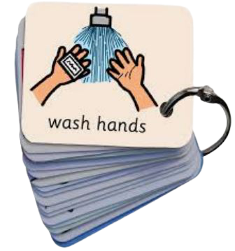
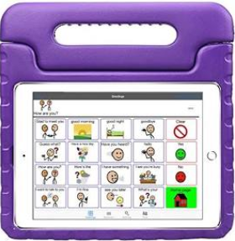
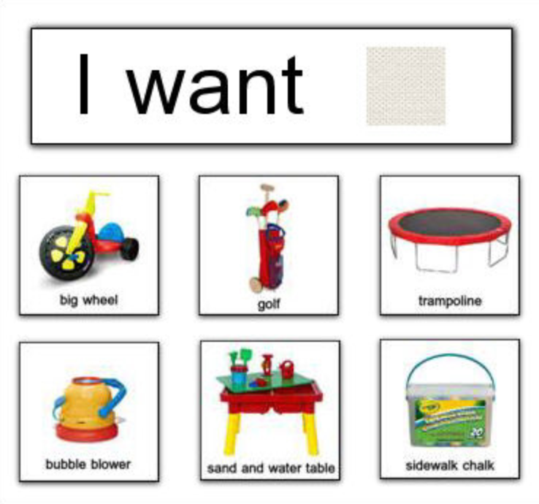
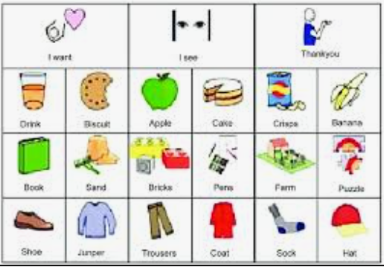
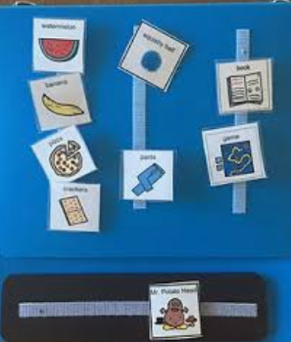
Structured Teaching: Picture Communication continued…
Examples:
For more tips for using Augmentative and Alternative Communication Devices in the remote setting: https://publications.ici.umn.edu/ties/building-engagement-with-distance-learning/distance-learning-communication-systems

Slide 34
Structured Teaching: Checklists for Task Analysis:
What it is…
Depicts each step of a specific skill (i.e., potty training, toothbrushing, transitioning, etc.) in an ordered chain
Creates routines, predictability and comfort
Used to teach independence
Used to prevent anxiety

Slide 35
Structured Teaching: Checklists for Task Analysis continued…
Tips…
Describe each step briefly
Some students will need more steps while other need less
Accompany each step with a picture
Some students will need 3-D objects while others may need real-life pictures of themselves, and still other may only need clipart or BoardMaker stick figures
All pictures are accompanied by words
Eventually, the pictures will be faded into simpler pictures or even just words

Slide 36
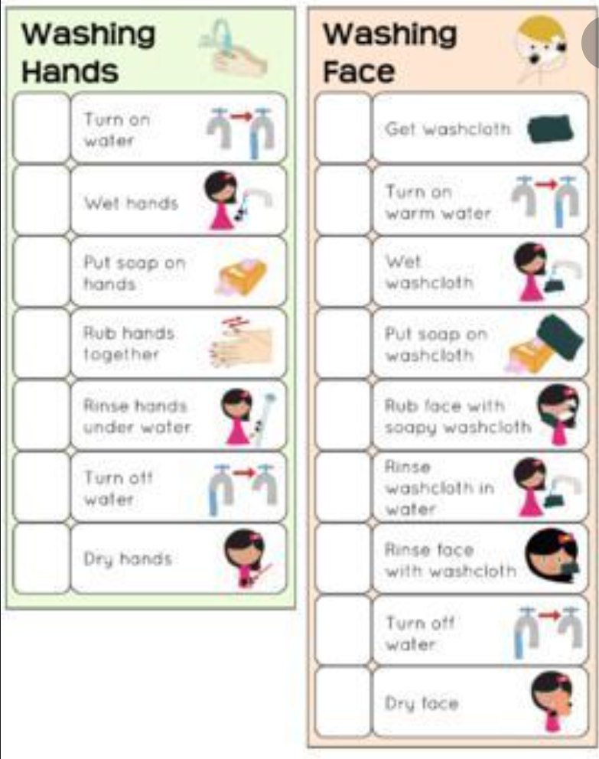
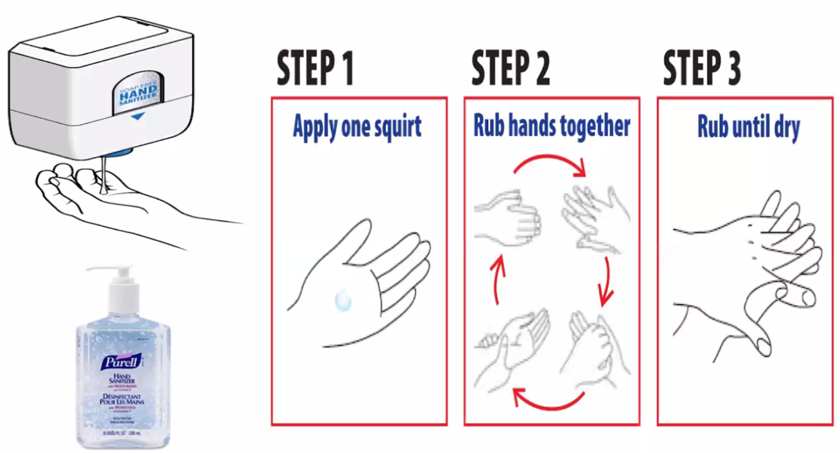
Checklists for Task Analysis
Examples:
Think of a task that you are teaching, want to teach or maybe something you do everyday. How many steps are involved in doing it? Could you make a task analysis checklist for it?

Slide 37
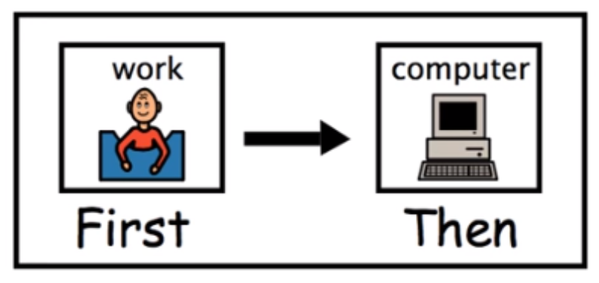
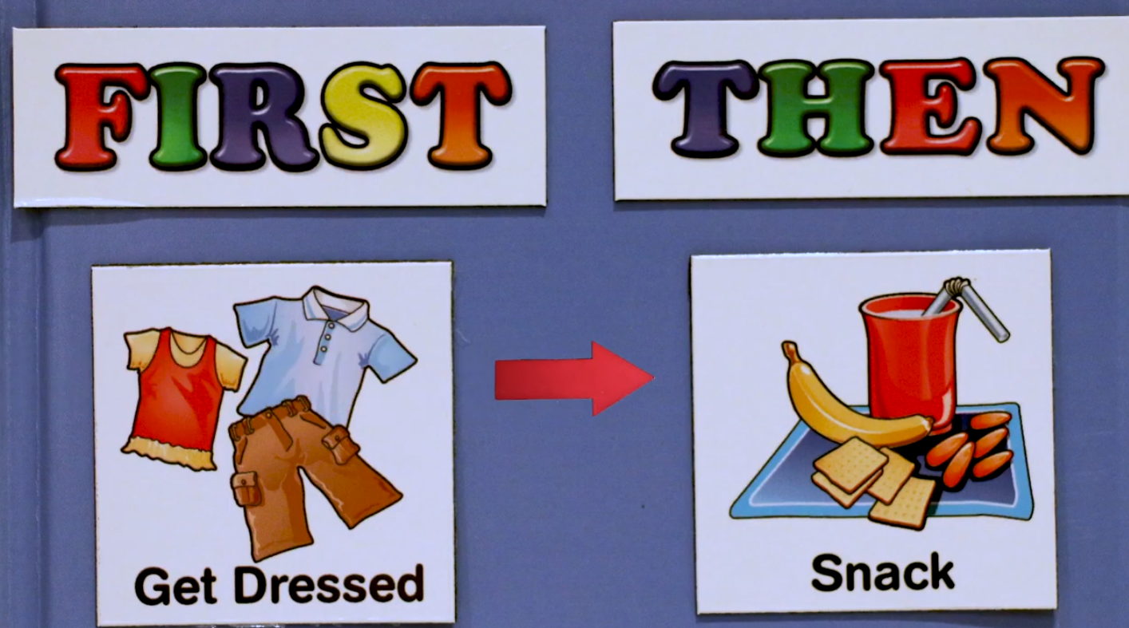
Structured Teaching: First – Then Board
What it is…
A First–Then Board is a visual strategy used to help children with language and/or behavior needs complete specific tasks.
Displays 2 pictures.
The “first” is usually a picture of a non-preferred activity.
The child must do the first before being able to do the second activity.
Helps with both receptive and expressive communication.
Children benefit by knowing exactly what is expected of them.
Helps them to understand and follow multi-step directions.
Aids in learning new skills.
Free first-then boards: https://www.ocali.org/project/resource_gallery_of_interventions/page/first_then_board

Slide 38
Structured Teaching: Visual Schedules
What it is…
A visual schedule is a graphic representation of scheduled tasks and activities.
Useful for breaking down tasks that have multiple steps and ensuring that children follow rules and deadlines.
Reduce anxiety by providing consistency while also reducing resistance that comes with certain activities
In addition to pictures or photos, events can be triggered through toys, objects & words or phrases
Constant reminder to students where they should be, what they should be doing and when they should start and finish

Slide 39
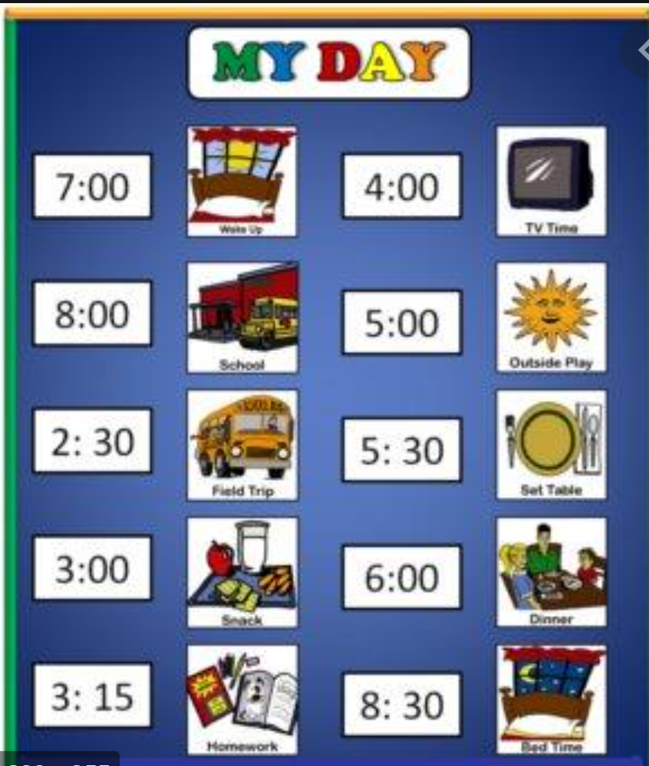
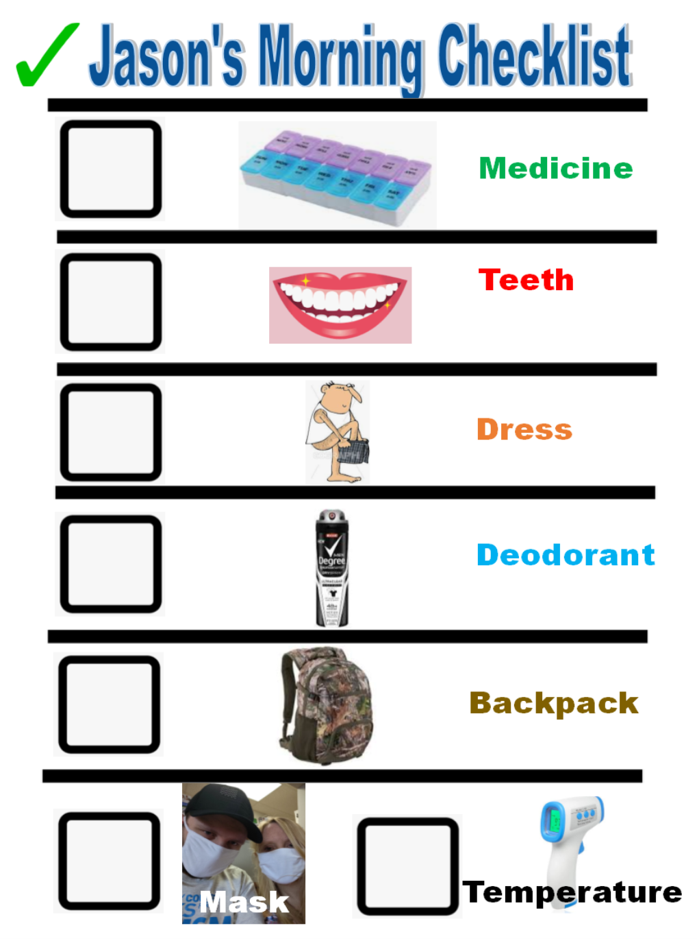
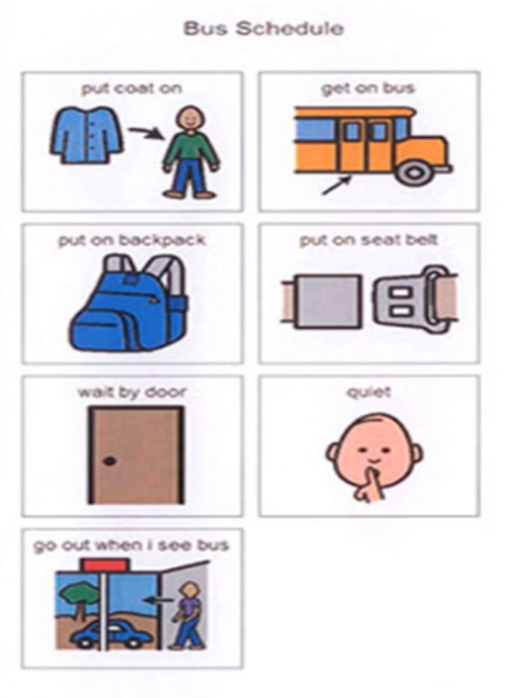
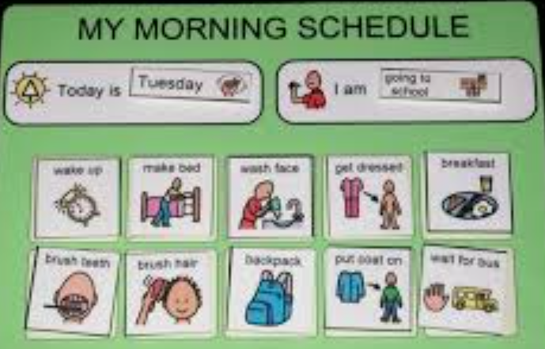
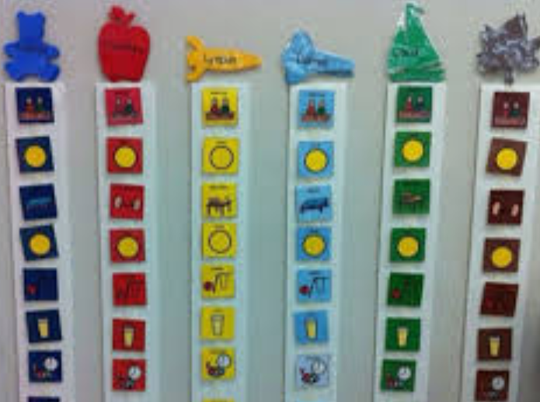
Structured Teaching: Visual Schedules continued…

Slide 40
Methodology: Instructional strategies to meet student needs - slide 6
Video Modeling:
What it is…
A visual teaching method that occurs by watching a video of someone modeling a targeted behavior or skill and then imitating the behavior/skill watched.
A simple and effective teaching tool that motivates children to learn through a fun and enticing visual medium.
Video Modeling has been proven to be a highly effective means of teaching all children, especially those with severe disabilities

Slide 41
Methodology: Instructional strategies to meet student needs - slide 7
Video Modeling Examples:
Whole Class
Asking a Friend to Play
Starting a Conversation
Taking Turns
Stranger Safety
Individual:
Toothbrushing
I can tie my shoes!
Do you use this technique?
If so, tell about it.
If not, how might you incorporate it into your instructional practice?

Slide 42
Methodology: Instructional strategies to meet student needs - slide 8
Video Modeling:
Tips:
Use the student, themselves as the model, if possible. If not, use a person who the student likes or a student who is similar to them.
Make the videos as a class for a whole group lesson or individually.
Delivery:
The student watches the model demonstrate the skill/skills
After watching the video, the student begins to imitate skills from the video. Skills performed can be either new skills learned or changes to existing behaviors.
Provide reinforcement for desired behaviors.
Provide corrective feedback for inaccuracies, redirect to the video and try again.
The student then begins to generalize or utilize that skill in their normal environment. This usually requires intervention and practice in the environment.
Video Modeling: What it is and How to Use it; Autism Classroom News & Resources

Slide 43
Methodology: Instructional strategies to meet student needs - slide 9
Social Narratives:
What it is...
Social narratives are individualized short stories that depict a social situation that your student may encounter or has encountered.
Used to teach communal skills through the use of precise and sequential information about everyday events that the child may find difficult or confusing.
Used to prevent further anxiety on the part of the child.

Slide 44
Methodology: Instructional strategies to meet student needs - slide 10
Social Narratives:
Examples…
Distance Learning and Covid-19
Jason’s Mask Social Story
My Medical Story
When Things Are Too Loud
New Rules at School
Video Social Narratives
No Kicking or Biting Story

Slide 45
Methodology: Instructional strategies to meet student needs - slide 11
Social Narratives:
Key Components
Descriptive sentence: in these sentences the “who, what, where, and why” details are emphasized making it recognizable and easier for the child to relate to when the situation actually occurs.
Directive sentence; here you include instructions as to how your child should appropriately respond to a specific situation
Perspective sentence: this should describe one of your child’s possible responses or feelings to a given situation

Slide 46
Methodology: Instructional strategies to meet student needs - slide 12
Social Narratives:
Key Components
Affirmative sentence: states a common value or opinion. Here you can emphasize the important points by referring to a law or rule the learner should understand
Cooperative sentence: describe the actions or possible help of the people around the child based on their response to the situation
Control sentence: actions or responses created by your child to aid in remembering the strategies that work for them
Partial sentence: This sentence should encourage your child to make a guess about the next step in the given situation. This is usually represented by a blank in the story.

Slide 47
Methodology: Instructional strategies to meet student needs - slide 13
Social Narratives:
Tips:
Use a clear title that tells the child exactly what the story is about
Make it from the child’s point of view and unique to them so they can relate to it
Use attractive, engaging photos
Use simple text that is clear and direct with quick, easy, simple steps
The story should tell what the problem is, how they may feel about it and replacement strategies or desired behaviors
Finish with an upbeat message that it’ll be okay and the situation will be better because they used the strategy or demonstrated the desired behavior
Delivery:
Role play each step
Provide corrective feedback
Consistently practice
https://carolgraysocialstories.com/social-stories/

Slide 48
Methodology: Instructional strategies to meet student needs - slide 14
Resources
Social Narratives & Video Modeling Apps
Printable Free Social Narratives
When I Get Frustrated Social Narrative
Understanding Social Distancing
Understanding Remote Learning
Learning from Home
Social Skills Story: School’s Out!
Understanding the Coronavirus
Remote Learning Social Narrative
I’m Going to be Okay!
OCALI Free Social Narratives
Do you use this technique?
If so, tell about it.
If not, how might you incorporate it into your instructional practice?

Slide 49
Delivery of Instruction: The way instruction is delivered
EXAMPLES:
Repetition, Repetition, Repetition!
Practice, Practice, Practice!
Prompting
Reinforcement
Generalization
Maintenance

Slide 50
Delivery of Instruction: The way instruction is delivered– slide 2
REPETITION, REPETITION, REPETITION:
Repetition is a key learning aid because it helps transition a skill from the conscious to the subconscious.
Through repetition, a skill is practiced and rehearsed over time and gradually becomes easier. As the student improves, he or she does not need to think consciously about the skill, freeing up mental resources to learn new skills and concepts.
Importantly, practice alone doesn’t make perfect — perfect practice makes perfect. Otherwise, bad habits will become ingrained.

Slide 51
Delivery of Instruction: The way instruction is delivered– slide 3
PRACTICE, PRACTICE, PRACTICE:
Deliberate practice involves attention, rehearsal and repetition and leads to new knowledge or skills that can later be developed into more complex knowledge and skills. Although other factors such as intelligence and motivation affect performance, practice is necessary if not sufficient for acquiring expertise (Campitelli & Gobet, 2011).
"Deliberate practice (DP) occurs when an individual intentionally repeats an activity in order to improve performance. The claim of the DP framework is that such behavior is necessary to achieve high levels of expert performance." (Campitelli & Gobet, 2011, p. 280).

Slide 52
Delivery of Instruction: The way instruction is delivered– slide 4
Prompting:
No response or incorrect response
Full individual demonstration (HoH)
Complete verbal prompt completion
Partial verbal prompt completion
Partial model prompt
Full gestural prompt for completion
Partial gestural prompt for completion
Total written or pictorial prompt for completion
Partial written or pictorial prompt for completion
Independent
Physical Prompting
Modeling Prompting
Gestural Prompting
Visual Prompting
Positional Prompting
Vocal Prompting
VIDEO: EXAMPLES OF PROMPTING: https://www.youtube.com/watch?v=TDijJjKHMVQ

Slide 53
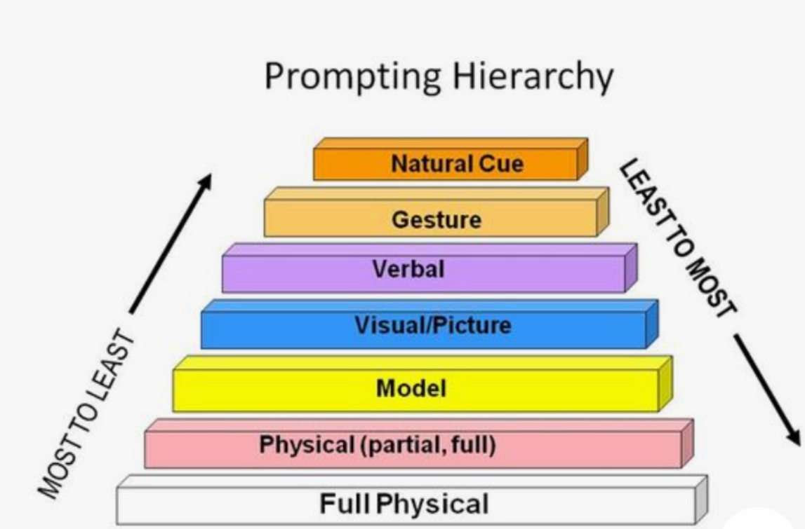
Delivery of Instruction: The way instruction is delivered– slide 5
Prompt Fading:
Fade the Intensity of the Prompt within the prompt hierarchy
Probe for readiness to move to the next level
Prompt Dependency:
When a child needs the prompt before they can respond.
Look for situations in which your child waits for you to give a cue even though you are pretty sure he knows how to do it.
Where do you do too much in order to speed things up or to prevent behaviors.
One of the first things we need to do is teach the child to ask for help so when they get frustrated, we can give them a way to ask for help rather than us avoiding triggering behaviors.

Slide 54
Delivery of Instruction: The way instruction is delivered– slide 6
Reinforcement:
What is it...
Reinforcers are rewards that we give to the child to signal to them that they have responded correctly and to encourage the child to respond that way again.
Why do we use it?
Communication is often an area of difficulty for many students with severe disabilities, using reinforcement “tells” them that their response is correct
Reinforcement provides motivation for the child to learn. The goal is to make learning so reinforcing that the child looks forward to this time of day.

Slide 55
Delivery of Instruction: Reinforcement
What can be used for reinforcement?
How do we use reinforcement?
Food or drink
Toys
Physical Touch
Verbal Praise
Activities
Ending the Task
Counters/Tokens
Must be provided immediately after the desired response
Must be delivered in an enthusiastic and involved manner
Reinforcement must be varied:
We must constantly change reinforcers
We must vary the intensity of the reinforcer based on how the child responds (differential reinforcement)
Video Example of Reinforcement: https://www.youtube.com/watch?v=crFjZlWWZo0&t=339s

Slide 56
Delivery of Instruction: Reinforcement continued…
How do we know what to use for reinforcement?
Schedules for Reinforcement:
Reinforcement Assessment: We must constantly looking for reinforcers so we have a wide variety from which to choose.
Observe what the child likes to do during natural play
Modify a child’s self-stimulating behaviors so they are non-disruptive and socially acceptable
Use a reinforcement survey
Behavior is shaped through process of continuous reinforcement of successive approximations of the targeted behavior
Intermittent Schedule of reinforcement where reinforcement is provided only some of the time.
Fixed (consistent) Ratio (amount of responses - like a ration of food)
Fixed Interval (time)
Variable (inconsistent) Ratio
Variable (inconsistent) Interval

Slide 57
Delivery of Instruction: Generalization & Maintenance
What is it…
What is it…
Generalization happens when the child is able to perform the skill across new & novel situations
Students need to generalize across:
People
Settings
Stimuli
Responses
Maintenance means practicing skills so the child doesn’t lose them.
PRACTICE, PRACTICE, PRACTICE

Slide 58
Teaching parents & families to deliver instruction
Supply parents with the necessary technology and materials for instruction
Use technology platform to provide any instruction that can be received by the student(s)
Videos of practitioner delivering the instruction with all necessary steps
Use technology platform to observe the instruction and give feedback
TIES Website: Family/Home Considerations to Support Behavior: https://publications.ici.umn.edu/ties/building-engagement-with-distance-learning/collaborative-start-to-behavioral-supports

Slide 59
Tips for Behavior Management in the virtual setting
Rules upfront with pictures and use system of reinforcements for good behavior and use of alternative behaviors
Keep lessons 15 minutes or less...or incorporate brain breaks because screen fatigue is a real thing and may contribute to behaviors.
Have engaging lessons that are multi-sensory. Videos, puppets, masks, Nearpod, summarizing with Twitter post and games that reinforce learned skills.
Establish and maintain relationships with parents because they are the teacher by proxy...you need to teach them to teach their child.
Use token boards
Teach parents about token economy systems to aid in engagement & behavior management.
Utilize your paraprofessionals (take data, looking at engagement and behaviors, can call kid or parent, mute kids or monitor breakout rooms)
Utilize visuals without overwhelming

Slide 60
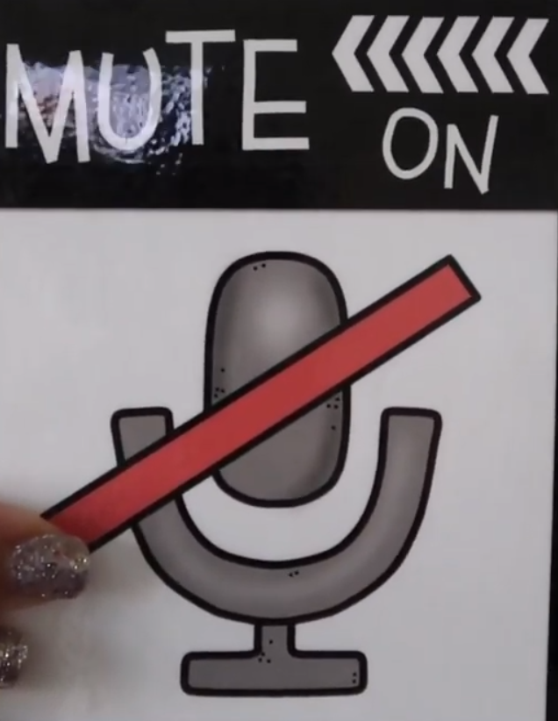
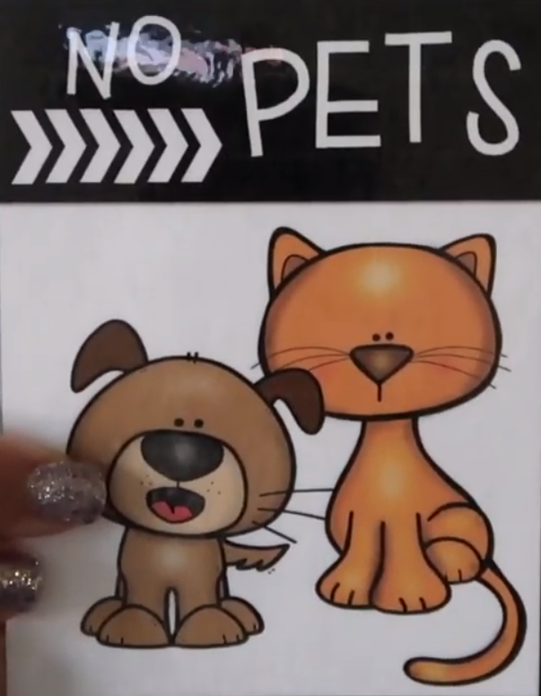
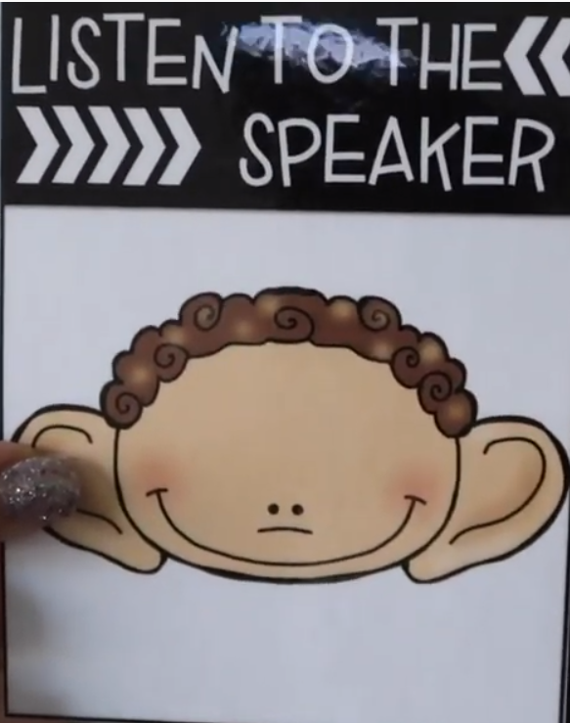
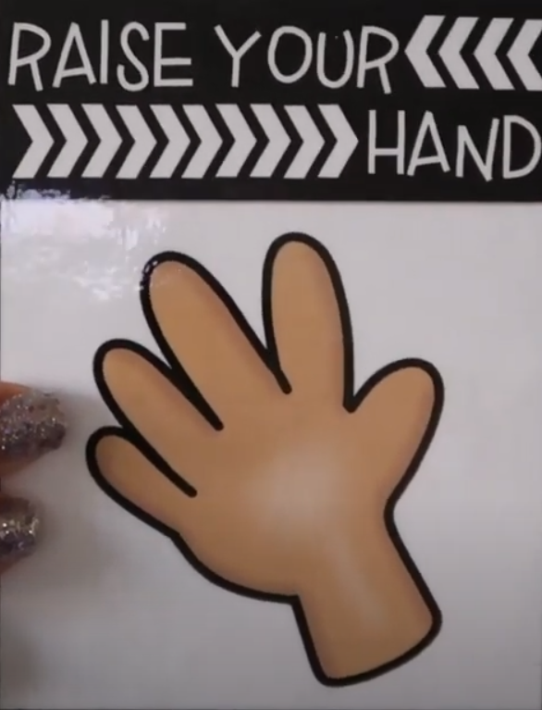
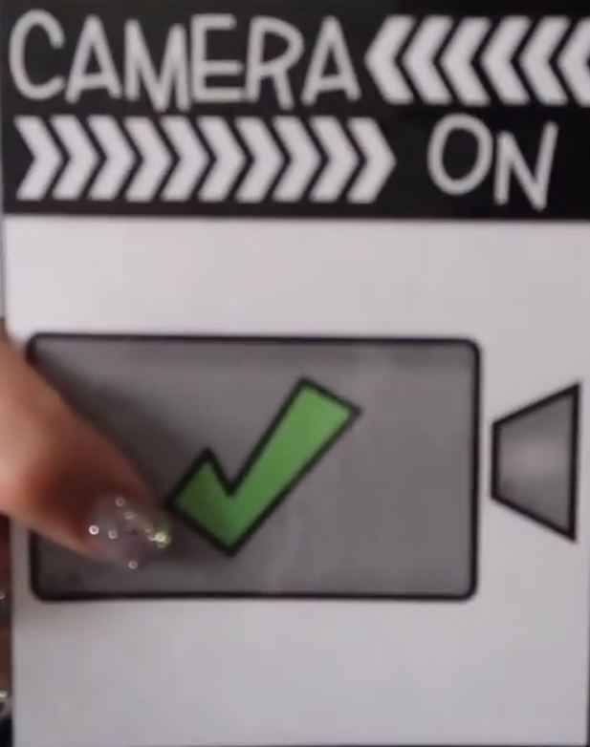
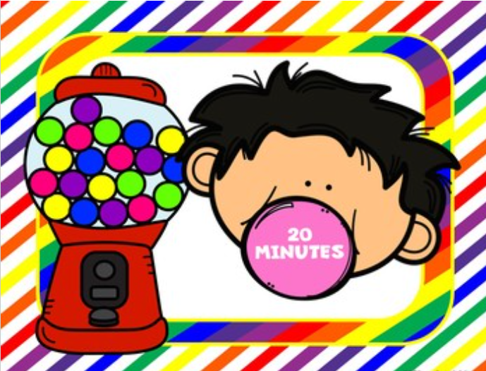
Needs Header

Slide 61
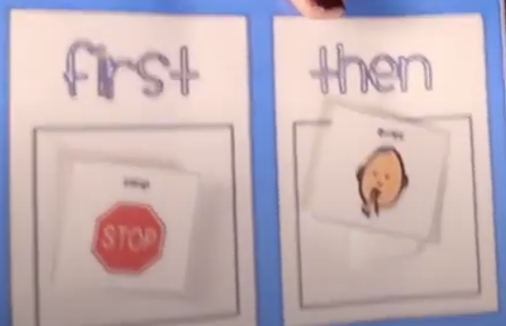
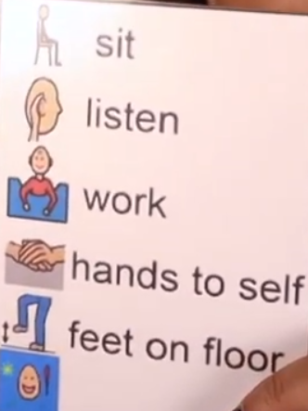
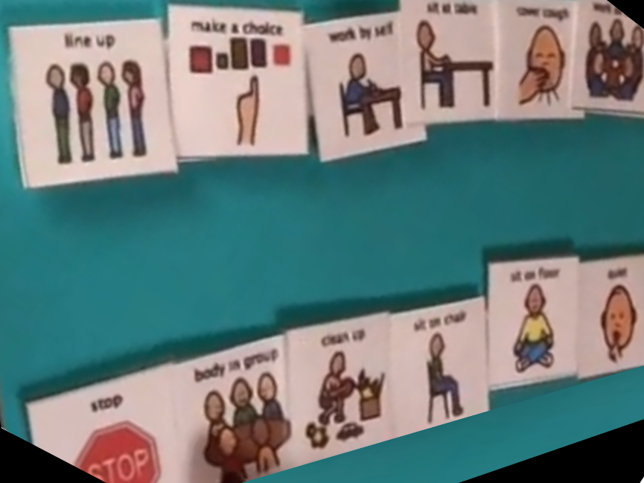
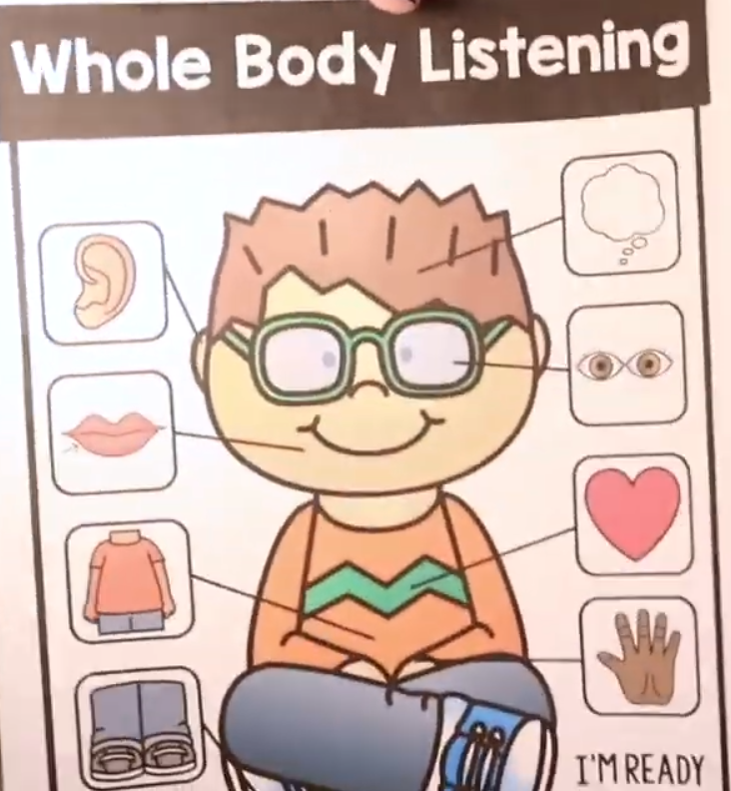
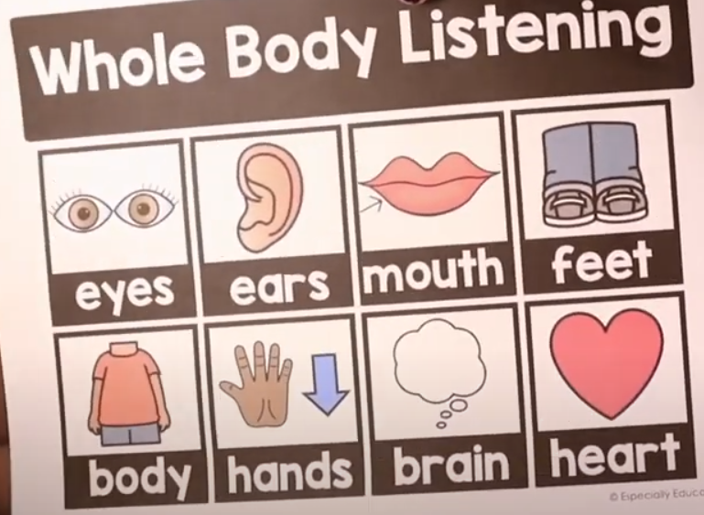
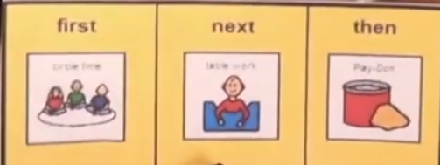
Needs Header

Slide 62
Reinforcement Chart
Name: Date:
First
Then
Free First-Then boards: https://www.ocali.org/project/resource_gallery_of_interventions/page/first_then_board

Slide 63
Token Chart
Name: Date:
Sticker Chart

Slide 64
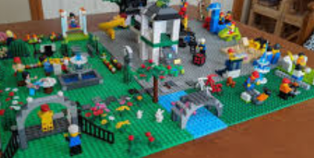
Token Chart continued…
What are some ways that you have supported parents and families in the area of behavior so you students can benefit from your instruction?
Name: Date:
Sticker Chart
Then

Slide 65
Moving Forward: Step 6
Step 6: Remote progress monitoring
Step 5: Remote Specially Designed Instruction
Step 4: Parent collaboration
Step 3: Team collaboration
Step 2: Identify SDI
Step1: Embrace the challenge

Slide 66
Step 6: Remote Progress Monitoring
Administer assessment
Remote Progress Monitoring
Guiding parents & families through the process
Graph data
Evaluate progress

Slide 67
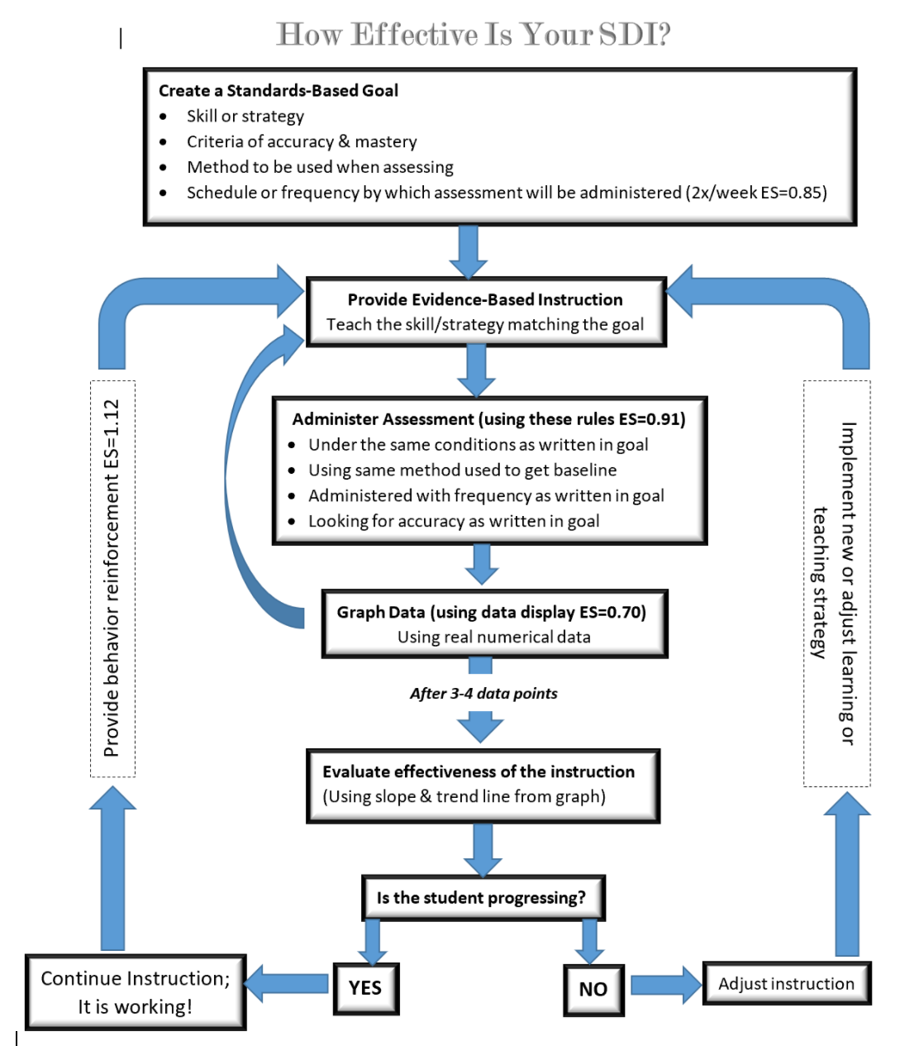
Remote Progress Monitoring
Does your progress monitoring system include all of these steps and parts?
If so, tell how it looks.
If not, how might you adapt your practice to make assessment a larger part of your practice?

Slide 68
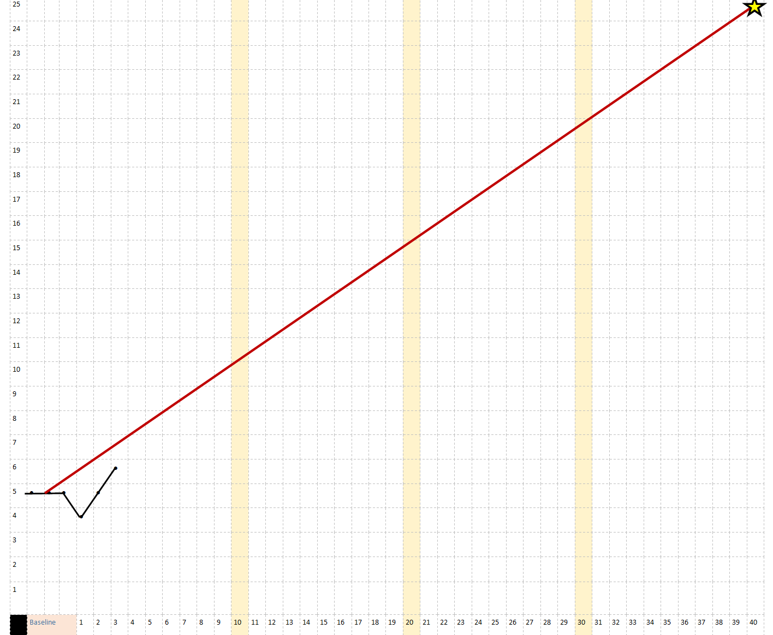
Remote Process Monitoring: How will I know if it’s working?
Data Collection & Charting
Collecting data means gather information from each assessment. In this case, each week the teachers uses the data collection form to record the number of words correctly identified once a week.
Charting data means analyzing that information to look for trends, patterns and progress
Notes:
Effects of Systematic Formative Evaluation: A Meta-Analysis, by Fuchs & Fuchs; Exceptional Children, Vol. 53, No. 3, pp. 199-208, 1986. The Council for Exceptional Children

Slide 69
6 Steps for Moving Forward revisited
Step 6: Remote progress monitoring
Step 5: Remote Specially Designed Instruction
Step 4: Parent collaboration
Step 3: Team collaboration
Step 2: Identify SDI
Step1: Embrace the challenge

Slide 70
References:
NYS Blueprint for Improved Results for Students with Disabilities
Focus and Repetition in Learning by APL nextED
Practice for Knowledge Acquisition (Not Drill and Kill)
Designing activities with the goal of transferring knowledge by APA… Mary Brabeck, PhD, NYU; Jill Jeffrey, PhD; Sara Fry, MA, NYU
Individuals with Disabilities Education Act (Federal Regulations)
Office of Special Education (NYS Regulations)
Next Generation Standards
Anchor Standards
Math Coherence Map
ELA & Math Standards at a Glance
Essential Elements
Explicit Instruction: Archer & Hughes, 2011
Explicit Instruction as a High Leverage Practice (Exceptional Children): McLeskey et al., 2017
Video Modeling: What it is and How to Use it; Autism Classroom News & Resources
Social Stories: Carol Gray
ABA Autism Training Videos: Introduction; The Discrete Trial; Reinforcement; Prompting; Generalization; Incidental Teaching
Effects of Systematic Formative Evaluation: A Meta-Analysis, by Fuchs & Fuchs; Exceptional Children, Vol. 53, No. 3, pp. 199-208, 1986. The Council for Exceptional Children
TIES Center Distance Learning: https://publications.ici.umn.edu/ties/building-engagement-with-distance-learning/categories
OCALI: https://www.ocali.org/project/resource_gallery_of_interventions/page/to-support-families-during-the-COVID-19-crisis

Slide 71
Thank you
Use this closing slide to include important contact or reference information.

