Slide 1

Part 5: Employment Preparation and Work Based Learning Experiences in a Virtual World

Slide 2


PURPOSE
Is: To share ideas and strategies you can use today in providing remote work based learning experiences/activities for students with disabilities while school and community access are severely restricted due to COVID-19.
Isn’t: To provide federal, state, or legal guidance regarding how to provide services and meet requirements under IDEA, WIOA, or other agency legislations.

Slide 3

CHALLENGING TIMES CAN PRESENT UNIQUE OPPORTUNITIES
Students with disabilities can still actively participate in work-based learning experiences
which is known to be one of the best predictors of successful post-secondary employment
  States are identifying innovative ways for students to participate in remote work-based learning experiences while practicing social distancing, and addressing community engagement concerns
  States are developing creative partnerships around coordinated service delivery between Education-VR- Provider in serving students with disabilities, which will be key to successful on-site work experiences moving forward
  States are sharing unique ways to engage and connect students virtually with business partners
Notes:
VR= ACCES-VR in NYS (Adult Career and Continuing Education Services-Vocational Rehabilitation)

Slide 4
Coordination and Delivery of
Work-based Learning Experiences

Slide 5
WBLE AND PRE-EMPLOYMENT TRANSITION SERVICES
Work-based learning experiences are one of the five required pre-employment transition services (Pre-ETS) that must be made available, in collaboration with local education agencies (LEAs), to all students with disabilities who need them, and are eligible or potentially eligible for ACCES-VR services:
1. Job exploration counseling
2. Work-based learning experiences, which may include in-school or after school opportunities, or experience outside the traditional school setting (including internships), that is provided in an integrated environment in the community to the maximum extent possible
Counseling on opportunities for enrollment in comprehensive transition or postsecondary educational
programs at institutions of higher education
Workplace readiness training to develop social skills and independent living
Instruction in self-advocacy (including instruction in person-centered planning), which may include peer mentoring (including peer mentoring from individuals with disabilities working in competitive integrated employment)
Notes:
When you look at WBLE in correlation with Pre-Employment Transition Services (Pre-ETS), it defines WBLE as one of the five Pre-Employment Transition Services that must be made available in collaboration with schools to all students with disabilities or those that are potentially eligible.
These activities can be made available in school or after school, or those outside the traditional school setting in an integrated environment (students with and without disabilities) to the maximum extent possible.
This is challenging right now but it is still the direction we should be going.

Slide 6
VIRTUAL WORK-BASED LEARNING EXPERIENCES
Work-based learning experiences that can be virtual, may include:
Career Mentorship: An opportunity for a student to engage with a mentor who teaches or provides career-related guidance and advice.
Informational Interviews: An informal conversation for a student with someone working in a career area/job that interests the student, who will give them information and advice. It is not a job interview and the objective is not to find job openings.
Job Shadowing: An opportunity for a student to observe different jobs and ask businesses questions
about the skills, knowledge, and abilities needed to perform the tasks involved in the job.
Workplace Tours/Field Trips: An excursion for students to gain first-hand observation of specific work sites. Students learn about the business, meet employees, ask questions and observe work in progress. Often conducted in a group.
Adapted From: Minnesota's Pre-ETS Toolkit with Resources

Slide 7
Work-Based Learning Continuum
Online videos touring businesses and specific jobs within a business
Group or individual
Student self- reflection
Interactive hands-
on demonstrations
Career cluster employer presentations
Group or individual
Match students
with adult mentors
Job Shadowing and Work Site tours
Informational
Interviews and Mentoring
Paid WBLE
Competitive, integrated employment settings
Industry-recognized credentials
Internships and Apprenticeships
Pre-boarding
and
Pre-boarding and onboarding videos for potential and new hires
Business culture
Onboarding
training
Notes:
The middle is divided into four quadrants:
The upper left quadrant looks at job shadowing and work site tours. When engaging in these activities make sure students have time to reflect on the experiences to learn more about their preferences and interests.
The upper right quadrant looks at informational interviews and mentoring. This can include interactive demonstrations, career cluster employer programs and mentoring that matches students with adult mentors.
The bottom right quadrant looks at pre-boarding and onboarding. These are videos that employers have out there for potential and new hires. These really show you the business culture and work environment.
The last quadrant in the lower left looks at internships and apprenticeships. It is in blue because this is going to be really difficult to do online. The other quadrants will hopefully prepare the students for this important quadrant when in-person placements can occur.

Slide 8
CAREER DEVELOPMENT CONTINUUM
Exploration
Preparation
Awareness
•Internships
•Apprenticeships
•Paid Employment
Elementary & Middle Grades
Post-Secondary
9th
Grade
10th
Grade
11th
Grade
12th
Grade
Ages
18-21
•Career Exploration
•Job Shadowing
•Career Planning
•Job Sampling
•Service Learning
•Paid Employment
•Career Planning
•Job Sampling
•Paid Employment
•Self Exploration
•Career Exploration
•Field Trips
•Job Shadowing
•Job Sampling
•Service Learning
•Paid Employment
•Service Learning
•Internships
•Apprenticeships
•Paid Employment
Individualized based on student strengths, interests, preferences
Revised from : nsttac.org
Notes:
The Career Development Continuum looks at activities that students should be working on at each grade level to move from career awareness, to career exploration, to eventually career preparation.
Many of these activities can be addressed virtually and later in this presentation are virtual tools to support these activities.
Activities such as career planning, self exploration, job shadowing, service learning, and field trips can be done virtually.

Slide 9
Student Outcomes from Participation in Virtual Work-Based Learning:
Gains insight into work experience opportunities
Receives information regarding employer and industry expectations
Learns job skills related to the expectations set for a position
Receives guidance from people practicing in an industry
Develops networking relationships
Adapted From: Minnesota's Pre-ETS Toolkit with Resources
Notes:
One of the key aspects of a successful virtual WBLE is to consider the outcomes for the experience when you are designing it. What do we want students to get from the experience? How will we know if they do?
Every WBLE either virtual or in-person should include an outcomes of creating networking relationships. Many people heard about their current job or career from someone they knew, either professionally or personally. Building those relationships is key to success.

Slide 10
COMPONENTS IN DEVELOPING VIRTUAL WBLE
Identify a platform to use for the provision of remote or virtual work-based learning opportunities for students with disabilities
Identify appropriate WBLE curricula and resources that will be shared with students
Determine how student participation, progress, and outcomes in remote WBLE activities, either in a group or individually, will be tracked, reported, and measured
Identify ways to enhance student and family engagement in remote WBLE
Work with businesses and career one-stop partners to develop a plan for employer engagement in creating remote WBLE opportunities for students
Notes:
Here is a list of things to consider when developing you virtual WBLE.

Slide 11
“WHO YA GONNA CALL”
Just because some school buildings are closed, it does not mean ACCES-VR Providers cannot continue to provide Pre-ETS services to students
If schools are open in some capacity teachers are encouraged to reach out to their ACCES-VR points of contact to help them find ways to connect with students:
  Teachers are the trusted source with families – solicit their help in getting paperwork and communicating with parents/families so they can understand and support the services you are offering
  Communicate with ACCES-VR provider if there is a scheduled day or scheduled times students are to be
available, and if “classroom time” could be shared or coordinated
  Communicate with ACCES- VR provider on how students are submitting assignments online, and if those methods could be used to share homework assignments or activities assigned by ACCES- VR in the delivery of WBLE
Notes:
The team approach is necessary to ensuring students have positive virtual WBLE. Key stakeholders may include: the students, parents, ACCES-VR, local community agencies, school personnel, and business partners.

Slide 12
Students Without Remote Access
Determine who will be responsible for providing WBLE virtually to students who do not have remote access
Work with the school to determine how students without remote access are participating
If a student doesn't have internet but has a laptop, you could put WBLE activities/modules or activities on jump/flash drives, and these could be mailed directly to the student or distributed to the students using the same delivery method as the school.
Can alter curriculum and activity assignments to paper/pencil, and use the phone to follow up.

Slide 13

Activities for Remote Work-based Learning Experiences

Slide 14
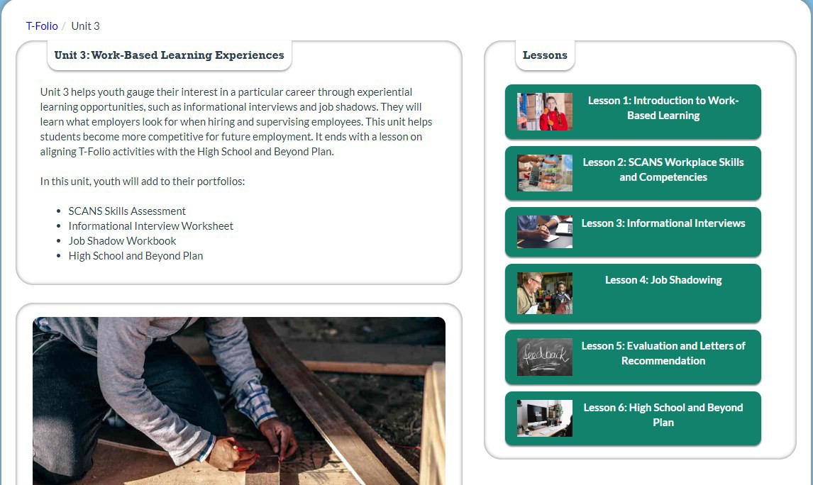
T-FOLIO: WORK-BASED LEARNING EXPERIENCES
T-
Notes:
The T-Folio title is a live link to access the content.
T-Folio is a free transition portfolio for high school students with disabilities. It is designed as a guide for students and is set up in 5 different units. Unit 3 is Work-Based Learning Experience.

Slide 15
REMOTE JOB SHADOWING AND WORK-SITE TOURS
To supplement existing on-line work-based learning curricula, we encourage partnering with American Job Centers to identify employers willing to participate in virtual job shadowing (even if business is not currently open) using phone video/facetime, etc.
Employers start by introducing themselves and explaining the work that their company does followed by an interactive discussion if possible with the student about their own interests and what they would like to do and learn during the job shadow. If job shadow is not able to be conducted live, discussion with the student can occur after they watch the recorded video.
Employers can provide a virtual workplace tour, introduce the student to employees that may be on-
site, and/or explain the job duties of employees.
Employers can also explain and demonstrate their own work tasks and encourage opportunities, when appropriate, for the student to think about and identify related work tasks at home.
Students should be encouraged and given time to ask any questions they have about the workplace
and the work that employees do.
adapted from www.ncwd-youth.info/innovative-strategies

Slide 16
STRUCTURED ASSIGNMENTS TO MAXIMIZE WBLE IN A GROUP SETTING
adapted from www.ncwd-youth.info/innovative-strategies
During job shadowing, students can benefit from assignments that encourage them to gather information from what they see, hear, and do during the activity and think critically about how the experience connects to their career interests and goals.
For example, to provide structure to the job shadowing experience, ask the student to complete a virtual career scavenger hunt activity.
This assignment is used primarily for group shadowing experiences and requires students to work as a team to answer the scavenger hunt questions. This could be done virtually in a group chat or zoom meeting room. Think about what type of reward they could receive for achieving the goal of answering all the questions.
This provides an opportunity for students to develop teamwork skills, one of the many soft skills that employers look for in new employees.

Slide 17
JOB SHADOWING SELF-REFLECTION
Have the student complete a student evaluation form online, via text, or mail with questions about what they learned and how they will apply the new information to career planning. Student can email, text or mail evaluation form back, and this can be used as documentation of student participation and progress.
The job shadowing evaluation form should include various reflection questions to include:
  what they learned about the job they shadowed including basic duties, work hours, and the type of
education and training needed for the job
  what they liked and didn’t like about the job and whether they would consider pursuing it as a career
  what other ideas for careers may have arisen as a result of the job shadowing experience
  suggestions for improving the experience
After the job shadowing experience, discuss these questions and others with the student to help them decide what next steps to take to further explore their interests or pursue their career and education goals.
Self-reflection is also a great activity to do on-line with the parent/family.
adapted from www.ncwd-youth.info/innovative-strategies
Notes:
It is important to incorporate self-reflection time for students to determine what they liked or didn’t like about the experience. Consider self-reflection documents to keep as a part of a portfolio.

Slide 18
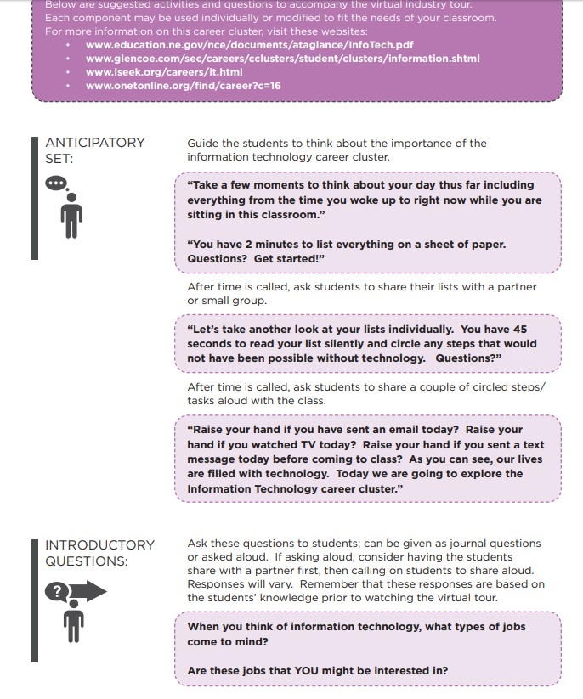
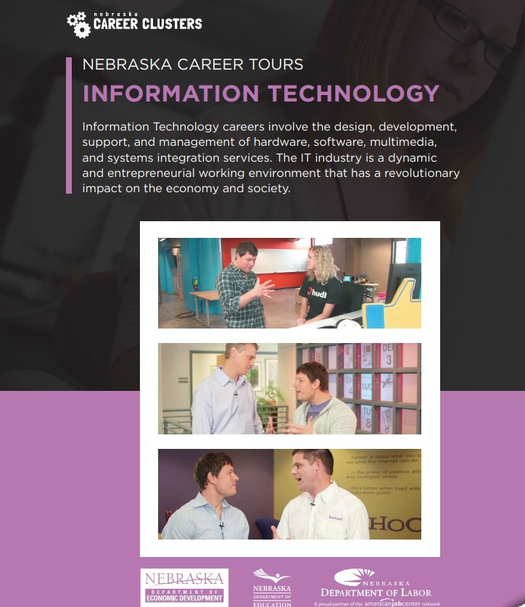
Online Career Tours
36
Notes:
There is an online document that you can download that includes specific activities that are related to the different career areas- this includes questions to consider before looking at the videos and follow up questions for each career area.

Slide 19
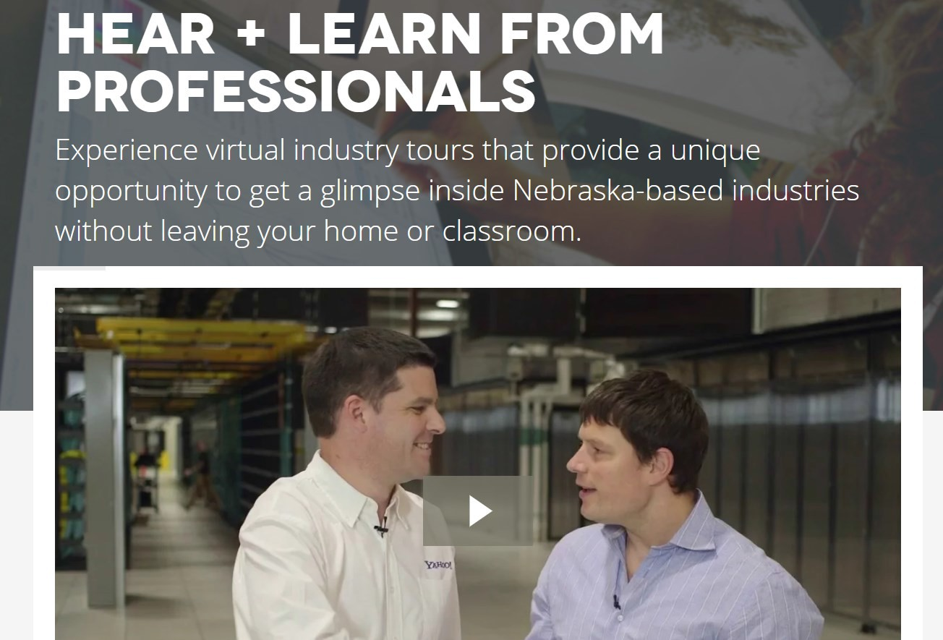
VIRTUAL INDUSTRY TOURS
These virtual industry tours provide a unique opportunity for students, parents and job-seekers to experience Nebraska-based industries without leaving the home or classroom.
The videos showcase different business and industries in each of the sixteen Career Clusters in the Nebraska Model. In addition to the tour of the business/industry, the videos also contain interviews with employees and managers discussing work requirements, education levels, salary and job prospects.
The videos will provide an accurate picture of today’s workplace, breaking down stereotypes and assumptions while emphasizing the knowledge and skills required to be successful.
Notes:
This aligns with the previous slide of Online Career Tours and provides follow up activities.

Slide 20
Virtual Work-Site Tours
Tour Jobs that People Do in One Workplace
  Virtual tours and visits are also a great way to show students a range of occupations and career options that may exist within one business or workplace.
  For example, an airport, zoo, manufacturing plant
Tour “Essential” Jobs (Today’s World)
  Grocery stores, hospitals, garage door repair, Heating and Air, Plumbing companies
Tour businesses that expose students with disabilities to employment opportunities that lead
to industry-recognized credentials, and/or opportunities for internships or apprenticeships.
Workplace tours and visits are most engaging when the employer is willing to provide hands- on opportunities for students to experience some aspects of one or more jobs.
  Tough to do virtually, but get creative. What might the student have available at home they could touch and work with that was talked about in the workplace video?
  If student is really interest in a workplace, document and follow up with an on-site visit in the fall if
possible.

Slide 21
ORGANIZE CAREER CLUSTER EMPLOYER DEMONSTRATIONS
Use Interactive Activities and Choices to Engage Students
Organize an event with employers from all 16 career clusters. One activity as an example, could be modeled after the TV game show, “What’s My Line?”
Professionals in nontraditional careers describe what they do at work and students guess what their occupation is.
Ideas for professionals include a skydiver, a female firefighter, a
chef, a falconer, etc.
The professionals each talk about how they got to where they are
professionally.
adapted from www.ncwd-youth.info/innovative-strategies

Slide 22
MAKE INFORMATIONAL INTERVIEWS INTERACTIVE
To keep students engaged, provide guidance to employers on how to make it interactive.
When employers talk about their jobs online, they can bring tools of their trade to show what they do.
  For example, a veterinarian can bring x-rays of animals to demonstrate parts of that job.
  For example, when inviting employees from a video game design company to speak, ask them to share some video games they are currently developing, and show how they test the games for bugs fix any errors they found.
adapted from www.ncwd-youth.info/innovative-strategies

Slide 23
TEACHING PROBLEM-SOLVING THROUGH WBLE
adapted from www.ncwd-youth.info/innovative-strategies
Interactive employer presentations are central to meaningful work-
based learning experiences.
Design employer presentations to engage the student or a group of students in completing a task or solving a problem that the professionals deal with on the job.
  For example, one employer had students work in groups to design a building site plan using information about city zoning requirements, a permit application, and a cost estimate worksheet.
  Think about how this very comprehensive activity could be completed virtually, and could include opportunities for a paid work-based learning experience in the summer or fall of next year.
Notes:
Employers provide on the job training for a new employee to learn about the job requirements. They do not provide training on how to work with other coworkers, the importance of appropriate dress and cell phone usage, etc. Now is the time to work on some of those Foundation Skills that are needed for every job.

Slide 24
adapted from www.ncwd-youth.info/innovative-strategies
Mentoring Activities
Career-focused mentoring involves matching students with vetted adult
mentors who assist them with career exploration in various ways.
One advantage of career-focused mentoring is its capacity to provide students with more individualized support for exploring careers specific to his or her interests.
The mentoring relationship can consist of telephone or online communication.
What distinguishes career-focused mentoring from general mentoring is that the mentoring interactions are intentionally focused on helping students identify and explore their career interests rather than just providing general support and encouragement.
Notes:
Example: Telephone communication can be a valuable learning opportunity as students prefer communication online. This could be a time to role play professional conversations and what is appropriate versus not appropriate.

Slide 25
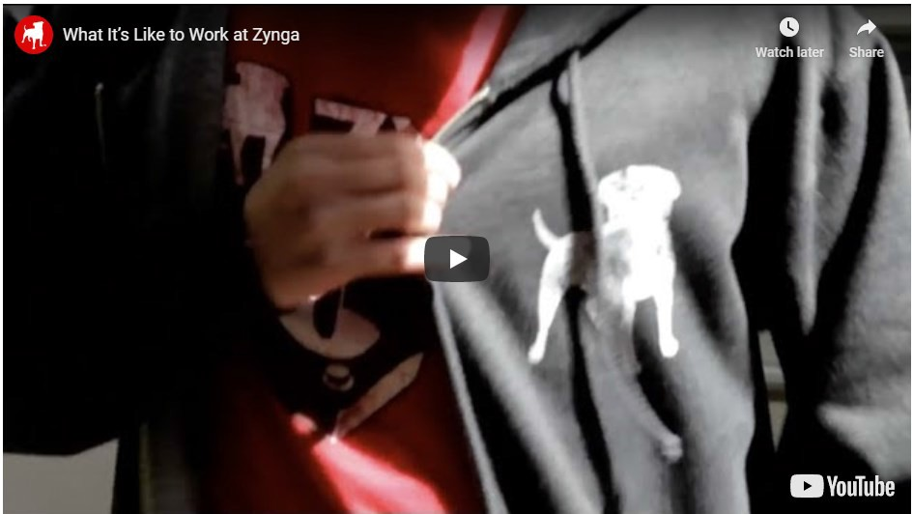
ZYNGA - GAMING COMPANY: ONBOARDING VIDEO
Students can watch these types of videos to gain an even greater insight into the company or business and many are available on-line. Some videos might even demonstrate essential features of performing some of the specific job tasks.

Slide 26

EXPLORE-WORK.COM
•
Created by WINTAC, Employment Resources, Inc. (ERI), the University of Wisconsin-Madison, and the University of Wisconsin-Stout Vocational Rehabilitation Institute (SVRI)
Series of web-based modules that align with the five required WIOA Pre-Employment Transition Services
Using Explore-Work.com Webinar
Notes:
There are specific activities that are related to WBLE

Slide 27
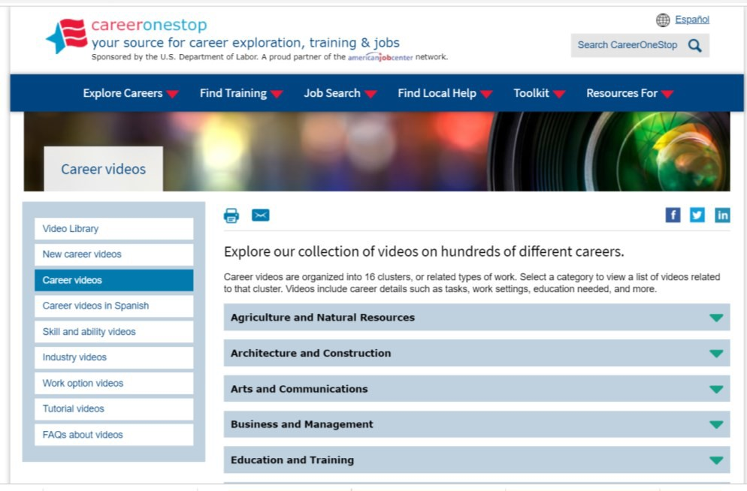
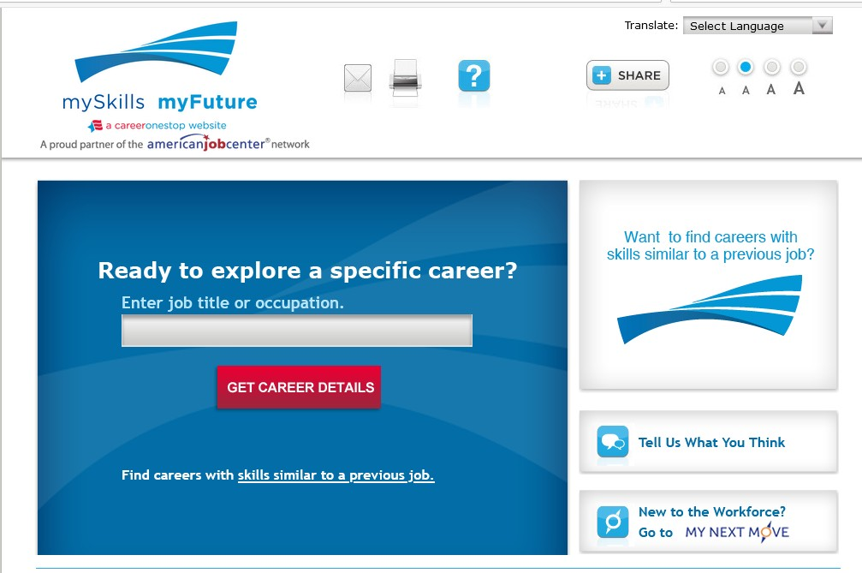
ASSESS INTERESTS AND EXPLORE CAREERS
CareerOneStop Videos mySkills - myFuture - Website
Notes:
Career One Stop videos for work exploration

Slide 28
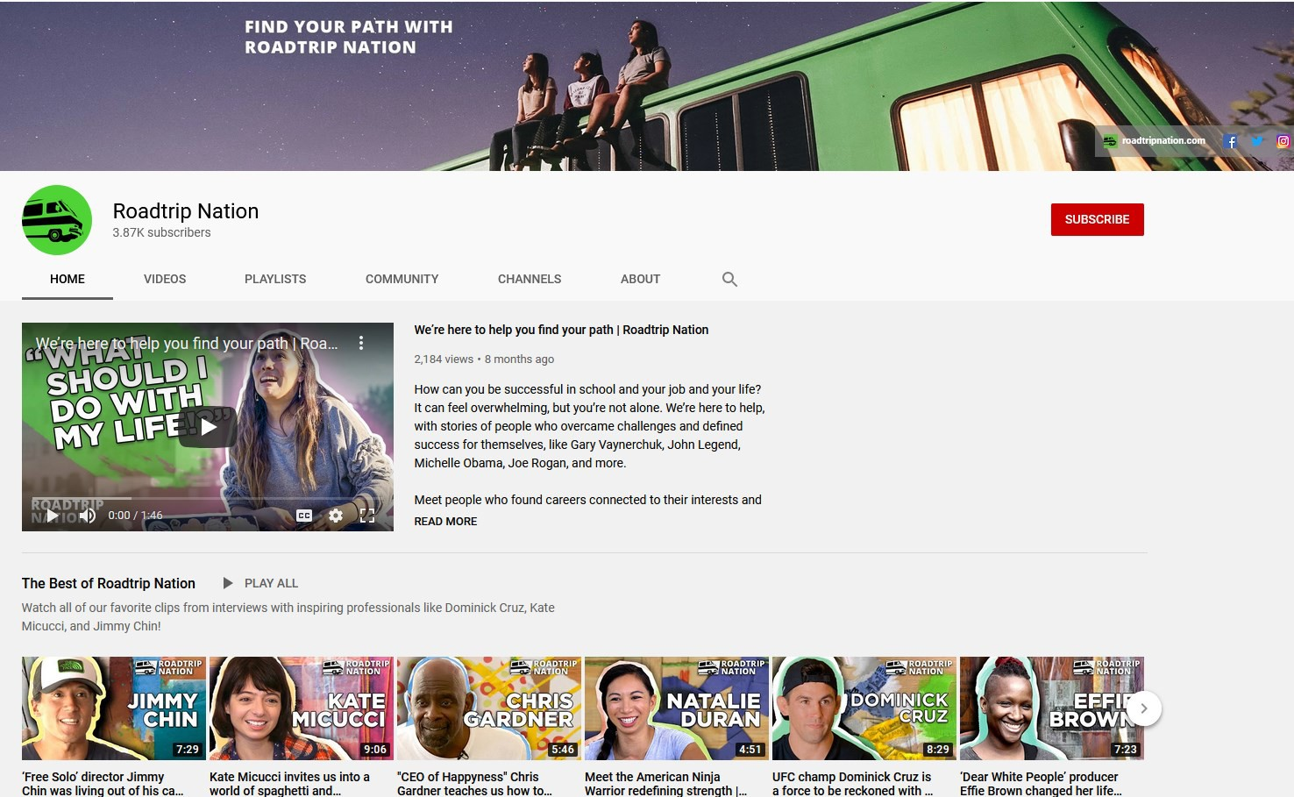
Road Trip Nation
Road Trip Nation - YouTube Channel
How can you be successful in school and your job and your life? It can feel overwhelming, but you’re not alone. We’re here to help, with stories of people who overcame challenges and defined success for themselves, like Gary Vaynerchuk, John Legend, Michelle Obama, Joe Rogan, and more.
Meet people who found careers connected to their interests and get inspiration and motivation for how you can find a fulfilling career and build a fulfilling life.
47
Notes:
Offers a number of videos on different career options from the actual employees about how they got into the field, what they like about the job, and how they can access a career in various fields.

Slide 29
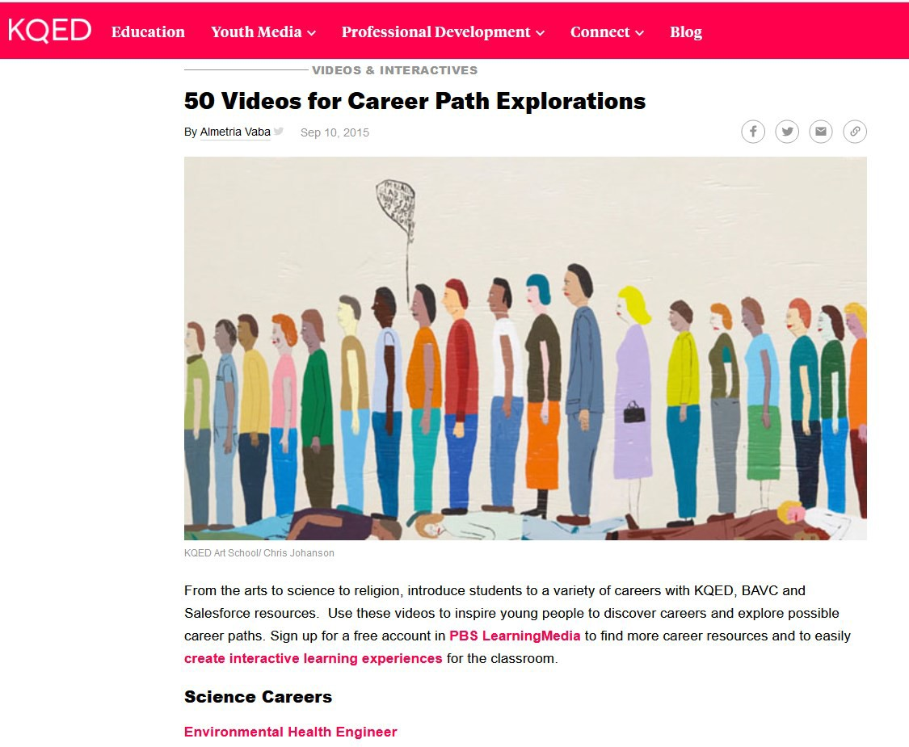
KQED CAREER PATH VIDEOS
KQED 50 Videos for Career Path Explorations
From the arts to science to religion, introduce students to a variety of careers with KQED, BAVC and Salesforce resources. Use these videos to inspire young people to discover careers and explore possible career paths. Sign up for a free account in PBS LearningMedia to find more career resources and to easily create interactive learning experiences for the classroom.
Notes:
This includes 50+ videos on career path explorations along with work activity guides that align to the videos

Slide 30
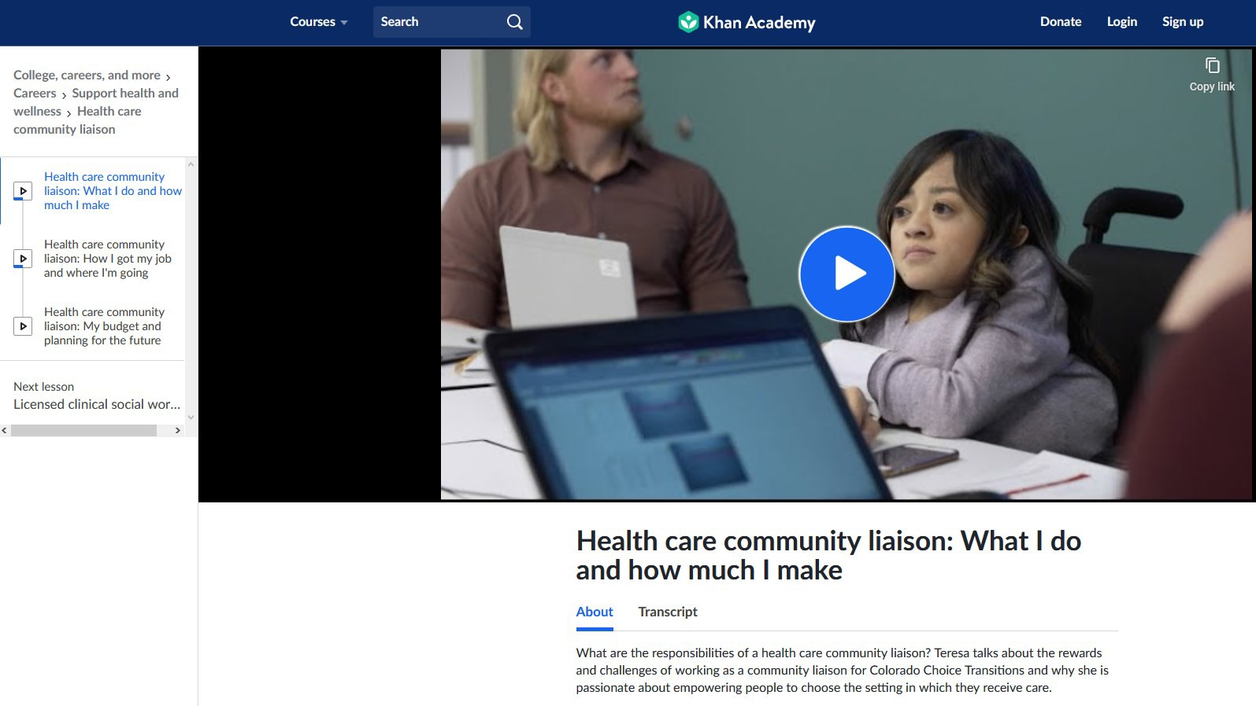
Khan Academy
49
Khan Academy Career Exploration Videos
Khan Academy - Healthcare Community Liaison
Notes:
Many times, students with disabilities do not see people that represent them in career exploration. Khan Academy provides many career exploration videos and the video on this slide is a video of an individual with a disability explaining how she got the job and what the job requires.

Slide 31

WORK BASED LEARNING MEASURES SERIES
Work Based Learning Measures Series available through The College and Career Readiness and Success Center. A resource on measuring student learning while participating in work-based learning experiences
Notes:
Modules and documentation on how to select appropriate measures and how to do portfolios, how to design a rubric for activities, and student self-assessments.

Slide 32
FURTHER YOUR LEARNING
Some slides from this NTACT presentation were not included as not all slides applied. To listen to the webinar in its entirety, you can find it at the NTACT Collaborative website. It will require you to make a free account.
Notes:
This slide deck includes slides from the National Technical Assistance Center on Transition (NTACT). Not all of the slides were included from the original presentation. If participants would like to further their learning, they will need to make a free account at NTACT The Collaborative and search for Employment Preparation and Work Based Learning Experiences in a Virtual World

