Slide 1
CULTURALLY RESPONSIVE– SUSTAINING EDUCATION IN REMOTE AND HYBRID ENVIRONMENTS
Module 4 – Identifying Inclusive Curriculum and Assessment

Slide 2
Immersive Scenario Part 1
I’m Shané, the Director of Educational Equity for IDE Corp., and I identify as a Black-American who uses the pronouns she/her. I’m going to share a personal story for this immersive scenario. Take a few moments to walk alongside me as I progressed through school.

Slide 3
Immersive Scenario Part 2
In 5th grade, I lived in the suburbs of a major city and was one of five Black students in that grade level. I was one of a dozen and a half at the school including my brother. Walking into school and down the hallways each day, it was clear that I was an “other.” My braided hairstyle and the darkness of my skin color were not highly visible in my surroundings. Every day, it was evident that my cultural experience was not similar to that of my peers or teachers. At that school, when I looked around at the adults in the building, few if any of them shared my skin tone. When I looked at the walls of famous faces, inspirational quotes, professions to aspire to, and more, my appearance was not fully represented. Do Black women not accomplish these same things? Do Black people not have inspiration to share? Are accomplished Black people only athletes?

Slide 4
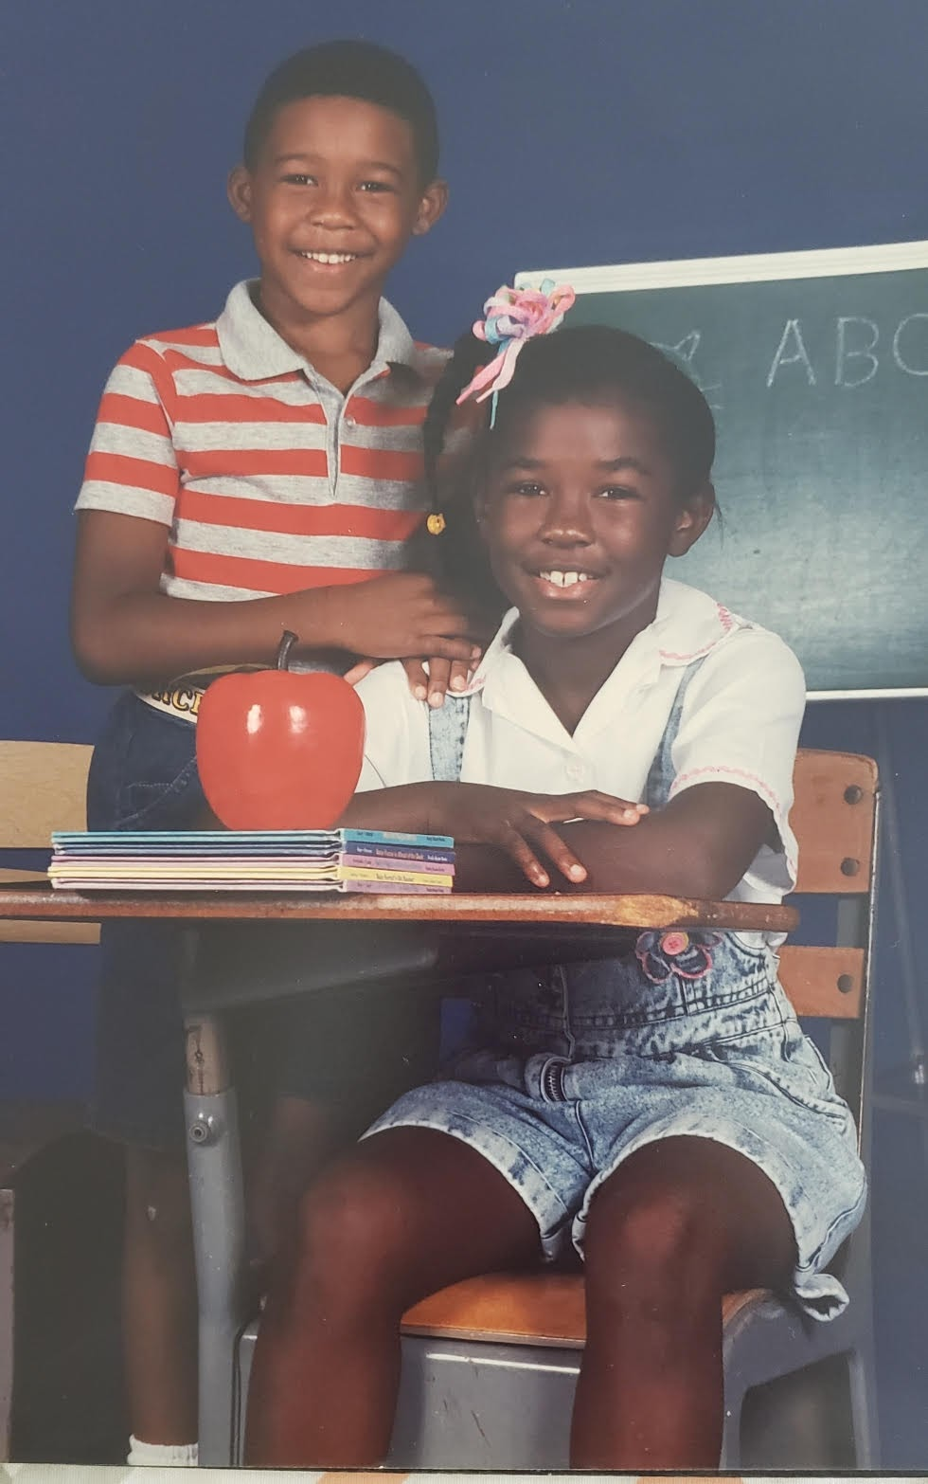
Immersive Scenario Part 3
Beyond the experience of what I was seeing in my environment, when I flipped the pages of our textbooks and reading materials, I was only seeing a singular narrative. It may not have been White faces, but it was clear the Eurocentric perspective was the dominant narrative in our curriculum. Were the experiences of Black and Brown people not meant to be explored? Though these were my thoughts as a young girl, I compliantly moved along.

Slide 5
Immersive Scenario Part 4
I moved at the start of 7th grade to a place where there was greater diversity at my school and in my neighborhood. Walking the halls of my school, there were many more students who had skin tones that were similar to my own. There were even three Black teachers at my middle school, and I was appreciative to have all three during my time there. My 7th-grade science teacher was a Black female, and for the first time at school, I felt I was seen — not for being so starkly different, but for being who I was. Though there was a greater diversity in my daily interactions, the resources and materials did not align with that experience. My biggest question that I would bring home to my parents was: “Is there more to Black history than the civil rights movement?” and “Does the Black experience begin before slavery?” There has to be more than these standard figures and it has to be more complex than this, right? Luckily, both of my parents are HBCU (Historically Black College and University) graduates, so they were able to shed some light on these gaps and introduce me to other authors, inventors, and experiences. If not for them, I would not know about the Tuskegee Airmen, for instance.

Slide 6
Immersive Scenario Part 5
Even in high school, the issue was the same. Though I was exposed to some Black authors and poets such as Langston Hughes, Zora Neale Hurston, and Maya Angelou, far and wide the stories, texts, and performance assessments were clearly not designed with me in mind. But how could I find the voice to express this? Would I be safe to share these views? Why was there not a greater conversation about race to normalize it?
My story takes place in the 1990s in three very different places. Things must be different now, right?
The fact is that in the past 20 years since I graduated from high school, progress in integrating curriculum and assessments wholly with diversity in mind has moved slowly.
But why is this even important?
Exposure to representative curriculum and resources supports the development of one’s own self-identity. How am I seen in the world? How do I see myself in the world? Though the gaps were filled in at home, the system of education still ingrains in all students what is of importance to study and know and what has been deemed irrelevant.

Slide 7
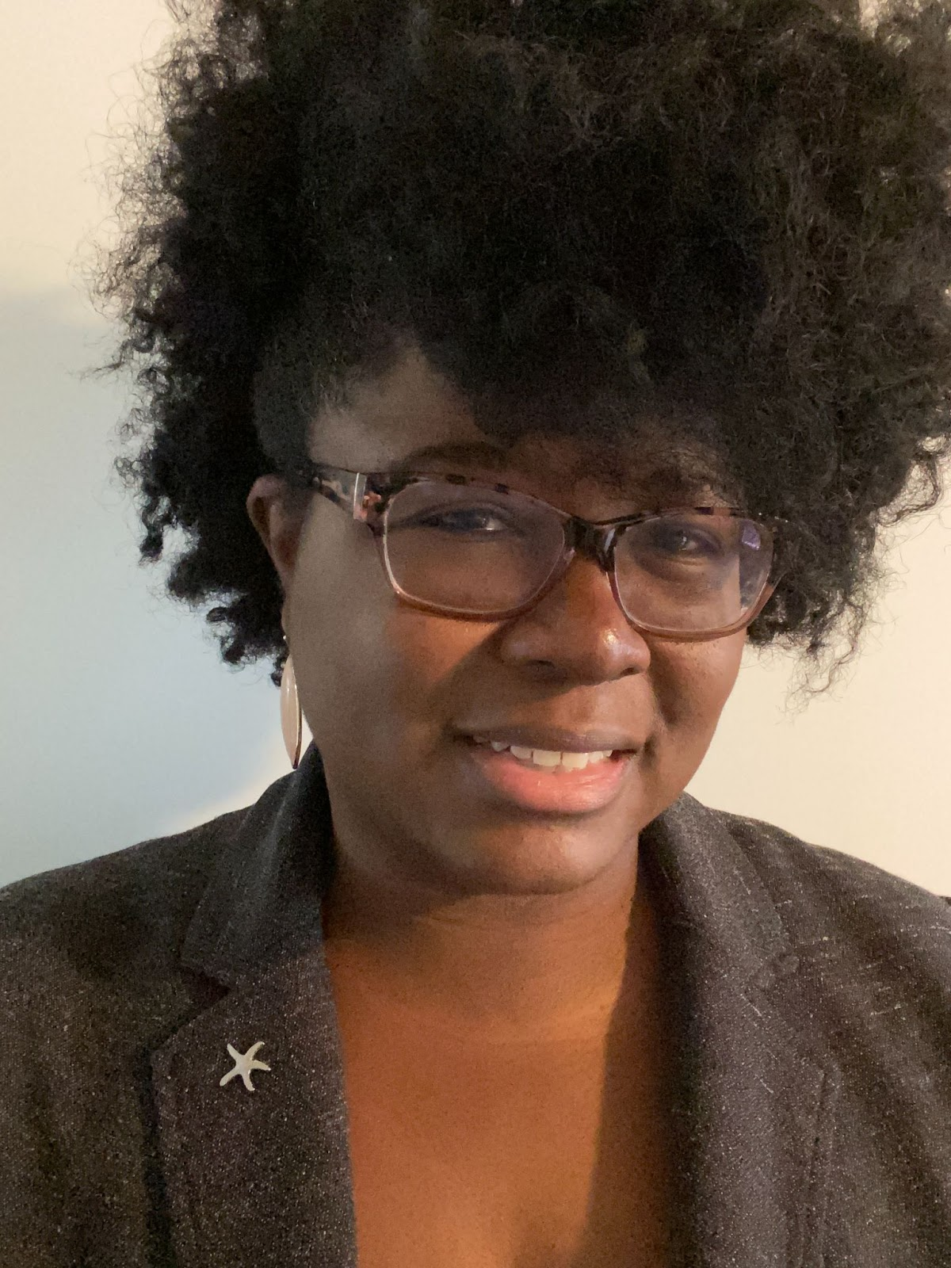
Immersive Scenario Part 6
When we think about an inclusive curriculum and assessments, we want our students to feel empowered to dismantle systems of bias, inequities, and instances of power and privilege. To accomplish this, we must first learn these systems and begin to work intentionally to uplift marginalized voices in our classrooms. As educators, when we recognize the need for change in the system, we can support our students in recognizing the same. We can support them in using their voice and provide them with the tools to do so successfully. How will you be an agent of change? How will you support your students to be agents of change, too?
Notes:
Add conversation slide

Slide 8
BOR Reflection (7 minutes)
In your breakout rooms….
Quickly introduce yourself and your role to the group
Discuss the question, “How can we begin to position our students to be agents of change in their communities?”

Slide 9
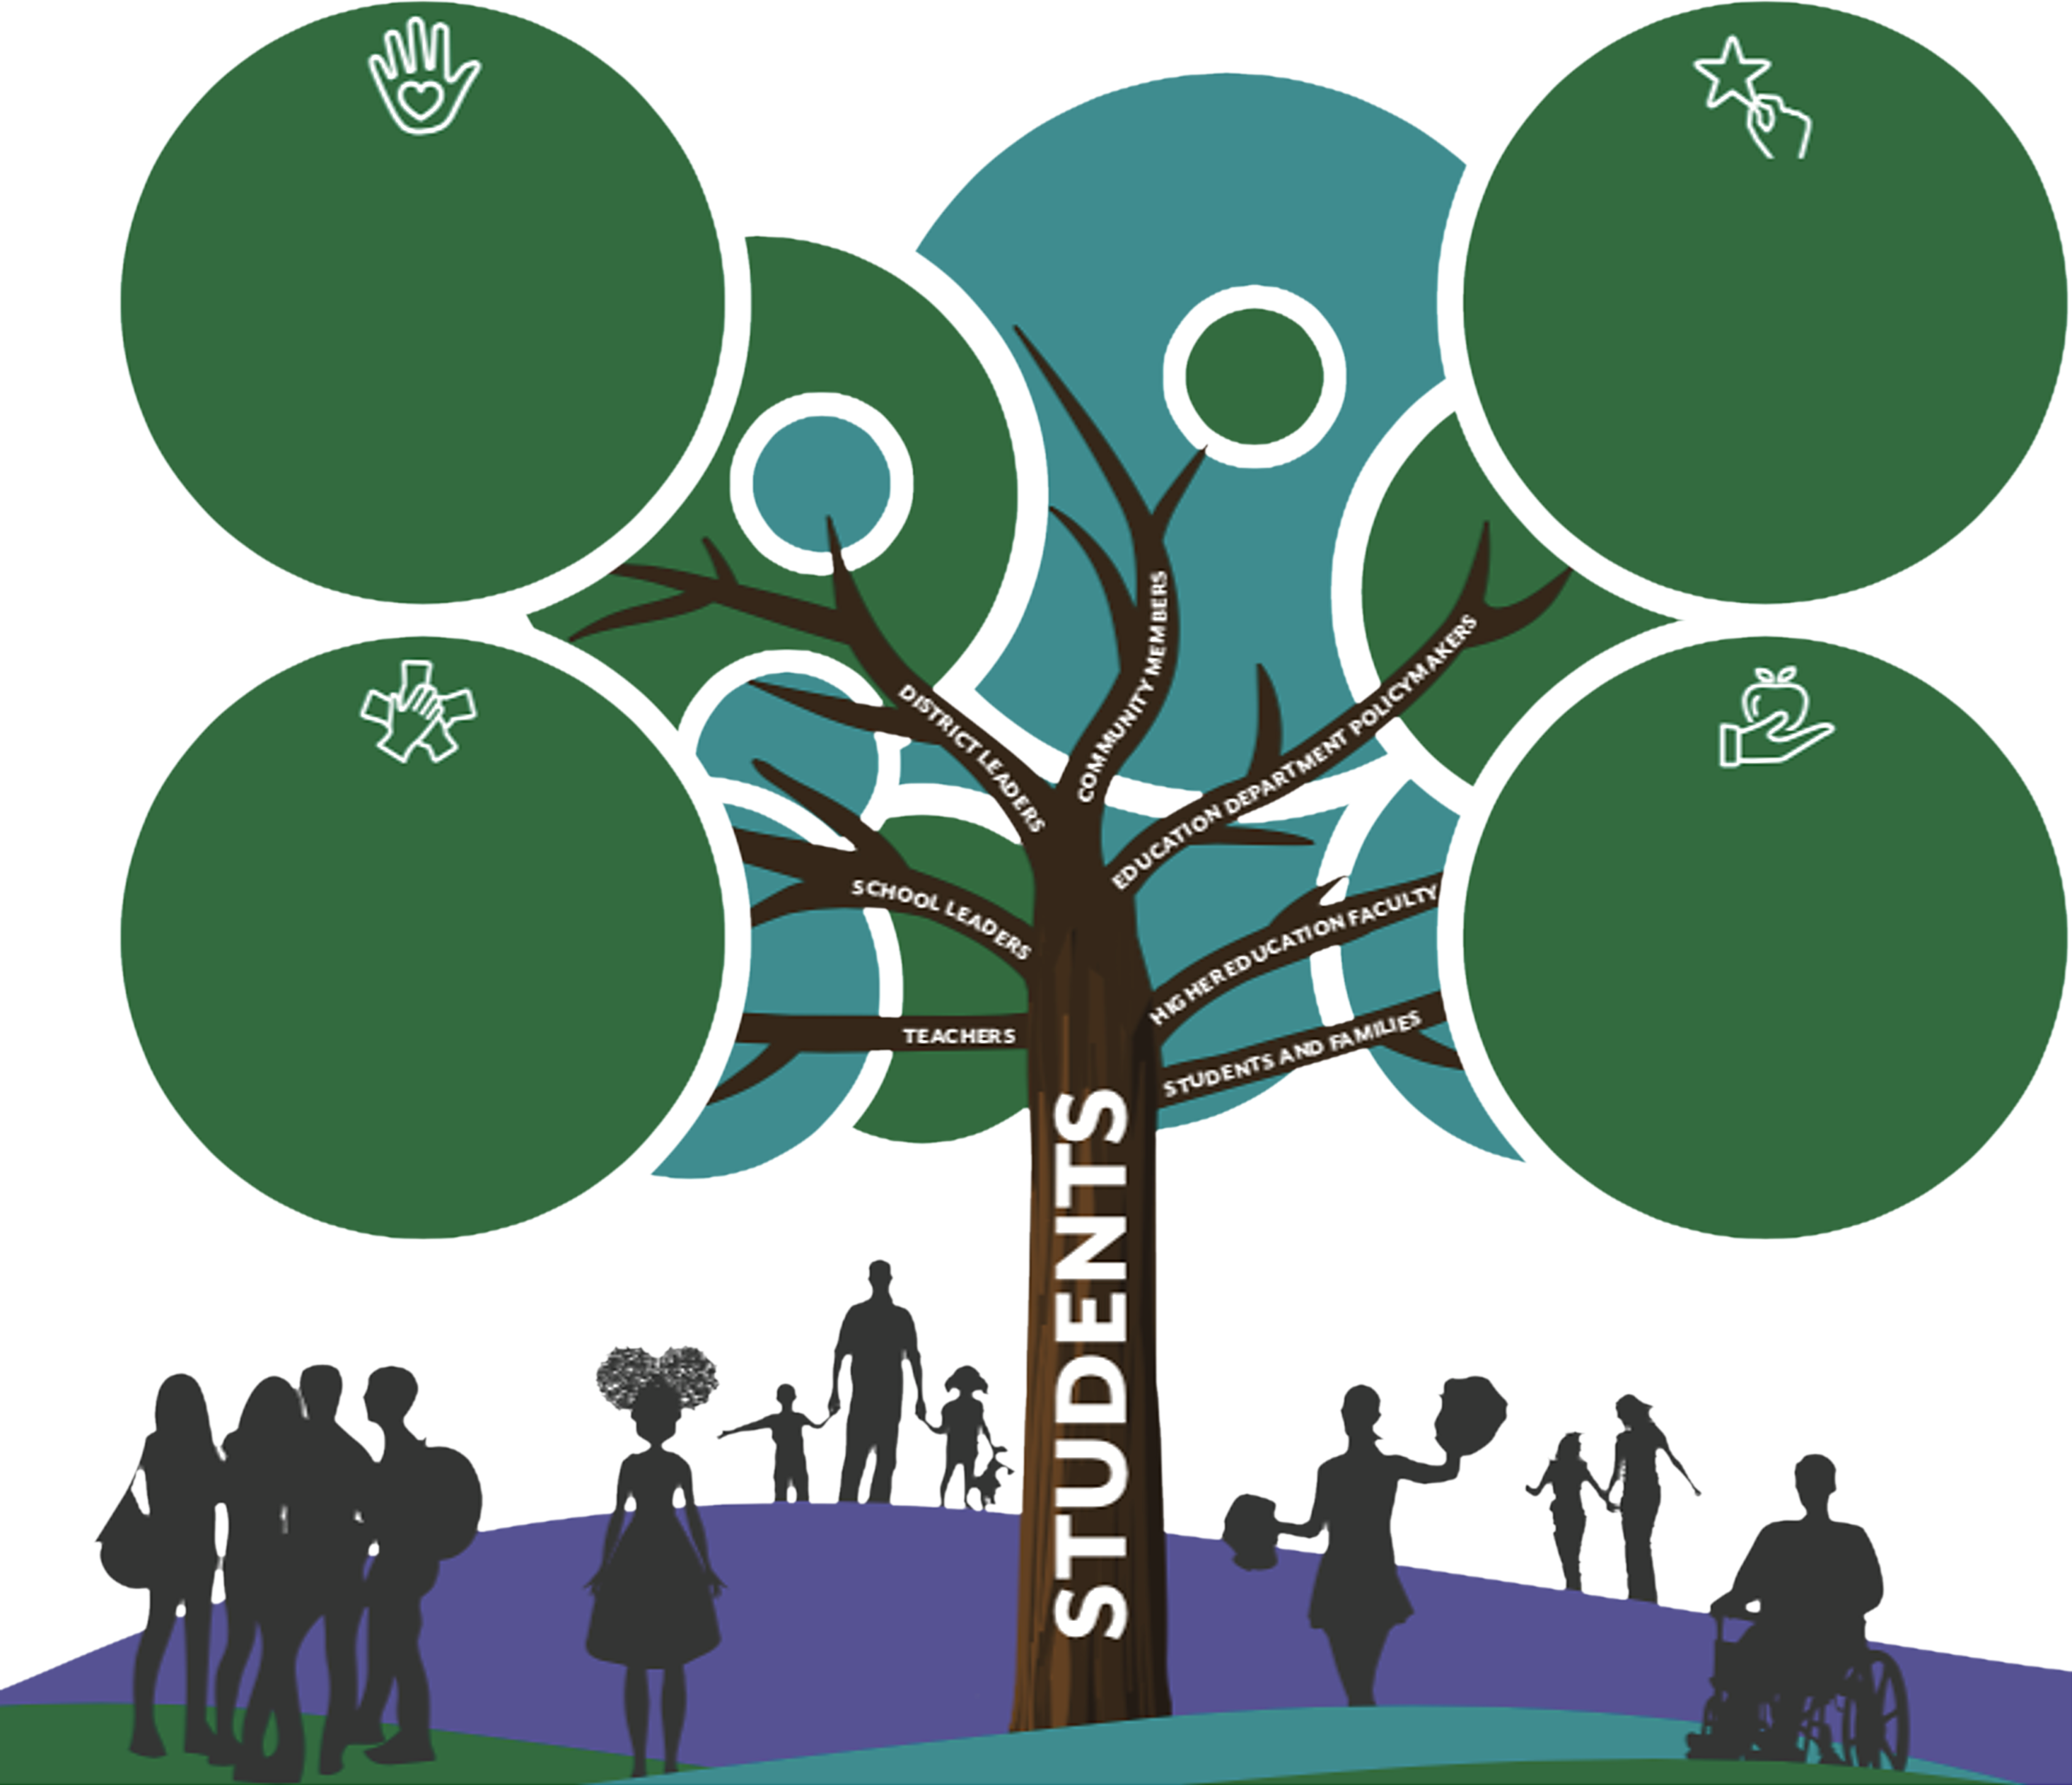
Inclusive Curriculum and Assessment
Welcoming and Affirming Environment
Collective responsibility to learn about student cultures and communities.
Close relationships with Students & Families.
Social-Emotional Learning Programs.
Materials that represent and affirm student identities.
High Expectations and Rigorous Instruction
Student-Led Civic Engagement.
Critical Examination of Power Structures.
Project-Based Learning on Social Justice Issues.
Student Leadership Opportunities.
Inclusive Curriculum and Assessment
Current events incorporated into instruction.
Students as co-designers of curriculum.
Resources written and developed by racially, culturally, and linguistically diverse perspectives.
Instructional strategies that adapt to diverse learning styles.
Ongoing Professional Learning and Support
Diversity, Equity, and Inclusion Training, examining implicit bias and interrogation of beliefs and assumptions.
Support in aligning curriculum and instruction to the histories, languages, and experiences of traditionally marginalized voices.

Slide 10
Learning Objectives
“Student Advocates” — Our learning environments should build up efficacious students who are agents of change for their communities. How are we positioning students to achieve this in our remote and hybrid learning environments?
“Self-Identity” — In order for our remote and hybrid learning environments to build up efficacious students, we must first empower them. How are students positively represented in curriculum and assessments? How are students learning more about who they are as remote learners?
“Risk-Taking and Change” — For our students to be advocates for change, they need to be engaged not only with the curriculum but with their communities. Teaching through PBLs, integrating service learning, and more allows students to feel a greater connection to the content presented.

Slide 11
Student Advocates

Slide 12
Student Advocates – Definitions
Supporting Self-Advocacy and Self-Awareness — To explore the role self-awareness plays in opportunities for students to advocate for themselves and others in remote and hybrid learning environments. This includes an e-text to read, a reflection and take action activity.
Power and Privilege — To define and reflect upon the term privilege and how it can be reflected in our curriculum and assessments. This includes a video, a reflection and a collaborative activity.
Multicultural Education in Remote and Hybrid Learning Environments — To understand and implement a framework for multicultural education within a curriculum that uplifts traditionally marginalized voices, offers diverse perspectives, and empowers all remote and hybrid learners. This includes a video, a reflection and a design activity.

Slide 13
Power and Privilege (20 – 30 min)
Goal:
To define and reflect upon the term privilege and how it can be reflected in our curriculum and assessments.
Notes:
https://www.youtube.com/watch?v=XlRxqC0Sze4

Slide 15
Stop and Think (BOR Discussion) 15 minutes
How would you define the concept of racial privilege? (T, SL, DL)
Why is it important to have high-quality representation in our curriculum and assessment? (T, SL, DL)
How do unconscious media messages affirm or disaffirm each of us? (T, SL, DL)

Slide 16
Self-Identity

Slide 17
Self-Identity – Definitions
Exploring Multiple Perspectives — To synthesize strategies for creating a remote and hybrid classroom where all learners can share and understand multiple perspectives of one another’s life experiences. This includes a video, a reflection, collaboration and a design activity.
The PBL-SEL Connection — To explore a variety of ways in which students can build self-awareness and identity affirming activities through the PBL approach. This includes an e-text and a design activity.
Asset-Based Assessments and Actionable Feedback — To explore actionable feedback and equitable representation in assessments to support and prioritize asset-based research on academic achievement. This includes a website exploration, a reflection and a take action activity.
Representative Curriculum — To review curriculum and additional remote and hybrid resources through a critical, culturally responsive lens. This includes a website exploration and a take action activity.

Slide 18
Representative Curriculum (30 – 45 min)
Goal:
To review curriculum and additional remote and hybrid resources through a critical, culturally responsive lens.
Notes:
What strikes you about this image? What terms stand out?

Slide 19
Representative Curriculum - Exploration
Representation
Does this resource represent (in images and narratives) the communities represented in my classroom? Will this resource give my students access to stories that celebrate them and their cultures?
Intersectionality
Does the resource present the multiple perspectives and counter-narratives of people who have the broadest view on the past, present and future? How are the voices of disabled, LGBTQIA+ people, etc. represented? Are they ignored in the resource? How will this resource allow for students to grow their anti-bias viewpoints?
Avoid Trauma
Does this resource ask students to learn about or process another traumatic situation? How might being asked to write a journal entry about Covid-19 harm those who have lost family or those who are anxious about the pandemic?
Critique and Challenge
If you aren’t able to change the resource, you can use it to build students’ opportunity to critique and challenge the content using knowledge they bring. How can this resource teach students to hear and engage with diverse perspectives?
Notes:
We are going to walk through one of the sample lesson plan provided for this activity.

Slide 20
Breakout Room Discussion (15 minutes)
When you consider digital resources that student's access…
Does this digital resource present the multiple perspectives and counter-narratives of people who have the broadest view on the past, present, and future?
How will this digital resource allow for students to grow their anti-bias viewpoints?
Though you may not be able to change the resource, how can you use it to build students’ capacity to critique and challenge the material?
Notes:
Take a moment to read some facts about Amanda Gorman. You will be placed in BORs and then will discuss some questions. Link to activity - https://docs.google.com/document/d/1J8Wc5QI0kAxqgq6SI5uYEtYg2jNZjmN7vY8XleOhI1I/edit

Slide 21
Risk-Taking and Change

Slide 22
Risk-Taking and Change – Definitions
Service Learning — To motivate students to engage in service-based projects to alleviate needs in their community. This includes a video, a reflection, and a design activity.
Place- and Pursuit-Based Learning — To provide learners of all ages with relevant and authentic opportunities to meaningfully engage in service learning through the Place and Pursuit-Based learning experiences. This includes a video, a reflection, and a design activity.
Maximizing Learning Through the Design Process — To explore IDE Corps.’s design process in remote and hybrid learning as an opportunity to prioritize risk taking to maximize student growth and achievement. This includes a video, a reflection, and a design activity along with additional resources.

Slide 23
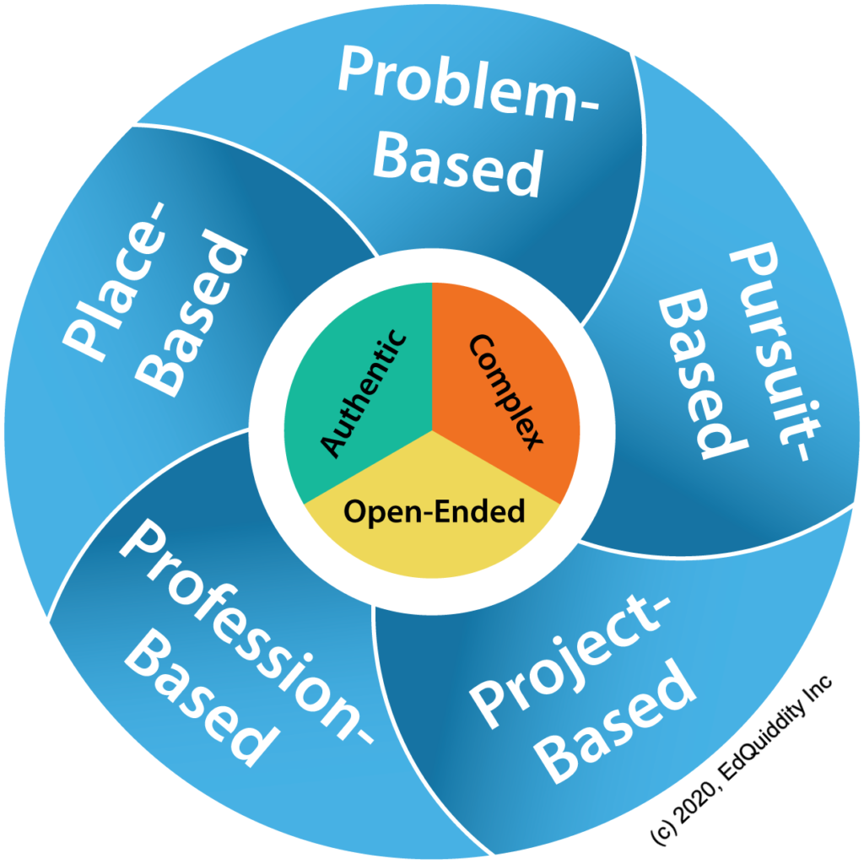
Place- and Pursuit-Based Learning (25 – 35 min)
Goal:
To provide learners of all ages with relevant and authentic opportunities to meaningfully engage in service learning through place- and pursuit-based learning experiences.

Slide 24
Pursuit-Based Opportunities
In pursuit-based learning, a problem or challenge is identified by students based on a personal interest they wish to pursue. The options may be narrowed to the curriculum or, if broader, the teacher would help the student see how the curriculum could fit into the problem or challenge.
Write an online newsletter or blog post for community distribution.
Plan and host online community forums or events (e.g., online concert, fundraiser, info session).
Have students participate in online games that teach civic responsibility such as www.icivics.org.
Create a social media campaign to bring about awareness of current social issues.
Conduct a phone, video, or socially distant interview with small business owners or professionals in a field of interest.
Conduct research on important issues and email stakeholders advocating for change.
Host a Math-a-Thon, where students can use content and engage in grade-level standards in order to meet a specific need in a specific area (here is one example).

Slide 25
Place-Based Opportunities
In place-based learning, students look to solve an open-ended, real-world problem or challenge that is specific to a location, which could be the classroom, home, local community, town or city, state, country, continent, world, or even outer space!
Have students create and record videos about environmental observations within their community or surroundings.
Create artwork to be displayed throughout the local community such as sidewalk chalk art, murals, and posters.
Connect a life-science unit to plant life and allow students to grow their own plants that will eventually be donated or placed in a community garden.
Set up online peer/group tutoring services between neighboring schools or schools overseas.
Engage families and students in local opportunities such as roadside cleanup or a community garden.
Create and send virtual birthday or greeting cards to local housing shelters, senior centers, or service members.
Allow students to go on virtual field trips to learn about a specific place or topic.

Slide 26
Learning Objectives Review
“Student Advocates” — Our learning environments should build up efficacious students who are agents of change for their communities. How are we positioning students to achieve this in our remote and hybrid learning environments?
“Self-Identity” — In order for our remote and hybrid learning environments to build up efficacious students, we must first empower them. How are students positively represented in curriculum and assessments? How are students learning more about who they are as remote learners?
“Risk-Taking and Change” — For our students to be advocates for change, they need to be engaged not only with the curriculum but with their communities. Teaching through PBLs, integrating service learning, and more allows students to feel a greater connection to the content presented.

Slide 27
Thank you for attending
CULTURALLY RESPONSIVE-SUSTAINING EDUCATION IN REMOTE AND HYBRID ENVIRONMENTS
Module 4 – Identifying Inclusive Curriculum and Assessment

