Slide 1
Deep Dive: Community & Communication
May 18, 2021

Slide 2
Session Goals
Reflect on and make connections between actions related to teacher credibility for in-person and virtual setting. Reflect on the importance of these connections in building community.
Explore activities to build community for hybrid & remote settings that focus on:
opening routines/rituals
daily interactions
small group activities
agreements
home-school communication

Slide 3
Where Have We Been?
A broad, overarching look at shifting to online learning in three major areas:
Structures & Routines
Curriculum, Instruction & Assessment
Community Building & Communication
to provide points of consideration, reflection and resources that could meet the unique needs of various regions, districts & schools

Slide 4
Guiding Priorities & Outcomes
We are trying to build in-person, hybrid and remote instructional environments that are:
PREDICTABLE
FLEXIBLE
CONNECTED
STUDENT EMPOWERED
Priorities by: Alex Shevrin Venet
Article by: Kara Newhouse, available at: kqed.org

Slide 5
Where Are We Going?
A more specific deep dive into one aspect of the main areas
Community Building & Communication
Specific purposes & strategies to build community
Curriculum, Instruction & Assessment
Deepening an understanding of different types of engagement & strategies
Structures & Routines
A structure for integrating EdTech tools in meaningful ways

Slide 6
Turnkey Options for Regional Training
Option 1
Option 2
Option 3
Use the following comprehensive slide deck to deliver learning experiences holistically or in parts.
(synchronously or asynchronously)
Utilize the note catcher or other reflection form of your choice to engage in an exploration of e-Notebook #3. (synchronously or asynchronously)
Select individual materials from e-Notebook #3 to use for learning experiences based on the targeted needs of your region.
(synchronously or asynchronously)

Slide 7
Setting the Stage with Teacher Credibility

Slide 8
Teacher Credibility
To build positive communities, teacher credibility is an important foundation.
"Students need to see teachers as: believable, convincing & capable of persuading students that they can make a difference"
p.68 Distance Learning Playbook
Trust - being true to your word
Competence -know how
Dynamism - passion
Immediacy - accessible & relatable

Slide 9
Teacher Credibility-Reflection
Reflection Question | How do I do this? | How might it need to be adapted in a remote environment?
How do I establish trust with my students?
How do I demonstrate competence to my students?
How do I display my passion to my students?
How do I ensure that my students feel I am accessible and relatable?
Note to Trainer:
This could be done individually or in breakout rooms with notes on a Google Doc or with an EdTech tool like Padlet or Nearpod were people can submit their ideas onto an electronic bulletin board.
Distance Learning Playbook by Fisher and Frey-Module 4

Slide 10
Teacher Credibility-other thoughts to consider
Reflection Question | Considerations | Virtual Adaptations
How do I establish trust with my students? | Keep your promises Give honest feedback about student performance Examine any negative feelings you may have about students | Use calendar invites to help keep appointments Use comment tool or voice record feedback Schedule 1:1 sessions for feedback
How do I demonstrate competence to my students? | Know your content well, be honest when you are not sure about a question Organize lesson experiences coherently Consider any non-verbal communications | Use digital agendas with links all in one place Minimize the number of tabs/EdTech tools Build in time/procedures to troubleshoot tech
Distance Learning Playbook by Fisher and Frey-Module 4
Notes:
Trainer Note: Use this slide to have participants compare their responses/ offer alternative ideas to consider. As review, have participants offer other adaptations they discussed

Slide 11
Teacher Credibility-other thoughts (cont.)
Reflection Question | Considerations | Virtual Adaptations
How do I display my passion to my students? | Communicate your enthusiasm for your content Remember your “why” for becoming a teacher Consider the relevance of your lessons | Voice, tone, SMILE Make a connection between the activity and/or EdTech tool and the learning Take screen breaks Use music; incorporate movement breaks
How do I ensure that my students feel I am accessible and relatable? | Get to know something personal about each of your students/Use students’ names Invite students to provide feedback Start and end class on time Smile | Office hours Have students enter early to music/chat Schedule "social time" Be early to links - use timers
Distance Learning Playbook by Fisher and Frey-Module 4
Notes:
Continuation of previous slide
Trainer Note: Use this slide to have participants compare their responses/ offer alternative ideas to consider

Slide 12
Building Community Activities

Slide 13
Welcoming/Closing Routines & Rituals
Short activities that are carefully chosen, connected to learning, & engagingly facilitated.
Welcoming Routines & Rituals Build Community by:
establishing safety & predictability
supporting contribution by all voices
setting norms for respectful listening
allowing students to connect with one another
creating a sense of belonging
allowing for reflection
Examples:
Sustainable Ed-Opening Routines
Edutopia-Six Ideas for Opening Routines
SEL Playbook-Three Signature Practices
Opening & Closing Routines from Facing History & Ourselves
Notes:
Trainer Note: Talk about importance of welcoming routines & rituals and point participants to links they might explore further after training - these are meant to be resources they can come back to revisit

Slide 14
Activity
Title: |  | circle one: Welcome Closure
Time: about how long will the activity take
Overview: briefly describe the activity, when & why you would use it
Steps: sequenced steps to complete the activity
Debrief: list ideas to have students share and/or reflect on their process, growth and/or connections
Adaptations for a Virtual or Hybrid Setting: list any adaptations or links to be able to complete this virtually
Note to Trainer:
This could be done individually or in breakout rooms with notes on a Google Doc. Individuals or groups can create their routine, then come back to the larger group and share/complete the routine they created.
adapted from SEL Playbook

Slide 15
Reflect: Review the resources provided on slide 13.
Name a welcoming/closing routine that you would like to try with your students in an upcoming lesson.

Slide 16
Small Group Activities
Activities that connect students to share interests, learn about each other or work towards a common goal
Small Group Activities Build Community by:
encouraging students to communicate and problem solve
facilitating a development of trust between peers
allowing students to learn about themselves and their peers
creating networks of support and connection
Examples:
Catlin Tucker-Small group Station Rotation
Protocol-Feedback Chat
Mindfulness Activities
Fun ideas for Online Classes
Hyperdocs-Building Classroom Community
Notes:
Trainer Note: Talk about importance of using small groups to build community and point participants to links they might explore further after training - these are meant to be resources they can come back to revisit

Slide 17
Activity - Team Building
Note Trainers:
Depending on the group size, you may want to adjust how high you count
Alternate would be to go through the alphabet, providing a word that starts with a particular letter
As a group we will count from 1 to 10
I will start and say "1"
Someone will unmute and say "2"
Continue until we get to 10
What's the catch? You can't discuss strategy ahead of time and if someone speaks over you, we have to start back at 1.
Notes:
After the activity - How can something like this build rapport and team within a community? Participants can share via chat or unmute.

Slide 18
Activity - Thinking Routine
Note to Trainer:
This could be done using the attached Google Slide Deck. Individuals can then share one box in a breakout room or add to a collaborative bulletin board (ex: Padlet, Nearpod).
Read this routine Who Am I
Complete the graphic organizer individually
Share one aspect of who you are with your breakout group
Reflect: How can a Thinking Routine like this build community?

Slide 19
Reflect: Review the resources provided on slide 16.
Name a small group activity that you would like to try with your students in an upcoming lesson.

Slide 20
Daily Interactions
Connecting with students daily in individual ways
Daily Interactions Build Community by:
building rapport and trust
allowing students and teachers to connect on a personal level to discover shared interests
support student individual needs
provide predictability
Modalities and Resources:
1:1, face-to-face
Feedback centered Exit Ticket
notes, cards, e-mails, post-its
messages on EdTech platform
Five Minute Chats
Video-Daily check-ins
Edutopia Article-Morning Meeting Online
Notes:
Trainer Note: Talk about importance of daily interactions and point participants to links they might explore further after training - these are meant to be resources they can come back to revisit

Slide 21
Trust Generators
from: Z. Hammond Culturally Responsive Teaching & the Brain
According to Zaretta Hammond in her book Culturally Responsive Teaching & the Brain, educators build trust with students through affirmation & trust
Affirmation = acknowledge personhood of student through words and actions that say, "I care about you."
Rapport = sympathetic connection with another person that results in warm, friendly feelings; feeling in sync.
Listening with Grace
Give full attention to speaker & what is being said
Understand the feelings behind the words and be sensitive to those
Suspend judgement & listen with compassion
Honor the speaker's cultural way of communicating
Trust Generators
Selective Vulnerability
Familiarity
Similar Interests
Concern
Compassion
Notes:
affirmation does not mean make kids feel good about themselves - that's a deficit mindset, thinking students don't come to school feeling good about themselves - instead,students from different backgrounds that students start to feel unseen, unwelcomed or silenced. This can be amplified when instruction is virtual - sometimes students don't engage or participate in virtual setting because they don't geel welcomed, seen or that their voice matters - it's about building trust

Slide 22
Activity - Trust Generators Online
Review the Trust Generators and how they typically look in a typical school setting
With your group, discuss how these might be adjusted to virtual settings and add your ideas to the last column
Share out with the whole group
Note to Trainer:
This could be done in small breakout groups using the attached Google Doc. Individuals can then share one box in a breakout room or add to a collaborative bulletin board (ex: Padlet, Nearpod).

Slide 23
Reflect: Review the resources provided on slides 20-21.
What are ways you can interact with your students frequently to build community remotely?

Slide 24
Agreements
Creating shared agreements for how learners will interact with each other
Team Building Activities Build Community by:
encouraging students to communicate and problem solve
facilitating a development of trust between team members
allowing students to learn about themselves and their teammates
creating networks of support
Examples:
Sample Agreements for Virtual Learning
Setting Agreements-National School Reform
Padlet-Video Etiquette
Facing History & Ourselves Creating Class Contracts
Notes:
Trainer Note: Talk about importance of agreements and point participants to links they might explore further after training - these are meant to be resources they can come back to revisit

Slide 25
Steps for Creating Agreements
Reflect on past school experiences and independently reflect on these questions then share with a partner:
When have you felt comfortable sharing your ideas and questions in a class? What happened in those moments to help you feel comfortable?
Divide students into small groups of three or four to come up with three agreements that they feel are important for everyone in the class to follow in order to foster the kind of space that invites participation, sharing, and growth.
Have groups share their agreements
Work as a group to combine or consolidate like ideas
Have students indicate which agreements should be kept by adding their initials, a post-it or other strategy to indicate agreement
Create & sign the contract
Reflect on the process as a class and have students set individual goals to help them achieve a class agreement.
adapted from: Facing History & Ourselves Creating a Classroom Contract

Slide 26
Reflect: Review the resources provided on slides 24-25.
What do you want your agreements to look like in your classroom? How do you include students that will be remote?

Slide 27
Home-School Communication
Creating opportunities for sharing classroom information, expectations and student progress as well as seeking family feedback and support
Communication Considerations:
Scheduled Communications
What are they?
When and why do they happen?
Daily Communications
What are they?
When and why do they happen?
Modalities
Newsletters, emails, vidoes, posts, calls
Items to always include in communications
Office hours, ways to access support
Examples:
Creating Parent Newsletters with Buncee
Virtual Tips for Grown Ups
Guide for Communicating with Parents
Creating Surveys for feedback

Slide 28
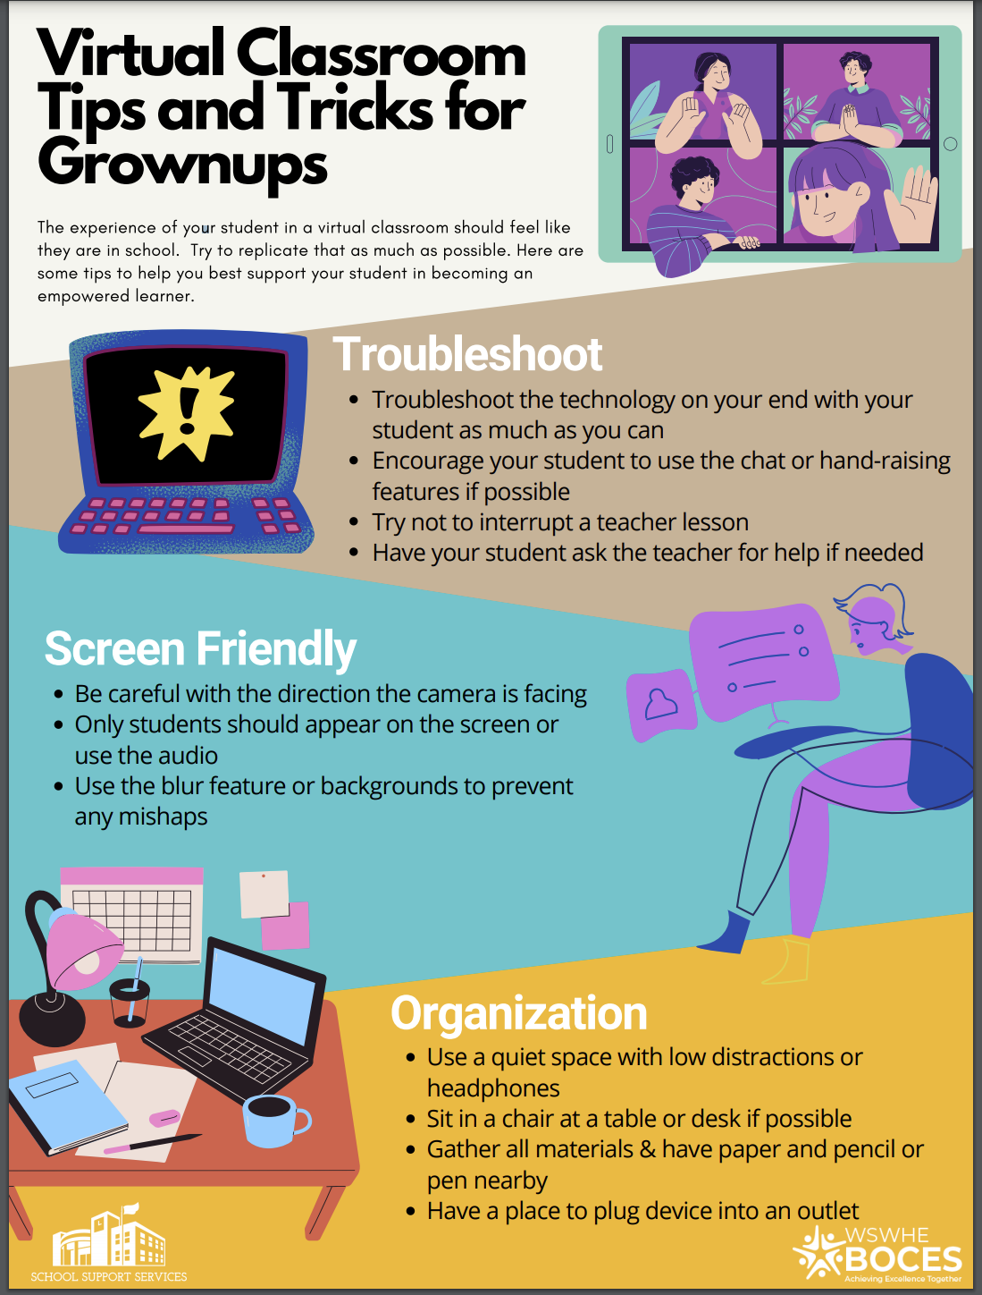
Example of Communication with Family

Slide 29
Reflect: Review the resources provided on slides 27-28.
What are some ways to enhance your communications with families?

Slide 30
Optimistic Closure
3-2-1
Note to Trainer:
This could be completed in a doc, Nearpod or Padlet. Participants can also be invited to unmute or share in the chat.
What are 3 takeaways from today?
Who are 2 people you can share this information with?
What is 1 thing you will immediately do this week?
Add your responses to the Padlet

Slide 31
Thank you
Use this closing slide to include important contact or reference information.

