Slide 1
FAMILIES AS PARTNERS
CELEBRATING RELATIONSHIPS, ROUTINES, AND RESOURCES
SESSION 5
Notes:
Families as Partners: Training Session 5 (3b)
*Take a moment to introduce yourself, and if you want, have the group introduce themselves as well. Consider using a warm welcome and an activity from the SEL Playbook (https://schoolguide.casel.org/uploads/2018/12/CASEL_SEL-3-Signature-Practices-Playbook-V3.pdf).

Slide 2
Families as Partners Sessions
Session One: Families as Partners Overview
Session Two (2A) and Three (2B): Deeper Dive Into Partnerships
Session Four (3A) and Five (3B): Celebrating Successful Partnerships
Notes:
Provide an overview of upcoming sessions:
Session One: Families as Partners Overview
Session Two (2A) and Three (2B): Deeper Dive Into Support Structures
Session Four (3A) and Five (3B): Celebrating Successful Partnerships

Slide 3
Today’s objectives
Identify attributes of positive relationships, routines, and resources with families as partners.
Celebrate successful strategies to support relationships, routines, and resources with families as partners.
Share reflective practices to plan for growing relationships, routines, and resources with families as partners.
Notes:
Provide an overview of session objectives:
Identify attributes of positive relationships, routines, and resources with families as partners
Celebrate successful strategies to support relationships, routines, and resources with families as partners.
Share reflective practices to plan for growing relationships, routines, and resources with families as partners.

Slide 4
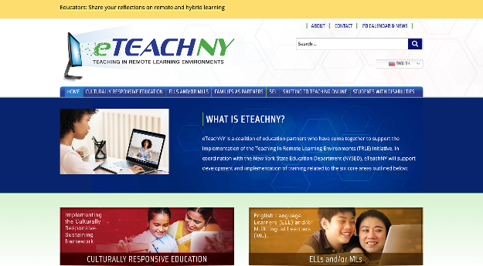
Materials needed
Access to the eTEACHNY Website
Families as Partners Slide Deck
Notes:
For today’s training, you will need a copy of this slide deck to guide conversations.
You’ll also want to visit eTEACHNY website - https://www.eteachny.org/. All of the resources shared today, plus future resources and resources from the other 5 areas of focus can be found on this website. You will want it in an easy place to return to and use.
Participants will benefit from having an electronic or printed version of the Session 5 slide deck and spreadsheets.

Slide 5
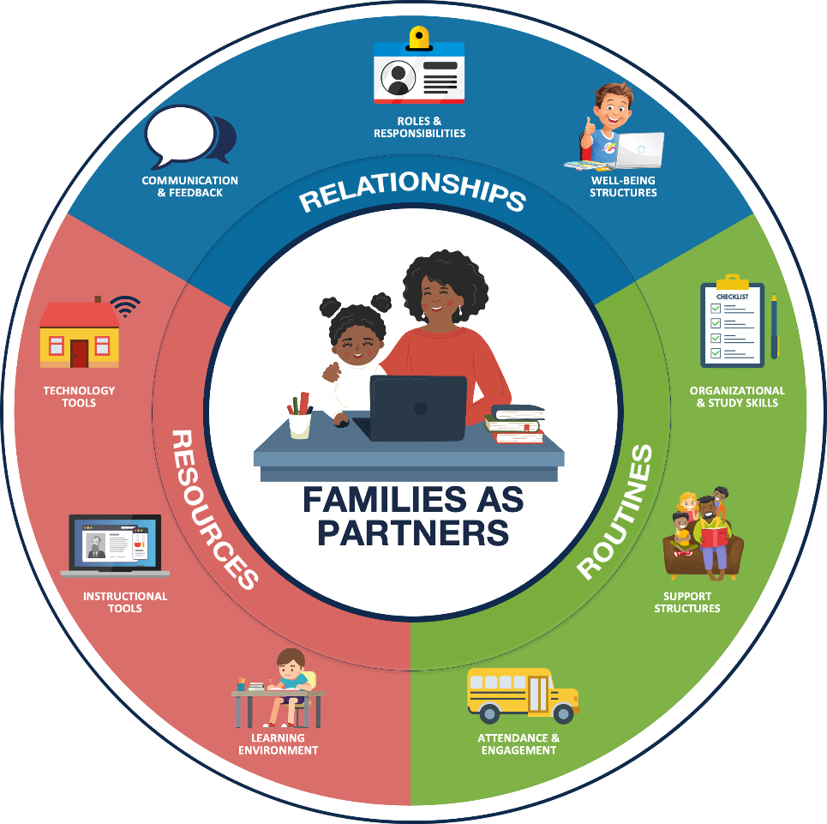
Foundation of partnership with families:
RELATIONSHIPS Positive connections that foster interaction and establish a nurturing environment of trust and support.
ROUTINES Rehearsed and predictable practices that provide structure to support efficient and effective learning.
RESOURCES Materials, Tools, and Supplies to support active learning and skill development.
Notes:
FOUNDATION OF PARTNERSHIP WITH FAMILIES: As teachers and leaders, we have always worked to develop and maintain positive experiences for students and families in our school buildings. We build relationships to foster positive connections and establish a nurturing environment of trust. We have routines in place that provide structure and support efficient and effective learning. Additionally, we ensure students have access to the materials, tools, and supplies needed to support active learning and skill development. Today we’ll look at how the pandemic has changed our approach - and as a result - how some of our newly adopted practices may change how we partner with families even after we return to fully in-person learning.

Slide 6
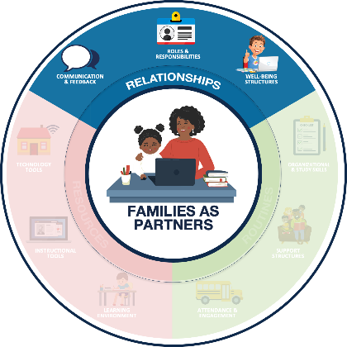
Relationships Positive connections that foster interaction and establish a nurturing environment of trust and support.
COMMUNICATION & FEEDBACK
ROLES & RESPONSIBILITIES
WELL-BEING STRUCTURES
Foster two-way communication (e.g., Minimize education jargon and use preferred communication channels)
Provide (actionable and regular) personalized information
Defining the team and the standard operating procedures
Managing expectations for all partners
Prioritize physical and emotional well-being
Promote Balance (e.g., allow breaks)
Notes:
RELATIONSHIPS:
Communications & Feedback: Fostering two way communication and personalizing information for families.
Roles & Responsibilities: Identifying the team and determining how you will work together to successfully manage expectations within the partnership.
Well-being Structures: Prioritization of physical and emotional well-being to promote balance.

Slide 7
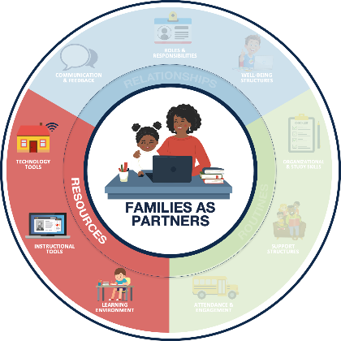
Resources Materials, Tools, and Supplies to support active learning and skill development.
LEARNING ENVIRONMENT
INSTRUCTIONAL TOOLS
TECHNOLOGY TOOLS
Dedicate a space for learning
Maintain an organized learning space
Leverage high-quality digital and print learning resources
Leverage consistent platforms across the district, when possible
Support access to devices and internet
Provide technology support resources and structures
Notes:
RESOURCES:
Learning Environment: A dedicated and organized space for learning.
Instructional Tools: Leveraging consistent platforms and high-quality digital and print resources.
Technology Tools: Access to devices, internet and technology support for these resources.

Slide 8
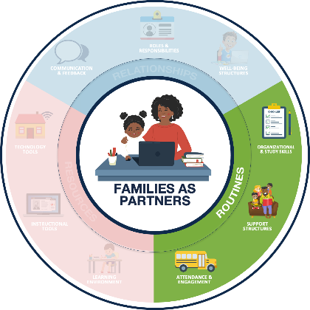
Routines Rehearsed and predictable practices that provide structure to support efficient and effective learning.
ORGANIZATIONAL & STUDY SKILLS
SUPPORT STRUCTURES
ATTENDANCE & ENGAGEMENT
Establish age-appropriate remote learning routines (e.g., setting weekly goals)
Encourage development of study skills (e.g., note taking templates)
Encourage students to reflect, identify needs, and seek help
Establish support routines (e.g., guardian learning office hours)
Foster regular communication about student attendance
Identify learning priorities and offer flexible structures (e.g., manageable and meaningful tasks)
Notes:
ROUTINES:
Organizational & Study Skills: Establishing learning routines and developing study skills.
Support Structures: Encouraging students to seek help when needed and establish routines to support those needs.
Attendance & Engagement: Fostering regular communication and flexible structures to promote student attendance and engagement.

Slide 9
How has COVID-19 impacted teaching and learning?
FAMILIES
EDUCATORS
LEADERS
The role of families in the learning process has shifted, putting new demands on parents and caregivers.
Parents, siblings, grandparents, daycare providers, and other partners are supporting learners while attending to other responsibilities.
Educators have taken on the challenge of shifting teaching and learning into remote formats.
Teachers are developing relationships, adjusting routines, and leveraging resources to support family partnerships and student learning.
Administrators have fostered the transition of traditional partnering practices into remote/hybrid learning environments.
Leaders are adjusting remote/hybrid learning plans based on feedback from educators and families.
Notes:
HOW COVID HAS IMPACTED FAMILIES, EDUCATORS, AND LEADERS:
FAMILIES: Parents, siblings, grandparents, daycare providers, and other partners are supporting learners while continuing to attend to other responsibilities. (i.e. balancing work, family needs, caring for multiple students at once, etc.)
EDUCATORS: Educators are developing relationships in new ways; adjusting routines and leveraging a variety of new resources to support the family and student learning partnerships.
LEADERS: Educational leaders are transitioning traditional effective partnering practices and adjusting plans based on feedback from educators and families.
*After setting the scene, you might consider a share out activity or even a brain break if you notice participants are wearing out. Checkout the engaging strategies and brain break ideas in the SEL Playbook from CASEL (https://schoolguide.casel.org/uploads/2018/12/CASEL_SEL-3-Signature-Practices-Playbook-V3.pdf)

Slide 10
Let’s dive in
How to use the families as partners resources
Notes:
The remainder of this training is going to focus on resources available to reflect of successful practices to support families as partners in remote and hybrid learning environments during the pandemic and plan for the 21-22 school year.
*Ensure participants have access to the website, printed or electronic versions of the slide deck and spreadsheets

Slide 11
Session 5: Celebrations (Format: Printable)
https://www.eteachny.org/families-as-partners/
Notes:
The first spreadsheet resource is the Session 5: Celebrations (Format: Printable). In the spreadsheet you will find a column providing a link to a printable story of successful strategies to partner with families in a remote or hybrid learning environment, a description of the article’s content, and which areas of family partnership the celebratory article best aligns to.

Slide 12
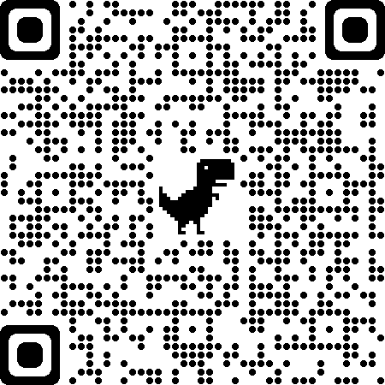
Get Outdoors! (NJ)
Successful Strategy to Celebrate
Learning Outside (Various Ideas)
Notes:
Use the QR code on this slide to view the article described in the title. Also, the area of partnership this article aligns to is highlighted.
URL: https://www.jerseyshoreonline.com/southern-ocean/beach-haven-school-recognized-as-back-to-school-success-story/

Slide 13
Volunteerism (NY)
Successful Strategy to Celebrate
College Students Help Out
Notes:
Use the QR code on this slide to view the article described in the title. Also, the area of partnership this article aligns to is highlighted.
URL: https://www.binghamton.edu/news/story/2370/binghamton-university-students-continue-to-teach-mentor-during-covid-19-crisis

Slide 14
Drones Deliver Internet (WI)
Successful Strategy to Celebrate
Internet Access for All
Notes:
Use the QR code on this slide to view the article described in the title. Also, the area of partnership this article aligns to is highlighted.
URL: https://www.techlearning.com/news/how-schools-use-drones-to-deliver-internet-to-students

Slide 15
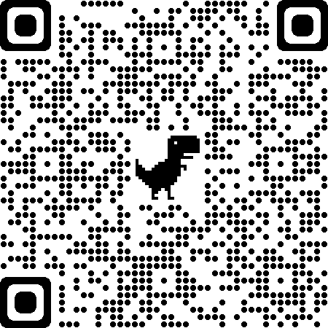
Fighting Absenteeism (CT)
Successful Strategy to Celebrate
Attendance Incentives
Notes:
Use the QR code on this slide to view the article described in the title. Also, the area of partnership this article aligns to is highlighted.
URL: https://www.courant.com/community/hartford/hc-news-hartford-attendance-20210329-kamjx63nzbcbzhgwjsplm5rkq4-story.html

Slide 16
Closing the Digital Divide (NY)
Successful Strategy to Celebrate
Internet Access for Students
Notes:
Use the QR code on this slide to view the article described in the title. Also, the area of partnership this article aligns to is highlighted.
URL: https://www.governor.ny.gov/news/governor-cuomo-announces-launch-connected-ny-fund-provide-no-cost-internet-access-50000

Slide 17
Virtual Learning Success (VA)
Successful Strategy to Celebrate
Flexible Scheduling
Notes:
Use the QR code on this slide to view the article described in the title. Also, the area of partnership this article aligns to is highlighted.
URL: https://dailyprogress.com/community/greenenews/lifestyles/virtual-learning-successful-for-some-students-parents/article_0f6f3536-8cb5-11eb-aadf-8f07e3e21ab0.html

Slide 18
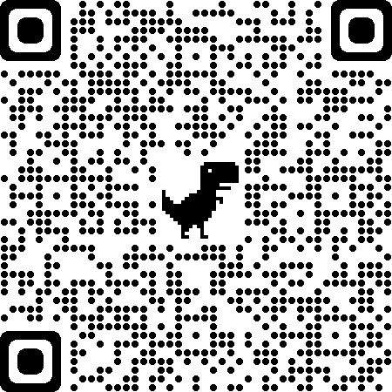
Let’s Get Ready (MN)
Successful Strategy to Celebrate
Virtual College/Career Readiness Week
Notes:
Use the QR code on this slide to view the article described in the title. Also, the area of partnership this article aligns to is highlighted.
URL: https://m.startribune.com/minneapolis-schools-offer-week-of-virtual-events-about-career-college-options/600040800/?clmob=y&c=n

Slide 19
Treehouse Teaching, Biking, and Laundry Art (DC)
Successful Strategy to Celebrate
Variety of Creative Ideas
Notes:
Use the QR code on this slide to view the article described in the title. Also, the area of partnership this article aligns to is highlighted.
URL: https://www.washingtonpost.com/local/education/creative-pandemic-teaching/2021/01/02/d96a1e92-3bdd-11eb-bc68-96af0daae728_story.html

Slide 20
Just a Little Innovation (CA)
Successful Strategy to Celebrate
Creative Ways to Engage Students (Various Ideas)
Notes:
Use the QR code on this slide to view the article described in the title. Also, the area of partnership this article aligns to is highlighted.
URL: https://www.sandiegouniontribune.com/news/education/story/2020-05-31/remote-distance-learning-digital-education-covid-19-coronavirus

Slide 21
The Big 10 (IL)
Successful Strategy to Celebrate
Engaging Educators (Various Ideas)
Notes:
Use the QR code on this slide to view the article described in the title. Also, the area of partnership this article aligns to is highlighted.
URL: https://www.news-gazette.com/coronavirus/big-10-creative-touches-to-teaching-during-a-pandemic/article_77f900bb-9566-55fc-996b-f2ad8f1bd3f6.html
*Use this slide as a template and add your own celebration stories relevant to your local area.

Slide 22
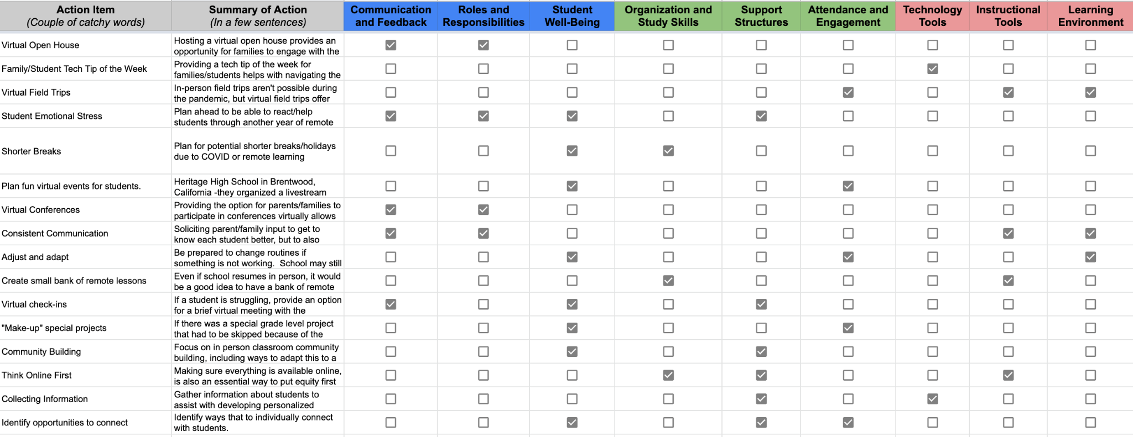
Session 5: A Starting Point for Educator New School Year Planning
https://www.eteachny.org/families-as-partners/
Notes:
The second spreadsheet resource is the Session 5: A Starting Point for Educator New School Year Planning. In the spreadsheet you will find a column providing an action item idea, a summary of the possible planning to consider as the school year begins, and which families and partners category the planning activity best aligns too. Use this spreadsheet as a jumping off point for conversation and planning. Try a reflective exercise on the next slide to help facilitate conversations.

Slide 23
Session 5: Ideas for Reflective Practice (Part 2)
https://www.eteachny.org/families-as-partners/
Notes:
The third spreadsheet resource is the Session 5: Ideas for Reflective Practice (Part 2). In the spreadsheet you will find a column with a link to a reflective practice item (Website/printable/etc.) and a description of what the activity entails.

Slide 24
We do not learn from experience...we learn from reflecting on experience.
John Dewey
Notes:
Insert this slide as a reflective transition or conversation starter

Slide 25
Growth goals are a key element to becoming a reflective teacher.
Robert Marzano
Notes:
Insert this slide as a reflective transition or conversation starter

Slide 26
Without reflection, we go blindly on our way, creating more unintended consequences, and failing to achieve anything useful.
Margaret J. Wheatley, 2002
Notes:
Insert this slide as a reflective transition or conversation starter

Slide 27
Example Implementation: How to use these spreadsheets together (1)
Is there a topic or section of family partnerships that you want to improve on or plan for? Routines *Reflection Activity Template
Notes:
This slide is an example of how all of these spreadsheet resources work together. First, when you plan for a PD session, you could look at the Reflective Practices Spreadsheet and read some articles to get new ideas for facilitating a reflective session. In this example, I really like the idea of a group talk template to reflect. In this example, I am pretending to be an educator, who when I reflected with a group of participants, I realized that I really want to help my student be more settled in their routines in the 21-22 school year.
This is just one of the countless scenarios that might play out as participants interact with these spreadsheets and plan for the 21-22 school year.

Slide 28
Example Implementation: How to use these spreadsheets together (2)
Is there a topic or section of family partnerships that you want to improve on or plan for? Routines *Reflection Activity Template
Find a celebration or successful strategy that speaks to you Big 10: Virtual Open House/Back-to-School Night
Notes:
This slide is an example of how all of these spreadsheet resources work together. Next, I can check out the celebration videos spreadsheet of successful strategies and the article with lots of different ideas from Illinois was interesting to me. I liked the idea shared about a virtual open house or back-to-school night. As a classroom teacher, I don’t get to make the decision on whether this happens or not, but it got my mind thinking about possibilities in 21-21.
This is just one of the countless scenarios that might play out as participants interact with these spreadsheets and plan for the 21-22 school year.

Slide 29
Example Implementation: How to use these spreadsheets together (3)
Is there a topic or section of family partnerships that you want to improve on or plan for? Routines *Reflection Activity Template
Find a celebration or successful strategy that speaks to you Big 10: Virtual Open House/Back-to-School Night
Are there other elements of your selected family partnership focus that you might plan for? Tech tip of the week
Notes:
This slide is an example of how all of these spreadsheet resources work together. I can keep on searching for planning ideas and check out the Starting Point for Educator New School Year Spreadsheet. When I look at this spreadsheet, saw the idea to think about doing a weekly technology tip for families. I am not interested in sharing tech tips, but I could combine the idea of virtual communication with parents and a weekly tip and instead plan to create weekly videos to send how to families with routine tips to help keep students and families organized with the changing learning environments, schedules, and structures.
This is just one of the countless scenarios that might play out as participants interact with these spreadsheets and get ready over the summer for the coming school year.

Slide 30
Additional resources
Additional resources to support the development of positive partnerships with families and other remote learning priorities can be found online at eTeachny.org.
Shifting to Teaching Online
Families as Partners
Students With Disabilities
English Language and Multilingual Learners
Culturally-Responsive Education
Social Emotional Learning
Notes:
If you are looking for more resources related to families as partners or any of the other 5 categories of support, please go to https://www.eteachny.org/ to access countless resources to support educators during the transition to remote and hybrid learning environments.

Slide 31
Questions?
Notes:
This concludes Families as Partners: Training Session 5. Questions?
*Consider ending using an optimistic closure from the SEL Playbook (https://schoolguide.casel.org/uploads/2018/12/CASEL_SEL-3-Signature-Practices-Playbook-V3.pdf).

