Slide 1
Welcome
As you arrive:
Prepare any materials that support your learning.
Introduce yourself in the Zoom Chat
Provide your name
School or organization representing, and role.
Notes:
Provide time for participants to gather materials they might need for the learning.
Suggestion: Use the chat function to have participants sign in indicating their name, position/role, and what educational organization they are representing.

Slide 2
Creating a Professional Learning Culture Based on SEL
2

Slide 3
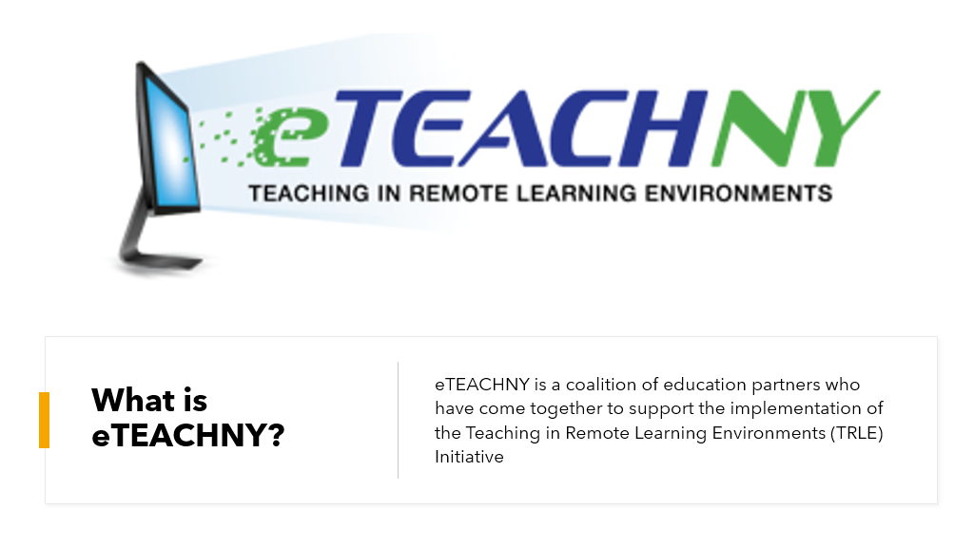
What is eTeachNY?
3

Slide 4
NYSED was awarded a grant to implement a Teaching in Remote/Hybrid Learning Environments (TRLE) initiative. Six applicants were selected to develop resources to support the TRLE initiative.
Coalition Partners
Areas of Focus
Broome-Tioga BOCES
Eastern Suffolk BOCES
Monroe2-Orleans BOCES
WSWHE BOCES
Greater Southern Tier BOCES
Students with Disabilities
Families as Partners
Culturally Responsive Education
English Language/Multiple Language Learners
Shifting to Online learning
Social Emotional Learning (SEL)
4

Slide 5
Responsibilities:
Develop and curate resources with coalition partners
Deliver turnkey trainings
Trainings will be recorded
Follow up email after training:
Training resources
Exit reflection
Links to eTeachNY website and social media

Slide 6
Your Role
Schedule and publicize trainings
Must be open to all NYS teachers at no cost
Collect registration data
Teacher’s name, distict, grade level/content area
Issue CTLE credits
Distribute reflection survey following each training

Slide 7
Norms: General best practices of all productive groups
We agree...
To proactively see and consider diverse voices, ideas, and perspectives
Pausing, Paraphrasing, Asking Questions, Listening
To embrace a mindset that promotes my own and other’s learning
Be Present, Listen, Put Ideas on the table, Presume Positive Intentions
To see opportunities to show gratitude and celebrate with colleagues
Be Present, Presume Positive Intentions, Ask Questions, Offer Support, Thank One Another
Notes:
Establishing norms for online learning experiences reinforces different behaviors, but also can improve the virtual meeting by providing participants with anticipated processes.
Norms can be written to reflect the needs and dynamics of the group.
Suggestion: If using Zoom or an online platform that includes a polling feature, participants can vote on which norms they agree. This allows participants to have voice and choice in the selection of norms for interaction.
The norms written for this slide are more specifically crafted for an audience of professional developers, and suggest strategies to assist participants in adhering to the norms for interaction.

Slide 8
Long term Learning Target
To build the capacity of teachers and educational leaders to effectively integrate SEL in remote leaning environments for all students.
Notes:
Review of the long term learning target related to the TRLE Grant work and Social Emotional Learning (SEL)
Facilitator's Pause Point: The learning target indicates for “all students”, and the language is specifically designed for inclusivity. Consider linking to the Culturally Responsive-Sustaining (CR-S) Education Framework. “The framework was designed to support education stakeholders in developing and implementing policies that educate all students effectively and equitably, as well as provide appropriate support and services to promote positive student outcomes.”
The 4 principles of CR-S Education are supported in this presentation…
Welcoming and affirming environment
High expectations and rigorous instruction
Inclusive curriculum and assessment
Ongoing professional learning

Slide 9
e-Learning Series
Session # | Topic | Date
1 | Introduction to SEL | 2/11/21
2 | Embedding SEL Schoolwide | 3/18/21
3 | Creating a PL Culture Based on SEL | 4/22/21
4 | Integrating SEL into a Culturally Responsive Classroom | 5/13/21
5 | Identifying and Selecting Evidence Based SEL Programs | 6/22/21
6 | Classroom-based SEL Activities to Support Student Development of the 5 Core Competencies | 7/26/2
This resource was adapted from SEL Online Education Modules developed by the Office of Superintendent of Public Instruction. Access the original work on the OSPI Student Support website: . https://learn.ospi.k12.wa.us/
Additional resources sourced from CASEL: https://casel.org
Notes:
Outline of the session in this e-Learning Series with representation of resources and contributing partners.
Note: The original module materials are from the Washington office of Superintendent of Public Instruction - https://learn.ospi.k12.wa.us/

Slide 10
Objective 1
Examine how we as adults recognize our own social awareness including; the abilities to understand the perspectives of and empathize with others, including those from diverse backgrounds, cultures, and contexts.
Notes:
The focus of the first objective is on adult’s recognizing their own social awareness as they move towards understanding perspectives from others to increase empathy and include others from diverse backgrounds, cultures, and contexts.

Slide 11
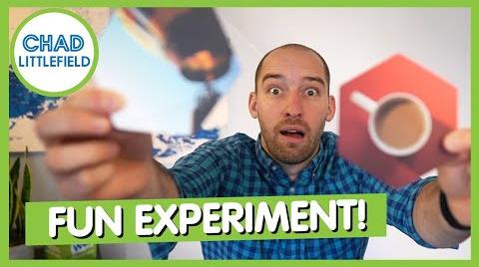
What’s Your Memory or Story?
Notes:
Start video - How to Engage a Virtual Team - at the 2 minute mark. The video will explain how the activity will run.
Facilitator’s Pause Point - Be ready to pause the video as participants unmute to share their story or memory that a picture elicits. Encourage participants to participate at their own comfort level. Asynchronous - thoughts on how this could be done

Slide 12
Quote
Every memory makes me who I am right now, in this moment. Good or bad, all experiences shape you.
~ L.H. Cosway
Notes:
We all have different memories or experiences that shape our beliefs, values and perceptions. As we look at school culture and climate it is important to take a closer look at the shared beliefs, values and perceptions that we have.

Slide 13
Trusted 10 Activity-Step 1
Topic
Talking Points
Define “cultural humility”
Understanding that everyone has implicit bias
Other’s stories may be first (what were created our background from - movies, books, experiences)
But we need to realize we are more than one story
Importance of exposure to different perspectives
Everyone is vulnerable to implicit bias
For me, the gift of “cultural humility” is that I no longer carry the burden of feeling that I have to know everything about every culture that I may encounter in my work.
Fear about not knowing enough doesn’t need to impact my confidence and approach to someone from another culture. Cultural humility also invites me to check my assumptions (sometimes an outgrowth of knowledge) at the door.
Rather, I can approach each relationship as a learner, open in my own spirit and inviting the individual to teach me.
Becoming a learner in a helping relationship might even level the power imbalance a bit, empowering others to help me to understand the richness of her culture.
In becoming a learner, I can see the individual, setting aside assumptions about her culture in order to encounter her unique experience. Even if I am encountering a culture that is completely unfamiliar to me, I may effectively enter into relationship by bringing a humble spirit, a self reflective posture, and a high value for the experience of other.
So, can we be culturally humble without being culturally competent? (good reflective question) - The answer is yes, which may open doors to other cultures and perspectives so we can build the competence
SEL Signature Practice - Engaging Strategies

Slide 14
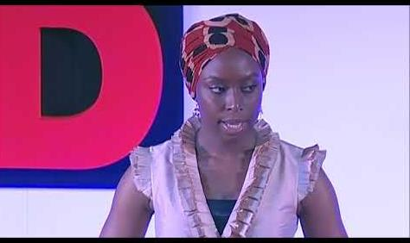
Trusted 10 Activity-Step 2
Three tenants of cultural humility and change.
There are 3 tenets that guide the thinking, behavior and actions of individuals and institutions influencing interpersonal relationships as well as systems change.
These principles are:
1. Lifelong learning and critical self-reflection
2. Recognize and change power imbalances
3. Institutional accountability
Critical Self-Reflection (First Tenant of Cultural Humility) - Ted Talk video –
Acknowledging that It’s ok that we don’t know everything, but we must still have an interest in learning (to break down the impact of our first story)
Notes:
https://youtu.be/sDd-MZTCbz4

Slide 15
Trusted 10 Activity-Step 3
The Trusted 10
The Trusted Ten exercise helps to unveil some of the ways in which we are likely learning through close contacts or perhaps not. How would making your trusted ten a more diverse group serve to support a practice of cultural humility?
It’s OK if they can’t think of 10 people.
Now ask them to add the following column headers across the table
First Name/Initials
Gender
Race/Ethnicity
Age
SexualOrientation
Education Disability Y or N?
Marital Status
Ask participants fill out the boxes for each person’s name and to notice what they notice as they go through the process.
Now have participants discuss in small groups what they notice about the characteristics of their trusted ten.
Bring the groups back and start a larger discussion
Discussion points: For many people, their trusted ten may look the same. This is because we are naturally and unconsciously drawn to other people like ourselves. We meet new people all of the time, but an extremely small number of them actually make it into our “inner circle.”

Slide 16
Trusted 10 Activity-Step 4
Tenants 2 and 3
2. Changing Power Imbalances
3. Institutional Accountability
2. Changing Power Imbalances
Reinforcing loop (positive things that would be a result of change) vs.
Balancing loop (negative things that hold initiatives from moving forward
If we don’t have a diverse Trusted Ten and we deal with a Balancing Loops, thus resulting in no change in power
3. Institutional Accountability
Institutional barriers - Time and money, number of people, lack of impact on one's self, lack of awareness, mandates
Institutional growth - unlimited resources, job satisfaction, ripple effect across all domains, sense of belonging,
hope, increased achievement, decreased behavior, build awareness of one’s self
Notes:
The video will be shared as a resource, not actually played in our session.

Slide 17
SEL Signature Practice - Engaging Strategies 1
Participants are placed in breakout rooms to examine -
A highlight - an aspect of their learning that was positive
A low light - an aspect of their learning that was a challenge or something they struggled with
An insight - a takeaway moment or an “a-ha”.
Notes:
Participants are placed in breakout rooms to examine -
A highlight - an aspect of their learning that was positive
A low light - an aspect of their learning that was a challenge or something they struggled
with
An insight - a takeaway moment or an “a-ha”.
Facilitator’s Pause Point - It is suggested to use smaller breakout rooms to afford participants with a more comfortable and intimate grouping to encourage their open reflection. Again, participants participate at their comfort level. Suggested time for reflection be more than 5 minutes to allow for all participants to have adequate time to share and to allow conversations to end naturally rather than abruptly as the breakout room closes.

Slide 18
Objective 2
Define transformative SEL, and apply transformative SEL to promote and leverage equity.
Notes:
This objective focuses on the recent (December 2020) changes CASEL has made to the definition of SEL and how there is now a focus or lens of equity. The new direction of transformative SEL as a way to promote and leverage equity.

Slide 19
Niemi: CASEL Is Updating the Most Widely Recognized Definition of Social-Emotional Learning. Here’s Why
CASEL’s Definition of SEL (2020 Update):
“Social and emotional learning (SEL) is an integral part of education and human development. SEL is the process through which all young people and adults acquire and apply the knowledge, skills and attitudes to develop healthy identities, manage emotions and achieve personal and collective goals, feel and show empathy for others, establish and maintain supportive relationships, and make responsible and caring decisions.
SEL advances educational equity and excellence through authentic school-family-community partnerships to establish learning environments and experiences that feature trusting and collaborative relationships, rigorous and meaningful curriculum and instruction, and ongoing evaluation. SEL can help address various forms of inequity and empower young people and adults to co-create thriving schools and contribute to safe, healthy, and just communities.”
Notes:
Summative statements from the article:
CASEL will be explicit about how SEL can advance educational equity and excellence
CASEL will work alongside researchers, educators and policymakers to address issues of identity, agency and belonging that are fundamental to human development
CASEL will continue emphasizing how environments, relationships and broader contexts shape learning and development
CASEL will support schools, districts and states to infuse SEL systemically into curriculum and instruction, out-of-school time, discipline, student support services, professional learning and ongoing assessment for continuous improvement
Resource - Article - Niemi: CASEL is Updating the Most Widely Recognized Definition of Social-Emotional Learning. Here’s Why - The CEO of CASEL, Karen Niemi, reviews why CASEL has updated the SEL definition and their commitment to “SEL affirms the identities, strengths and experiences of all children, including those who have been marginalized in our education systems.”

Slide 20
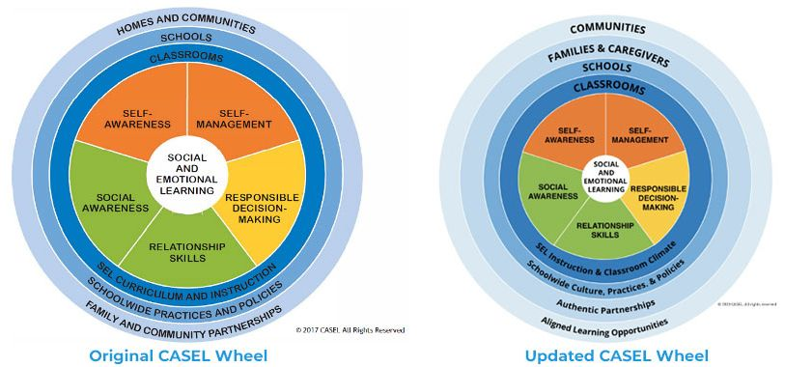
Original CASEL Wheel vs Updated CASEL Wheel
These competencies can also support students and adults in building more meaningful relationships where they can critically examine and interrupt inequitable policies and practices in their schools or districts, analyze social problems in the broader community, and work together to co-create solutions and take collective action...SEL competencies can cultivate change agents and leaders who will meaningfully contribute to their communities and the world.

Slide 21
Break 1
SEL Signature Practice - Brain Break

Slide 22
Simply put, to be effective equity-centered educators, we cannot be emotionally intelligent without being culturally responsive.
Simmons, Dena. Why SEL Alone Isn’t Enough. Educational Leadership. March 2021.

Slide 23
Transformative SEL
...a process where by young people and adults build strong, respectful, and lasting relationships that facilitate co-learning to critically examine root causes of inequity, and to develop collaborative solutions that lead to personal, community, and societal well-being.

Slide 24
Deepening the definition of the 5 SEL Core Competencies to support equity and collective well-being.
SEL Competency | Example
Self-Awareness | Personal and sociocultural identities, recognition and beliefs, mindsets & biases
Self-Management | Stress management, self-care, perseverance, agency
Social Awareness | Perspective-taking, empathy, belonging
Relationship Skills | Collaborative problem solving, co-construction, effective interpersonal communication.
Responsible decision making | Ethical responsibility, distributive justice, collective well-being
CASEL Webinar Series: SEL as a Lever for Equity and Social Justice
https://www.youtube.com/watch?v=UPWrnBA2274&list=PLM3PYurzmKsBDCoQ-eoqL9ODbppZ-3kbA

Slide 25
SEL Signature Practice - Engaging Strategies 2
Deeper Reflective Dive into Core Competencies through the Equity Lens - Activity
Review the CASEL Core Competency using the CASEL Interactive SEL Framework.
Examine the Core Competency and its relation to the rings (settings) and the examples provided.
Read the reflection questions and consider what the responses could be from the districts or teachers you are supporting.
If you feel that you would like to have a deeper understanding of the Core Competency, consider watching the PBS video that is offered as a resource, and the CASEL Personal SEL Reflection.
Returning to the main room and share 1 or 2 major takeaways.
Notes:
Asynchronous activity.
Facilitator’s Pause Point: This activity can also be done in an breakout room. However, there is a fair amount of content and so allow for enough exploration and processing time.

Slide 26
Core features of Transformative SEL include:
Authentic partnering among students and adults with a deep focus on sharing power and decision-making between young people, educators, families and communities.
Academic content that integrates issues of race, class, and culture.
Prioritizing students’ individual and collective agency to take action for social justice.
Focus on creating belonging and engagement for all individuals.
Enhancing and foregrounding social and emotional competencies needed for civic engagement and social change, such as reflecting on personal and social identities, examining prejudices, and biases, interrogating social norms, disrupting and resisting inequities, and co-constructing equitable and just solutions.
Instruction that honors and makes connections to students’ lived experiences and identities, and scaffolds learning to build an understanding of others’ lived experiences.
Notes:
Identify 1 that you feel your curriculum/instruction already meets and then share an example.
What unique challenges are presented in the hybrid or virtual learning environment? Which one is harder or easier?

Slide 27
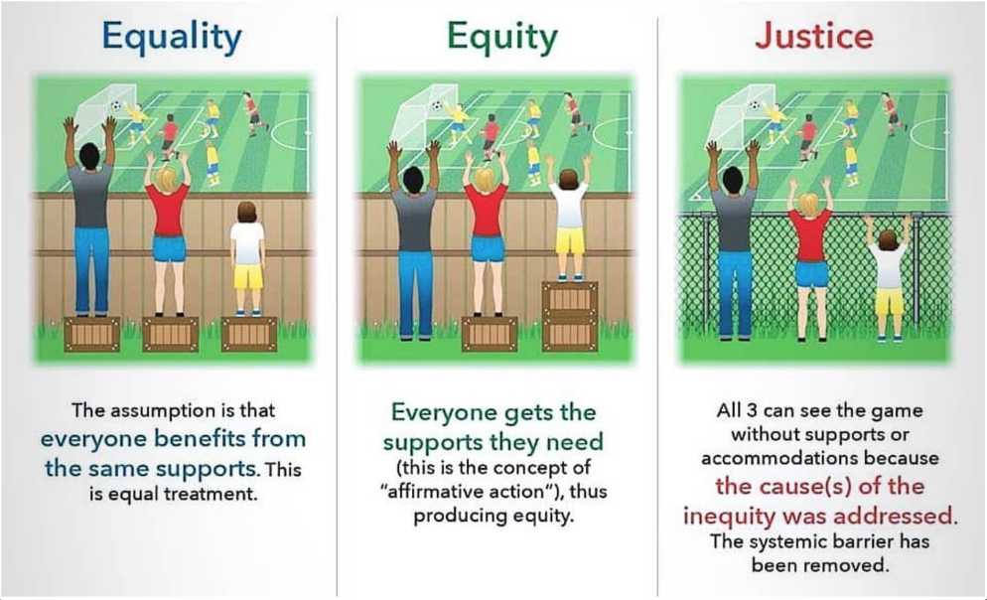
Equality, Equity, Justice
Notes:
In the first two images the fence represents structural or systemic inequity. Without the wooden fence, the cause of the inequity is addressed, and the systemic barrier is removed.
Possible open discussion with participants regarding what they observe or perceive as systemic inequities (wooden fences).

Slide 28
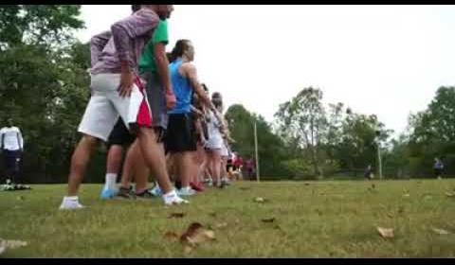
Race, Equality, Equity
3:30
Video
Notes:
Resources - Video - Race, equality, equity (3 minutes, 29 seconds)
Breakout Room Protocol - to be used for after the video - SRI Equity First Debriefing for Equity
Facilitator's Pause Point: The purpose of the protocol is to assist with framing the discussion about the content and participant observations and equity related to student success.
This protocol is lengthy and it is suggested to commit the time to the discussion in the hopes of having in-depth dialogue.
For Facilitator Reflection:
How did you support the group’s learning around educational equity and excellence?
What did you do to help the group make continued progress around the SRI mission?
What might you do next time to illuminate/surface/raise up an explicit connection to equity?
What are the assumptions and beliefs you carry that keep us from learning to facilitate for equity? What gets in your way?

Slide 29
Debriefing for Equity Protocol
Review protocol with participants
Provide time in breakout rooms for participants to go through the protocol and encourage meaningful discussions.
SEL Signature Practice - Engaging Strategies
Debriefing for Equity

Slide 30
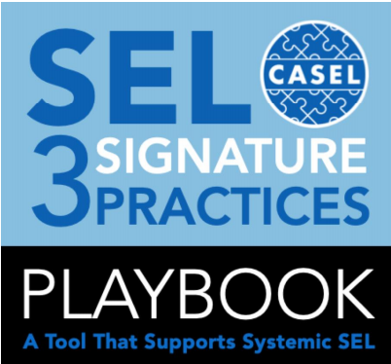
SEL 3 Signature Practices
When the SEL 3 Signature Practices are effectively implemented as part of a comprehensive SEL plan, they promote these essential elements of an equitable learning and working environment:
Equity of voice: All participants are encouraged to speak and are respectfully heard.
Inclusion: All degrees of participation are welcomed and acknowledged.
Collectivism: All engage in and contribute to a “for the good of the group” experience.

Slide 31
Continued exploration....

Slide 32
Break 2
SEL Signature Practice - Brain Break

Slide 33
Essential Question
What role does the individual play in deepening their adult SEL skills, like self-awareness or social awareness, to promote and maintain a healthier culture and climate, and overall professional learning community?

Slide 34
Objective 3
Identify the importance of adults’ social and emotional competencies for their work with students and their own well-being, and in relation to district SEL implementation.
Notes:
The third focus objective is to identify the importance or the ‘why’ of adult social and emotional competencies. Adult SEL is a cornerstone of SEL district implementation. Adults developing their skills in the core competencies means that they will be better positioned to support the growth and development of students in the core competencies. Adult self-care is a public service and is not selfish, but is showing up for the greater good.

Slide 35
The WHY of self-care?
Using the Jamboard provide a visual or quote that reflects a why for self-care from an educational expert/author/researcher..
Self-care includes anything you do to keep yourself healthy - physically, mentally, and spiritually.
Brené Brown cites masses of research that shows the importance of self-care, including allowing ourselves to experience our feelings of vulnerability and shame.
Mindfulness experts suggest that we can feel better if we just take 10 minutes a day to practice self-kindness.
SEL Signature Practice - Engaging Strategies
Notes:
Activity: Jamboard. Do a Gallery Walk. Use Brene Brown as the example.
Self-care includes anything you do to keep yourself healthy – physically, mentally and spiritually. Brené Brown cites masses of research that shows the importance of self-care, including allowing ourselves to experience our feelings of vulnerability without shame. And yes, she says, feeling vulnerable is part of caring for yourself. And mindfulness experts suggest that we can feel better if we just take 10 minutes a day to practice self-kindness.

Slide 36
Teacher Self-Care
Notes:
Video- 2:50 minutes

Slide 37
Onward by Elena Aguilar
Self-Care
Self-care includes all the things you do to take care of your well-being in four key dimensions
Emotional health - to love, care and be in relationship with yourself and others
Physical health - to live, move, and breathe
Psychological health - to learn, think, and grow
Spiritual health - to connect with purpose and meaning

Slide 38
4 Reasons Why We Don’t Take Care of Ourselves:
We are missing information. Sometimes we hear new information about exercise or sleep and it catapults us into a behavior change.
We don’t know how. We want to eat better, but where do we start?
We don’t really think we need to take care of ourselves. We get by on minimal sleep, we can teach with a cold. We figure we can rest later.
We don’t feel we deserve to take care of ourselves. We don’t say no to anyone. We take on too much work and overcommit.
Onward by Elena Aguilar page 150

Slide 39
Adult SEL District Program Implementation and Rubric Review
Directions:
Take 7 minutes and complete the rubric review for your district to identify where you currently are in district Adult SEL Implementation
Reflect on what your school is already doing to support Adult SEL, and what next steps might be.
SEL Signature Practice - Engaging Strategies
Notes:
CASEL Adult Rubric - https://schoolguide.casel.org/rubric/?focus-area=focus-area-2&rubric-item=professional-learning
Resource for activity:https://schoolguide.casel.org/rubric/
Participants will complete the rubric review for their district to identify where they currently are in district Adult SEL Implementation. Participants will reflect on what their school is already doing to support Adult SEL, and what next steps might be.

Slide 40
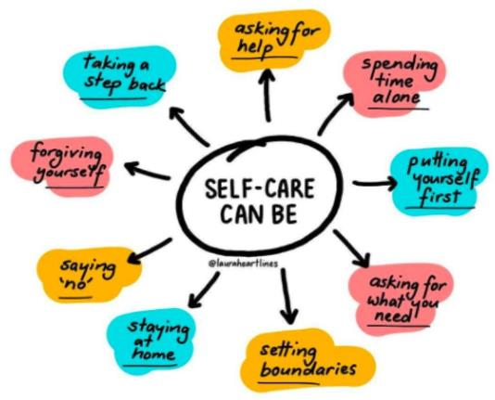
Self-Care Strategies and Ideas
https://www.virusanxiety.com/take-care
https://socialwork.buffalo.edu/resources/self-care-starter-kit/self-care-assessments-exercises/exercises-and-activities.html
Notes:
https://www.virusanxiety.com/take-care
https://socialwork.buffalo.edu/resources/self-care-starter-kit/self-care-assessments-exercises/exercises-and-activities.html

Slide 41
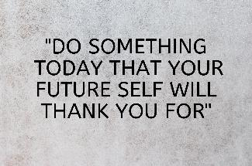
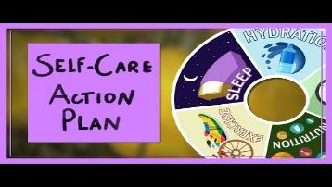
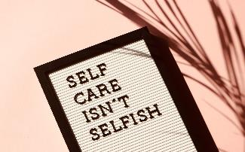
CHOICE BOARD of SELF CARE - Personal Wellness Choice Board
Directions: Choose to complete one of the following self-care activities
Write a letter to your future self
Watch a video on planning self-care
Explore and decide which one of the 22 mindfulness activities you will incorporate into your daily routine.
Complete the Self-Care Assessment Worksheet
Explore the following articles on prioritizing teacher self care... Healthy Schools Start with Healthy Adults: Strategies to Support Educator Wellness
5 Strategies for Teacher Self-Care – ASCD Reflect on one of the following questions through journaling…
What is one action of self-care I have taken recently?
In what ways does teacher self-care impact the culture and climate of my classroom and my school?
Notes:
Facilitator’s Pause Point: This choice board includes several activities participants can do to continue exploring the topic of self-care or to practice self care.
The link to the Personal Wellness Choice Board is to a slide deck with 6 additional choice boards related to personal wellness and self-care.
Resources for Activities:
Write a letter to your future self - https://www.futureme.org/
A Self Care Action Plan - https://youtu.be/w0iVTQS8ftg
22 Mindfulness Activities - https://positivepsychology.com/mindfulness-exercises-techniques-activities/
Complete the Self-Care Assessment Worksheet - https://www.mentoring.org/wp-content/uploads/2020/03/MARCH_2015_Self_Care_Assessment.pdf
Articles on Self-Care -https://portal.ct.gov/-/media/SDE/COVID-19/CSDE_Healthy_Adults_Healthy_Schools.pdf
http://www.ascd.org/ascd-express/vol15/num13/5-strategies-for-teacher-self-care.aspx

Slide 42
Waterfall Chat
What is one (new) way you practice self-care?
The “waterfall” strategy is when the teacher poses a question, and students type their answer in the chat, but they do not submit their answer until the teacher prompts everyone to hit enter at the same time, resulting in a cascade of answers in the chat.
SEL Signature Practice - Engaging Strategies
Notes:
Wrap-up self-care with this.

Slide 43
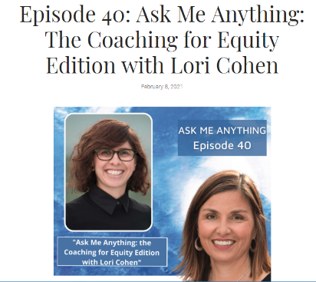
Continue to explore through Podcasts….

Slide 44
Anthem - Optimistic Closure I will… or I believe...
SEL Signature Practice - Optimistic Closure

Slide 45
Questions?
45

