Slide 1
FAMILIES AS PARTNERS
RESEARCH-BASED BEST PRACTICES THAT SUPPORT FAMILY PARTNERSHIPS
SESSION 3
Notes:
Families as Partners: Training Session 3 (2b)
*Take a moment to introduce yourself, and if you want, have the group introduce themselves as well. Consider using a warm welcome and an activity from the SEL Playbook (https://schoolguide.casel.org/uploads/2018/12/CASEL_SEL-3-Signature-Practices-Playbook-V3.pdf).

Slide 2
Families as Partners Sessions
Session One: Families as Partners Overview
Session Two (2A) and Three (2B): Deeper Dive Into Partnerships
Session Four (3A) and Five (3B): Celebrating Successful Partnerships
Notes:
Provide an overview of upcoming sessions:
Session One: Families as Partners Overview
Session Two (2A) and Three (2B): Deeper Dive Into Support Structures
Session Four (3A) and Five (3B): Celebrating Successful Partnerships
Please note that Session 3 builds on Session 2, each diving deeper into best practices for supporting families as partners

Slide 3
Today’s objectives
Identify attributes of positive relationships, routines, and resources with families as partners
Discuss strategies to support relationships, routines, and resources with families as partners.
Share action steps to enhance relationships, routines, and resources with families as partners.
Notes:
Provide an overview of session objectives:
Identify attributes of positive relationships, routines, and resources with families as partners
Discuss strategies to support relationships, routines, and resources with families as partners.
Share action steps to enhance relationships, routines, and resources with families as partners.

Slide 4
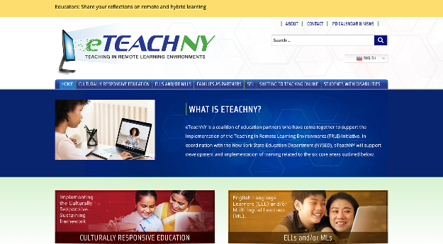
Materials needed
Access to the eTEACHNY Website
Families as Partners Slide Deck
Notes:
For today’s training, you will need a copy of this slide deck to guide conversations.
You’ll also want to visit eTEACHNY website - https://www.eteachny.org/. All of the resources shared today, plus future resources and resources from the other 5 areas of focus can be found on this website. You will want it in an easy place to return to and use.
Participants will benefit from having a printed or electronic version of the Session 3 Resource Outline.

Slide 5
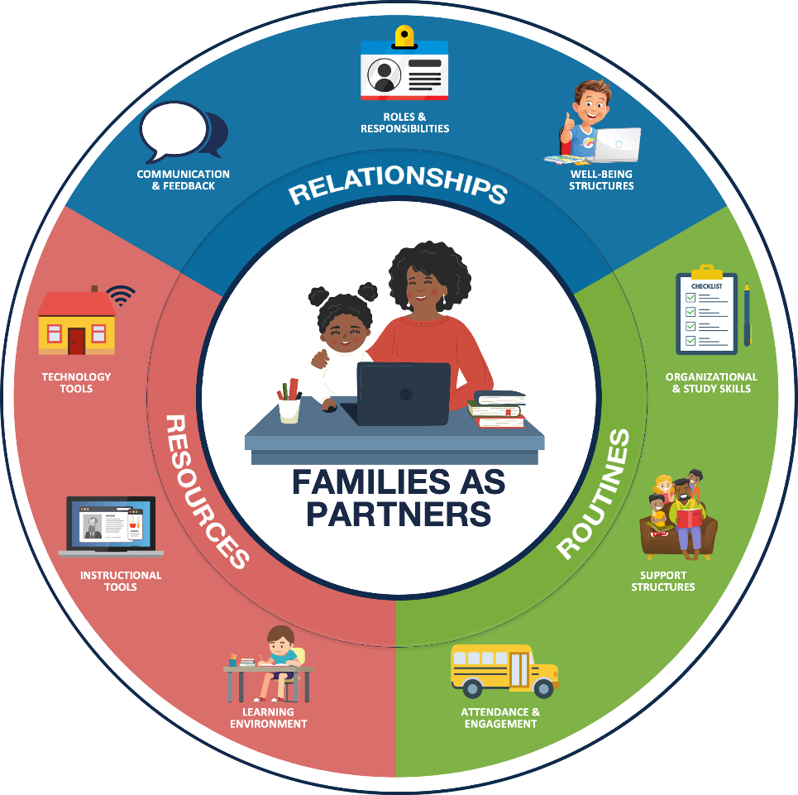
Foundation of partnership with families:
RELATIONSHIPS Positive connections that foster interaction and establish a nurturing environment of trust and support.
ROUTINES Rehearsed and predictable practices that provide structure to support efficient and effective learning.
RESOURCES Materials, Tools, and Supplies to support active learning and skill development.
Notes:
FOUNDATION OF PARTNERSHIP WITH FAMILIES: As teachers and leaders, we have always worked to develop and maintain positive experiences for students and families in our school buildings. We build relationships to foster positive connections and establish a nurturing environment of trust. We have routines in place that provide structure and support efficient and effective learning. Additionally, we ensure students have access to the materials, tools, and supplies needed to support active learning and skill development. Today we’ll look at how the pandemic has changed our approach - and as a result - how some of our newly adopted practices may change how we partner with families even after we return to fully in-person learning.

Slide 6
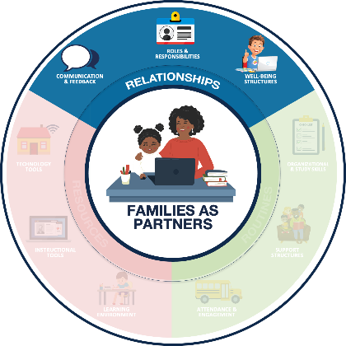
Relationships Positive connections that foster interaction and establish a nurturing environment of trust and support
COMMUNICATION & FEEDBACK
ROLES & RESPONSIBILITIES
WELL-BEING STRUCTURES
Foster two-way communication (e.g., Minimize education jargon and use preferred communication channels)
Provide (actionable and regular) personalized information
Defining the team and the standard operating procedures
Managing expectations for all partners
Prioritize physical and emotional well-being
Promote Balance (e.g., allow breaks)
Notes:
RELATIONSHIPS:
Communications & Feedback: Fostering two way communication and personalizing information for families.
Roles & Responsibilities: Identifying the team and determining how you will work together to successfully manage expectations within the partnership.
Well-being Structures: Prioritization of physical and emotional well-being to promote balance.

Slide 7
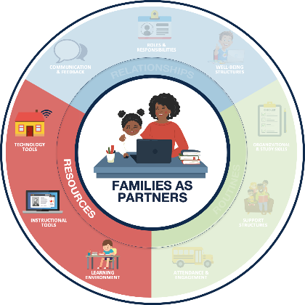
Resources Materials, Tools, and Supplies to support active learning and skill development.
LEARNING ENVIRONMENT
INSTRUCTIONAL TOOLS
TECHNOLOGY TOOLS
Dedicate a space for learning
Maintain an organized learning space
Leverage high-quality digital and print learning resources
Leverage consistent platforms across the district, when possible
Support access to devices and internet
Provide technology support resources and structures
Notes:
RESOURCES:
Learning Environment: A dedicated and organized space for learning.
Instructional Tools: Leveraging consistent platforms and high-quality digital and print resources.
Technology Tools: Access to devices, internet and technology support for these resources.

Slide 8
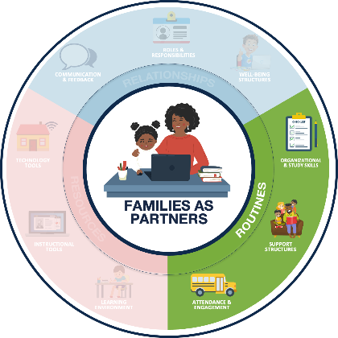
Routines Rehearsed and predictable practices that provide structure to support efficient and effective learning.
ORGANIZATIONAL & STUDY SKILLS
SUPPORT STRUCTURES
ATTENDANCE & ENGAGEMENT
Establish age-appropriate remote learning routines (e.g., setting weekly goals)
Encourage development of study skills (e.g., note taking templates)
Encourage students to reflect, identify needs, and seek help
Establish support routines (e.g., guardian learning office hours)
Foster regular communication about student attendance
Identify learning priorities and offer flexible structures (e.g., manageable and meaningful tasks
Notes:
ROUTINES:
Organizational & Study Skills: Establishing learning routines and developing study skills.
Support Structures: Encouraging students to seek help when needed and establish routines to support those needs.
Attendance & Engagement: Fostering regular communication and flexible structures to promote student attendance and engagement.

Slide 9
How has COVID-19 impacted teaching and learning?
FAMILIES
EDUCATORS
LEADERS
The role of families in the learning process has shifted, putting new demands on parents and caregivers.
Parents, siblings, grandparents, daycare providers, and other partners are supporting learners while attending to other responsibilities.
Educators have taken on the challenge of shifting teaching and learning into remote formats.
Teachers are developing relationships, adjusting routines, and leveraging resources to support family partnerships and student learning.
Administrators have fostered the transition of traditional partnering practices into remote/hybrid learning environments.
Leaders are adjusting remote/hybrid learning plans based on feedback from educators and families.
Notes:
HOW COVID HAS IMPACTED FAMILIES, EDUCATORS, AND LEADERS:
FAMILIES: Parents, siblings, grandparents, daycare providers, and other partners are supporting learners while continuing to attend to other responsibilities. (i.e. balancing work, family needs, caring for multiple students at once, etc.)
EDUCATORS: Educators are developing relationships in new ways; adjusting routines and leveraging a variety of new resources to support the family and student learning partnerships.
LEADERS: Educational leaders are transitioning traditional effective partnering practices and adjusting plans based on feedback from educators and families.
*After setting the scene, you might consider a share out activity or even a brain break if you notice participants are wearing out. Checkout the engaging strategies and brain break ideas in the SEL Playbook from CASEL (https://schoolguide.casel.org/uploads/2018/12/CASEL_SEL-3-Signature-Practices-Playbook-V3.pdf)

Slide 10
Let’s dive in
How to use the families as partners resources
Notes:
The remainder of this training is going to focus on remote/hybrid learning scenarios that educators might have encountered during the pandemic (activity vignettes); as well as resources to aid educators in successfully navigating family partnerships in remote/hybrid learning environments (Resource Outline/Practical Templates/Reading Resources).
*Handout or ensure participants have access to the Session 3 Resource Outline and Activity Vignettes

Slide 11
Session 1 and 2 Resources
Overview Video
Assessment Workbook
Action Toolkit
Practical Templates
Book Suggestion
Activity Vignettes
https://www.eteachny.org/families-as-partners/
Notes:
The activity vignettes are a tool used to explore practical scenarios educators might be encountering while supporting family partnerships in a remote or hybrid learning environment.

Slide 12
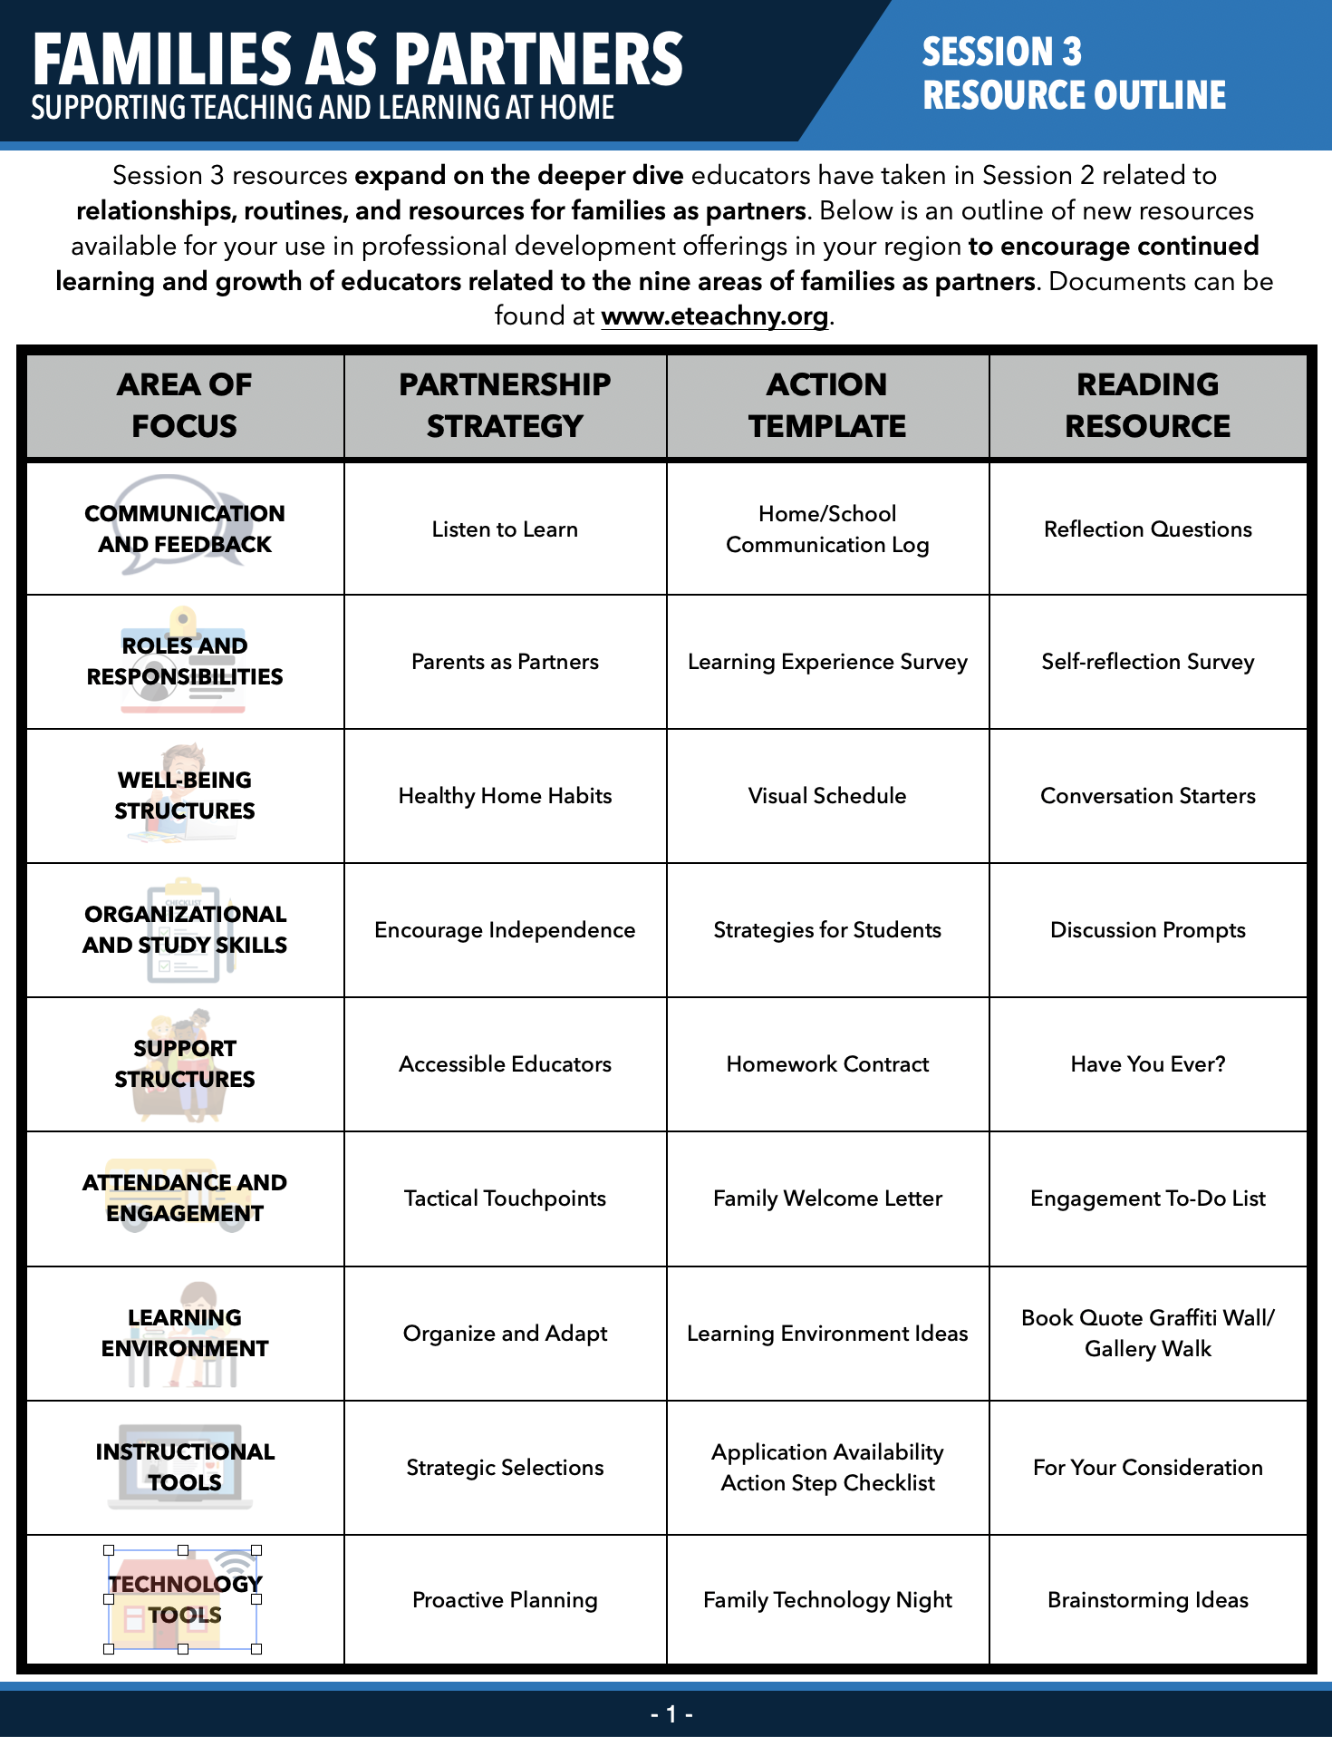
Families as partners Resource Outline
https://www.eteachny.org/families-as-partners/
Notes:
The Session 3 Resource Outline is a pdf document that gives participants a snapshot into the resources they can access to enhance their learning and development related to families as partners.

Slide 13
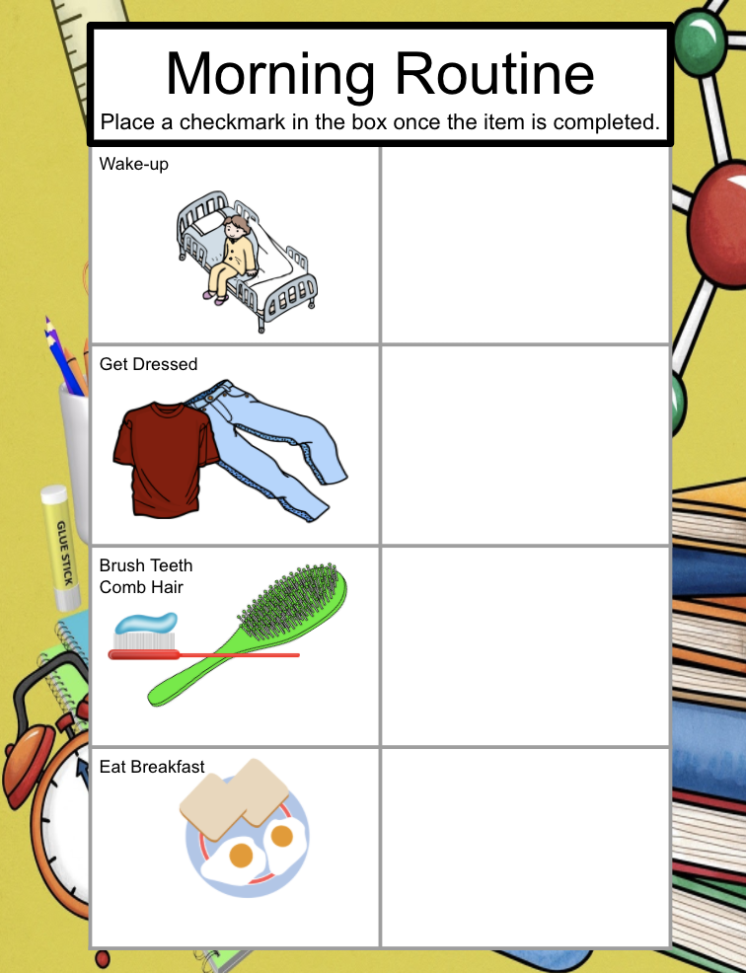
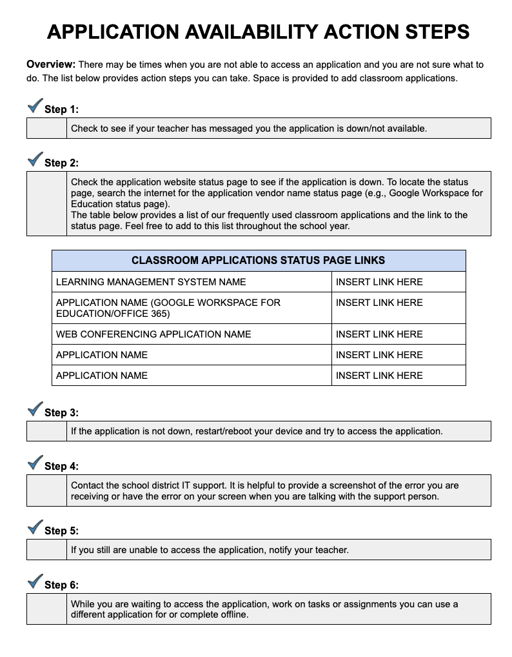
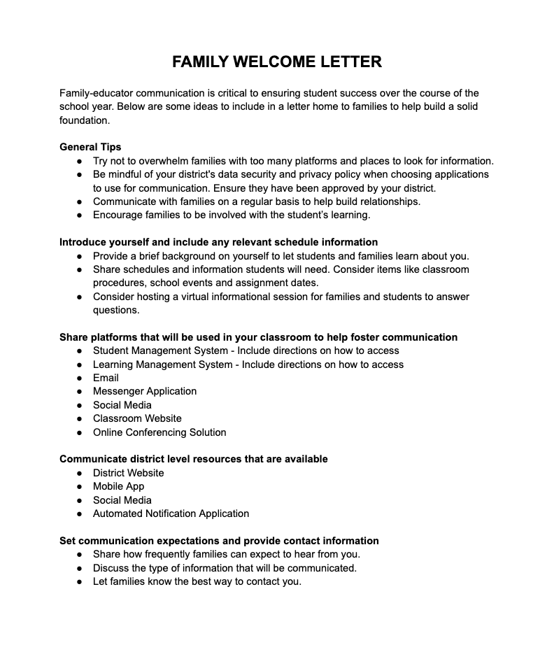
Families as partners Practical Templates
https://www.eteachny.org/families-as-partners/
Notes:
A practical template is a google-based template that can be used to make a best practice actionable. There is a different template for each of the 9 areas of the families as partners circle.

Slide 14
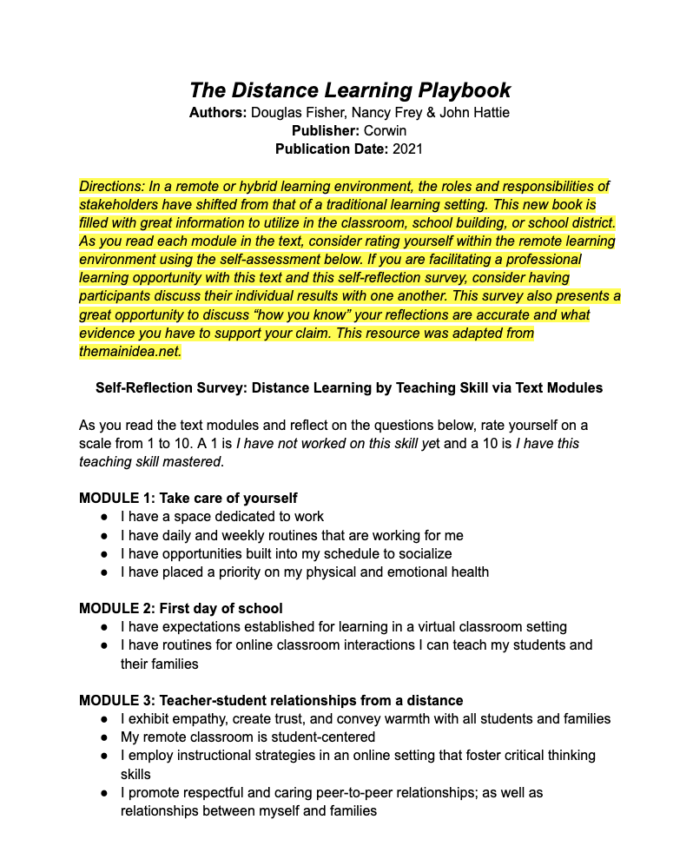
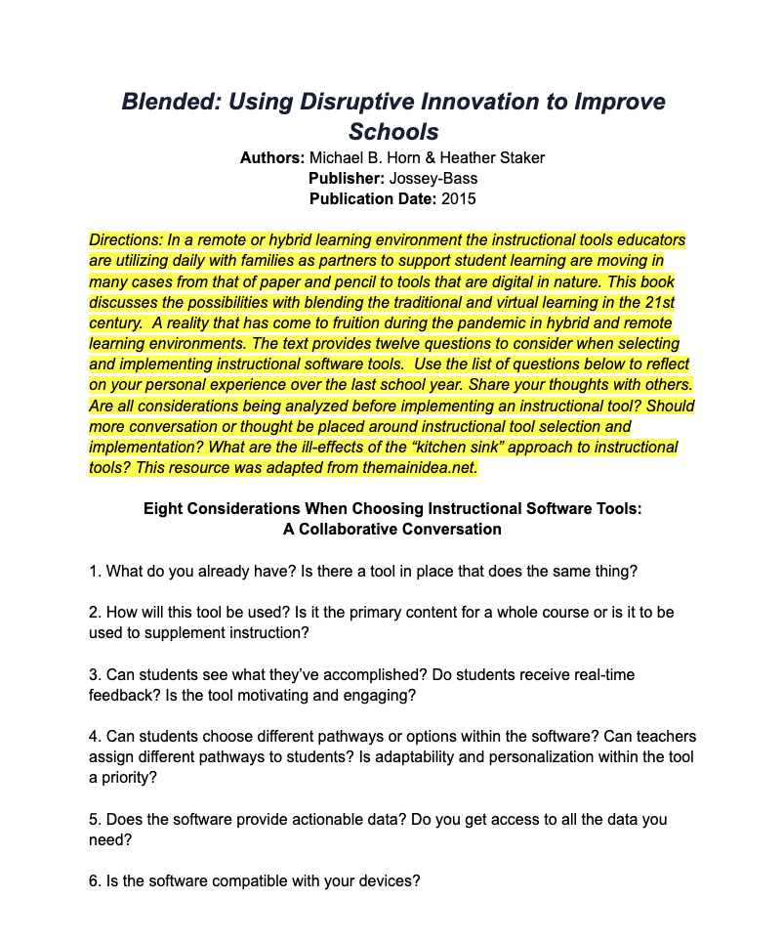
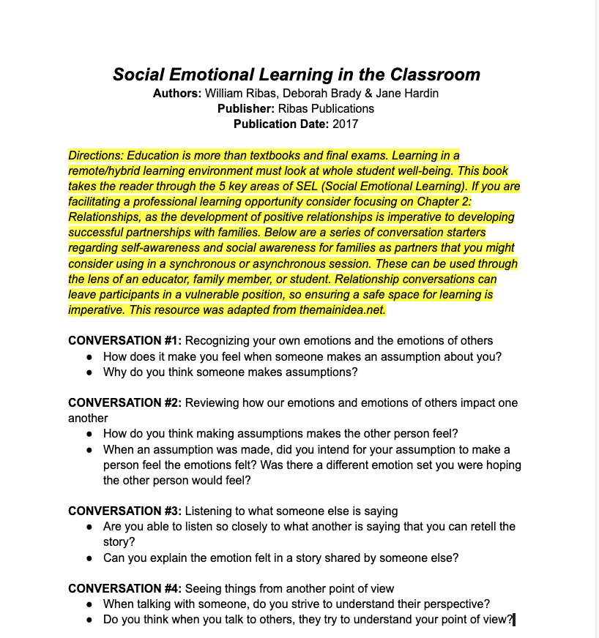
Families as partners Reading Resources
https://www.eteachny.org/families-as-partners/
Notes:
If you like to read, the Action Toolkit from Session 2 provided a book selection to checkout. The reading resource expands upon your interaction with the book in include an activity to do in combination with reading the text.

Slide 15
ASYNCHRONOUS PD OFFERING
Notes:
Once participants have been introduced to the resources developed to support this professional development session, there are a variety of ways you could proceed with your PD offering.
*One method for delivery is an asynchronous professional development model. Also, if participants have taken the Families as Partners Self-Reflection Survey, they might want to use those results to help them focus in a on a particular subcategory topic to focus on during the asynchronous learning opportunity.
If you are going to be delivering this session synchronously, consider setting a timer for participants or giving them a time that the group will reconvene together. An engaging strategy could be employed for collaborative conversations. Additionally, you might want to consider a share out activity or even a brain break if you notice participants are wearing out. Checkout the engaging strategies and brain break ideas in the SEL Playbook from CASEL (https://schoolguide.casel.org/uploads/2018/12/CASEL_SEL-3-Signature-Practices-Playbook-V3.pdf)

Slide 16
SAMPLE: Asynchronous PD Offering-Step 13
STEP 1:
The What and Why of Families as Partners
Introduce the Families as Partners Wheel using slides 5-9 from this slide deck.
Notes:
*Whether the professional development offering is synchronous or asynchronous, you might want to consider level setting for the group first by discussing the what and the why of families as partners. One option is to use the slides in this deck. Slides can be added to an asynchronous presentation no matter the platform. You might choose to record narration or add the slide notes.

Slide 17
SAMPLE: Asynchronous PD Offering-Step 23
STEP 2:
Capture Initial Learning
Have participants respond to a reflection question based on their understand of what families as partners is and why family partnerships are so important during the pandemic. A reflection question might be:
Based on the slides you just reviewed, which of the 3 areas of family partnerships are you having the greatest success with? Provide an example as to why you believe this to be true. What area do you think is providing you the greatest challenge? Provide an example to illustrate your point.
Notes:
*If you are completing this PD session asynchronously, no matter the platform, including a means of capturing learning is important. You can do this in a variety of ways. A written response to a question is just one option.

Slide 18
SAMPLE: Asynchronous PD Offering-Step 33
STEP 3:
Choice Board
Next, consider including a choice board with links to the different templates. Participants could complete a given template and then submit the completed version so you have record of their engagement with the content. Depending on the number of hours being earned might depend on the number of activities to complete.
Notes:
*Offering participants in an asynchronous PD offering choice is a positive strategy for engagement. A sample choice board is provided on the next slide and might be the vessel to get participants the information needed in a personalized way. Don’t forget to capture completed resources so a trail of interaction is established.

Slide 19
SAMPLE: Asynchronous PD Offering-continued
Communication and Feedback Home/School Communication Log | Roles and Responsibilities Learning Experience Survey | Well-being Structures Visual Schedule
Organizational and Study Skills Strategies for Students | Support Structures Homework Contract | Attendance and Engagement Family Welcome Letter
Learning Environment Learning Environment Ideas | Instructional Tools Application Availability Action Steps Checklist | Technology Tools Family Technology Night
Notes:
*This board could be added to any learning platform and then links to the resources could be added on the images for easy participant navigation.

Slide 20
SAMPLE: Asynchronous PD Offering-Step 43
STEP 4:
Capture Final Learning
Finally, ask participants to reflect again on their learning now that they have created one or more resources to help enhance their partnerships with families. A reflection question might be:
Explain how you will make use of the resource(s) created during this professional development session in your classroom. Additionally, how will the resource(s) created during this session enhance your relationships with families. Please provide three examples.
Notes:
*Again capturing learning is important in an asynchronous PD session. A reflection question could be used at the end of the session. If you prefer a quiz of some sort, a multiple choice resource to capture final learning could be created as well. Also, don’t forget to include the TRLE Survey at the end of any PD session.

Slide 21
Additional resources
Additional resources to support the development of positive partnerships with families and other remote learning priorities can be found online at eTeachny.org.
Shifting to Teaching Online
Families as Partners
Students With Disabilities
English Language and Multilingual Learners
Culturally-Responsive Education
Social Emotional Learning
Notes:
If you are looking for more resources related to families as partners or any of the other 5 categories of support, please go to https://www.eteachny.org/ to access countless resources to support educators during the transition to remote and hybrid learning environments.

Slide 22
Questions?
Notes:
This concludes Families as Partners: Training Session 3. Questions?
*Consider ending using an optimistic closure from the SEL Playbook (https://schoolguide.casel.org/uploads/2018/12/CASEL_SEL-3-Signature-Practices-Playbook-V3.pdf).

