Slide 1
Scaffolding for ELLs in Distance Learning or Hybrid Settings
Meghan Gregoire-Smith, M.A. • April 2021
Twitter: @SupportEduc • Facebook: bit.ly/FBSupportEd • www.GetSupportEd.net
Notes:
Welcome to our SupportEd webinar “Scaffolding for ELLs in Distance Learning or Hybrid Settings” We are so happy you are able to take part. My name is Meghan Gregoire-Smith, and I’ll be presenting our content today.

Slide 2
Session Presenter
Meghan Gregoire-Smith, M.A.
Twitter: @MeghanGSmith
www.GetSupportEd.net
Notes:
I am an EL coach at SupportEd. SupportEd provides professional development, technical assistance, and curriculum support to ELLs and their educators. We provide educators the tools they need to effectively teach ELLs so that this population of students can be positioned for academic success. SupportEd is a New York State certified Women’s Business Enterprise and a NYSED certified CTLE provider.
Prior to working at SupportEd I was worked as an ESOL teacher and ESOL teacher specialist for Anne Arundel County Public Schools in Annapolis Maryland where I taught elementary ELLs in grades K-5, wrote ESOL curriculum, planned and delivered professional development on best practices for ELLs, and coached ESOL teachers new to the field. I have a passion for supporting educators of ELLs and am thrilled to have the opportunity to share research and strategies for scaffolding instruction for ELLs.

Slide 3
Thank you!
Notes:
Before we get started with our content, I wanted to take a moment to thank all of you. You all have adapted quickly to a new normal while taking care of yourselves and your families. We at SupportEd know that your students and families greatly appreciate everything you’ve done. Thank you.

Slide 4
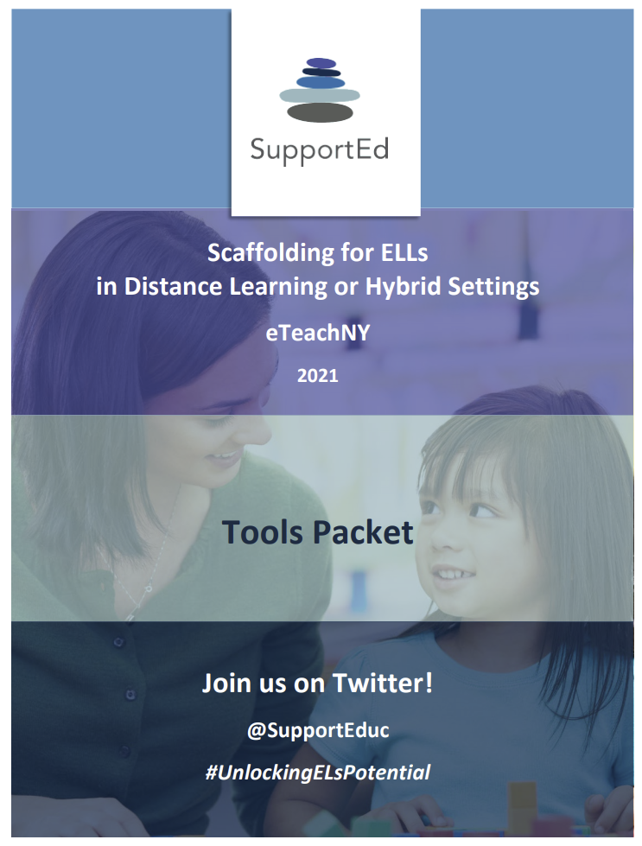
Format of this PD Opportunity
Notes:
This is a self-paced, asynchronous professional development opportunity. It includes a recorded webinar, opportunities to stop and think, a Padlet of resources, and a tools packet.
We’ve designed the webinar to be used with the tools packet and we will reference them throughout. The Padlet also includes the tools packet for your convivence.

Slide 5
Objectives
Describe
Define
Explore
Apply
Notes:
There are four objectives for this webinar. It is expected that by the end of the webinar you will be able to…
Describe challenges and opportunities for ELLs during distance or hybrid learning
Define scaffolding for ELLs.
Explore strategies for scaffolding tasks for ELLs during distance or hybrid learning, and
Apply a 5-step framework to scaffold content instruction for ELLs in a distance or hybrid learning environment.
This presentation is divided into four sections framed around these objectives.

Slide 6
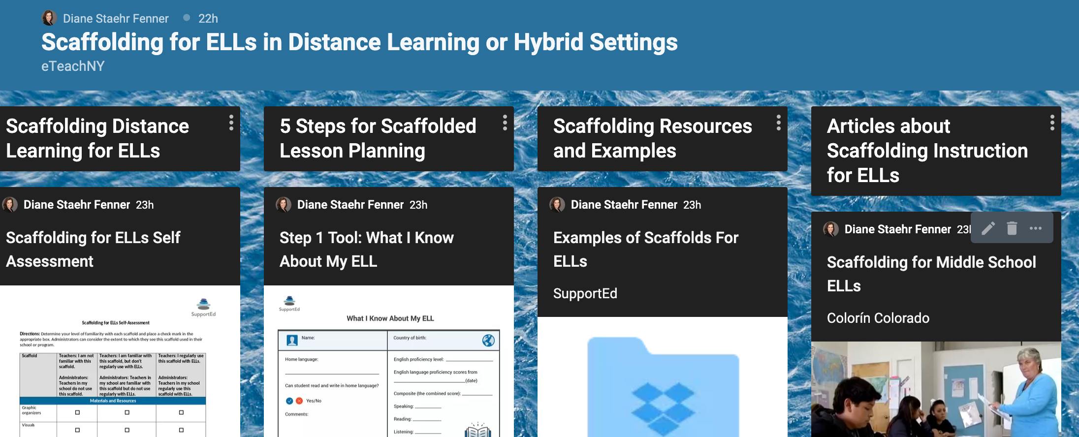
bit.ly/eTeachNYELLs (Case Sensitive)
Notes:
We have created a Padlet of online resources for you as a way we can share relevant resources on supporting ELLs in distance and hybrid learning environments. You can also use the Padlet to share your own resources and comment on this topic. Anyone who watches this on-demand webinar can add to the conversation at any time, and this Padlet will remain open indefinitely, so I encourage you to check on it periodically.

Slide 7
Icons
Stop and Think
Tools Packet
Padlet
Notes:
Throughout this webinar you will see two icons. The lightbulb icon indicates that a “stop and think” reflection question will be posed. The page icon indicates that the resource referenced is available in your tools packet. The Padlet icon indicates that the resource references is available on our Padlet of resources.

Slide 8
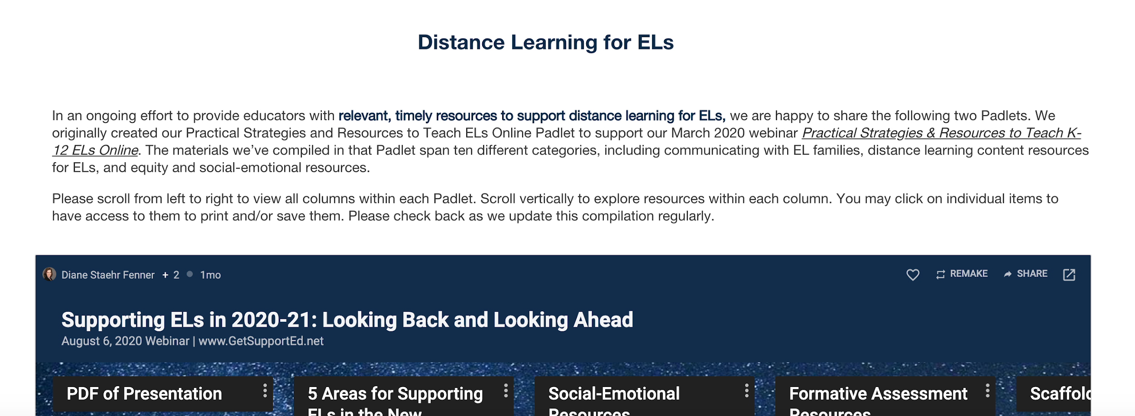
Resources on Teaching K-12 ELs Online
https://getsupported.net/distancelearning
Notes:
We are also sharing links to our distance and hybrid learning resources Padlet and our free webinar archive. Be sure to check these out!

Slide 9
Unlocking ELs’ Potential
Why you need this book to support ELs
Using a culturally responsive framework
Scaffolding instruction for ELs
Fostering ELs’ oral language development
Teaching academic language to ELs
Vocabulary instruction and ELs
Teaching ELs background knowledge
Scaffolded text-dependent questions
Formative assessment for ELs
Staehr Fenner & Snyder, 2017
Notes:
Today we’ll be drawing from Chapter 3, “Scaffolding Instruction for ELs:”, of Diane Staehr Fenner and Sydney Snyder’s book, Unlocking English Learner’s Potential – Strategies for Making Content Accessible.
More information about this book can be found on the Padlet.

Slide 10
Challenges and Opportunities for ELLs During Distance or Hybrid
Notes:
We’ll begin by discussing challenges and opportunities for ELLs in distance learning and hybrid settings.

Slide 11
Stop and Think: Challenges and Opportunities
What challenges have ELLs faced during distance and hybrid learning?
What opportunities exist for ELLs during distance and hybrid learning?
Notes:
Take a moment to reflect on challenges and opportunities that ELLs have experienced during distance or hybrid learning. What challenges have ELLs faced during distance and hybrid learning? (pause) What opportunities exist for ELLs during distance and hybrid learning? (pause)
Please pause the presentation now to take a moment to stop and think.

Slide 12
Selected Challenges
Inequity around technology
Privacy concerns
Pressure on families
Trauma
Stress on educators
Shifts in models and routines
Insufficient opportunities for language use
Lack of scaffolding for content instruction
Notes:
Distance and hybrid learning environments present a variety of challenges for ELLs. Some challenges educators of ELLs have noted in relation to distance and hybrid learning include
Inequity around technology. In March 2019, as school systems adapted to a distance learning environment, inequities became abundantly clear including access to devices and high-quality internet.
Privacy concerns. Schooling in a distance learning or hybrid setting poses privacy concerns for students and their families. For example, many educators have noted students reluctancy to turn on their cameras during distance learning as they do not feel comfortable welcoming the class into their home.
Pressure on families. Distance and hybrid learning put intense pressure on families. In families where parents work outside of the home, many older siblings have been tasks with supporting their younger siblings schooling experience.
Trauma. Students experiencing trauma has increased tremendously due to issues related to the pandemic. Supporting students’ social emotional well-being in a distance learning environment is a challenge.
Stress on educators. Transitioning to distance learning and hybrid settings has put a lot of stress on educators and this stress can have an impact on student learning.
Shifts in models and routines. Creating clearly established routines is an important part of high-quality education for ELLs. Much of the stress experienced by educators, students, and families is due to shifts in models and routines as school systems adjust to schooling in a pandemic.
Insufficient opportunities for language use. Throughout a typical, face-to-face school day, ELLs have numerous opportunities to use both social and academic language. These natural opportunities for language use and practice do not exist within a distance learning setting. Teachers must intentionally plan opportunities for language use.
Lack of scaffolding for content instruction. Many educators have noted a lack of scaffolding for ELLs during content instruction in distance learning and hybrid settings. Without appropriately scaffolding instruction and materials, ELLs do not have access to rigorous grade-level curriculum.

Slide 13
Selected Opportunities
Valuable time with families
Home language use
Collaboration
Learning opportunities
Flexibility
Repetition of language
Notes:
Despite the many challenges that exist, there are a number of opportunities for ELLs in distance and hybrid learning settings, including
Valuable time with families. The pandemic has led to families spending a lot more time together than in the past. We cannot disregard the value in this time.
Home language use. One incredibility value aspect of more time with families is increased home language use. Research tells us that a strong foundation in a student’s home language aids in acquiring a second language.
Teacher collaboration. This experience has led teachers to find creative ways of collaborating. Virtual meetings are now a regular part of a teacher’s day. This opens opportunities for increased collaboration within and across school buildings. Also, the use of digital shared planning documents are now the norm, opening up opportunities for co-planning and co-teaching that did not easily exist in the past.
New learning opportunities. Teacher creativity has been incredible throughout this pandemic. Everyday teachers are finding new, innovative ways to engage students whether it be through games for learning, virtual field trips, or digital pen pals.
Flexibly. Within distance and hybrid learning, there are many opportunities for increased flexibility with more student choice, small group instruction, and independent work.
Repetition of language . ELLs benefit from repetition of receptive and productive language. In distance and hybrid learning teachers are able to record lessons and directions for students to engage with multiple times. Students have opportunities for repeated language practice in a more private setting, which may lower the affective filter.

Slide 14
Stop and Think: Opportunities
Have any of the opportunities surprised you?
How can you build on the opportunities that exist to better support ELLs in your context?
Notes:
Take a moment to reflect on your experience with distance and hybrid learning. Have any of the opportunities that exist for ELLs in distance and hybrid learning surprised you? (pause) How can you build on the opportunities that exist to better support ELLs in your context? (pause)
Please pause the presentation now to take a moment to stop and think.

Slide 15
Define Scaffolding for ELLs
Notes:
Now we will define scaffolding for ELLs.

Slide 16
Stop and Think: Scaffolds
What are scaffolds?
What are they intended to do?
How do they work?
Notes:
Take a moment to look at the image of scaffolds. Think about scaffolds in this context. What are scaffolds? What are they intended to do? How do they work? (pause)
Please pause the presentation now to take a moment to stop and think.

Slide 17
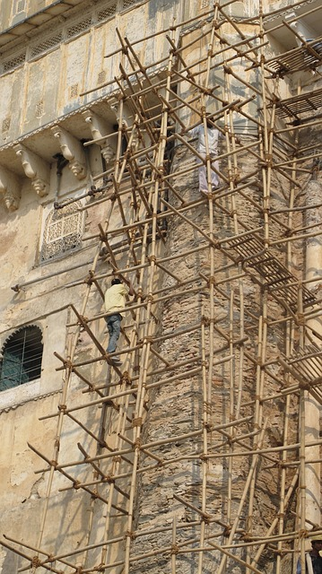
What are Scaffolds for ELLs Intended to Do?
Temporary supports
Support students to perform a task they could not do without help
Facilitate students completing tasks independently in the future
August, Staehr Fenner, & Snyder, 2014; National Governors Association for Best Practices, CCSSO, 2010
Notes:
Now, let’s think about scaffolds specifically for ELLs. What are scaffolds for ELLs intended to do? (pause)
When considering the use of scaffolds for ELLs it is important to remember that they are defined as temporary supports that an instructor or more capable peer provides another student.
Scaffolds support a student in being able to perform a task he or she could not do without help. The ultimate goal of scaffolds is to facilitate a student completing the same type of task independently in the future once they have acquired more language and more skill related to the task. A scaffold is not meant to be a permanent support.

Slide 18
Why Use Scaffolds with ELLs?
Comprehensible input
Help make rigorous grade-level curriculum and assessment accessible to ELLs
Opportunities to model language
Differentiated by English proficiency level, home language literacy, and other factors specific to ELLs
Staehr Fenner & Snyder, 2017
Notes:
Why is it important to use scaffolds with ELLs? (pause)
It is important because of the support that they provide. Scaffolds can help make rigorous grade-level curriculum accessible to all students by providing what Krashen referred to as comprehensible input. Academic texts and concepts can be broken down into meaningful pieces and be presented with key instructional supports in order to support ELLs understanding of and engagement with the content. Scaffolds also provide opportunities to model language, such as when students work in pairs or small groups with non-ELLs or through the use of sentence stems and frames. When using scaffolds its important to recognize that they aren’t a one-size fit all. They should be provided to ELLs based on each student’s English proficiency level, home language literacy, and other background factors.

Slide 19
Stop and Think: Self-reflection
What factors do you take into consideration when selecting appropriate scaffolds for ELLs?
What are some scaffolds that work best for ELLs in your classroom?
How do you differentiate the scaffolding you provide in order to meet the needs of ELLs of varying proficiency levels?
Notes:
Take a moment to self-reflect on your use of scaffolds. (pause)
What factors do you take into consideration when selecting appropriate scaffolds for ELLs?
What are some scaffolds that work best for ELLs in your classroom?
How do you differentiate the scaffolding you provide in order to meet the needs of ELLs of varying proficiency levels?
Please pause the presentation now to take a moment to stop and think.

Slide 20
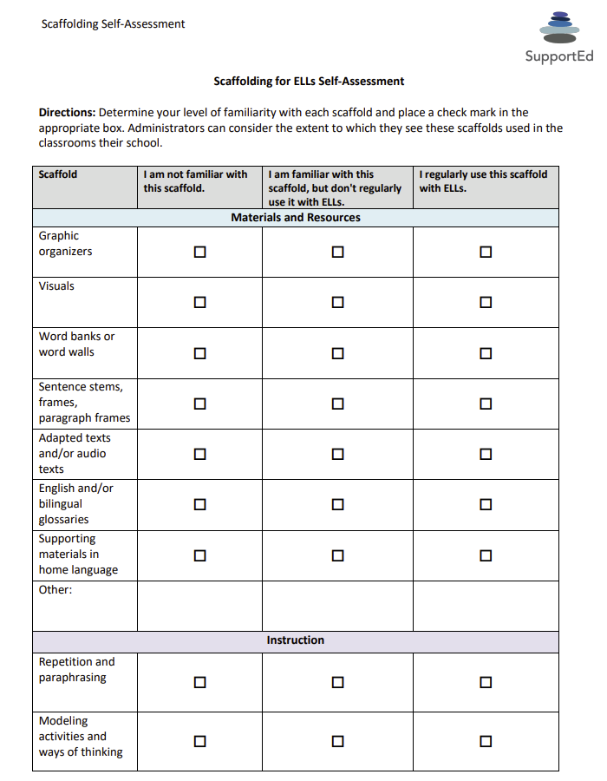
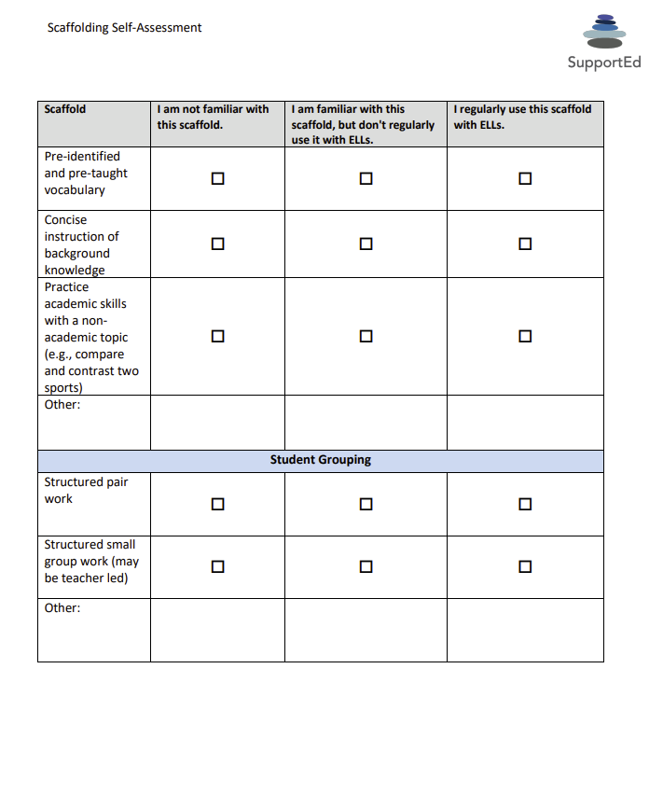
Scaffolding for ELLs Self-Assessment (Tool 1)
Adapted from Staehr Fenner & Snyder, 2017
Notes:
It is helpful to reflect on your own use of scaffolds for ELLs. At this time take a look at the Scaffolding for ELLs Self-Assessment in your tools packet, which can be found on page 1. This self-assessment is meant to help you reflect on your familiarity with scaffolding instruction for ELLs. It will help you determine scaffolds you are familiar with and scaffolds you might be interested in learning more about.
This tool is also something you can share with colleagues.
Please pause the video and complete the self-assessment now.

Slide 21
Scaffolding Strategies for Distance and Hybrid Learning
Notes:
Now that you have had a chance to reflect on your use of scaffolds for ELLs, we will be exploring specific scaffolding strategies.

Slide 22
Types of Scaffolds
Materials
Scaffolds
Staehr Fenner & Snyder, 2017, adapted from WIDA Consortium, n.d.
Student Grouping
Instruction
Notes:
Based on the work of the WIDA Consortium, we group scaffolds into three categories: instruction or instructional practices, materials, and student grouping. We’ll be exploring each of these in the upcoming slides. It’s important to note that depending on the task and their language proficiency level, ELLs may need one or more scaffold in each of the three categories to complete a specific task.

Slide 23
Types of Scaffolds (Tool 2)
Categories of Scaffolds | Examples
Materials and Resources | Graphic organizers English and/or bilingual glossaries English and/or bilingual dictionaries Home language materials Sentence frames, sentence stems, and paragraph frames Visuals Word banks or word walls
Instruction | Preidentified and pretaught vocabulary Concise instruction of background knowledge Reduced linguistic load, repetition, paraphrasing, and modeling
Student Grouping | Structured pair work Structured small-group work Teacher-led small-group work
WIDA, n.d.; Adapted by Staehr Fenner & Snyder, 2017, p. 61
Notes:
This table lists the three types of scaffolds and provides examples of each. It is a very helpful resource to have when lesson planning and collaborating with colleagues. A copy of this table can be found in your tools packet on page 3. Please turn to this table in your packet now.

Slide 24
Stop and Think: Types of Scaffolds
Which category of scaffolds do you use the most with ELLs in distance and hybrid learning?
Materials and resources
Instruction
Student grouping
What implications do you see for scaffolding during distance and hybrid learning?
Notes:
Take a look at the types of scaffolds table.
Which category of scaffolds do you use the most with ELLs in distance and hybrid learning?
Materials and resources, Instruction, or Student grouping?
What implications do you see for scaffolding during distance and hybrid learning?
Please pause the presentation now to take a moment to stop and think.

Slide 25
Materials Scaffolds
Graphic organizers
Visuals
Word banks or word walls
Sentence stems and/or frames, paragraph frames
English and/or bilingual glossaries
Supporting texts or materials in home language
Staehr Fenner & Snyder, 2017
Image: http://imbloghoppin.blogspot.com
Notes:
I’m now going to explore each of the three categories of scaffolding with you and will provide examples of each that you can use in distance or hybrid learning with ELLs.
The first category of scaffolds I would like to talk about are instructional materials. These are things that you develop to support ELLs’ engagement and understanding. Some examples of materials that can be used as scaffolds include:
Graphic organizers
Visuals
Word banks or word walls
Sentence stems or frames
Paragraph frames
English or bilingual glossaries
Home language materials.
We will now take a look at examples of a number of these materials scaffolds.

Slide 26
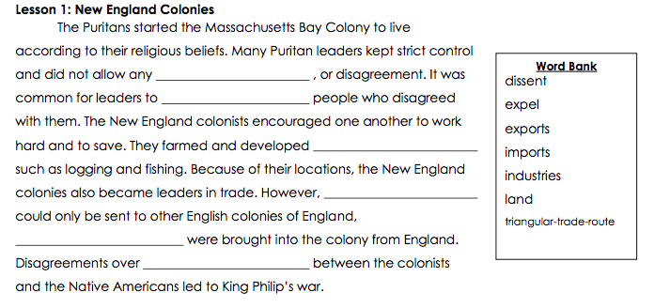
Materials Scaffolds Example: Word Banks
studylib.net
Notes:
Word banks are a vocabulary resource for ELLs that support their speaking and writing. They offer vocabulary to support ELLs in completing a particular task. For example, students may use a word bank to complete sentence frames about a text. They may also use a word bank in responding orally to questions. In this example, you can see that students can use a work bank of key unit vocabulary to complete a paragraph about the New England colonies.
In distance and hybrid learning, you can also create drag and drop word banks to be used in sentence frames and paragraph frames using a tech tools such as Google Jamboard.

Slide 27
Materials Scaffolds Example: Virtual Word Wall
Mrspark.org/free
Notes:
This is an example of a virtual word wall. Word walls are most often seen at the elementary level, but they can provide support at upper grade levels as well. At the elementary level, words walls include sight words, high frequency words, and words that do not follow standard spelling patterns for students to use when writing. Word walls can also be developed for unit vocabulary. For upper grade ELLs, word walls might include academic words, transition and signal words for writing, and content words for the current unit of study. At all levels, students and teachers often co-create the wall. Word walls can include visuals and translations of the words in students home languages.
One opportunity for word walls in distance and hybrid learning is to include recordings of the words for students to reference as needed.

Slide 28
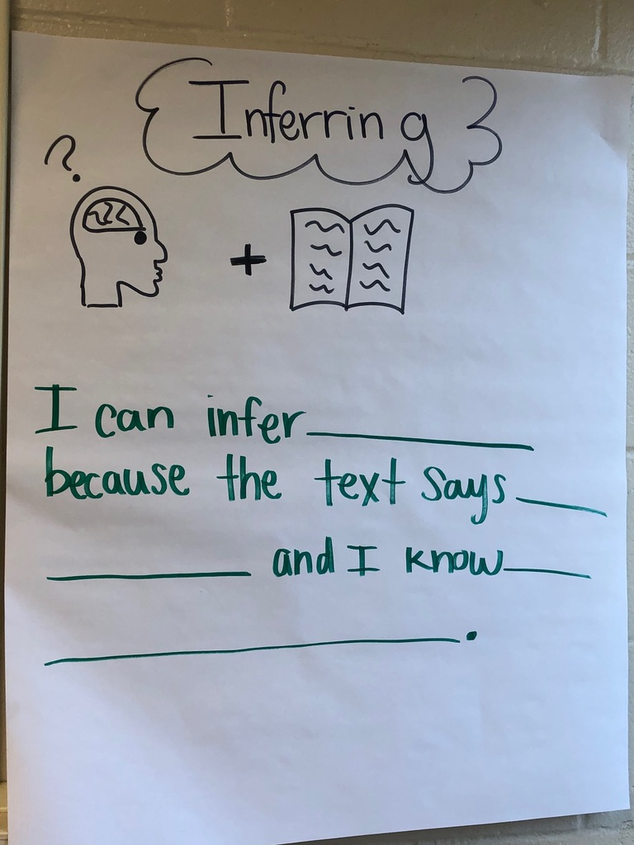
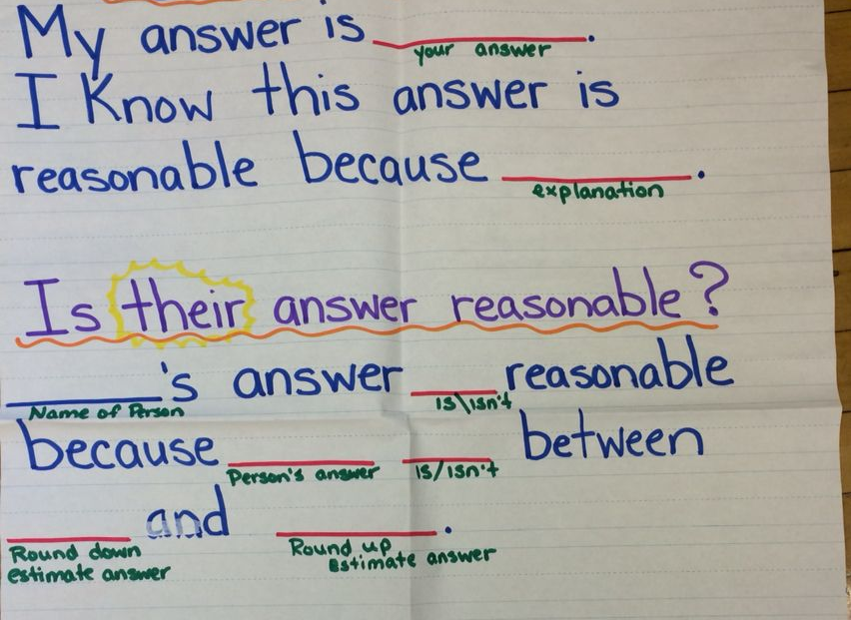
Materials Scaffolds Example: Paragraph Frame
Image 1: Maria Va; Image 2: MCPS, 2019
Notes:
Paragraph frames are another material support. They provide students support with extended discourse. The amount of support varies, but often includes language for organizing a paragraph.
Teachers can provide paragraph frames that provide more support for language at the beginning of the essay and gradually decrease the amount of language provided. In this example, you can see that the teacher has also provided clues as to what the students need to do in completing the frame. For example, insert a literary device. The idea is that as students gain familiarity with the structure and language used in constructing a paragraph, they will need less support. When completing a paragraph frame, ELLs may also benefit from a graphic organizer that helps them clarify their ideas and find evidence to support their ideas.

Slide 29
Materials Scaffolds Example: Bilingual Glossary
Glossary
Word and Translation | English Definition | Example from Text | Picture or phrase to represent the word | Cognate (Yes or No)
instinct instinto | natural behavior, not learned | Some scientists claim play is a natural instinct—just like sleep. | (Photo of four baby birds in a nest) | yes
humanity humanidad | all people | That might explain why sports are likely to be as old as humanity. | (Group of people standing outdoors) | yes
August, Staehr Fenner, & Snyder, 2014
Notes:
Another materials support is the use of a bilingual glossary. This example includes definitions, pictures, examples and whether or not the word is a cognates. It is important to have an understanding of an ELLs’ home language literacy skills when planning for this support. ELLs’ with literacy skills in their home language will benefit greatly from this support.

Slide 30
Materials Scaffolds Example: Supporting Texts
Online resources for home language texts:
International Children’s Digital Library http://en.childrenslibrary.org
Unite for Literacy/Unite Español https://www.uniteforliteracy.com
Niz, 2006 (Capstone Press); Orwell, 1946 (Samjisa, 2011)
Notes:
Another home language support is to provide supporting materials in the ELLs’ home language. Research has shown the benefit of providing ELLs who are fluent in their home language with supporting materials in that language. Teachers can provide these types of resources even when they do not speak the student’s home language. For example, a teacher can provide ELLs with books, articles, or websites that can support their understanding of a particular content area. Teachers can also work with a native speaker of the student’s home language to develop a short text or video to provide background knowledge on a topic. It can also benefit ELLs of lower proficiency levels to demonstrate understanding of content in their home language.
The International Children’s Digital Library website has a selection of digital books in 59 different languages. You can also use this website to explore books from around the world.
Unite for Literacy has texts in Spanish and it includes a read-aloud feature. Both are linked on the Padlet.

Slide 31
Instruction Scaffolds
Pre-identified and pre-taught vocabulary
Concise instruction of background knowledge
Modeling, repetition, paraphrasing
Staehr Fenner & Snyder, 2017
Notes:
Scaffolds that fall into the instruction category are things that a teacher can do to support ELLs’ in working with and understanding the material. For example, the pre-teaching of key vocabulary is a scaffold that will help students understand a new text. Vocabulary can be taught and practiced with the use of visuals, student-friendly definitions, and examples and non-examples. Teachers can also concisely teach background knowledge that ELLs may need to engage with a text or new concept. I’ll be talking more about this in an upcoming slide.
Additionally, ELLs, as well as many other students, also benefit from the clear modeling of a task. They benefit from the repetition of key ideas and concepts, especially when they have an opportunity to practice their understanding of content in varied ways. It’s important to remember that when giving directions, ELLs benefit from seeing the directions, hearing the directions, and having the directions restated by themselves or another student.

Slide 32
Instruction Scaffolds Example: Background Instruction
The Mississippi River
August, Staehr Fenner, & Snyder, 2014
Notes:
One instructional scaffold is the concise instruction of background knowledge. While providing essential background knowledge is important to ELLs’ engagement and understanding of a text, it is important to not provide too much background information. It’s important to focus on background knowledge that is essential to ELLs’ understanding. You don’t want to preteach information that students can learn from the text or task, and you also don’t want to spend more time focusing on background knowledge than you do on the new content.
This slide shows an example of background on the Mississippi River for a text students will read about a man who helped clean up the Mississippi River. A short text was developed to provide the necessary information. The background activity includes a short text and glossary, a map, and a video about the Mississippi river. Background knowledge should include visuals or simple language. It can be done as a homework task or a ’do now’ activity.

Slide 33
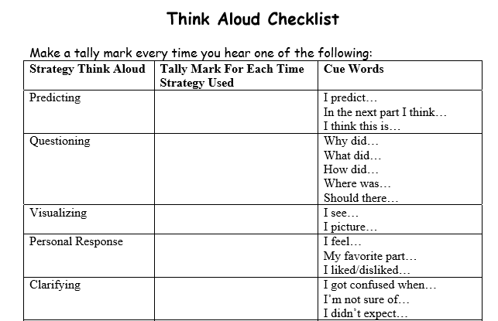
Instruction Scaffolds Example: Modeling Checklist
Template based on activity in Schoenbach, R., Greenleaf, C. L., Cziko, C., Hurwitz, L. (2000). Reading for Understanding: A Guide to Improving Reading in Middle and High School Classrooms. San Francisco, CA: Jossey-Bass, 78. Adapted by CAST http://www.cast.org
Notes:
Modeling is an essential scaffold for ELLs. It involves the teacher or another student demonstrating a new concept or approach to learning and the students learning by observing. Teachers can model behaviors, language, thinking, or steps to an activity. This checklist provides an example of strategies that can be modeled for students. Students could use the checklist to listen for other students using specific strategies or for recognizing when they use a particular strategy. Before introducing a checklist like this, it would be beneficial to present each strategy independently along with opportunities for students to practice. For example, you might begin with predicting.
For hybrid or distance learning, you could record video or audio of a think-aloud for students to reference.

Slide 34
Student Grouping Scaffolds
Structured pair work
Structured small group work
Teacher-led small group work
Staehr Fenner & Snyder, 2017
Notes:
Student grouping is the third type of scaffold. When grouping students its important to carefully consider the purpose of the activity and how you are grouping them. Student groups include:
Structured pair work
Structured small group work
Teacher-led small group work
Pair work can be effective as a scaffold when carefully structured. Teachers should intentionally pair students together. For example, a teacher may pair ELLs with the same home language to work together, thus bringing in language support the teacher may not be able to provide. Alternatively, the teacher could create mixed ability or language proficiency pairings in which one student is providing additional support to the other. It’s important to change up your pairings, both to keep students interested, but also to give every student an opportunity to demonstrate their strengths.
Small group work also can be an effective scaffold. In order for groups to work effectively, ELLs need structured activities, preparation for group work, and intentional groupings. The activities should be designed to provide positive interdependence, equal participation with specific roles and duties for each group member, and individual accountability. ELLs will need practice in communicating their ideas, listening, and resolving differences. How you group students is critical. Ideal groups are comprised of mixed ability and personalities that mesh well. Small group work can also be a time for the teacher to provide directed support to a group with similar strengths and needs. For example, the teacher can provide targeted mini-lessons about a particular concept, strategy, or language function based on the needs of the group.

Slide 35
Student Grouping Scaffolds in Distance or Hybrid Settings
Shared writing document
Breakout rooms
Recording responses and commenting on each other’s responses
Pen pals
Notes:
Student grouping is a challenging type of scaffold to use during distance and hybrid learning, but it is essential to find ways to provide this scaffold to ELLs.
Some ideas for pair and small group opportunities for distance learning include
Utilizing shared writing documents. This can be done with various tech tools such as Google Docs or Google Slides.
The use of breakout rooms is another great tool. It is important that you provide students clear roles and instructions for their time in breakout rooms. For older students, you can also create pair assignments in which you ask students to meet virtually.
You could also ask students to record their responses to certain questions and then comment on each other’s responses using tech tools such as Flipgrid or Padlet.
Another idea might be to pair students as pen pals and have them write back and forth to each other on a particular topic.

Slide 36
Student Grouping Scaffolds Example: Breakout Rooms
Google slide from mrspark.org/free
Notes:
This slide is a great example of providing students with specific roles when utilizing breakout rooms. This example comes from ESOL teacher Esther Park. A link to her website with various free resources is provided on our Padlet.

Slide 37
Stop and Think: Student Collaboration
Which strategies or tools you use, or would you like to use to support student collaboration during distance and hybrid learning?
Notes:
Take a moment to stop and think about which strategies or tools you use, or would you like to use to support student collaboration during distance or hybrid learning?
Please pause the presentation now to take a moment to stop and think.

Slide 38
Describe Strategies for Planning Scaffolded Lessons for ELLs
Notes:
Now that we’ve explored categories of scaffolds we’ll describe strategies for planning scaffolded lessons for ELs.

Slide 39
Steps for Scaffolding a Lesson
Know your ELLs
Identify the language and/or skills students will need in the lesson
Plan the lesson
Select and develop appropriate materials
Teach the lesson, adapting scaffolding and materials as needed
Staehr Fenner & Snyder, 2017
Notes:
This the our 5-step framework to scaffold content instruction for ELLs in a distance or hybrid learning environment. I’ll be discussing each of these steps in greater detail during this presentation. The steps are:
Know your ELLs
Identify the language and/or skills students will need in the lesson
Plan the lesson
Select and develop appropriate materials
Teach the lesson, adapting scaffolding and materials as needed

Slide 40
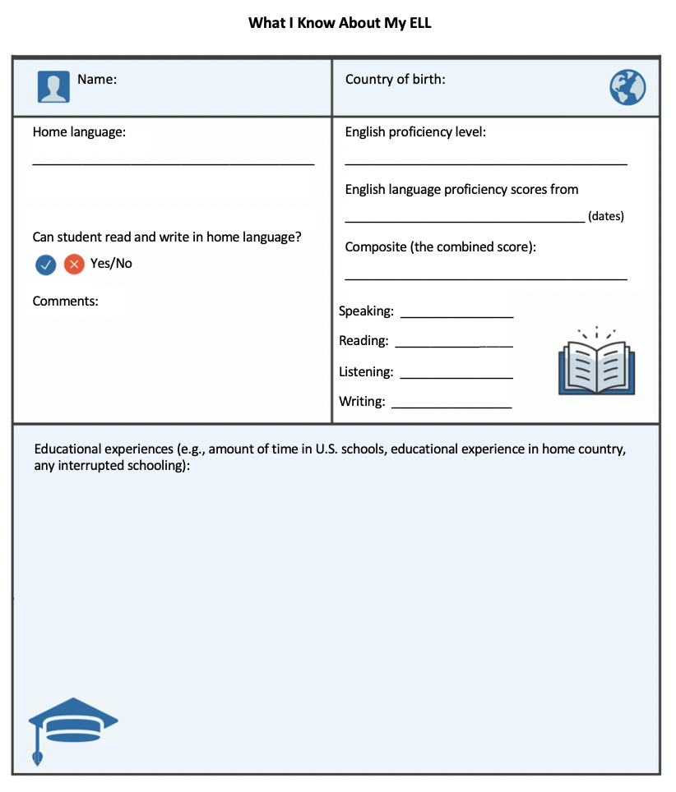
Step 1. Know Your ELLs (Tool 3)
Step 1 Tool: What I Know about My ELL
Select one particular ELL you are currently teaching.
Use this form to gather information on this student.
Share the form and information with a colleague.
Staehr Fenner & Snyder, 2017
Notes:
The first step in planning a scaffolded lesson for ELLs is to know your ELLs. It is essential to know their strengths and their needs, so that you can provide scaffolds that are tailored to these needs. It’s also important to know their home language, and their level of literacy in their home language. This will allow you to determine possible bilingual scaffolds such as translated materials or bilingual glossaries or word walls. Learning more about your ELLs will also give you a better sense of how to group students in relation to specific learning goals. This tool, found on page 4 in the tools packet, is entitled What I Know about My ELL. It can be a useful tool in finding out some of this important information. I’d encourage you to give the tool a try. Select a particular ELL that you are teaching and gather information about the student in order to complete the form. Collaborate with colleagues if you don’t currently have all the information. Then share the information with another teacher who works with the same student. Discuss how what you have learned about the student might impact your instruction of this student.

Slide 41
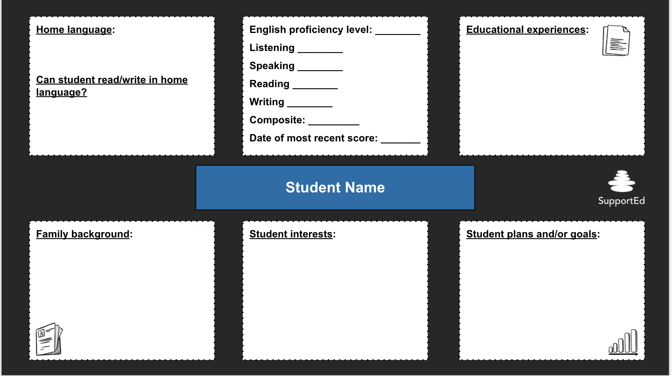
Virtual “What I Know About My EL” Template
bit.ly/KnowYourELs
Notes:
We’ve created a virtual version of this tool in Google slides. If you visit the bitly you will be prompted to make a copy of the Slides. The link is also available on our Padlet. You can use these templates to fill in information on your ELLs and share with colleagues working with ELL students. You should be sure check with your school about student privacy. We’ve included a tip for inserting a recording of a student saying their name so teachers can hear correct pronunciation.

Slide 42
Step 2. Identify Language Demands
Background knowledge
Vocabulary
Sentence
Discourse
Staehr Fenner & Snyder, 2017
Notes:
The second step in developing scaffolded lessons is to analyze the language demands of the academic tasks and texts that you are planning to include in your lesson. Identify areas where ELLs may need explicit background instruction prior to the lesson. Also consider the language demands for students at the vocabulary, sentence, and discourse levels. In other words, what vocabulary might be challenging for ELLs, which sentences might be confusing or difficult to deconstruct, and what about how the text or activity is organized may be challenging for ELLs. Chapters 5 and 6 in the Unlocking English Learners’ Potential book offer explanations of the types of language demands that can be challenging for ELs and how to respond to these challenges through your instruction.

Slide 43
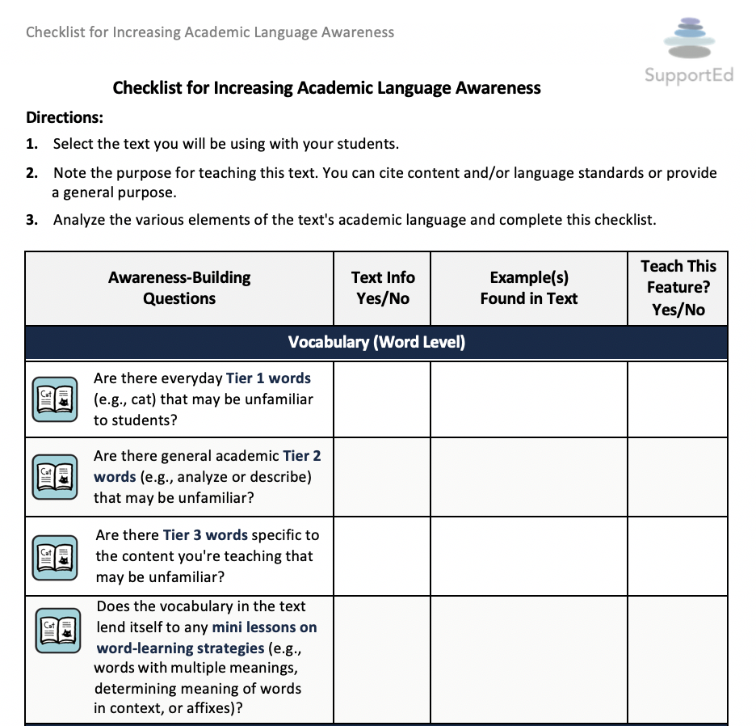
Step 2. Identify Language Demands (Tool 4)
Step 2 Tool: Checklist for Increasing Academic Language Awareness
Staehr Fenner & Snyder, 2017, p. 129
Notes:
Step 2 includes a tool that you can use to analyze a text that you plan to use with your students. It is called the Checklist for Increasing Academic-Language Awareness and can be found on page 6 of your tools packet. It allows you to think about the particular aspects of a text at the word, sentence, and discourse level in order to identify areas that you may want to focus on in support of ELLs’ understanding and engagement.

Slide 44
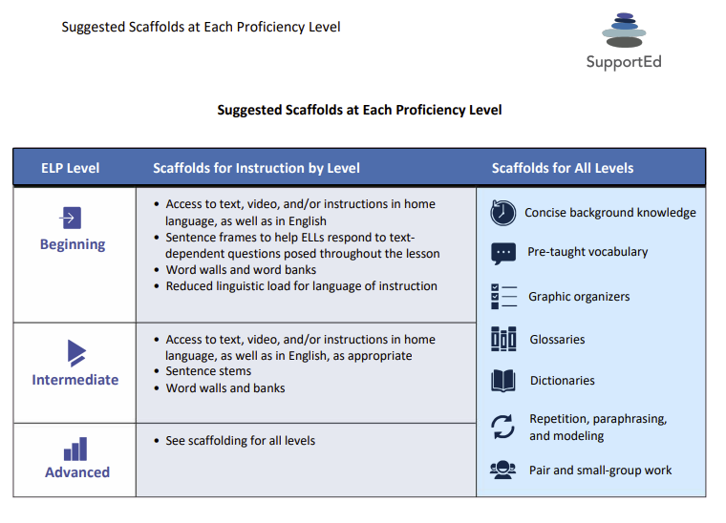
Step 3. Plan the Lesson (Tool 5)
Step 3 Tool: Suggested Scaffolds at Each Proficiency Level
Staehr Fenner & Snyder, 2017, p. 236
Notes:
Once you have analyzed your lesson to identify possible challenges for ELLs, you can begin to plan for the particular scaffolds that you will use in the lesson to meet the needs of your ELLs. Once again, it is important to remember that not all ELLs will require the same scaffolds. Step 3, suggested scaffolds at each proficiency level, is a list of recommended scaffolds for ELLs by proficiency level as well as scaffolds that benefit ELLs at all levels. Knowing the types of scaffolds that might be appropriate for different proficiency levels and tasks can be a challenge, so please be sure to share this tool with colleagues who may find it useful. It can be found on page 8 of the tools packet.

Slide 45
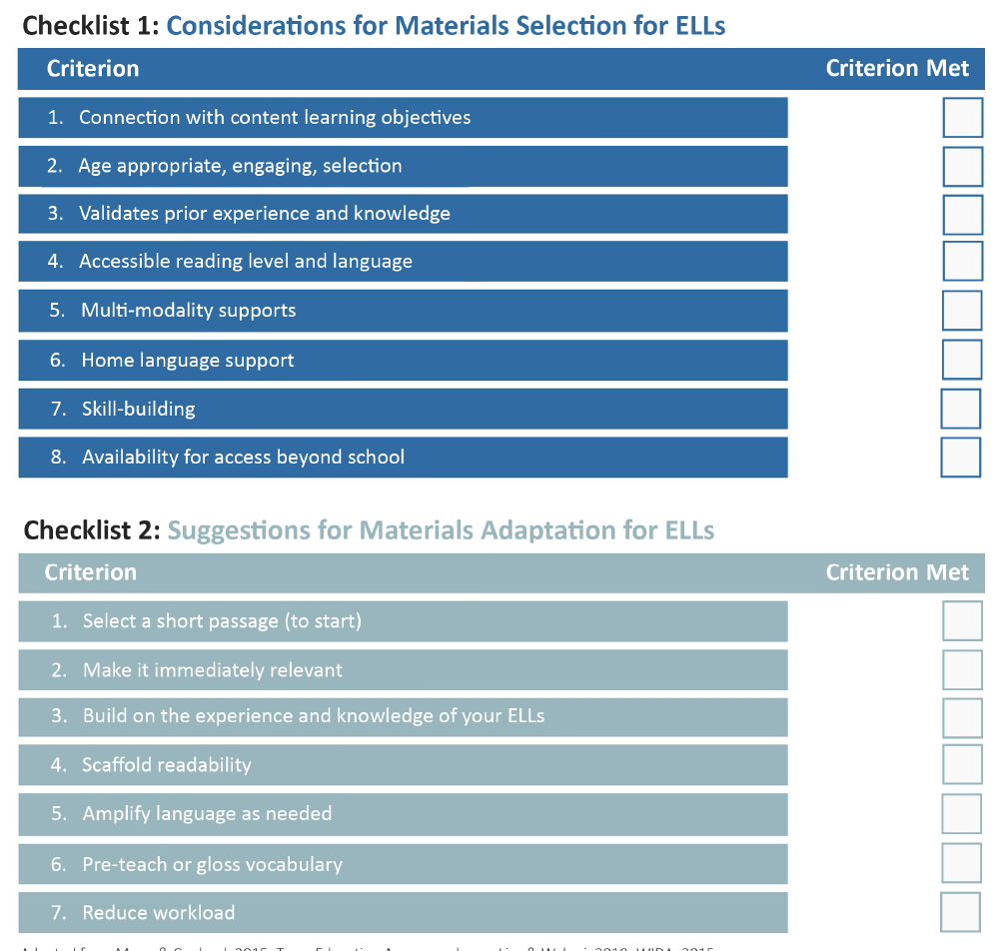
Step 4. Select and Develop Materials (Tool 6)
Step 4 Tool: Materials Selection and Adaption Considerations
Staehr Fenner & Kester, 2017; Adapted from: WIDA, 2015; Custodio & O’Loughlin, 2017; DeCapua & Marshall, 2015; Texas Education Agency, n.d.
Notes:
Once you have planned your lesson, you can begin selecting and developing materials. Step 4, the ELL Materials Checklists, which can be found on page 9 in the tools packet, includes two checklists that you might find useful for this process. Sometimes the thought of preparing scaffolded materials for every lesson can seem daunting, especially if you are trying to scaffold for ELLs at different levels of proficiency. I encourage you to start with one lesson or unit and get a feel for what really seems effective in supporting your ELLs and what is less effective. It can also be very helpful to collaborate with other educators who are developing scaffolded materials. What systems are in place to easily share resources? Your ESOL teachers and school librarians are another great resource for finding new materials. They might be able to help finding translated or bilingual materials or texts at different reading levels. They also might have suggestions for some online resources on different content topics.

Slide 46
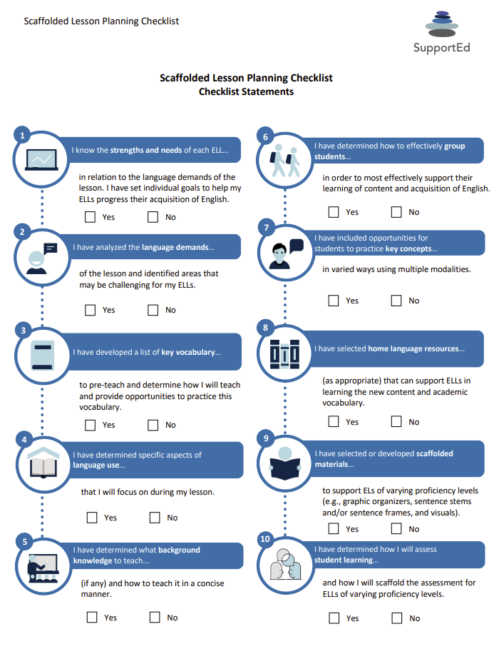
Step 5. Teach the Lesson (Tool 7)
Step 5 Tool: Scaffolded Lesson Planning Checklist
Staehr Fenner & Snyder, 2017 p. 74
Notes:
The final step in the scaffolding process is to teach the lesson. Step 5 is a checklist that you can use to make sure that you have completed all the steps in planning for a scaffolded lesson. It can be found on page 10 in the tools packet.

Slide 47
Lesson Scaffolding Review
What I Know About My ELL (Tool #3)
Checklist for Increasing Academic Language Awareness (Tool #4)
Suggested Scaffolds at Each Proficiency Level (Tool #5)
ELL Materials Checklist (Tool #6)
Scaffolded Lesson Planning Checklist (Tool #7)
Notes:
All of the tools to this 5-step framework for scaffolding instruction are available in your tools packet. Please pause the video now and review the 5 tools.

Slide 48
Application and Wrap-Up
Notes:
The final piece of this webinar is the application activity – planning a scaffolded lesson.

Slide 49
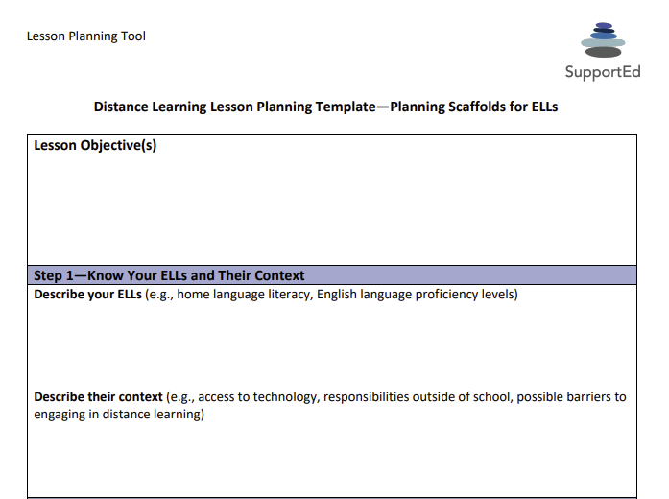
Lesson Planning Template (Tool 8)
Notes:
To support your work in the 5 steps, we’d like to share with you our distance learning lesson planning template – planning scaffolds for ELs. This is a lesson planning tool can be used to synthesize the strengths and needs of your ELLs, particular challenges they might have with the content, and scaffolds that you might potentially use in the three categories of instruction, materials and student grouping.
This scaffolded lesson planning template is available in your tools packet on page 11. Please pause the video and use this lesson planning template to plan for intentionally incorporating scaffolds for ELLs into an upcoming lesson. This is an optional application activity, we recommend you try it out to help you synthesize and apply your learning, but it is not required.

Slide 50
Stop and Think: Reflection
Which new scaffolds you would you like to try?
How will you incorporate scaffolds into your distance or hybrid classroom?
Notes:
Now that you have had a chance to apply your learning, take a moment to stop and reflect. Consider the information that you have learned about scaffolding for ELLs. Which new scaffolds would you like to try? How will you incorporate scaffolds into your distance or hybrid classroom? Consider setting a goal for yourself around your use of scaffolds for ELLs.
Please pause the presentation now to take a moment to stop and think.

Slide 51
Wrap-Up
Notes:
It is now time to wrap-up our webinar.

Slide 52
Objectives Review
Describe
Define
Explore
Apply
Notes:
Our objectives for this webinar were to
Describe challenges and opportunities for ELLs during distance or hybrid learning
Define scaffolding for ELLs
Explore strategies for scaffolding tasks for ELLs during distance or hybrid learning, and
Apply a 5-step framework to scaffold content instruction for ELLs in a distance or hybrid learning environment

Slide 53
Thank You for exploring this important topic!
Twitter: @SupportEduc
Facebook: bit.ly/FBSupportEd
www.GetSupportEd.net
Notes:
This concludes the webinar. I’d like to thank you for joining me in exploring this important topic. Again, my name is Meghan Gregoire-Smith, and it has been my pleasure to share research and strategies for scaffolding instruction for ELLs. Thank you again for all the work you are doing to support students through uncertain times. You can contact us and connect with our team on Twitter or Facebook to continue conversations critical to the success of ELLs. Thank you so much.

