Slide 1
CULTURALLY RESPONSIVE-
SUSTAINING EDUCATION IN
REMOTE AND HYBRID ENVIRONMENTS
Module 3 – High Expectations and Rigorous Instruction

Slide 2
Immersive Scenario Part 1
At work, you were just awarded a major project to complete; you
believe you can do it and are excited to get started. Your supervisor
puts a team in place and meets with all of you to share expectations
and deadlines. The next day, you start work based on what was laid
out in the initial meeting. Soon after you get started, your supervisor
comes in to work alongside you and the team to ensure that the
objectives of the project are met.

Slide 3
Immersive Scenario Part 2
The supervisor reviews each document and provides answers and solutions to
issues you have not even yet had time to address. At one point, the supervisor
tells you that you do not have to complete a certain aspect of the project because
it would be too difficult and would require a different level of expertise. Soon, you
and the team begin simply following the supervisor’s directions. The deadline
arrives and the work is handed in, though you don’t necessarily have a big picture
of what was accomplished.

Slide 4
Immersive Scenario Part 3
What are your thoughts?
Do you believe your supervisor has trust in your abilities to complete this project?

Slide 5
Immersive Scenario Part 4
Alternatively, you meet with your supervisor to discuss the plan of action for completing the project
in a timely manner with your team. You brainstorm ideas and your supervisor provides you with
various resources to support you as you work on the project. Each day, your supervisor checks in
to ask questions, check progress and provide feedback on what has been completed. Your
supervisor provides affirmations and works alongside you and your team as you all grapple with the
challenges that arise. There is a firm adherence to the time frame, staying within the budget, and
meeting all the objectives that were initially set, and your supervisor works alongside you to meet
those goals. You and your team work diligently and are able to accomplish the task at hand,
meeting all the criteria.

Slide 6
Immersive Scenario Part 5
What are your thoughts?
Do you believe your supervisor has trust in your abilities to complete this project?

Slide 7
Immersive Scenario
In many schools, you will see mission or vision statements that include terms such as rigor and high expectations for ALL students. How do we ensure that we are doing more than paying lip service to the phrase high expectations?
When reflecting upon being culturally responsive, the ultimate goal is to facilitate learning to build efficacious students. The bar is the bar, and as teachers, our actions propel the conditions for all students to succeed. At its core, setting high expectations for students is about creating a culture of perseverance and empowerment.

Slide 8
BOR Reflection (7 minutes)
In your breakout rooms….
Quickly introduce yourself and your role to the group
Discuss the question, “How do we ensure that our intentions for high expectations for all students matches our daily actions?”

Slide 9
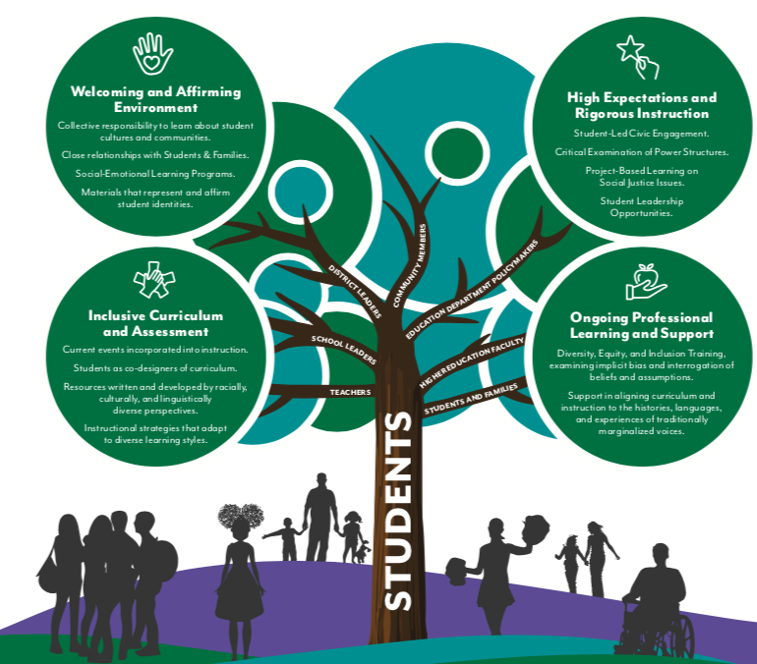
Culturally Responsive-Sustaining Education Framework

Slide 10
Learning Objectives
“The Expectations-Support Connection” — Setting high expectations for all students is
important but requires providing support to ensure all have the resources and learning
opportunities to succeed. How do you create a classroom climate of high expectations in a
remote learning environment?
“Opportunity and Access” — It is important to provide students with opportunities to learn
that are accessible in terms of cognitive levels, learning styles, language, and cultural
relevance. How do you ensure differentiated support in a remote learning environment?
“The Power of Language and Feedback” — Supporting students to achieve at high levels
Involves personalized facilitation through the use of language and feedback in terms of both
academics and the learning process. How do you provide powerful facilitation and feedback in
a remote learning environment?

Slide 11
The Expectations-Support Connection

Slide 12
The Expectations-Support Connect
The Expectations-Support Connection
Sharing Student Work — To design opportunities for students to showcase and share their quality work. This activity includes a website exploration and action tool.
Bias in Remote Learning: Identifying and Addressing Your Biases to Advance Student Achievement — To reflect on your own implicit bias, as well as the systems of bias prevalent in remote learning, and the steps you can take to address that bias and its impact on students. This activity includes a website exploration, reflection questions, and a brainstorm and design activity.
A Climate of Executive Function — To learn about executive function and how to implement strategies for student success. This activity includes an e-text, reflection questions, and an action tool.
Investing in Cultural Pluralism to Empower Learners — To learn about cultural pluralism and how to implement strategies that support student achievement. This activity includes a video, reflection questions, and an action tool.
The Power of Believing That You Can Improve — To understand the importance of creating a growth mindset and develop growth mindset practices within a remote and hybrid learning environment. This activity includes a video, reflection questions, and a brainstorm and design activity.

Slide 13
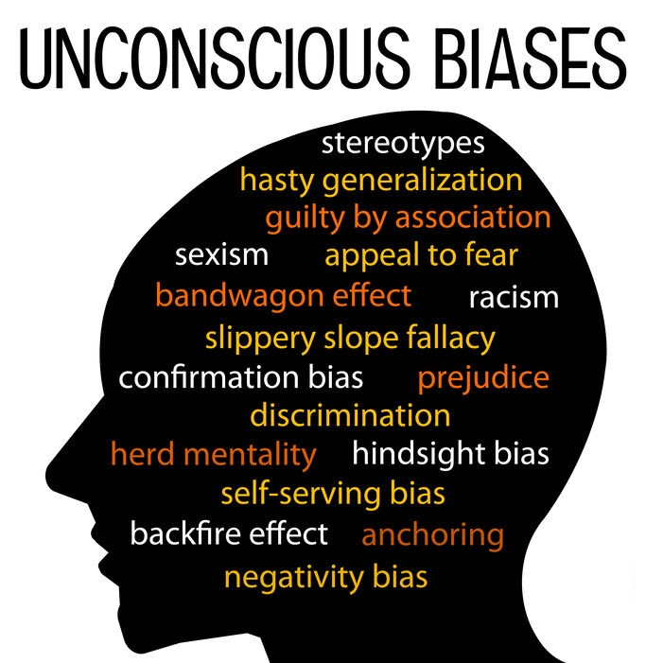
Bias in Remote Learning: Identifying and Addressing Your Biases to Advance Student Achievement (30 – 45 min)
To reflect on your own implicit bias, as well as the systems of bias prevalent in remote learning, and the steps you can take to address that bias and its impact on students.
Notes:
What strikes you about this image? What terms stand out?

Slide 14
Brainstorm and Design
Directions: For each question, rate yourself using the following scale: 1—never, 2—rarely, 3—sometimes, 4—often, 5—always.
Addressing Race and Racism (Frequency)
How often are students given opportunities to learn about people from different races, ethnicities, or cultures in instructional activities and assignments?
How often are students given opportunities to learn from their peers with different backgrounds and cultures from their own?
How often do you think about what students of different races, ethnicities, or cultures experience?
At your school, how often are students encouraged to think more deeply about race-related topics?
How often do remote learners at your school have important conversations about race, even when they might be uncomfortable?
When there are major news events related to race, how often do adults at your school talk about them with students, in any learning environment?
How often do you provide opportunities for students to complete alternative assignments (in place of video conference, synchronous instruction, etc.)?
How often do you collect data on/consider the number of times you call on Students of Color in a video conference?
How often do you collect data on/consider the number of times you provide feedback to Students of Color?

Slide 15
Breakout Room Question
Were there any trends or insights into your unconscious biases that stood out?

Slide 16
Opportunity and Access

Slide 17
Opportunity and Access: Introduction
Authentic Instruction: Exploring PBL — To learn about and design a Problem-Based Learning or Project-Based Learning (PBL) task that creates authenticity for your curriculum. This activity includes a website exploration, reflection questions, and a brainstorm and design activity.
Addressing Race, Racism, and Current Events in Your Remote/Hybrid Environment — To explore strategies that address race and racism to foster high expectations through rigorous instruction of current events. This activity includes an e-text, reflection questions, and a brainstorm and design activity.
Benchmark Lesson — To reflect on the format, purpose, and use of a benchmark lesson and discussion. This activity includes a video, reflection questions, and a brainstorm and design activity.
Five Types of Instructional Activities — To provide a deliberate progression of instructional activities from which all students can learn in remote and hybrid environments. This activity includes a video, reflection questions, and an e-text.

Slide 18
Addressing Race, Racism, and Current Events in your Remote and Hybrid Environment (30 – 45 min)
To explore strategies that address race and racism to foster high expectations through rigorous instruction of current events.
Notes:
What strikes you about this image? What terms stand out?

Slide 19
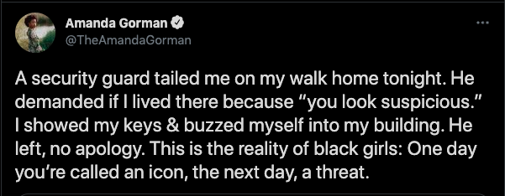
Amanda Gorman: From Icon to Threat
Kelia Anne/Sun Literary Arts via AP
Notes:
We are going to walk through one of the sample lesson plan provided for this activity

Slide 20
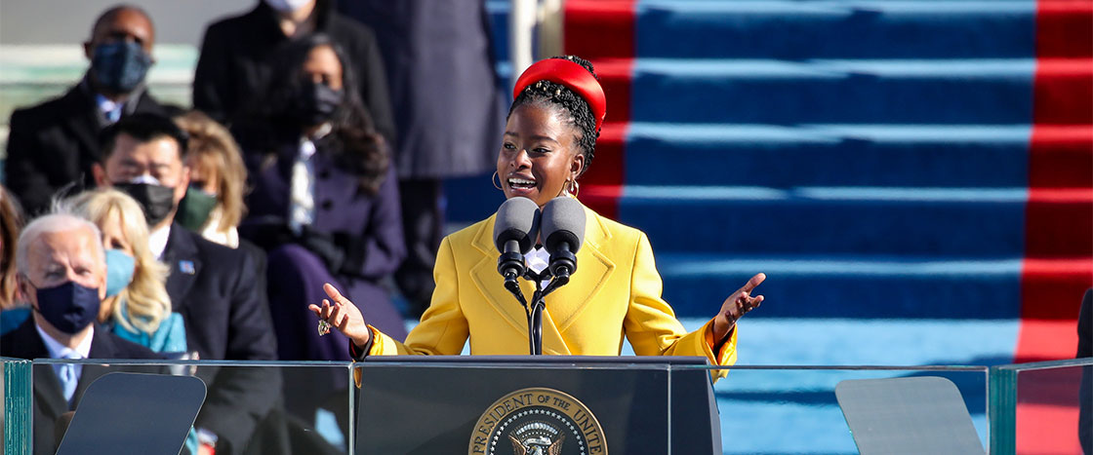
Amanda Gorman: From Icon to Threat (cont.)
Notes:
Take a moment to read some facts about Amanda Gorman. You will be placed in BORs and then will discuss some questions. Link to activity - https://docs.google.com/document/d/1J8Wc5QI0kAxqgq6SI5uYEtYg2jNZjmN7vY8XleOhI1I/edit

Slide 21
The Power of Language and Feedback

Slide 22
The Power of Language and Feedback: Introduction
Asset-Based Feedback Protocol — To analyze the nature and benefits of culturally responsive, asset-based feedback in a remote and hybrid learning environment. This activity includes a website exploration, reflection questions, and an action tool.
Framing Language to Support Achievement — To examine the impact words have on student achievement, classroom climate, and belief in oneself in a remote and hybrid learning environment. This activity includes an e-text, reflection questions, and a brainstorm and design activity.
Providing Culturally Sustaining and Responsive Feedback in a Remote and Hybrid Environment - To determine and implement guidelines for providing effective feedback to students in response to their learning and developmental needs within a remote or hybrid learning environment. This activity includes a video, reflection questions, and an action tool.

Slide 23
Asset-Based Feedback Protocol (25 – 35 min)
To analyze the nature and benefits of culturally responsive asset-based feedback in a remote and hybrid learning environment.

Slide 24
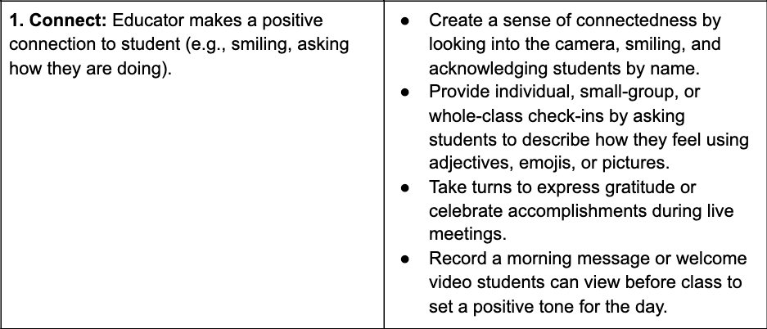
Asset-Based Feedback Protocol - 1

Slide 25
Asset-Based Feedback Protocol - 2

Slide 26
Asset-Based Feedback Protocol - 3

Slide 27
Asset-Based Feedback Protocol - 4
In order for feedback to be effective it must be received as valid and acted upon by students. A trusting relationship between the educator and the student must be established. The educator must deeply believe that the student is capable of rigorous cognitive work and convey that belief authentically to the student. Understanding one’s biases is critical to developing and communicating this belief.

Slide 28
Learning Objectives (review)
“The Expectations-Support Connection” — Setting high expectations for all students is
important but requires providing support to ensure all have the resources and learning
opportunities to succeed. How do you create a classroom climate of high expectations in a
remote learning environment?
“Opportunity and Access” — It is important to provide students with opportunities to learn
that are accessible in terms of cognitive levels, learning styles, language, and cultural
relevance. How do you ensure differentiated support in a remote learning environment?
“The Power of Language and Feedback” — Supporting students to achieve at high levels
Involves personalized facilitation through the use of language and feedback in terms of both
academics and the learning process. How do you provide powerful facilitation and feedback in
a remote learning environment?

Slide 29
CULTURALLY RESPONSIVE-
SUSTAINING EDUCATION IN
REMOTE AND HYBRID ENVIRONMENTS - Conclusion
Module 3 – High Expectations and Rigorous Instruction

