Slide 1
SHIFTING TO ONLINE LEARNING
SESSION #3
Building Relationships, Community and Communication

Slide 2
What is eTEACHNY?
eTEACHNY is a coalition of education partners who have come together to support the implementation of the Teaching in Remote Learning Environments (TRLE) Initiative
Notes:
Steph

Slide 3
Coalition partners and areas of focus
NYSED was awarded a grant to implement a Teaching in Remote/Hybrid Learning Environments (TRLE) initiative. Six applicants were selected to develop resources to support the TRLE initiative.
Coalition partners | Areas of focus
Broome-Tioga BOCES | Students with Disabilities
Mohawk Regional Information Center (MORIC) | Families as Partners
Eastern Suffolk BOCES | Culturally Responsive Education
Monroe2-Orleans BOCES | English Language/Multiple Language Learners
WSWHE BOCES | Shifting to Online Learning
Greater Southern Tier BOCES | Social Emotional Learning (SEL)
Notes:
Steph

Slide 4
Presentation Structure
Phase 1: Setting the Stage: mindful planning
Phase 2: Secure your Safety Belt: taking care of yourself first
Phase 3: Welcoming your Learners: focus on connectedness
Phase 4: Warming up the Think Tank: building predictability
Phase 5: Connections During the Lesson: connectedness
through collaborative work
Phase 6: Students Drive the Learning: empowering student voice
Phase 7: Closing: checking in before checking out
Phase 8: Communicating With Families: establishing partnerships
Link to note-catcher
Notes:
During today’s presentation we will be offering information and ideas on how to build community and enhance communication during these eight phases of instruction. The focus will be on the importance of building community and structures for predictability in an online environment, but much of what we share today will also be pertinent to in person learning.

Slide 5
Turnkey Options for Regional Training
Option 1
Option 2
Option 3
Use the following comprehensive slide deck to deliver learning experiences holistically or in parts.
(synchronously or asynchronously)
Utilize the note catcher or other reflection form of your choice to engage in an exploration of e-notebook # 3 (synchronously or asynchronously)
Select individual materials from e-Notebook #3 to use for learning experiences based on the targeted needs of your region.
(synchronously or asynchronously)

Slide 6
SETTING THE STAGE
When you set the stage, you build the foundational structure for your classroom community by establishing classroom agreements, rituals, and routines.
For example, you and your students may co-author an agreement that, if a bathroom break is needed, students will write “2 minutes” in the chat to signal that they are departing and will return shortly.
1
Notes:
The first phase of building classroom community and communication is to set the stage for online, in person, or hybrid learning. Setting the stage for learning means laying the foundational structures on which your classroom is built. These are elements that are necessary to have in place prior to engaging students in content, because they show students how to function in the larger classroom setting, and set the expectations for how we act, interact, and participate, to name a few. Three ways to set the stage are to build classroom agreements, rituals, and routines with students.
Once this solid foundation is built, students will be invested in and clear about the predictable elements of the larger classroom community, and can then spend their mental focus on acquisition of content. Agreements, rituals, and routines are essential to begin the year with, but must be adapted and managed as they year goes on and students, behaviors, or formats of instruction change.

Slide 7
Build Community: Agreements
Agreements should be developed as a classroom community to establish:
student behavioral expectations
strategies to engage in discussions and
ways to collaborate as a team.
Behavior
Discussion
Team Building
Notes:
One way to set the stage is with classroom agreements. Agreements should be co-developed with students, and should clarify the behavioral expectations, how the classroom community engages and discusses in a virtual or hybrid environment, and what it looks, sounds, and feels like to collaborate as a team. These agreements, once written, should be posted in your physical or virtual classroom, modeled, practiced, and referred to often to routinize the common language you’ve built as a class.

Slide 8
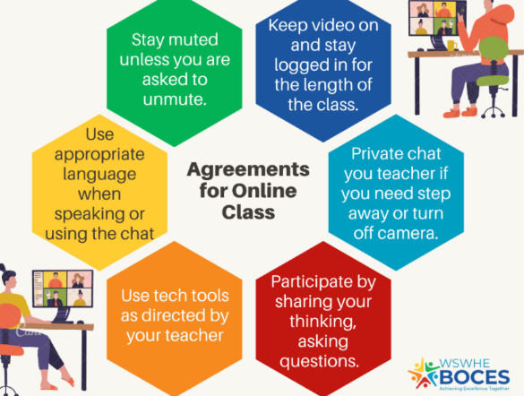
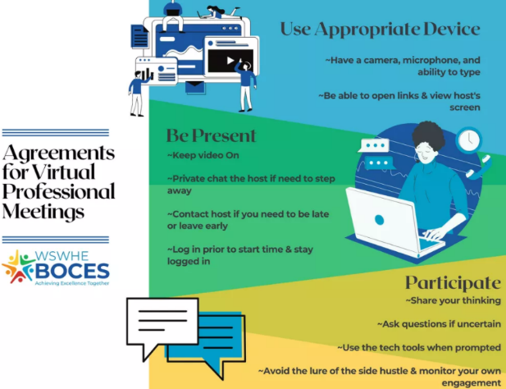
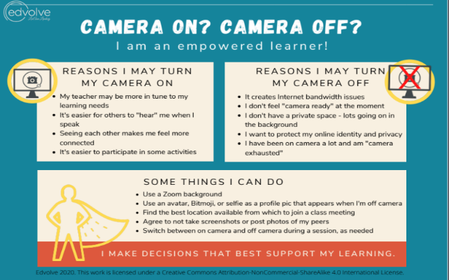
Classroom Agreements
Notes:
Here are some examples of class agreements written with students for the virtual classroom. What do you notice? What do you wonder?

Slide 9
Build Community: Rituals and Routines
Check Ins
Work Submission
Instruction
Routines should be established and clearly communicated to all stakeholders for how to:
check in with students
submit work and
engage in instructional experiences
Notes:
Another way of setting the stage to build a strong foundation for your virtual, hybrid, or in person learning environment is to establish very clear rituals and routines. Examples of these rituals and routines include but are not limited to: how and when teachers will check in with students, how students will submit work, and how to engage in instructional experiences. While these rituals and routines are always important, no matter what the format of instruction, they do often differ between formats. For instance, a routine for turning in work in person may be to place it in a basket at the front of the room, while the same routine for a Google Classroom may be to submit to a particular folder in the Google Classroom. These distinctions are really important to make for students so that expectations are clear and predictable, and will allow students to focus on the content itself, rather than the logistics behind it.
Possible article connection: https://www.edutopia.org/article/establishing-routines-remote-learning

Slide 10
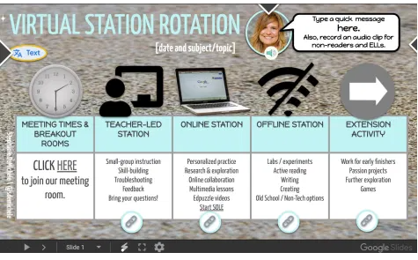
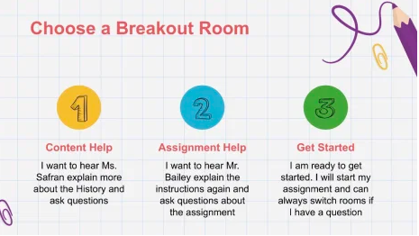
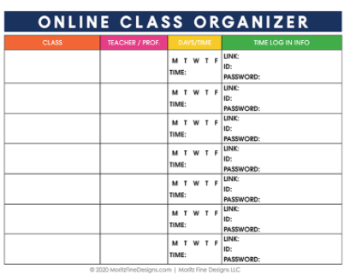
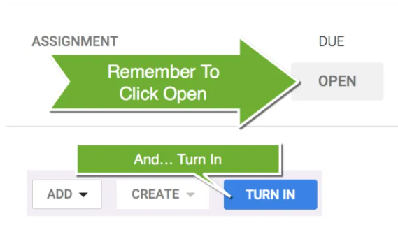
Classroom Rituals and Routines
Notes:
Here are some rituals and routines for a virtual world that can be established to set the stage for your classroom. What do you notice? What do you wonder? What else would you add to these?

Slide 11
REFLECTION: SETTING THE STAGE
1
In your note-catcher, consider:
How will the “setting the stage” phase look for me and my students? What tangible takeaways can I apply tomorrow?
Notes:
Use this time to capture notes on phase 1 take-aways. On your note catcher, there is also a place to write out explicitly how this phase can be applied to you and your students.

Slide 12
SECURE YOUR SAFETY BELT FIRST
When you secure your safety belt first, you check in with yourself and your emotional readiness to ensure a smooth start to instruction.
For example, prior to a lesson, you may realize that you are feeling anxious. Take 30 seconds to practice mindful breathing before welcoming your students.
2
Notes:
The second phase of building classroom community and communication is the secure your safety belt first. This is when we get a chance to practice and model self care for ourself and our students. Self care is a part of social emotional learning and as we have experienced all levels of change during the pandemic, so have we experienced all levels of stress. It is important as educators we are taking care of ourselves as well as taking opportunities to model for our students how to do this through engaging them in mindfulness practices, and also allowing them the time and space they need to prepare to enter the learning environment.

Slide 13
SECURING OUR SAFETY BELTS: PRACTICE
Notes:
One way to practice securing our safety belts is to practice mindful breathing. We are going to take a moment to practice right now! As we do, keep in mind how you feel before, during, and after, and how this activity might be useful to you and your students as they prepare for the day/ lesson.

Slide 14
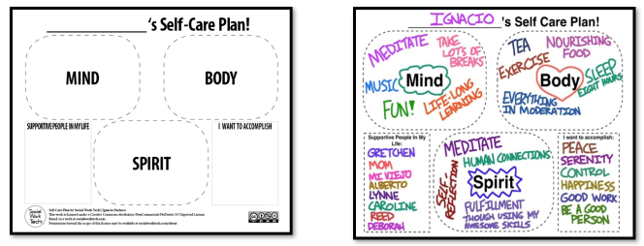
Modeling Self Care For Students
Notes:
Here are some other examples of how to practice self-care, including creating self-care plans, and examples of different types of self care that teacher and students can do.

Slide 15
SECURE YOUR SAFETY BELT FIRST: Notes
2
In your note-catcher, consider:
How will the “securing our safety belts” phase look for me and my students? What tangible takeaways can I apply tomorrow?
Notes:
Use this time to capture notes on phase 2 take-aways. On your note catcher, there is also a place to write out explicitly how this phase can be applied.

Slide 16
WELCOMING YOUR LEARNERS
Focus on connectedness, not content:
Prioritize relationships
teacher to student
student to teacher
student to student
Honor students’ identities
Consider student social emotional readiness
3
Notes:
Now that you have planned consistent routines and structures and you have ensured you are in a good space to begin your lesson, you are ready plan for the third phase of building community and communication in you classroom which is being thoughtful of how you welcome your students. This time should be designed to connect and check in with your students at the beginning of your time together. Be aware of how you greet your students as they enter the classroom. Purposefully begin with an activity that is focused on connectedness, not content. Decades of research show that by building relationships and establishing classroom cultures have a positive impact on learning. When students feel safe, appreciated, heard and accepted they are more likely to take risks and engage in their learning.

Slide 17
Building a sense of community
Community
What is it?
Aligning SEL Competencies
Why it matters:
Community is a emotionally and physically safe and supportive learning environment that promotes all students’ social and emotional development.
By establishing a classroom community, students are better able to express themselves, empathize with their classmates, and take risks with their learning.
Self Awareness
Social Awareness
Relationship Skills
Notes:
The Collaborative for Academic, Social and Emotional Learning, CASEL, has identified 4 Critical Actions for reopening of schools. The 3rd action describes the importance of building a healthy learning community for your students. Phases 1-3 set the foundation for creating the safe and welcoming space where students feel valued.
https://docs.google.com/presentation/d/1dr304Zpw3CWsOeZdiuYfJxKW1EH4Pkp6ip1R9BYdJmg/edit#slide=id.g8ec7c78a32_0_0

Slide 18
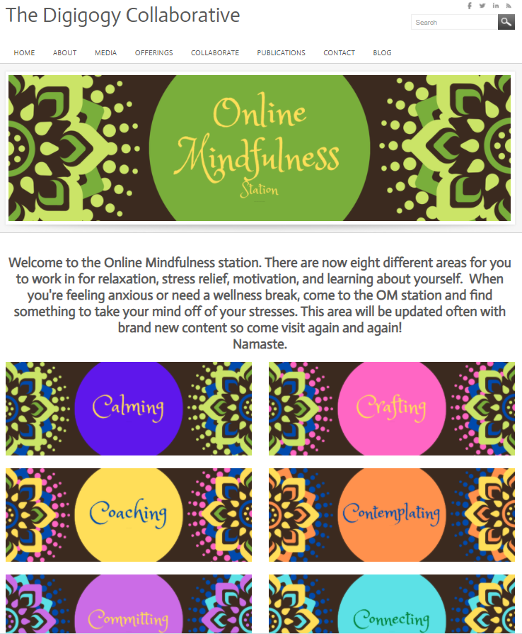
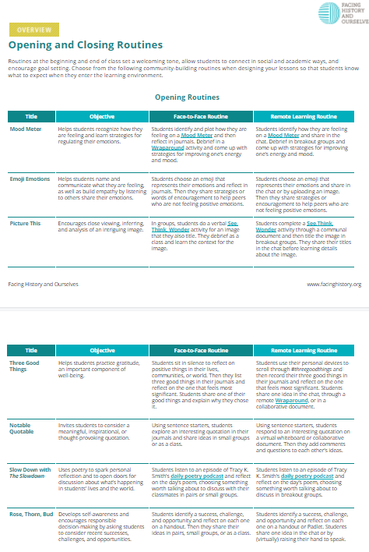
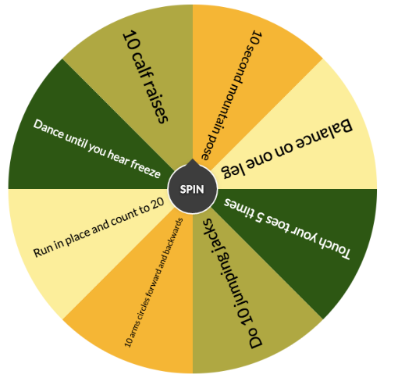
Ideas for welcoming students
Notes:
Facing History and Ourselves and The Digigogy Collaborative are just two many sites that have some great ideas for virtual opening activities that help to build relationships and attend to students social emotional readiness before jumping into lessons. These ideas can be used in any setting. Let’s jump in to each site and take a look.

Slide 19
WELCOMING YOUR LEARNERS: Notes
In your note-catcher, consider:
How will the “welcoming your learners” phase look for me and my students? What tangible takeaways can I apply tomorrow?
3
Notes:
Take a minute to capture any new thinking in your note catcher.

Slide 20
WARMING UP THE THINK TANK
4
Engaging student inquiry through entry activities:
Predictability builds stability
Connecting content and community
Notes:
Now you are ready to engage your learner in the content for the day. In the fourth phase you have an opportunity to build community and connections. Your bellringer or opening activity should be designed so that the student is beginning to engage prior thinking and preparing for the academic learning for the day. This time can also be designed to continue to build community through collaborative options and options that allow for student sharing.

Slide 21
Warm up routines build a sense of safety.
Predictability
What is it?
Aligning SEL Competencies
Why it matters:
This is an uncertain time for students, families and teachers. Unpredictability can create a sense of insecurity as normal routines are lost. Creating predictability around learning and school helps provide a sense of safety and a feeling of normalcy in an uncertain environment.
Providing predictability means establishing routines such as warming up the think tank.
Self Awareness
Self Awareness
Self Management
Responsible Decision Making
Notes:
By creating predictable routines such as entry routines that engage content and community, students are better able to transition into learning. In an online environment, these routines are even more important as students transition not from one class to another via the school hallway, but through any number of possible experiences from home. Many times students have competing needs in their home environments that make it even more challenging to remain engaged in learning. Routines including content and community help to increase that engagement.

Slide 22
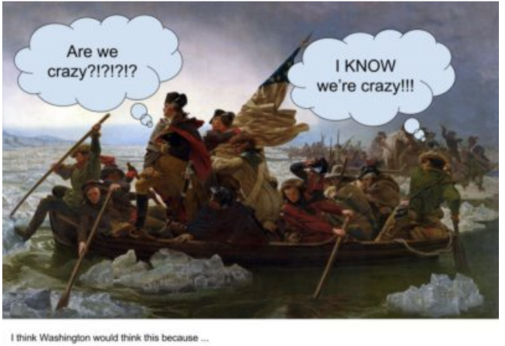
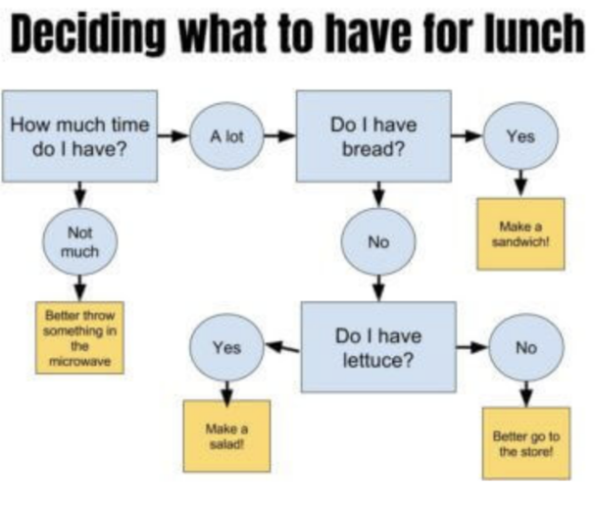
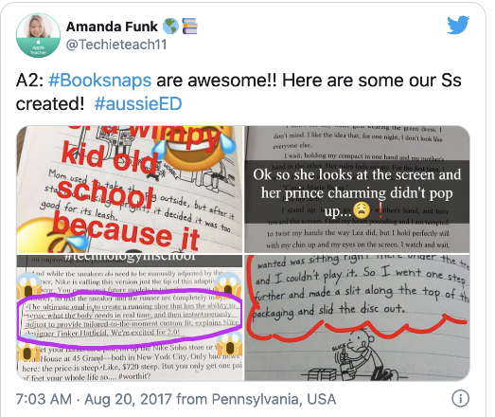
Ideas for Virtual Bellringer Activities
What
if . . .
Notes:
After you have allowed students time to center themselves, you can now begin to engage them in thinking about the content for the day. Here are some ideas for community building bellringer activities in a virtual environment. Present an image from your topic and ask students to add speech bubbles, have your students pick a famous person from your topic (an author, mathematician, person in history, scientist) and have them ask a question of that person. Have your students create a flowchart using Google Slides/Drawings to demonstrate the understanding of a concept. Have your students pick a passage from a reading that resonates with them, ask them to take a picture and annotate their thoughts to share with the class. Post a “What if . . “ questions to do with your topic and allow your students to explore thinking beyond the classroom. Find more ideas like these at ditchthetextbook.com.
https://ditchthattextbook.com/10-digital-bell-ringer-activities-to-kickstart-class-part-1/

Slide 23
WARMING UP THE THINK TANK: Notes
4
In your note-catcher, consider:
How will the “warming up the think tank” phase look for me and my students? What tangible takeaways can I apply tomorrow?
Notes:
Take a minute to capture ideas for how you can begin to engage your student thinking through a virtual bellringer activity.

Slide 24
CONNECTIONS DURING THE LESSON
Hattie (2009) found: • an effect size of 0.59 for cooperative learning when compared to individual work • an effect size of 0.54 for cooperative learning when compared to competitive learning.
classroom discussion= .82
jigsaw activity= 1.20
5
Notes:
During the fifth phase of building community and communication, you can plan for allowing students to work collaboratively to build connections in content and in community. John Hattie’s research on the effect size of instructional practices show that cooperative learning has a greater impact on student growth than individual or competitive learning. Specifically, classroom discussions have an effect size of .82 and jigsaw activities have an effect size of 1.20. Collaborative work not only positively supports student academic growth, it also supports social emotional growth by building:
Positive Interdependence– The idea that the success of the group depends on the success of each individual.
Promotive Interaction– Students should be expected to actively help one another.
Individual and Group Accountability– The group is assessed both as a whole and individually, holding each individual accountable.
Development of Teamwork Skills– Students are learning academic material as well as how to work in groups.
Group Processing– Students assess their group’s productivity and discuss where changes are needed.
(taken from https://www.peertutoringresource.org/2016/03/the-why-and-how-of-collaborative-learning/)

Slide 25
Building a sense of connectedness
Connectedness
What is it?
Aligning SEL Competencies
Why it matters:
During this time, many of the relationships students have changed in the frequency of interactions or the way they interact. Focusing on making and keeping connections is important for students as they struggle through uncertain times. Being connected to others is linked to resilience.
Being connected with others means having relationships with others who understand and care about you. Relationships are key to being connected with others.
Self Awareness
Relationship Skills
Social Awareness
Notes:
Through collaborative work, students continue to build connectedness within their academic community. By designing purposeful ways to have students work together, you are fostering the development of student self awareness, relationship skills and social awareness, three of social emotional competencies identified by CASEL.

Slide 26
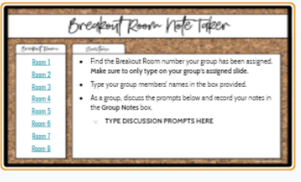
Examples of Collaborative Learning Online
break-out group discussions
jigsaw activities
brain writing
peer review
note-taking pairs
collaborative debates
daily discussion questions
think-pair-share
Notes:
Here are some examples of how to bring collaborative learning into your virtual classroom.
https://www.eduflow.com/blog/online-collaborative-learning-strategies-to-keep-students-engaged-while-at-home
https://www.peertutoringresource.org/2016/03/the-why-and-how-of-collaborative-learning/

Slide 27
CONNECTIONS DURING THE LESSON: Notes
5
In your note-catcher, consider:
How will the “connections during the lesson” phase look for me and my students? What tangible takeaways can I apply tomorrow?
Notes:
Reflect using your note catcher on how you can bring more collaborative learning into your virtual classroom.

Slide 28
STUDENTS DRIVE THE LEARNING
Why, What, How
“Why is about relevance.” Students will invest in learning if they understand the importance.
“Let student interests drive the content that teaches skills and concepts.” Students will feel valued and heard.
“Offer a variety of product options based on what you know about your students.”
— John McCarthy
6
https://www.edutopia.org/blog/student-centered-learning-starts-with-teacher-john-mccarthy
Notes:
From the article, “Student Centered Learning Starts with Teachers” by John McCarthy-
Why is about relevance. Learners need to understand the value of the subject, vocabulary, and skills before they are willing to invest effort. The answers "It's required curriculum," "You need it for the test," or "Because I say it's important" are intended to save time, but they only result in students giving lip service to the rest of instruction. Gathering input from students allows teachers to plan for opportunities that match student interest. This will provide that necessary engagement that is foundational to giving students the reigns. What is learned involves students choosing the focus of content. Let their interests drive the content that teaches skills and concepts. For example, when learning how to write persuasively, some students may want to deconstruct commercials, product reviews, op-eds, and/or social issue points of view. The best strategy is simply asking what students want to explore. Start with a brainstorm of what they like to do, and dialog together to match their interests with the skills and concepts. How learning will be demonstrated depends on the different ways that students processes understanding. Offer a variety of product options based on what you know about your students. A safe approach is to offer three options. The teacher designs two options based on what most students may like to do. The third choice is a blank check -- students propose their own product or performance. If a proposal meets the academic requirements, perhaps with some negotiation, the student gets a green light. Some examples include using Minecraft to design models and prototypes, presenting through social media tools, or writing in a professional medium.

Slide 29
Creating an Environment for Student Centered Learning
EMPOWERMENT
What is it?
Aligning SEL Competencies
Why it matters:
By empowering students, educators can give back some control to students that they feel they lost in the current setting. Teaching students to consider choices or authentic problems allows them to build self-awareness and insight into their own feelings and understandings. It also lets them develop their social awareness and relationships.
Empowerment means giving students voice, choice and allowing them to participate in shared decision making.
Self Awareness
Relationship Skills
Social Awareness
Responsible Decision Making
Notes:
Students need to feel empowered if you want them to drive the learning. In a virtual space it is even more critical to make them feel like they own the experience and are not just attending. If we think about empowerment, it hones in on some of the SEL competencies that we need to encourage our students to practice and refine. Some of the more obvious competencies are self awareness, relationship skills, social awareness and responsible decision making. By empowering students, educators can give back some control to students that they feel they lost in the current setting. Teaching students to consider choices or authentic problems allows them to build self-awareness and insight into their own feelings and understandings. It also lets them develop their social awareness and relationships.

Slide 30
Toolbox for Student Centered Learning
Tools | Examples
Authentic Tasks | Types and Examples of Authentic Tasks
Choice Boards | Grade 3-5 EL
Students Ask the Questions | Question Stems 10 Simple Ways to Encourage Students to Ask Questions
Collaborative Learning | Collaborative Discussion Techniques & Reciprocal Teaching
Notes:
The tools included on this slide give you an idea of how to plan for opportunities to allow students to drive the learning. You could plan for authentic tasks, choice boards, stems to provide space for students to ask questions and create purposeful conversation platforms.

Slide 31
STUDENTS DRIVE THE LEARNING
In your note-catcher, consider:
How can I be sure to plan for student centered learning and opportunities for students to drive the learning?
What tangible takeaways can I apply tomorrow?
6
Notes:
Reflect, using your note catcher, on how you plan to ensure that your classroom environment in the virtual space empowers learners and allows for students to take the driver’s seat to own the learning. Consider those things that you could put into play immediately.

Slide 32
CLOSING
Closing routines provide an opportunity for students to check in before checking out.
This allows them to:
re-establish connections
summarize learning
reflect on emotions and needs
set up goals that are both academic and personal.
Also allows the teacher to gauge progress and needs.
7
Notes:
We mentioned earlier that predictability is a powerful tool for students to feel safe and secure in the learning environment. The same holds true for mapping out a consistent and purposeful closure to every learning session. Once in the routine, students will be preparing for the wrap up at the end of a lesson. They will recognize this opportunity to re-establish connections, summarize their learning, reflect on emotions and needs and set up goals that are both academic and personal. The closure is also a chance for the teacher to gauge progress and needs of the students to be able to plan next steps based on readiness.

Slide 33
Providing Opportunity for Metacognition
Metacognition
What is it?
Aligning SEL Competencies
Why it matters:
Students need an opportunity to reflect on their learning. If the purpose of the lesson is clear, students should be able to identify where they are in the learning continuum and can practice advocating for their needs and goals. This investment builds a growth mindset and supports ownership of learning.
Metacognition is thinking about thinking or becoming aware of one’s knowing.
Self Awareness
Responsible Decision Making
Notes:
The process of closure builds the skill of metacognition or thinking about one’s knowing. This ties in nicely with the SEL competencies of self-awareness and responsible decision making. Giving students the space for closure allows them to identify where they are in the learning continuum and practice advocating for their needs and goals. This investment builds a growth mindset and supports ownership of learning. This time and space should be planned in to the virtual lesson time and not once the virtual session is shut down to demonstrate the importance of this activity.

Slide 34
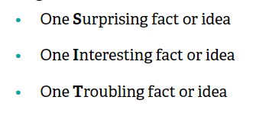
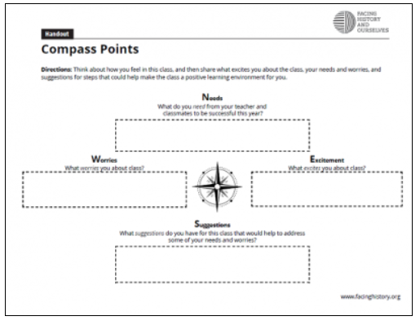
Examples for Closing
Closing Challenge
Notes:
There are multiple resources for closure activities. These are just a few. What do you notice? What would you do to adapt some of these “tried and true” practices to the virtual setting? https://www.facinghistory.org/resource-library/back-school-2020-building-community-connection-and-learning/establishing-opening-closing-routines

Slide 35
CLOSING: Notes
In your note-catcher, consider:
How can I be sure to plan for meaningful lesson closure?
What tangible takeaways can I apply tomorrow?
7
Notes:
Reflect, using your note catcher, on how you can plan for more meaningful and purposeful lesson closure in your classroom.

Slide 36
COMMUNICATING WITH FAMILIES
Building a relationship with parents and families is important. Effective communication is a time for parents and teachers to share valuable information about the student.
Points to consider:
Everyone's situation is different.
Find out what works best for parents.
Being flexible is key.
Different families have different needs and schedules.
Make yourself available. Offer office hours where parents or students can reach out.
8
Notes:
Susan Graham-Clay states in her article about communicating with parents that “Teachers strive to establish partnerships with parents to support student learning. Strong communication is fundamental to this partnership and to building a sense of community between home and school. In these changing times, teachers must continue to develop and expand their skills in order to maximize effective communication with parents.”
https://www.adi.org/journal/ss05/Graham-Clay.pdf

Slide 37
When to Communicate
Schedule
Plan
Frequency
Notes:
A student who knows that the teacher communicates on a regular basis with their parents and who knows that their parents trust the teacher will likely put more effort into school. Start the communication process early. Let parents and families know when you will be communicating and how often.

Slide 38
How to Communicate
Modalities
Use at least three different methods of communication to reach families
Process
Provide opportunities for two way communication.
Consider Options:
No Tech
Low Tech
High Tech
Notes:
Susan Graham-Clay states in her article about communicating with parents that “Communication should involve one-way and two-way exchanges. One-way communication occurs when teachers seek to inform parents about events, activities, or student progress through a variety of sources, such as an introductory letter at the beginning of the school year, classroom or school newsletters, report cards, communication books, radio announcements, school Web sites, and so on. Two-way communication involves interactive dialogue between teachers and parents. Conversations may occur during telephone calls, virtual meetings, parent-teacher conferences, surveys and emails. Teachers should actively incorporate both strategies to maximize sharing information with parents.”
https://www.adi.org/journal/ss05/Graham-Clay.pdf

Slide 39
What to Communicate
Group:
Attendance expectations
Participation expectations
Instructional expectations
Required components
Learning Targets and Topics
Individual:
Student Progress and opportunities for support
Article by Web Business

Slide 40
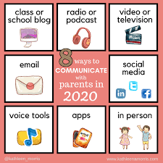
Tools to Communicate with Families
Notes:
Here are some tools that you could consider when planning for communication with families. What else would you add? What have you used that has been effective?

Slide 41
COMMUNICATING WITH FAMILIES: Notes
8
In your note-catcher, consider:
How can I enhance my communication efforts?
What tangible takeaways can I apply tomorrow?
Notes:
Susan Graham-Clay states in her article about communicating with parents that “Teachers should attempt to use a variety of effective strategies to make communication with parents as informative and interactive as possible, incorporating new communication methods and yet retaining the human connection.” Every communication exchange, regardless of format, should reflect a thoughtful, planned approach and should be viewed as an opportunity for teachers to promote parent partnerships and, ultimately, to support student learning. Reflect using your note catcher on how you can enhance your communication efforts in your classroom.
https://www.adi.org/journal/ss05/Graham-Clay.pdf

Slide 42
Thank you

Slide 43
Resources
Attention Infographic Trust.pdf
Video Etiquette Padlet
Building Community Slides
Krause, C. (2020). How to Forge a Strong Community in an Online Classroom. Edutopia. retrieved from https://www.edutopia.org/article/how-forge-strong-community-online-classroom
Krause, C. (2020). Three Ways to ‘Get Grounded’ at the Beginning of Hosting Your Online Session. Retrieved from https://caitlinkrause.com/2020/04/09/3-ways-to-get-grounded-at-the-beginning-of-hosting-your-online-session/
SEL for the Remote School Year Slides
Priorities by: Alex Shevrin Venet
Article by: Kara Newhouse, available at: kqed.org
https://www.kqed.org/mindshift/55679/four-core-priorities-for-trauma-informed-distance-learning
Virtual Station Rotation
Google Meeting Visual
Self care plans 1 and 2
Class agreements
Serravallo, J. (2021). Connecting with Students Online.Portsmouth, NH: Heinemann.
The Why and How of Collaborative Learning
CASEL
https://www.adi.org/journal/ss05/Graham-Clay.pdf

