Slide 1
Welcome!
As you arrive…
Prepare any materials that support your learning
Introduce yourself in the Zoom Chat
Name
School or organization representing, and role.
Notes:
5 minutes - Jess

Slide 2
TRLE SEL Session #2 Embedding SEL Schoolwide
Notes:
Beth Slides 2-6 5 minutes

Slide 3
What is eTEACHNY?
eTEACHNY is a coalition of education partners who have come together to support the implementation of the Teaching in Remote Learning Environments (TRLE) Initiative
Notes:
Steph

Slide 4
TRLE – Teaching in Remote/Hybrid Learning Environments
NYSED was awarded a grant to implement a Teaching in Remote/Hybrid Learning Environments (TRLE) initiative.
Six applicants were selected to develop resources to support the TRLE initiative.
Coalition Partners
Areas of Focus
Broome-Tioga BOCES
Mohawk Regional Information Center (MORIC)
Eastern Suffolk BOCES
Monroe2-Orleans BOCES
WSWHE BOCES
Greater Southern Tier BOCES
Students with Disabilities
Families as Partners
Culturally Responsive Education
English Language/Multiple Language Learners
Shiftin to Online Learning
Social Emotional Learning (SEL)
Notes:
Steph

Slide 5
Develop and curate resources with coalition partners
Deliver turnkey trainings
Trainings will be recorded
Follow up email after training:
Training resources
Exit reflection
Links to eTeachNY website and social media
Notes:
Steph 5 minutes for slides 3-6

Slide 6
Your Role...
Schedule and publicize trainings
Must be open to all NYS teachers at no cost
Collect registration data
Teacher’s name, district, grade level/content area
Issue CTLE credits
Distribute reflection survey following each training
Notes:
Steph

Slide 7
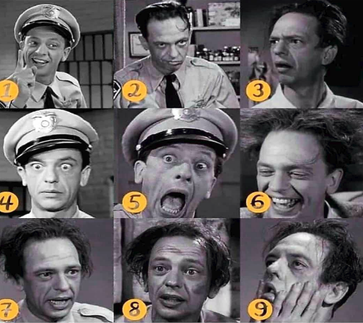
Stages of Barney Fife
Welcoming Inclusion Activities (1-9 minutes)
Adults bring their experience; allow them to use it.
Rituals or routine openings establish safety and predictability, support contribution by all voices, set norms for respectful listening, and allow people to connect with one another creating a sense of belonging. To be successful these activities must be: carefully chosen, connected to the work of the day, engagingly facilitated, and thoughtfully debriefed.
Examples
Community Building: Using an open-ended question(e.g. fromSEL Reflection cards),build community in a quick and lively way. Each participant shares their response with a partner. After sharing, ask for 2-3 comments for the whole group.
Check-in: Begin with a sentence starter:
“A success I recently had___.”
“One thing that’s new ___.”
“One norm I will uphold today is ___.”
Look to establish and help maintain positive relationships
When teachers use purposefully and connect it in some way to the learning of the day… it strengthens the curricular connections and climate of the classroom.
Promote engagement and allow for a check in with students

Slide 8
Norms
General best practices of all productive groups
We agree…
To proactively see and consider diverse voices, ideas, and perspectives
Pausing, Paraphrasing, Asking Questions, Listening
To embrace a mindset that promotes my own and other’s learning
Be Present, Listen, Put Ideas on the Table, Presume Positive Intentions
To see opportunities to show gratitude and celebrate with colleagues
Be Present, Presume Positive Intentions, Ask Questions, Offer Support, Thank One Another
Notes:
Steph – 2 minutes
Consider the use of "our learning" verbiage to support that everyone in the room is learning and this is a shared experience with principals and staff. Norms/agreements can change based upon the group meeting and the needs of the group.
Option: Have a 4th or 5th norm decided by a poll
7 min

Slide 9
Long Term Learning Target
To build the capacity of teachers and educational leaders to effectively integrate SEL in remote learning environments for all students.
Notes:
Jess
Goal specific to the grant – the whole SEL grant, units, the main focus
2 min

Slide 10
e-Learning Series
Session # | Topic | Date
1 | Introduction to SEL | 2/11/21
2 | Embedding SEL Schoolwide | 3/18/21
3 | Creating a PL Culture Based on SEL | 4/22/21
4 | Integrating SEL into a Culturally Responsive Classroom | TBD
5 | Identifying and Selecting Evidence Based SEL Programs | TBD
6 | Classroom-based SEL Activities to SUpport Student Development of the 5 Core Competencies | TBD
The original module materials are from the Washington Office of Superintendent of Public Instruction - https://learn.ospi.k12.wa.us/
Additional resources sourced from CASEL - https://casel.org/.
Notes:
Steph
Our e-Learning Series will cover 5 Overarching SEL topics with each unit rolling out every 6 weeks. There will also be professional learning opportunities in between the unit topics that will include classroom-based SEL Activities and other areas around SEL. We are thankful for the support from Greece CSD, CITI BOCES, and the resources from CASEL, American Institute for Research and OSPI
3 min

Slide 11
Objectives for our learning today...
Describe a systemic approach to implement SEL, using implemented models, recognizing that schools and districts can promote social and emotional development even in times of budgetary stress and leadership turnover.
Recognize the importance of implementing SEL schoolwide, such that SEL is not an add-on but a part of the fabric of school life.
Connect SEL with other important efforts that occur within the school (e.g., universal design for learning [UDL], educator effectiveness [TPEP], discipline, mental health, bullying, trauma-responsive practices, and cultural responsiveness).
Identify strategies to embed SEL within a cycle of continuous improvement to reflect SEL as a priority.
Create action steps to explicitly embed SEL within the daily function and instruction of schools and classrooms
Notes:
Steph - 2

Slide 12
Throughout this presentation there are specific citations to this additional resource.
http://www.p12.nysed.gov/sss/documents/GuideToSystemicWholeSchoolImplementationFINAL.pdf
"Systemic whole school implementation of SEL encourages safe, supportive school communities in which all young people are valued." - pg 5.
Notes:
Steph - 2

Slide 13
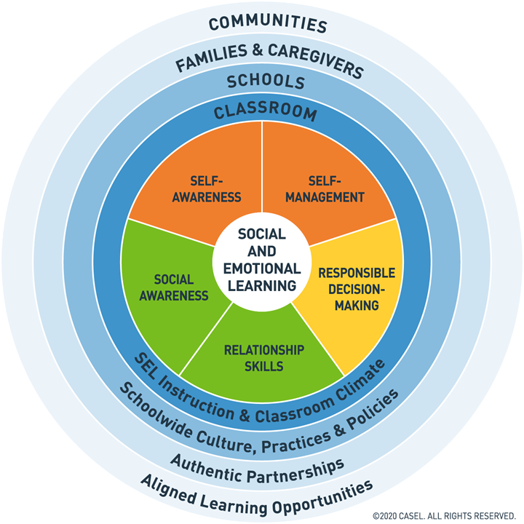
5 Social Emotional Competencies
Intrapersonal
Interpersonal
Greater Good
http://www.nysed.gov/common/nysed/files/core-competencies-handout.pdf
Notes:
Steph - 2

Slide 14
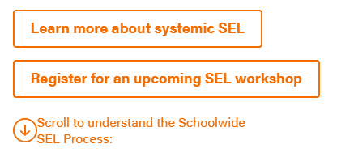
The CASEL Guide to Schoolwide SEL
The CASEL Guide to Schoolwide SEL leads school-based teams through a process for systemic SEL Implementation
This process helps schools coordinate and build upon SEL practices and programs to create an environment that infuses SEL into every part of students’ educational experience and promotes equitable outcomes for all students.
https://schoolguide.casel.org/how-it-works/
CASEL Guide to Schoolwide SEL- Implementation Timeline .pdf - Google Drive
Notes:
Steph
10 minutes (embed Video)
Walk Participants through the web page and potentially show the HOW it WORKS Video

Slide 15
Key Insights from DIstrict Level Work
7 factors that contribute to effective large-scale implementation of SEL and how districts overcame challenges that arose in the process
https://www.casel.org/wp-content/uploads/2017/03/Final-CDI-Report-3-17-17.pdf
Notes:
Jess – 3 minutes

Slide 16
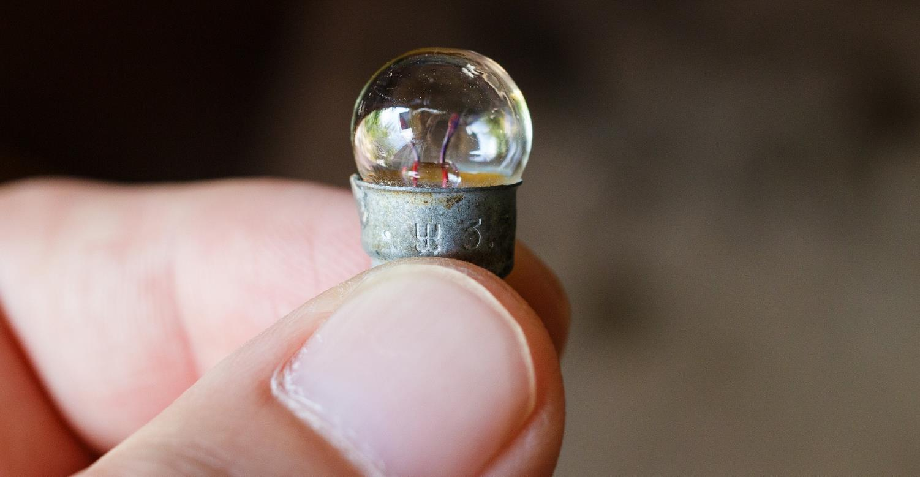
Systemic SEL is possible, even with leadership changes and relatively small budgets.
NYSED Social Emotional Learning: A Guide to Systemic Whole School Implementation – page 20
1.
Notes:
Steph – 1 minute
Conversations around – policy driving practice approach – shared decision making starting at the K-5 level – Elementary Report Card, 9 work habits and turned into 8 SEL skills (teachers and leaders collaborative efforts) - SEL REPORT CARD – no cost efforts
Strategic Plan – teacher leaders to help support the process – SEL teacher leaders – just specifically focused – culling out pieces to drive the work (utilized release time to help support the work) - EMPOWERING your People
Children's Institute partnered – needs assessment for the district – survey and teacher voice (grant funds) - reground in the competencies
4 Main Challenges to SEL System Wide
Include a connection to COVID – 19 – reopening committee work (no cost)

Slide 17
4 Major Challenges Moving Forward with SEL
Entry point into leading this work | Assessing Current State of SEL | Identifies implications of all constituents rolls in this work
Prioritizing SEL – Leaders must embrace SEL and recognize that it’s central for overall success
Grounded in data
Mindset and Core Values that drive your vision
Operationalize – Shifting the vision to incorporate SEL requires resources and training
Funding
Allocating Human Capital
Building Professional Capacity
Integrate – Institutionalizing SEL as a common practice – “This is the plate”
Strategies for Integration
Additional vs. Interwoven components
Measure/Evaluate – Accountability, but not with high stakes consequences
Surveys/Observations/Climate and Culture
Student Outcomes
(Adopted from Rennie Center Education Research and Policy)

Slide 18
4 Major Challenges Moving Forward with SEL
Entry point into leading this work | Assessing Current State of SEL | Identifies implications of all constituents rolls in this work
Prioritizing SEL – Leaders must embrace SEL and recognize that it’s central for overall success
Grounded in data
Mindset and Core Values that drive your vision
Operationalize – Shifting the vision to incorporate SEL requires resources and training
Funding
Allocating Human Capital
Building Professional Capacity
Integrate – Institutionalizing SEL as a common practice – “This is the plate”
Strategies for Integration
Additional vs. Interwoven components
Measure/Evaluate – Accountability, but not with high stakes consequences
Surveys/Observations/Climate and Culture
Student Outcomes
(Adopted from Rennie Center Education Research and Policy)
Notes:
David – 4-5 minutes
The Rennie Center undertook a scan of all 50 states to understand the extent which SEL is integrated into policy. As a result of their study with each state and focus districts, they identified 4 challenges when it comes to implementing SEL. These challenges can be used as a
Blueprint for Leaders
Entry point into leading this work
Assessing Current State of SEL
Identifies implications of all constituents rolls in this work
Handout 4 Challenges Paper copies - https://docs.google.com/presentation/d/1OB3fqsarm1fab94p8k1oKfk_aGR0Aj5ZA-eeMbvmCt4/edit?usp=sharing

Slide 19
An Implemented & Continuous Model
http://www.p12.nysed.gov/sss/documents/GreeceCSDGrades6-8ScienceSELActivitiesandTeachingPractices.pdf
4 Major Challenges Moving Forward with SEL
Notes:
David – 4-5 minutes
The Rennie Center undertook a scan of all 50 states to understand the extent which SEL is integrated into policy. As a result of their study with each state and focus districts, they identified 4 challenges when it comes to implementing SEL. These challenges can be used as a
Blueprint for Leaders
Entry point into leading this work
Assessing Current State of SEL
Identifies implications of all constituents rolls in this work
Handout 4 Challenges Paper copies - https://docs.google.com/presentation/d/1OB3fqsarm1fab94p8k1oKfk_aGR0Aj5ZA-eeMbvmCt4/edit?usp=sharing

Slide 20
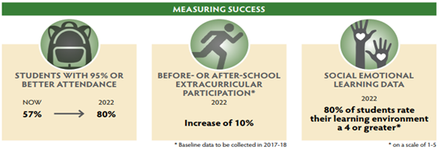
The desired school environment and culture is built around SEL. ~ David Blahowicz, Greece Central School District
Notes:
David – 4-5 minutes
The Rennie Center undertook a scan of all 50 states to understand the extent which SEL is integrated into policy. As a result of their study with each state and focus districts, they identified 4 challenges when it comes to implementing SEL. These challenges can be used as a
Blueprint for Leaders
Entry point into leading this work
Assessing Current State of SEL
Identifies implications of all constituents rolls in this work
Handout 4 Challenges Paper copies - https://docs.google.com/presentation/d/1OB3fqsarm1fab94p8k1oKfk_aGR0Aj5ZA-eeMbvmCt4/edit?usp=sharing

Slide 21
Prioritizing Remote Learning Environments & Resources Related to SEL
Mental Health of Staff and Students
Promoting Self-Care
Community Discussion
Check-Ins
School Reopening Plan - Assurances
Relationship Mapping - In-Person, Virtual
3 Signature Practices - Adult, Challenging Times, Classroom, Playbook
Surveys - Panorama (3-5), Student Reflection (6-12), Primary Project, Questionnaire,
Community Circles - Leadership, Staff

Slide 22
Greece CSD Response to 4 Challenges Related to SEL School-wide Implementation
Prioritize
Operationalize
Integrate
Monitor & Evaluate
Strategic Plan/School SIP
Montly Parent Roundtables
Elementary SEL Report Card
All staff, leaders, BOE grounding/training in CASEL
Summer Leadership Academy

Slide 23
Prioritizing School-Wide SEL Implementation
How can I help make SEL a priority in our district?
What are some systems or structures already in place that now can turn into opportunities for SEL?
Looking at the human capital in our district/school, who do we already have on staff that can take a leadership role in modeling practice?
Prioritizing School-Wide SEL Implementation (padlet.com)

Slide 24
Activities To Help with Processing and Looking at SEL at Key Points in the District
SEL Reflection Questions for School Leaders and Administration
In breakout rooms, review the reflection questions for Prioritizing SEL.
Think about a district you are working with or supporting.
What might their responses be to these questions be?
What additional questions might they need to consider or reflect on?

Slide 25
Delve Deeper to Extend Learning
https://www.renniecenter.org/sites/default/files/2017-01/Social%20and%20Emotional%20Leaning%20-%20Opportunities%20for%20MA%2C%20Lessons%20for%20the%20Nation_1.pdf
https://docs.google.com/viewerng/viewer?url=https://www.greececsd.org//cms/lib/NY01913679/Centricity/Domain/2128/Envision+Greece.pdf

Slide 26
SEL ideally is integrated into every aspect of the district's work, from the strategic plan and budgets to human resources and operations.
NYSED Social Emotional Learning: A Guide to Systemic Whole School Implementation - pages 16-17, 21-22
2.
Notes:
Steph – 1 minute
Conversations around – policy driving practice approach – shared decision making starting at the K-5 level – Elementary Report Card, 9 work habits and turned into 8 SEL skills (teachers and leaders collaborative efforts) - SEL REPORT CARD – no cost efforts
Strategic Plan – teacher leaders to help support the process – SEL teacher leaders – just specifically focused – culling out pieces to drive the work (utilized release time to help support the work) - EMPOWERING your People
Children's Institute partnered – needs assessment for the district – survey and teacher voice (grant funds) - reground in the competencies
4 Main Challenges to SEL System Wide
Include a connection to COVID – 19 – reopening committee work (no cost)

Slide 27
4 Major Challenges Moving Forward with SEL
Entry point into leading this work | Assessing Current State of SEL | Identifies implications of all constituents rolls in this work
Prioritizing SEL – Leaders must embrace SEL and recognize that it’s central for overall success
Grounded in data
Mindset and Core Values that drive your vision
Operationalize – Shifting the vision to incorporate SEL requires resources and training
Funding
Allocating Human Capital
Building Professional Capacity
Integrate – Institutionalizing SEL as a common practice – “This is the plate”
Strategies for Integration
Additional vs. Interwoven components
Measure/Evaluate – Accountability, but not with high stakes consequences
Surveys/Observations/Climate and Culture
Student Outcomes
(Adopted from Rennie Center Education Research and Policy)
Notes:
David - 2 minutes
The Rennie Center undertook a scan of all 50 states to understand the extent which SEL is integrated into policy. As a result of their study with each state and focus districts, they identified 4 challenges when it comes to implementing SEL. These challenges can be used as a
Blueprint for Leaders
Entry point into leading this work
Assessing Current State of SEL
Identifies implications of all constituents rolls in this work
Handout 4 Challenges Paper copies - spend some time on each of these challenges and the questions to consider - think about where you are in this work whether personally or with other districts, what questions might help you with supporting these challenges

Slide 28
SEL 5 Year Plan
Consensus Building
Infrastructure Building
Implementation and Evaluation
Focus: Working together to develop a shared understanding, collective commitments, and a vision for SEL. How do we build a system with SEL as a priority?
SEL Needs Analysis
Define SEL
5 CASEL Competencies
Strategic Plan (Vision for SEL)
Report Card
Experts
Focus: Defining the work that is vital to the success of our vision, developing the methods and systems for delivery imperative to teh implementation of the work. Providing mentorship, coaching and other PL opportunities to ensure the success and roll out in our districts.
5 CASEL Competencies
Strategic Plan
Report Card
Innovation (Scheduling, Mindfulness, Self-care, Resilience, etc.)
Alignment with Other Initiatives
Focus: Evaluating overall implementation as well as all stakeholders understanding, systemsd and processes.
Strategic Plan
YRBS - 1 Caring Adult Student/ Family/Parent Perception Survey
Syatems and Structures
ODRS, Suspensions
Needs Analysis for Next Steps
MTSS Alignment

Slide 29
Guide to Screening Candidates
30 Essential Behavioral Interview Questions
Embedding SEL Practices and Beliefs into Hiring Processes - Hiring practices and biases - Screening candidates for soft skills is often the toughest part of an interview. Interviewers have less than an hour to figure out if the person has the qualities the district is looking for in their next hire.
The good news is that behavioral interview questions are a proven way to reveal a person’s ability to collaborate, adapt, and more. By looking at their past behavior, you can more easily determine what someone will be like to work with.
Additionally, the practice assists with establishing the SEL culture and expectations at the beginning of the relationship with a potential hire.
https://business.linkedin.com/content/dam/me/business/en-us/talent-solutions/resources/pdfs/linkedin-30-questions-to-identify-high-potential-candidates-ebook-8-7-17-uk-en.pdf

Slide 30
Greece CSD Response to 4 Challenges Related to SEL School-wide Implementation
Prioritize
Operationalize
Integrate
Monitor & Evaluate
Strategic Plan/School SIP
Montly Parent Roundtables
Elementary SEL Report Card
All staff, leaders, BOE grounding/training in CASEL
Summer Leadership Academy
Budgeting for 14 SEL TLs, SFAST, TOSA for Wellness, TOSA for SIP and PL, TOSA for LIM, TOAS for AVID
POSA for Equity, TOSA for Equity and Restorative Practices, Drug Abuse Coordinator
Partnerships with Children's Institute, Ghandi Institute, PiRI BOCES, Ginsberg Resilience
Mindfulness certified Teachers

Slide 31
Activities To Help with Processing and Looking at SEL at Key Points in the District
SEL Reflection Questions for School Leaders and Administration
In breakout rooms, review the reflection questions for Operationalizing SEL.
Think about a district you are working with or supporting.
What might their responses be to these questions be?
What additional questions might they need to consider or reflect on?

Slide 32
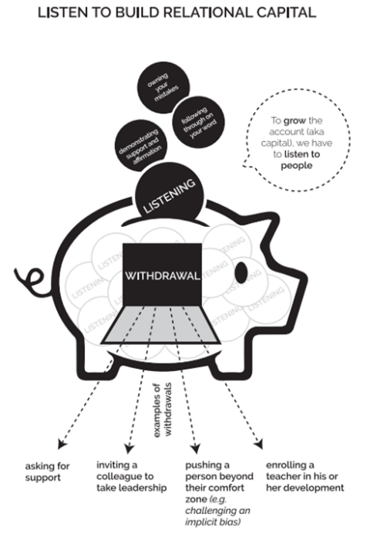
Continue to Explore

Slide 33
Break Time!

Slide 34
SEL can and should be integrated into every aspect of the school, from classroom instruction to school discipline to community partnerships.
NYSED Social Emotional Learning: A Guide to Systemic Whole School Implementation – pages 31-40
3.
Notes:
Steph – 1 minute
Conversations around – policy driving practice approach – shared decision making starting at the K-5 level – Elementary Report Card, 9 work habits and turned into 8 SEL skills (teachers and leaders collaborative efforts) - SEL REPORT CARD – no cost efforts
Strategic Plan – teacher leaders to help support the process – SEL teacher leaders – just specifically focused – culling out pieces to drive the work (utilized release time to help support the work) - EMPOWERING your People
Children's Institute partnered – needs assessment for the district – survey and teacher voice (grant funds) - reground in the competencies
4 Main Challenges to SEL System Wide
Include a connection to COVID – 19 – reopening committee work (no cost)

Slide 35
4 Major Challenges Moving Forward with SEL
Entry point into leading this work | Assessing Current State of SEL | Identifies implications of all constituents rolls in this work
Prioritizing SEL – Leaders must embrace SEL and recognize that it’s central for overall success
Grounded in data
Mindset and Core Values that drive your vision
Operationalize – Shifting the vision to incorporate SEL requires resources and training
Funding
Allocating Human Capital
Building Professional Capacity
Integrate – Institutionalizing SEL as a common practice – “This is the plate”
Strategies for Integration
Additional vs. Interwoven components
Measure/Evaluate – Accountability, but not with high stakes consequences
Surveys/Observations/Climate and Culture
Student Outcomes
(Adopted from Rennie Center Education Research and Policy)
Notes:
David - 2 minutes
The Rennie Center undertook a scan of all 50 states to understand the extent which SEL is integrated into policy. As a result of their study with each state and focus districts, they identified 4 challenges when it comes to implementing SEL. These challenges can be used as a
Blueprint for Leaders
Entry point into leading this work
Assessing Current State of SEL
Identifies implications of all constituents rolls in this work
Handout 4 Challenges Paper copies - spend some time on each of these challenges and the questions to consider - think about where you are in this work whether personally or with other districts, what questions might help you with supporting these challenges

Slide 36
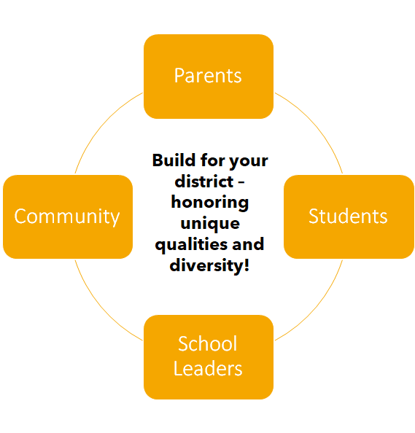
SEL Implementation looks different for each district.
Begin with a Needs Assessment.
Ownership across all stakeholder groups.
Examples of Greece CSD School Wide Implementation
•Report Card
•https://sites.google.com/greececsd.org/elementarysel/home
•Home Base / SEL Block
•Mosaics
•SEL Course Offerings
•RtI Tier 2 blocks / Problem Solving Protocol Integration
•After School clubs
•Talk Moves
•NYSED SEL Crosswalks
•Quarterly Data Dives
•Zaretta Hammond/Brene Brown
•SEL Coaching/Walkthroughs
SEL Connections Document
Notes:
David - 2 minutes
The Rennie Center undertook a scan of all 50 states to understand the extent which SEL is integrated into policy. As a result of their study with each state and focus districts, they identified 4 challenges when it comes to implementing SEL. These challenges can be used as a
Blueprint for Leaders
Entry point into leading this work
Assessing Current State of SEL
Identifies implications of all constituents rolls in this work
Handout 4 Challenges Paper copies - spend some time on each of these challenges and the questions to consider - think about where you are in this work whether personally or with other districts, what questions might help you with supporting these challenges

Slide 37
Roles in Implementation
Administrators
Teachers
Students
Building own capacity for what SEL is and how it relates to their own personal life
Teacher Goal setting and observations during SEL times
Trauma-informed care
ACES
Scheduling for SEL and Tiered blocks
Finding Connectors and Leaders of SEL
Data Dive Process
Building own capacity for what SEL is and how it relates to their own personal life
Report card skills and how to explicitly teach and assess SEL skills
PD on Circles, Self-Care, Personal Triggers, Mindfulness
Planning SEL Block and Tier 2 blocks of time for SEL support
Administering SEL Screeners
10 SEL Teaching Practices
Building own capacity for what SEL is and how it relates to their own personal life
Personal Assessment Surveys for SEL , Health, Wellness, and ACES
Clubs and Peer Leaders – Above the Influence program

Slide 38
•Perception Surveys
•Code of Conduct
•Vaping Intervention Program

Slide 39
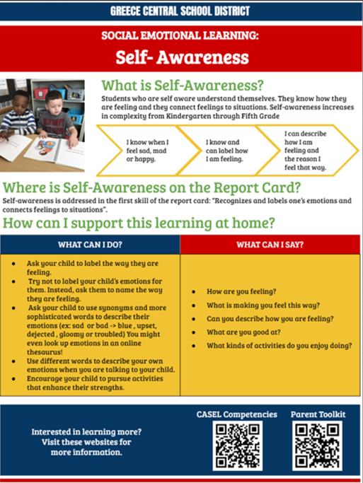

Slide 40
School Discipline Example

Slide 41
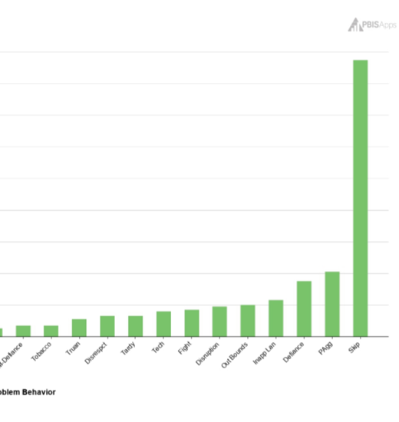
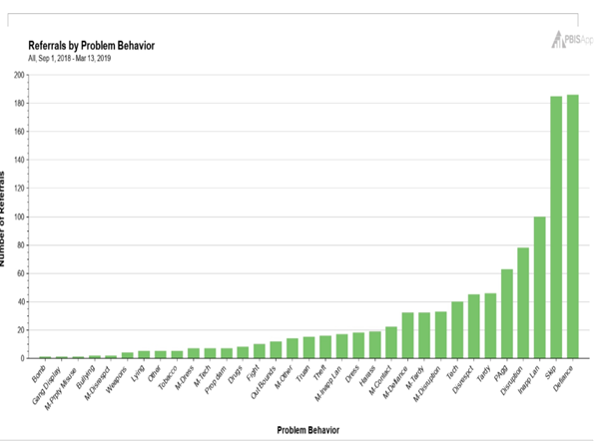

Slide 42
Activities To Help with Processing and Looking at SEL at Key Points in the District
SEL Reflection Questions for School Leaders and Administration
In breakout rooms, review the reflection questions for Integrate SEL.
Think about a district you are working with or supporting.
What might their responses be to these questions be?
What additional questions might they need to consider or reflect on?

Slide 43
Feeling Curious?...
https://www.readpbn.com/pdf/Data-Analysis-For-Continuous-School-Improvement-Sample-Pages.pdf

Slide 44
Successful implementation can follow multiple pathways, based on each district's unique needs and strengths. Regardless of the approach, the engagement and commitment of both school and district leadership is essential.
NYSED Social Emotional Learning: A Guide to Systemic Whole School Implementation – pages 25-26, 49-51
4.
Notes:
Steph – 1 minute
Conversations around – policy driving practice approach – shared decision making starting at the K-5 level – Elementary Report Card, 9 work habits and turned into 8 SEL skills (teachers and leaders collaborative efforts) - SEL REPORT CARD – no cost efforts
Strategic Plan – teacher leaders to help support the process – SEL teacher leaders – just specifically focused – culling out pieces to drive the work (utilized release time to help support the work) - EMPOWERING your People
Children's Institute partnered – needs assessment for the district – survey and teacher voice (grant funds) - reground in the competencies
4 Main Challenges to SEL System Wide
Include a connection to COVID – 19 – reopening committee work (no cost)

Slide 45
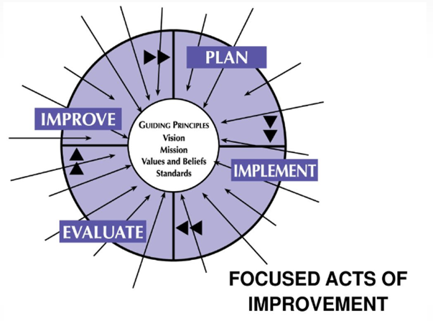
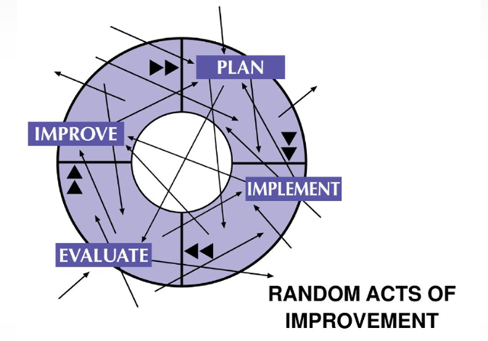
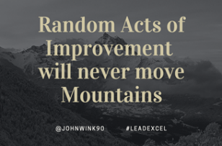
Without a critical piece of information, a target, our results might resemble "random acts" when we really want "focused acts" of improvement.
Notes:
Steph – 1 minute
Conversations around – policy driving practice approach – shared decision making starting at the K-5 level – Elementary Report Card, 9 work habits and turned into 8 SEL skills (teachers and leaders collaborative efforts) - SEL REPORT CARD – no cost efforts
Strategic Plan – teacher leaders to help support the process – SEL teacher leaders – just specifically focused – culling out pieces to drive the work (utilized release time to help support the work) - EMPOWERING your People
Children's Institute partnered – needs assessment for the district – survey and teacher voice (grant funds) - reground in the competencies
4 Main Challenges to SEL System Wide
Include a connection to COVID – 19 – reopening committee work (no cost)

Slide 46
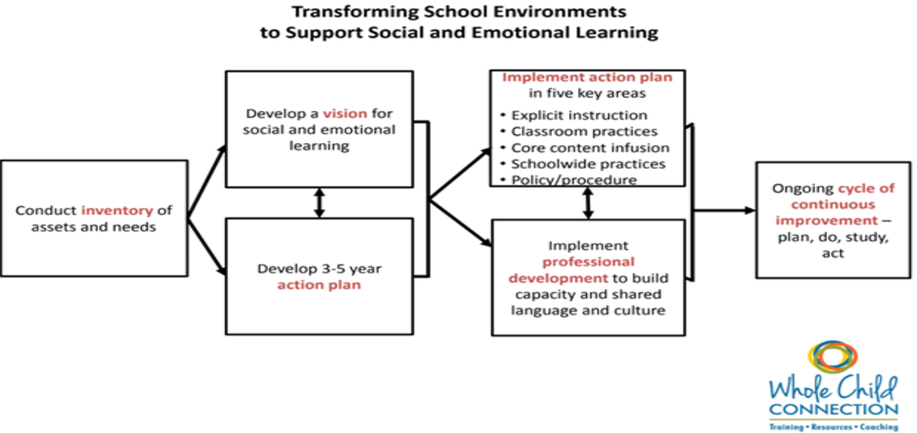
Theory of Action

Slide 47
SEL Needs Assessment
Needs assessment addresses these concerns from all levels, starting at the 30,000 foot view and drilling down further and further into the individual organization, to arrive at a plan with specific actions for improvement.
Needs assessments are important because it helps an organization determine the gaps that are preventing it from reaching its desired goals
Knowledge, practices, or skills

Slide 48
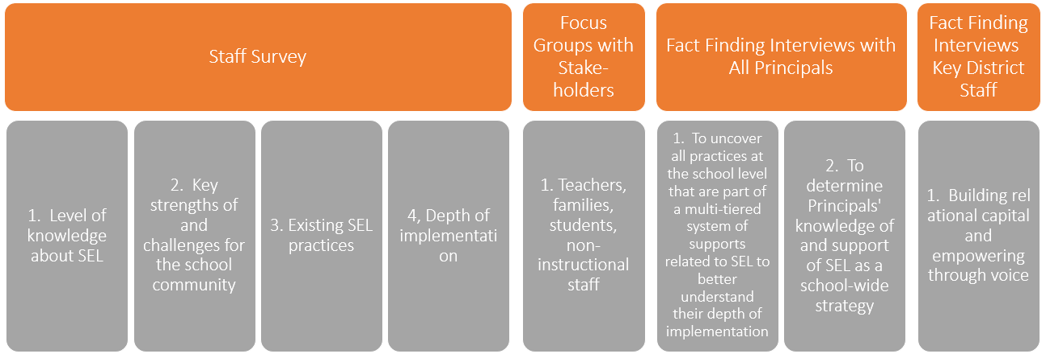
Conducting a SEL Needs Assessment?

Slide 49
Break Time!

Slide 50
Using the Google Slides, review the data slides and complete the Notice and Wonder slides assigned to your breakout room.

Slide 51
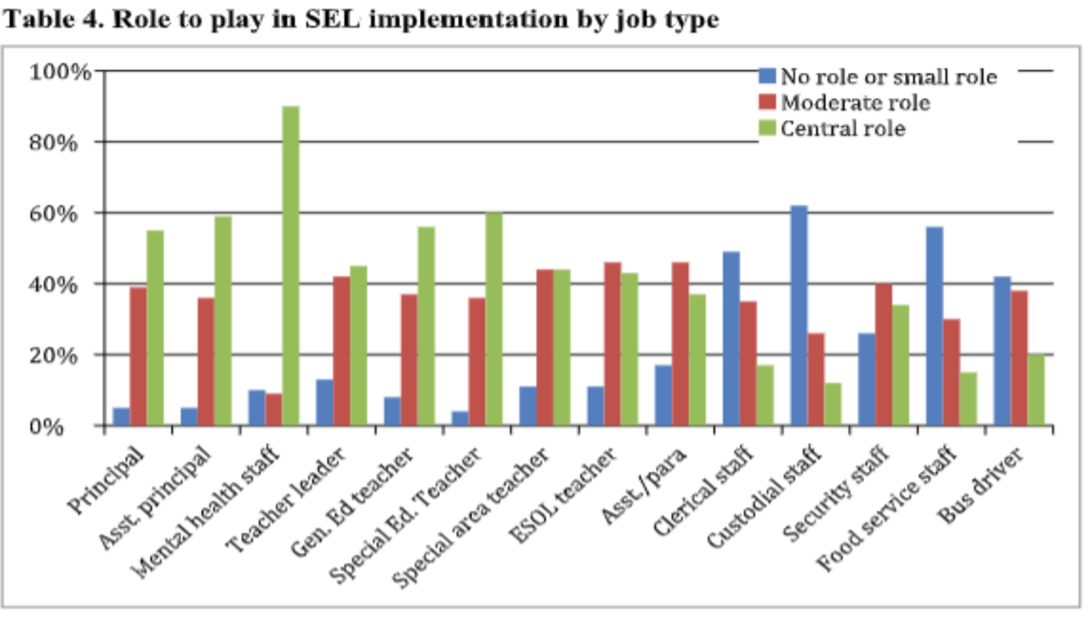

Slide 52
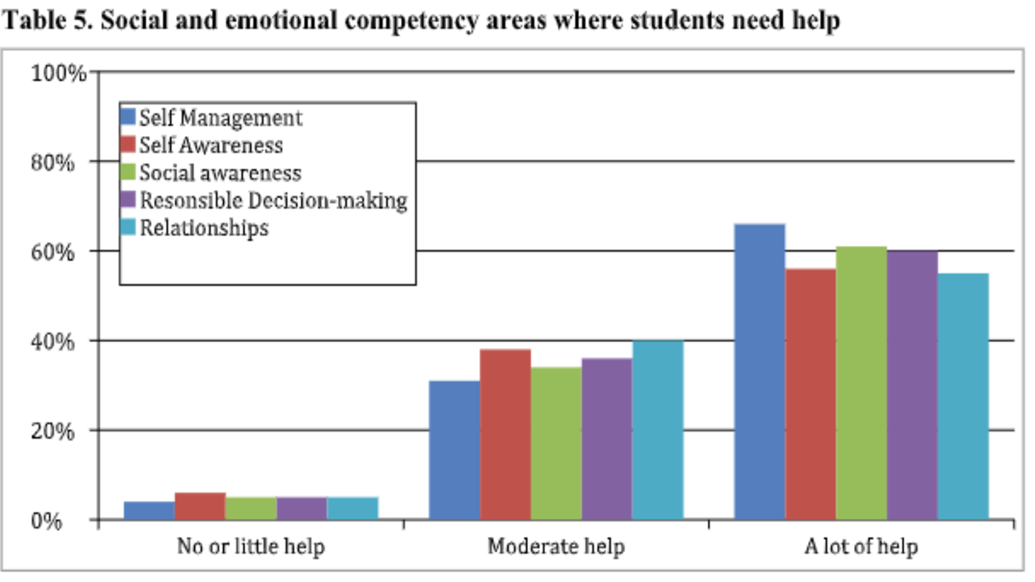

Slide 53
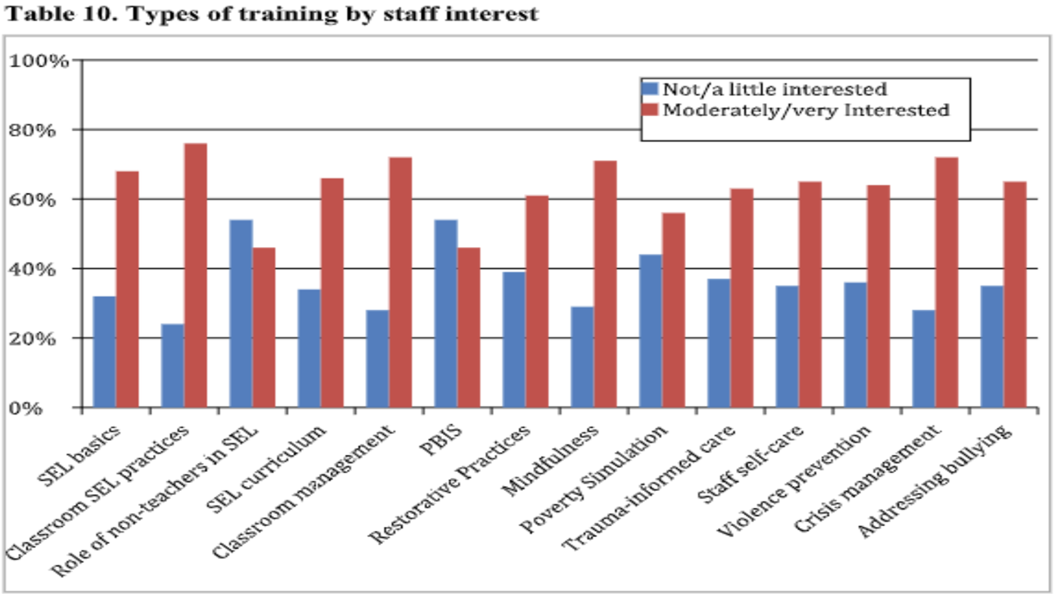

Slide 54
Greece CSD Response to 4 Challenges Related to SEL School-wide Implementation
Prioritize
Operationalize
Integrate
Monitor & Evaluate
Strategic Plan/School SIP
Montly Parent Roundtables
Elementary SEL Report Card
All staff, leaders, BOE grounding/training in CASEL
Summer Leadership Academy
Budgeting for 14 SEL TLs, SFAST, TOSA for Wellness, TOSA for SIP and PL, TOSA for LIM, TOAS for AVID
POSA for Equity, TOSA for Equity and Restorative Practices, Drug Abuse Coordinator
Partnerships with Children's Institute, Ghandi Institute, PiRI BOCES, Ginsberg Resilience
Mindfulness certified Teachers
SEL Block/Community Circles/Day with Play/Homebase
Website
Monthly-Bimonthly Competency focus
MTSS, PBIS, LIM, SEL, CRE, RtI alignment
Talk Moves
"I can" posters and learning targets

Slide 55
Adult SEL matters, too.
NYSED Social Emotional Learning: A Guide to Systemic Whole School Implementation – pages 35-36
5.
Notes:
Steph – 1 minute
Conversations around – policy driving practice approach – shared decision making starting at the K-5 level – Elementary Report Card, 9 work habits and turned into 8 SEL skills (teachers and leaders collaborative efforts) - SEL REPORT CARD – no cost efforts
Strategic Plan – teacher leaders to help support the process – SEL teacher leaders – just specifically focused – culling out pieces to drive the work (utilized release time to help support the work) - EMPOWERING your People
Children's Institute partnered – needs assessment for the district – survey and teacher voice (grant funds) - reground in the competencies
4 Main Challenges to SEL System Wide
Include a connection to COVID – 19 – reopening committee work (no cost)

Slide 56
4 Major Challenges Moving Forward with SEL
Entry point into leading this work | Assessing Current State of SEL | Identifies implications of all constituents rolls in this work
Prioritizing SEL – Leaders must embrace SEL and recognize that it’s central for overall success
Grounded in data
Mindset and Core Values that drive your vision
Operationalize – Shifting the vision to incorporate SEL requires resources and training
Funding
Allocating Human Capital
Building Professional Capacity
Integrate – Institutionalizing SEL as a common practice – “This is the plate”
Strategies for Integration
Additional vs. Interwoven components
Measure/Evaluate – Accountability, but not with high stakes consequences
Surveys/Observations/Climate and Culture
Student Outcomes
(Adopted from Rennie Center Education Research and Policy)
Notes:
David - 2 minutes
The Rennie Center undertook a scan of all 50 states to understand the extent which SEL is integrated into policy. As a result of their study with each state and focus districts, they identified 4 challenges when it comes to implementing SEL. These challenges can be used as a
Blueprint for Leaders
Entry point into leading this work
Assessing Current State of SEL
Identifies implications of all constituents rolls in this work
Handout 4 Challenges Paper copies - spend some time on each of these challenges and the questions to consider - think about where you are in this work whether personally or with other districts, what questions might help you with supporting these challenges

Slide 57
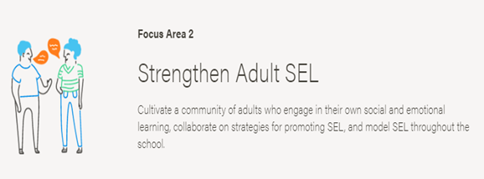
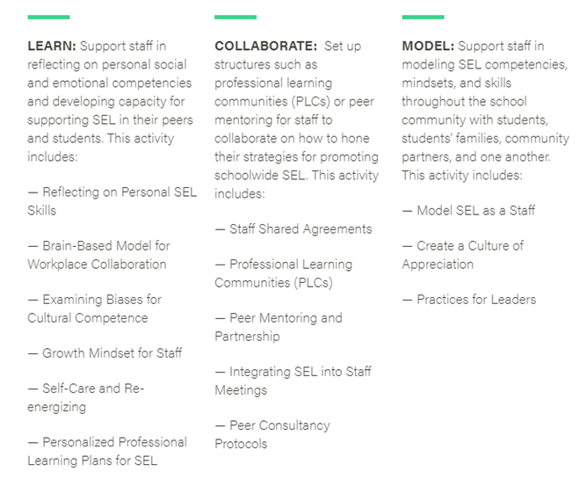
4 Major Challenges Moving Forward with SEL
https://schoolguide.casel.org/focus-area-2/overview/
https://schoolguide.casel.org/uploads/sites/2/2020/04/Blank-Rubric-Template-3.30.20.pdf
Notes:
David - 2 minutes
The Rennie Center undertook a scan of all 50 states to understand the extent which SEL is integrated into policy. As a result of their study with each state and focus districts, they identified 4 challenges when it comes to implementing SEL. These challenges can be used as a
Blueprint for Leaders
Entry point into leading this work
Assessing Current State of SEL
Identifies implications of all constituents rolls in this work
Handout 4 Challenges Paper copies - spend some time on each of these challenges and the questions to consider - think about where you are in this work whether personally or with other districts, what questions might help you with supporting these challenges

Slide 58
SEL Personal Assessment Survey
https://docs.google.com/document/d/1lKQxhfgmech8lVz0dQgG1cYjJOrXzkbJFju_fB2izgM/edit?usp=sharing
Notes:
David - 2 minutes
The Rennie Center undertook a scan of all 50 states to understand the extent which SEL is integrated into policy. As a result of their study with each state and focus districts, they identified 4 challenges when it comes to implementing SEL. These challenges can be used as a
Blueprint for Leaders
Entry point into leading this work
Assessing Current State of SEL
Identifies implications of all constituents rolls in this work
Handout 4 Challenges Paper copies - spend some time on each of these challenges and the questions to consider - think about where you are in this work whether personally or with other districts, what questions might help you with supporting these challenges

Slide 59
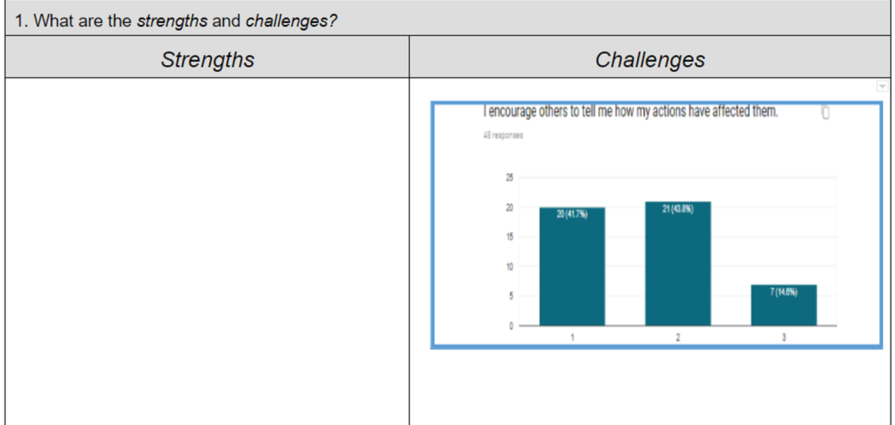
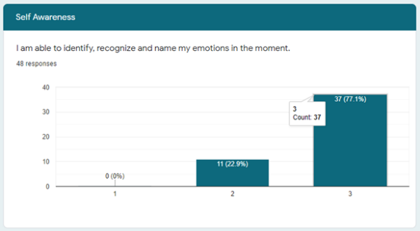
Topic Discussion: SEL Competency Survey
Notes:
David - 2 minutes
The Rennie Center undertook a scan of all 50 states to understand the extent which SEL is integrated into policy. As a result of their study with each state and focus districts, they identified 4 challenges when it comes to implementing SEL. These challenges can be used as a
Blueprint for Leaders
Entry point into leading this work
Assessing Current State of SEL
Identifies implications of all constituents rolls in this work
Handout 4 Challenges Paper copies - spend some time on each of these challenges and the questions to consider - think about where you are in this work whether personally or with other districts, what questions might help you with supporting these challenges

Slide 60
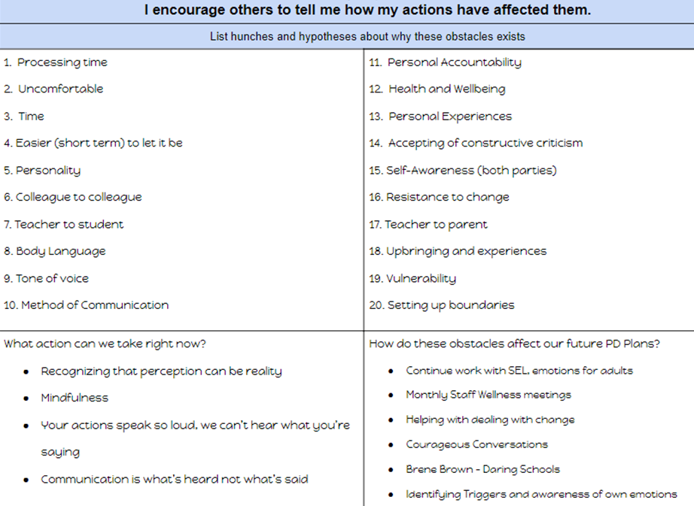
Identify the Problem
https://docs.google.com/document/d/1TuqjJsdTRNvcbiFf7j9WdhmHzGcv4AdlTZaoTV5yq4Q/edit?usp=sharing
Notes:
David - 2 minutes
The Rennie Center undertook a scan of all 50 states to understand the extent which SEL is integrated into policy. As a result of their study with each state and focus districts, they identified 4 challenges when it comes to implementing SEL. These challenges can be used as a
Blueprint for Leaders
Entry point into leading this work
Assessing Current State of SEL
Identifies implications of all constituents rolls in this work
Handout 4 Challenges Paper copies - spend some time on each of these challenges and the questions to consider - think about where you are in this work whether personally or with other districts, what questions might help you with supporting these challenges

Slide 61
Activities To Help with Processing and Looking at SEL at Key Points in the District
SEL Reflection Questions for School Leaders and Administration
In breakout rooms, review the reflection questions for MEASURE/EVALUATE.
Think about a district you are working with or supporting.
What might their responses be to these questions be?
What additional questions might they need to consider or reflect on?

Slide 62
Extension Activity
Have participants take CASEL Adult SEL Self-Assessment https://schoolguide.casel.org/resource/adult-sel-self-assessment-ost/
Then, depending on the size of the training and your knowledge of the group, consider either the use of Break out rooms or open discussion for participants to share their learning through the assessment. What did they have confirmed or possibly challenged them?
Maybe even talk about how they might combat those challenges and how does that connect to how they deal with students, colleagues, etc

Slide 63
Resolute Exploration

Slide 64
Data for continuous improvements are essential.
NYSED Social Emotional Learning: A Guide to Systemic Whole School Implementation – pages 43-47
6.
Notes:
Steph – 1 minute
Conversations around – policy driving practice approach – shared decision making starting at the K-5 level – Elementary Report Card, 9 work habits and turned into 8 SEL skills (teachers and leaders collaborative efforts) - SEL REPORT CARD – no cost efforts
Strategic Plan – teacher leaders to help support the process – SEL teacher leaders – just specifically focused – culling out pieces to drive the work (utilized release time to help support the work) - EMPOWERING your People
Children's Institute partnered – needs assessment for the district – survey and teacher voice (grant funds) - reground in the competencies
4 Main Challenges to SEL System Wide
Include a connection to COVID – 19 – reopening committee work (no cost)

Slide 65
Rather than just relying on quantitative metrics that repeatedly tell the same deficit stories about a particular system or the way the system is functioning, let’s start to listen to the voices and lived experiences of those we aspire to serve. Let’s demonstrate humility, deep thinking, and a commitment to the kind of rigorous reflection that breaks the cycle of inequity and challenges the traditional school system structure that has not supported the social emotional wellbeing of our learning community but has helped it grow to levels that allow us no other choice but to change.
Think about how you typically use/look at data. Reflect on this quote – where are you on the continuum of belief/action with this quote?
Notes:
Steph – 1 minute
Conversations around – policy driving practice approach – shared decision making starting at the K-5 level – Elementary Report Card, 9 work habits and turned into 8 SEL skills (teachers and leaders collaborative efforts) - SEL REPORT CARD – no cost efforts
Strategic Plan – teacher leaders to help support the process – SEL teacher leaders – just specifically focused – culling out pieces to drive the work (utilized release time to help support the work) - EMPOWERING your People
Children's Institute partnered – needs assessment for the district – survey and teacher voice (grant funds) - reground in the competencies
4 Main Challenges to SEL System Wide
Include a connection to COVID – 19 – reopening committee work (no cost)

Slide 66
Greece CSD Data Drive
Asychronous Learning - 38 minutes
In this video, David Blahowicz narrates a series of slides related to the data process conducted by Greece Central School district as SEL schoolwide implementation progressed

Slide 67
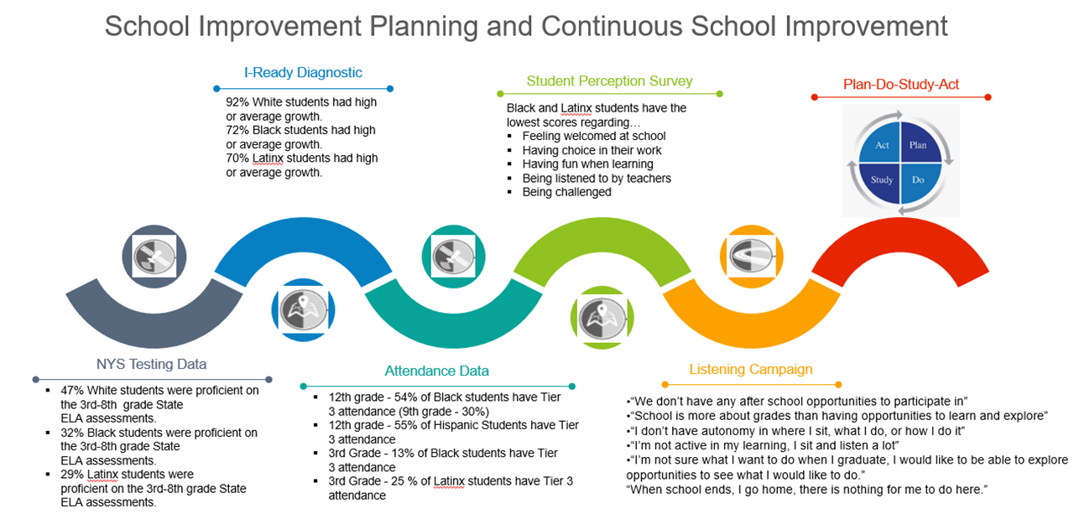
Data Dive Process

Slide 68
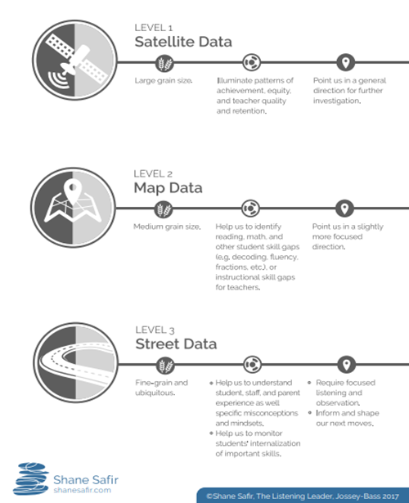
Levels of Data
Attendance, Suspensions, ODRs, NYS Data
SEL Report Card Data, Perception Surveys, Assessments
Deep/Strategic Listening Stances w/ members of school community

Slide 69
Greece CSD Response to 4 Challenges Related to SEL School-wide Implementation
Prioritize
Operationalize
Integrate
Monitor & Evaluate
Strategic Plan/School SIP
Montly Parent Roundtables
Elementary SEL Report Card
All staff, leaders, BOE grounding/training in CASEL
Summer Leadership Academy
Budgeting for 14 SEL TLs, SFAST, TOSA for Wellness, TOSA for SIP and PL, TOSA for LIM, TOAS for AVID
POSA for Equity, TOSA for Equity and Restorative Practices, Drug Abuse Coordinator
Partnerships with Children's Institute, Ghandi Institute, PiRI BOCES, Ginsberg Resilience
Mindfulness certified Teachers
SEL Block/Community Circles/Day with Play/Homebase
Website
Monthly-Bimonthly Competency focus
MTSS, PBIS, LIM, SEL, CRE, RtI alignment
Talk Moves
"I can" posters and learning targets
SEL Report Card Data
Parent, Staff, Student Surveys (3x yearly)
Mentoring and SEL teaching practices
SIP Reports and Data Dive Days
Metrics
Evaluating and working to update the Strategic Vision Plan

Slide 70
Districts benefit from collaborating with each other.
7.
Notes:
Steph – 1 minute
Conversations around – policy driving practice approach – shared decision making starting at the K-5 level – Elementary Report Card, 9 work habits and turned into 8 SEL skills (teachers and leaders collaborative efforts) - SEL REPORT CARD – no cost efforts
Strategic Plan – teacher leaders to help support the process – SEL teacher leaders – just specifically focused – culling out pieces to drive the work (utilized release time to help support the work) - EMPOWERING your People
Children's Institute partnered – needs assessment for the district – survey and teacher voice (grant funds) - reground in the competencies
4 Main Challenges to SEL System Wide
Include a connection to COVID – 19 – reopening committee work (no cost)

Slide 71
https://drive.google.com/file/d/1ar3V04jKH_AXVl2G2LI_IhidXXSkkK1w/view?usp=sharin
Notes:
Steph – 1 minute
Conversations around – policy driving practice approach – shared decision making starting at the K-5 level – Elementary Report Card, 9 work habits and turned into 8 SEL skills (teachers and leaders collaborative efforts) - SEL REPORT CARD – no cost efforts
Strategic Plan – teacher leaders to help support the process – SEL teacher leaders – just specifically focused – culling out pieces to drive the work (utilized release time to help support the work) - EMPOWERING your People
Children's Institute partnered – needs assessment for the district – survey and teacher voice (grant funds) - reground in the competencies
4 Main Challenges to SEL System Wide
Include a connection to COVID – 19 – reopening committee work (no cost)

Slide 72
Continued Exploration of Examples from Across the Nation
https://casel.org/districts-2/ - Link to multiple schools working in partnership with CASEL on schoolwide SEL implementation
Exit Ticket Reflection Form
https://docs.google.com/forms/d/e/1FAIpQLSe3lLBlRVszjrYjSs_jd67KhI2OwVhzY3Pu1-XXL18wo99zdg/viewform?usp=sf_link

Slide 73
Case Studies
What was similar and different between the districts reviewed? - How is this similar to or different from your own district?
What key insights did you gather through exploring the case studies?
What can you take away for your own context as you begin to plan or continue your SEL efforts?
As you think about your school, what realistic barriers might you encounter as you begin or continue your SEL district implementation?

Slide 74
Case Studies
Questions?
Comments?

Slide 75
Thank you
Use this closing slide to include important contact or reference information.

