Slide 1
UNDERSTANDING HOW LANGUAGE IMPACTS LEARNING
for English Language Learners (ELLs)
Notes:
Hello and welcome to the webinar, “Understanding How Language Impacts Learning for ELLs”. In this webinar, you will learn some basic strategies and techniques that are the first steps to best practice in the instruction of English Language Learners also known as ELLs. This course is the start of an English Language Learner teaching journey to help educators understand how they can foster achievement in English Language Learner or ELL. We hope that you will be inspired to delve in further to some of the topics shared today. Throughout this course, we will refer to a Resource Link Page. This page is a collection of all the resources mentioned in this presentation and is organized by slide number. Pause the video and check out the resources with your facilitator or on your own as you navigate your way through the course.

Slide 2
Topics Covered
Comprehensible Input
Home Language Supports
Student English Proficiency Levels
Instructional Supports
Developing Relationships
One Page Tip Sheet
Notes:
After watching this webinar, you will have introductory knowledge of the following topics:
Comprehensible input
Home language supports
Scaffolds for English Proficiency Levels
Planning ELL Supportive instructional practices
Developing relationships
Here is a one page tip sheet with an overview of key topics

Slide 3
New York State
256,736 English Language Learners (ELLs)
18.2% increase
ALL TEACHERS ARE TEACHERS OF ELLs
Notes:
Blueprint: https://www.nysabe.net/wp-content/pdfs/Blueprint-for-ELL/nys-blueprint-for-ell-success.pdf
In New York State, as of 2020, there were approximately 256,736 ELLs. This number is reflective of an 18.2% increase in the past five years. Chances are, if you are an educator in New York State, you will have the opportunity to make a positive impact on an English Language Learner sometime within your career. One of the most important concepts teachers should keep in mind as they are working with English Language Learners is that “All teachers are teachers of ELLs.” This concept was presented in The Blueprint for ELL Success, upon which was Commissioner’s Regulations PART 154 was revised in 2015.

Slide 4
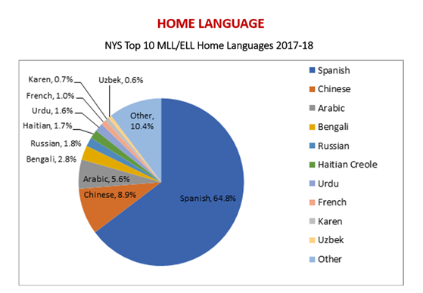
Languages Spoken by ELLS in NYS
Notes:
http://www.nysed.gov/common/nysed/files/programs/bilingual-ed/nysed_ell_mll_data-report_2018-2019-a.pdf
This chart depicts the top ten languages spoken by English Language Learners in New York State. Notice that Spanish is the top language, making up 64.8% of all English Language Learners in the state. Apart from the “other” languages category, after Spanish, the top languages are Chinese, Arabic, Bengali, and Russian. Each region may vary on these numbers, so it would be a good idea to see which languages are more prevalent in your specific region.

Slide 5
Let's check our current thinking
Notes:
Photo by David Travis on Unsplash
Before we begin, let’s examine our own ideas about second language learning, or acquisition, and what we believe. On a scrap paper, jot down your answers to the following true or false questions. Keep these handy because later on, we will re-visit these ideas to check our learning. Numbers 1 through 5

Slide 6
1. True or False?
If students can speak English, they have acquired a second language.
Parents of ELLs should mostly speak English in the home.
The best thing that you can do for your ELL student is translate all of their classwork and homework.
The instruction of my ELL students is the responsibility of the English as a New Language (ENL) or English to Speakers of Other Languages (ESOL) teacher.
Students should not speak their home language in school because it interferes with their learning.
Notes:
Fenner, D. S. (2013). Advocating for English Learners: A Guide for Educators (1st ed.). Corwin.
Quiz:
1.True or False: If students can speak English, they have acquired a second language. (Pause)
2.True or False: Parents of ELLs should speak mostly English at home. (Pause)
3.True or False: The best thing that you can do for your ELL students is translate all of the classwork and homework that you give them. (Pause)
4.True or False: The instruction of my ELL students is the responsibility of the ENL or ESOL teacher. (Pause)
5.True or False: Students should not speak their home language in school
because it interferes with their learning. (Pause)
Remember to keep these to refer to later...

Slide 7
Comprehensible Input
language input that students can understand even if they do not understand all the words and structures of the language.
Stephen Krashen
The essence or the gist
visuals, context clues, providing background information, use of home language vocabulary, classroom labels, and gestures.
https://www.colorincolorado.org/ells-language-online
Notes:
Stephen Krashen’s Seven Tips for Teaching Language During Covid-19 - Language Magazine
Comprehensible Input Online
One of the first and most vital things you can do for your ELL students in the classroom, is to provide them with comprehensible input. Comprehensible input is language input that students can understand even if they do not understand all the words and structures of the language. It is the basic message or gist of what is being said or presented. With comprehensible input, students understand the essence of what is being said or asked, without mastery of the language. Providing comprehensible input could include providing visuals, context clues, providing background information, using home language vocabulary, classroom labels, and gestures. Pioneer Researcher, Stephen Krashen, gets the credit for systematizing and formalizing Comprehensible Input for ELLs, and it can be done through Remote teaching, too. On your Resource Link Page, you will find the links to Stephen Krashen’s Theory of Second Language Acquistion and an article by Colorin Colorado on Teaching ELLs online.

Slide 8
Comprehensible Input Demo for Language Rich Classrooms Training
Notes:
https://www.youtube.com/watch?v=0KZmBGNsYC4
Let’s look at comprehensible input in action. In this video, Valentina Gonzalez, an ELL educator and Professional Development specialist asks us to complete a task, using her native Serbian language. In demonstration one, speaking only in Serbian, Ms. Gonzalez communicates the task without any comprehensible input. Notice what she does in her demonstration to provide us with comprehensible input. Click on the link found on your Resource Link Page for slide #8 to watch the comprehensible input demo. (Play video) https://www.youtube.com/watch?v=0KZmBGNsYC4

Slide 9
Video Reflection
Which forms of comprehensible input did you notice in demonstration #2?
Can you now, with more repetition, recognize and/or use a few Serbian words?
How and where can you add comprehensible input to your own lessons?
Notes:
What forms of comprehensible input did you notice in demonstration number two? What did Ms. Gonazlez do to help you understand what was being asked? You may have noticed the visuals and gestures she used. What else did she do? (Pause video) Did you see how she focused on key words, repeated them, showed pictures that we understood?
Stop to Reflect: Now stop to think before we move ahead, “Where do you or can you add comprehensible input in your lessons to help ELL students understand?”

Slide 10
Home Language as Comprehensible Input
What is the student's literacy level?
If appropriate...
Sentence stems
Labels in the home language
Directions in the home language
NYSED Bilingual Glossaries by Subjects & Courses
Notes:
https://steinhardt.nyu.edu/metrocenter/language-rbern/education/bilingual-glossaries-and-cognates
Using elements of a student’s home language is another way that teachers can add comprehensible input to lessons and student work. To be successful with this technique we must be aware of students’ literacy levels. Some students will come to our schools with the ability to read and write fluently in their home language while others will not yet have had any formal schooling. In all cases, we want to ensure that we are not providing students with word for word translations of all assignments. Rather, we can use sentence stems or targeted vocabulary that make use of a few translated vocabulary words that help students understand. Examples of using home language as a form of comprehensible input include providing bilingual sentence stems, labels in the home language or directions in the home language. It is best practice to provide comprehensible input for our ELL students so that they can make meaning out of their learning even as they are learning English. Having students work together, using their home language for making connections and discussion, helps them too.
Both teachers and students can make use of word for word subject glossaries such as the NYSED glossaries. These are useful during teaching and can be used by students on assessments. You will find the link to the glossaries on your Resource Link Page. Please remember that it is is NOT a good option to use online translation features for full text or test translations.

Slide 11
Developing Relationships
Educational History
Languages
English Proficiency Level
Literacy Level in English
Literacy Level in Home Language
Culture
Life Experiences
Family
Goals
Blank Learner Profile
Notes:
Developing and fostering relationships with students is one of the reasons why many of us go into the teaching field in the first place. However, with ELL students, this may be harder to do due to limitations in language and communication. There are some key elements that all teachers of ELLs can know about their students. These elements include the student’s background and history, the languages they speak, if they read in their home language, and some of their cultural preferences and customs. It is important to be able to pronounce the student’s name, so always try your best and let the student help you.. Obtaining this information is made possible by showing consideration, openness and respectful curiosity. Additionally, a learner profile can be included in the student’s permanent record file. There are many examples of learner profiles that can be used. Whatever is used, it should not be only deficit focused, but also recognizes the strengths and assets that the ELL carries. Here is one example of a Learner Profile that you can use. There are numerous others and your ENL Teacher may have one available in your district. On your Resource link page, you will find one example of a learner profile that you can use. (See Link to Learner Profile)

Slide 12
Partnering with Families
Home is Your Child's First Classroom
Fun Home Learning Resources
Notes:
https://drive.google.com/drive/folders/1Io_kwOFaqlL4R3QEAxjzH8HMaTOXIB6Y
https://www.youtube.com/watch?v=qkD_GlAYt3c
Partnering with families is also important for all learners and studies show that higher rates of family involvement provide specific benefits for educators, families, community and most importantly, students themselves. Academic benefits include higher grades, higher test grades, and higher graduation rates. (Rubin, R., Abrego, H., & Sutterby, J., 2012). One of the first things that we can do to begin this partnership is to encourage families to become a part of their child’s education, even at home. This might include reading stories or playing games in the home language. Many studies have shown that students who already have an academic skill set in their home language will have an easier time understanding academic content in their second or additional language. The New York State Regional Bilingual Education Resource Networks (RBERNs) have created a resource that you might find helpful in delivering this message. The resource includes a brief Public Service Announcement, a Home Learning Activities one pager translated into multiple languages, and an accompanying webinette. These are free and available to share using the link on your Resource Link Page.

Slide 13
English Language Learner Proficiency Levels
Scaffolding Guides for Standards
Entering | Emerging | Transitioning | Expanding | Commanding
Notes:
teachers-guide-to-implement-the-bilingual-cc-progressions (1).pdf
Scaffolding Guides for Standards
Knowing the English proficiency level of your students will allow you to scaffold your instruction appropriately for your student and the classroom. In New York, through a combination of state mandated assessments (such as the NYSITELL and the NYSESLAT), and knowledge of language levels identified by ENL professionals, students are identified at five progressive levels. These levels begin at the entering or beginning level and move through emerging, transitioning, expanding, and finally commanding levels, where they demonstrate English Proficiency. The whole learner picture of an ELL is based on the four language modalities of Listening, Speaking, Reading, and Writing. Students may develop skills in each modality at different rates. For a better picture of what students can typically do at each of these levels, refer to the Differentiating Instruction and Assessment for ELLs packet on your Resource Link Page that outlines student descriptors. (See Link to New Language Arts Progressions)

Slide 14
Scaffolding
A scaffold in the classroom is a temporary support used to help level the playing field for students while they are learning language. These supports can be taken away as students gain more language proficiency.
What is a scaffold in terms of education?
Notes:
Photo by John Salvino on Unsplash
When you know what your students are already capable of doing and where they can grow in their English level, it becomes much easier to decide how to scaffold your lessons for students. Scaffolding is a teaching skill to be practiced. This could be an entire workshop of its own. There will be future sessions on this topic on the eTeachNY website, and/or other NYSED funded workshops. What picture comes to mind when you think of the word scaffold? Perhaps you see a ladder or lift that helps you to reach something. A scaffold in the classroom is a temporary support used to help level the playing field for students while they are learning language. These supports can be taken away as students gain more language proficiency.

Slide 15
Types of Scaffolds
Materials and Resources
Instructional Scaffolds
Student Grouping
Student Assignments
Student Descriptors
Notes:
Fenner, D. S. (2013). Advocating for English Learners: A Guide for Educators (1st ed.). Corwin.
There are three different types of scaffolds in instruction. Materials and Resource scaffolds include things like graphic organizers, home language texts and materials, visuals, and word walls. Instructional Scaffolds are scaffolds that you embed into your lesson plan. This might include pre-teaching vocabulary and building background knowledge, reducing linguistic load, and modeling. Student grouping can be a form of scaffolding as well. This might include structured paired work, small group work, or teacher led small group work. Lastly, scaffolded assignments might include short answers, or sentence frames and use word banks. Refer to your Link Resource page for Student Descriptors. (See Student Descriptors here)

Slide 16
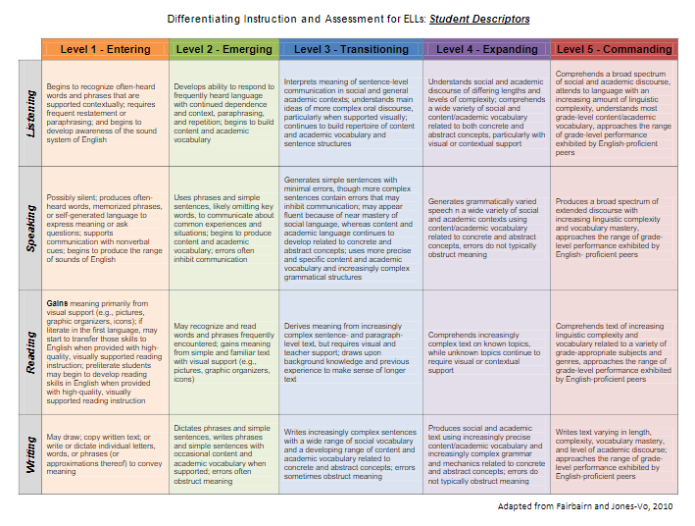
Scaffolding Activity
Notes:
https://libguides.monroe2boces.org/ld.php?content_id=59443528
Let’s do an introductory activity to help you begin thinking about scaffolding strategies. Linked here is a page you will need for this activity. It is a chart titled “Student Descriptors”. Student descriptors will tell you what general characteristics students at each level may demonstrate. Remember that this is a general chart and does not necessarily apply to all students but is our best guess to guide teachers. Let’s take a pause to review some of these student descriptors. An example in Speaking...Students start out either silent or use single words, they progress to phrases, then to simple sentences with errors, then to simple sentences with minimal errors, then to more complex variations of sentences & use of abstract academic language and finally to extended discourse (at the Commanding level). Take a moment to look at the chart and consider how language changes from beginning to advancing proficiency. Pause to look at the chart

Slide 17
What can you scaffold for your students now that would be appropriate for their level of English?
Notes:
(Pause and generate ideas) Let’s consider your classroom. What assets do your students bring? What do they need to build on their learning? How will you know that all your students met the learning objectives? What scaffolds are your ELLs able to use now to help them engage and achieve success in your class?

Slide 18
Collaboration
Classroom/Content Teacher
ENL Teacher
Guide students/teachers in content knowledge
Guide teachers/students in understanding language acquisition and scaffolding
Together:
Communicate with families
Scaffold lessons
Deliver content
Menor in the education of ELL students
Notes:
NYSED Integrated Teaching Resources
Scaffolding work often happens with collaborative teaching. ENL Teachers have expertise and training on how to support language development, while classroom teachers have knowledge and expertise on content development. Together, the ENL teacher and classroom educator can work together for the students to make the greatest gains in both content areas and language development.

Slide 19
Basic Strategies
Teach Background Knowledge
Use visuals
Simplify Directions and Speech
Increase Wait Time
Speak Slowly, Not Loudly
Expanded Ideas for classrooms with ELLs
Notes:
Expanded Ideas for classrooms with ELLs
There are some basic and quick instructional strategies you can incorporate into your teaching right away which may help your native English-speaking students as well as English Language Learners. It is also important that these are proven strategies for students at ALL levels of instruction, kindergarten all the way up. Teach background knowledge: Students come in with varying amounts of knowledge in a variety of topics. It is important that students are given the opportunity to generate/review background knowledge needed to understand academic material and therefore teachers should gauge how much is already known about a topic. This can be done through informal assessments or anticipation guides and activities. Remember also, that although students may come with different background knowledge, what they bring to the table can be an asset to instruction and may be a basis for deeper learning.
Incorporate visuals into your classroom. Visuals can be in the form of word walls, graphics, or sentence starters. Visuals can also be used as an instructional tool to help students transition through the routines of the day and will truly help foster understanding in our students. Try to use real photos whenever possible rather than clip art. Realistic visuals can be more helpful than clip art or drawings, whenever possible.
Simplify your directions and general speech for some students. Without realizing it, we often incorporate a lot of extra language into our daily speech. When it comes to giving directions, make sure that your words and phrases are simple and to the point. This is also another example where visual cues may prove to be helpful. Avoid idioms or catch-phrases, unless you teach them explicitly.
Increase wait time. Students who are working and thinking in two languages need more time to process what is being said or what is being asked of them. An interesting experiment you might try is videotaping or recording your instruction time and using a stopwatch to time the seconds between proposing questions and calling on students. If you were thinking in a language other than English would it be enough time for you to process the question, formulate a response, and produce the language necessary to answer the question?
Speak Slowly, not loudly. ELL students typically do not have trouble hearing but just need more processing time for comprehension.
More ideas can be found Here or on your Resource Link Page under slide number 19.

Slide 20
Lesson Planning for ELLs
Plan and prepare for:
Vocabulary instruction
Home language supports
Notes:
Lesson Planning Ells Resources
There are some additional instructional techniques to use in your lesson planning for ELLs. Additional areas of focus might include vocabulary instruction including instruction of Greek and Latin words parts, looking at the difference between social and academic language, and utilizing home language supports. Another great resource from Colorin Colorado is listed on your Link Resource Page.

Slide 21
Vocabulary Instruction
How do we embed this into our instruction?
Games
Interactive notebooks
Explicit vocabulary instruction
What vocabulary will help my students build background knowledge?
Notes:
Vocabulary teaching is particularly important to the instructional practice of teachers working with ELLs. Explicit vocabulary instruction for ELLs is important for all teachers of all subjects and should be embedded into our lessons. We might do this through games, interactive notebooks, and specific vocabulary lessons. Think about vocabulary that is specific to your content area and how you can help your students build background knowledge to learn this vocabulary. Words that have multiple meaning in different contexts also need to be taught explicitly...such as table, volume, anchor. We will talk more about this later.

Slide 22
Choosing Vocabulary
Is it...
Representative or critical to understanding?
Repeatable?
Transportable?
Cognitive load?
Notes:
There is so much vocabulary to learn, especially when learning a new language How do we decide where to start or which vocabulary is most essential? There are some considerations according to Fisher and Fry (2008) that you may want to consider as you select vocabulary appropriate for your students. Is the vocabulary...
Representative or critical to understanding?
Repeatable or Will it be used again?
Transportable to other areas or is it needed for discussions or writing?
Additionally, can students use context clues or structural analysis to determine meaning?
Lastly, what is the Cognitive Load? When is too much, too much? Have you exceeded the load for beginning level ELLs? More information on this can be found at https://vocablog-plc.blogspot.com/2011/04/selecting-words-important-consideration.html

Slide 23
Greek and Latin Word Parts
Content area vocabulary such as for Math and Science:
Many are derivative of Greek and Latin roots
Polygram
Hexagon
Evaporation
Biology
Notes:
Helping students to understand Greek and Latin Word Parts can help them in the understanding of many words. Content area vocabulary is largely Greek and Latin in nature. Many of the words students will encounter in classes such as Math and Science, have recognizable word parts; many of them are derivatives of Latin and Greek roots. Knowledge of these roots link pronunciation, meaning, and spelling, even for young readers. (Pause to think of examples...read Polygram, Hexagon, Evaporation, Biology)

Slide 24
Social Language vs Academic Language
Social
Academic
Acquired first
Takes many years to acquire
Notes:
Another way we can ensure understanding for our students is to ensure we can delineate academic language from social language and see where they overlap. Social language is typically acquired by students first. This could include asking to go to the bathroom or ordering lunch, and having conversations in the cafeteria. Academic language takes much longer to develop. It may be tricky for ELLs when academic and social language overlap and it is important to keep this in mind as you plan lessons. Examples of this overlap include activities such as the word “match” (a match that you use to light something and match the words on the page), and “skim” (skim like skim milk vs skim as in read quickly or peruse text). By knowing when you have words with double meanings, you can clarify for your students before confusion sets in.

Slide 25
Home Language Supports
A tool for comprehensible input
Bilingual sentence stems & glossaries
Labels in home language
Directions in home language
Short text or videos to generate background knowledge
Notes:
For the last topic of this webinar, let us discuss Home Language supports. If you do not speak the student’s language fluently, the best way to use a student’s home language as a tool for teaching is to use it for comprehensible input. Examples of using native language as a form of comprehensible input are providing bilingual sentence stems, labels in the native language or directions in the native language. Providing native language support is a much better and more feasible solution to instruction than using a computer to poorly translate entire documents or packets for students. This can cause confusion especially because machine translated documents are not always accurate and appropriate. Our goal is to teach the language as we teach content area skills and concepts. Translation does not teach, only translates.

Slide 26
Communication
Translation
Interpretation
One way communication
Emails, report card comments, letters to families
Live, person-person, two-way communication
On the spot
Parent teacher conferences, phone calls, meetings
Notes:
Translation and Interpretation is a topic that is often discussed on when it comes to working with families of ELLs. To begin, understanding the difference between the two can be helpful. Translation is One way communication that usually exists in the form of emails, report card comments, and letters to families, written. On the other hand, Interpretation is live, person to person, two-way communication on the spot, often oral, but can be written in text too.

Slide 27
What should be translated or interpreted?
Key ideas or background text or videos, if possible
Isolated words or phrases planned strategically during instruction
IEP meetings
Parent teacher conferences
School notices
Transportation and emergency notices
Classroom communications
How to Fulfill Interpretation & Translation Requirements: Tools for Guiding Decisions by Laura Gardner, Immigrant Connections
Notes:
https://www.immigrantsrefugeesandschools.org/post/how-to-fulfill-interpretation-translation-requirements-tools-for-guiding-decisions
There are certain times for schools to hire a professional to translate or interpret for students and families who need communication in other languages. Interpreters should be present for IEP meetings and other important parent teacher meetings. Documents that should be translated include official school notices, transportation and emergency notices, and classroom communications. Laura Gardner, professional development facilitator and founder of Immigrant Connections, wrote an article titled, “How to Fulfill Interpretation & Translation Requirements: Tools for Guiding Decisions” that you can find on your Resource Link Page. In the article, Gardner points out some of the most important highlights of how to make the best decisions when it comes to communication with those who speak other languages.

Slide 28
2. True or False?
If students can speak English, they have acquired a second language.
Parents of ELLs should mostly speak English in the home.
The best thing that you can do for your ELL student is translate all of their classwork and homework.
The instruction of my ELL students is the responsibility of the ENL or ESOL teacher.
Students should not speak their home language in school because it interferes with their learning.
Notes:
Now that we have covered some of the basic elements of ELL education, let’s revisit the True or False questions that we opened with. Consider whether or not your perceptions have changed since the beginning of this webinar. Take out your previous answers.
True or False: If students can speak English, they have acquired a second language. False. Though your student may sound fluent, social English is acquired more quickly than academic English. Therefore, it isn’t accurate for us to assess students solely on conversational skills. Instead, the education of ELLs is focused on a combination of Listening, Speaking, Reading, and Writing modalities.
True or False: Parents of ELs should speak only English at home. False. Parents should provide a strong model of rich language usage in the language that they are most comfortable in. It is easier for students with language skills in their home language to transfer these skills to additional language acquisition.
True or False: The best thing that you can do for your ELL students is translate all of the classwork and homework that you give them. FALSE. It is essential that before you make decisions about how you can utilize home language in the classroom, you are aware of your student’s literacy level. Translating homework for a child who cannot read or write in their home language can cause unnecessary confusion for the student.
True or False: The instruction of my ELL students is solely the responsibility of my school’s ENL or ESL teacher. FALSE. Teachers of ELLs can work together to share resources and expertise in areas and in this way, we understand that the academic success of these students is the responsibility of all.
True or False: Students should not speak their home language in school because it interferes with their learning. FALSE. Language acquisition takes time. Allowing students to speak in their home language in school can help students process and highlight what students already know. Errors that reflect the structure of the home language are a part of the learning process and will often disappear over time.
Pause video and ask: Take a moment to reflect on your answers. Did your ideas about ELL learning change? Was there anything that truly surprised you? Are there any areas you still want to know more about?

Slide 29
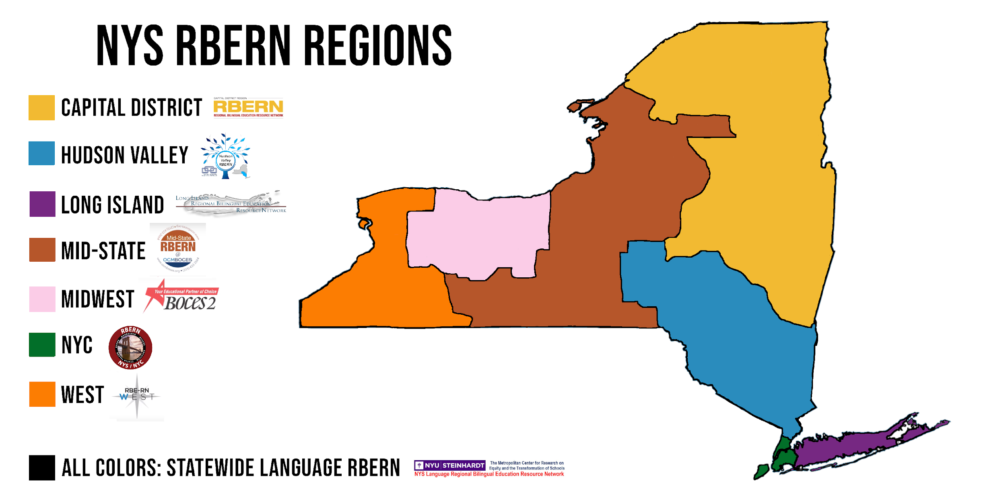
Contact your local RBERN!
http://www.nysed.gov/bilingual-ed/regional-supportrberns
Notes:
Contact your local RBERN
As a reminder, the topics that we covered today are only introductions to techniques to use in your classroom with English Language Learners. There are so many things to learn and techniques to try when it comes to the education of ELLs. Hopefully after learning some of the basics here, you feel inspired to continue learning. Please contact your local Regional Bilingual Education Resource Network, or (RBERN) for additional support and information. (RBERN On Demand) There are many, many learning opportunities offered across the state to learn about English Language Learners and Multilingual Learners.

Slide 30
Questions? Comments?
THANK YOU
Notes:
In this Session, we have included many links and resources for you to share and continue exploring more deeply. Please continue to share and review them to improve your ability to reach and teach all your students, including your ELLs.
Thank you for taking the time to join us today.

