Slide 1
Fine Tuning Your Hybrid/Remote Learning Environment
PART III
Notes:
This presentation is Part 3 - the concluding part - of the Fine-Tuning Your Virtual/Remote Learning Environment: Building Peer to Peer Relationships. Part 1 focuses on the importance of having a classroom management plan that includes establishing classroom norms, agreements, and routines/procedures. Part 2 focuses on building relationships, trust, and credibility with students and families. Though Parts 1 & 2 are not prerequisites for Part 3, it is highly encouraged to participate in those sessions as well.
This presentation was originally made for a “live” session with teachers and has been adapted to be used for either synchronous or asynchronous, self-directed learning.
There are some resources referenced in this presentation. When directed, download or print supplemental materials for use throughout the presentation and visit hyperlinked websites for additional resources on the topic.

Slide 2
Our Learning
Today’s Outcomes
Describe strategies for students with disabilities when fostering peer relationships in a hybrid and remote learning environment.
Create a plan using the reflection document to ensure students with disabilities are explicitly considered in your learning space.
Notes:
The content in this presentation is focused on teaching in a remote/hybrid learning environment, but the concepts are applicable across any type of learning environment.
We extend focus and consideration to students with disabilities as much as possible throughout. As best practice in any learning environment, our learning outcomes are measurable with expectation of the participant to acquire new knowledge or enhance current knowledge and put into practice what has been learned.

Slide 3
Agenda
Welcome
Why must we focus on relationships?
What strategies can I use to build high quality, peer to peer relationships? What strategies can I use to build relationships with all students:
Before we start?
During the first week?
How can I sustain them?
What considerations am I making for students with disabilities when building relationships with and between my students?
What can high quality peer to peer relationships look like in the virtual classroom?
Notes:
We proceed through this presentation answering the questions listed in this agenda with research-based content and New York State teacher experiences; There is space provided for participants to consider their own perspective and reflect on their own teaching in the context of the topic at hand. If you are working through this presentation at the start of the school year, there is opportunity for you to think about the year ahead and plan. If you are working through this presentation while school is already in session, you are offered opportunities to reflect and potentially adapt your current perspective and practices.
Notice again that particular emphasis has been placed on considerations for students with disabilities, but we should also always consider other student populations such as English Language or Multilingual Learners as well.

Slide 4
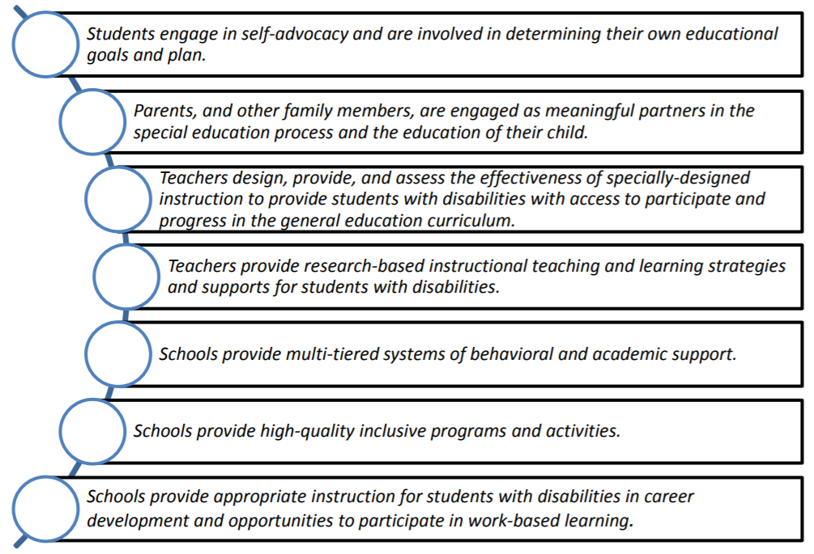
Blueprint for Improved Results for SWDs
1
Look for the numbers throughout the presentation to know when a particular core principle is being addressed!
The stars on the right side of the slide indicate which principles are addressed in this presentation. By Part 3 of this series, all but Principle #7 will be addressed.
2
3
4
5
6
7
Notes:
New York State Education Department’s office of Special Education released the Blueprint for Improved results for Students with disabilities in November of 2015. This document focuses on seven research- and evidence-based core principles and practices for all students with disabilities. Improving results for students with disabilities requires a renewed focus on these core principles. Therefore, we have explicitly linked the content in this presentation to some of the appropriate principles in the Blueprint reinforcing that these essential practices are effective for improving results for all students in general, but also for students with disabilities.
The Blueprint for Improved Results for Students with Disabilities:
1- Students engage in self-advocacy and are involved in determining their own educational goals and plan.
2- Parents, and other family members, are engaged as meaningful partners in the special education process and the education of their child.
3- Teachers design, provide, and assess the effectiveness of specially-designed instruction to provide students with disabilities with access to participate and progress in the general education curriculum.
4- Teachers provide research-based instructional teaching and learning strategies and supports for students with disabilities.
5- Schools provide multi-tiered systems of behavioral and academic support.
6- Schools provide high-quality inclusive programs and activities.
7- Schools provide appropriate instruction for students with disabilities in career development and opportunities to participate in work-based learning.
The bolded principles indicate which core principles are addressed in this presentation. The numbers in the different colored circles will be found on slides where content is directly aligned to one or more core principles. A special note will also be included in the presentation notes on the slides
For direct reference: http://www.p12.nysed.gov/specialed/publications/2015-memos/documents/blueprint-students-disabilities-special-education-june-2019.pdf

Slide 5
Session Norms
Notes:
Honoring the content presented in Part 1 of this learning series, we ask that you establish norms for this session regardless of whether you are facilitating a synchronous training or engaging in self-directed learning with one or more people. When everyone agrees to the group-constructed norms, successful learning can take place because norms help establish expectations of a safe and productive learning environment. For more information regarding norms and how to construct them, see Part 1 of this training series.

Slide 6
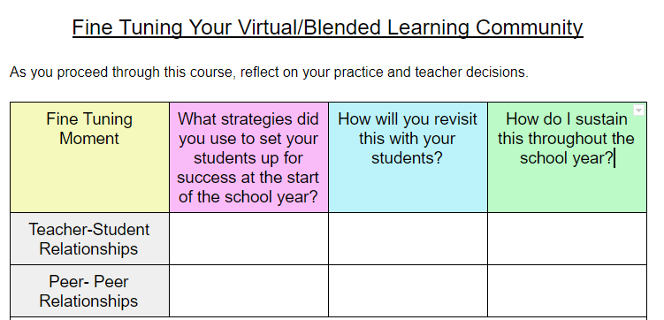
What do I need to fine-tune when it comes to building positive relationships
When you see an image of this chart on a slide, it is time to use it.
Use the document linked below for your planning. Select the one appropriate for your situation. We will continue to add to this throughout the the next couple of sessions.
Before School starts planning document
Mid School Year planning document
Notes:
The document shown on this slide is to be used as a supplemental resource for your learning. It is used for all 3 parts of this learning series. If you are participating in this presentation at the start of the school year, click on “Before school starts planning document” and if you are participating after school as has already commenced for the year, click on “Mid School Year planning document.” You will be prompted to “Make a copy.” Print it out or complete it electronically as you move through the presentation. There are prompts throughout the presentation as to when you should complete particular sections. If you are participating in this presentation with others, you are encouraged to share and discuss!

Slide 7
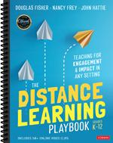
Resources Frequently Referenced:
The Distance Learning Playbook
High Leverage Practices for SWD
https://resources.corwin.com/distancelearningplaybook
4
https://highleveragepractices.org/about-hlps
Notes:
The Distance Learning Playbook was written by Douglas Fisher, Nancy Frey, and John Hattie to help teachers and administrators navigate the recent interruption of traditional in-person schooling and quick move to hybrid/remote learning for teachers and students. The hyperlink on the screen will take you to Corwin’s website where you will find free videos and reproducible forms that accompany the book. The reproducible forms are organized by modules and the content referenced in this presentation is from Module 3.
The link to the resources is also here: https://resources.corwin.com/distancelearningplaybook
The link for High Leverage Practices (HLPs) for SWD will take you to a webpage focused on 22 high leverage practices - practices that are intended to address the most critical practices that every K–12 special education teacher should master and be able to demonstrate. The selected practices are used frequently in classrooms and have been shown to improve student outcomes if successfully implemented. There are many tools for learning more about HLPs and how they can help all teachers overcome barriers presented by remote learning by implementing HLPs. The link is also found here: https://highleveragepractices.org/about-hlps
Note the green circled “4” in the bottom right corner of the page. This is indication that the resources on this slide meets the fourth core principle in the Blueprint for Improved Results for Students with Disabilities. Utilizing suggested strategies from this book with students in the classroom enables teachers to, “provide research-based instructional teaching and learning strategies and supports for students with disabilities.”

Slide 8
Why is it important to foster peer relationships amongst students?
Notes:
NEW SECTION: This section shifts to strategies to foster relationships between students in a hybrid/remote learning environment.

Slide 9
Benefits of Peer to Peer Relationships
Students feel safer and are more willing to take risks
Students have access to other ideas and opinions other than their own
Increased students engagement
Increase attendance/participation
Decreased behavior issues
Develops communication skills
Fosters creativity
Higher levels of achievement
4
Notes:
Thus far, teacher-student and teacher-family relationships have been addressed. Both have their benefits but also their challenges given the hybrid/remote learning models being implemented. The ultimate challenge is fostering peer to peer relationships, yet doing so results in immense benefit to everyone, even in a hybrid/remote learning environment. This and the next slide display the greatest benefits and challenges that a group of teachers reported during a synchronous training on this topic. Note the green circled “4” in the corner referencing the 4th principle in the Blueprint because these are research proven benefits of peer to peer relationships.

Slide 10
Challenges of Peer to Peer Relationships in the Remote/Hybrid Environment
Setting up structures to foster relationships (taking turns, communication)
Use of technology - some students are more tech savvy than others
Fears of the unknown
Accountability
Unstable network connections preventing “presence in class”
Not being able to read facial and other non-verbal cues
One on one support that might be present in the in person classroom and not in the virtual classroom
Using assistive technology or other modifications when working with peers
Notes:
These are challenges that were shared by teachers in New York during a virtual training on this topic.

Slide 11
How do we foster peer relationships amongst students?
Notes:
NEW SECTION: This section shifts to strategies to foster relationships between students in a hybrid/remote learning environment.

Slide 12
Building Community
In order for students to work collaboratively they need to feel safe in their environment and with their peers.
This can be especially challenging for students with disabilities who might struggle with social skills.
Incorporating time for students to get to know their peers leads to a greater sense of community and paves the way for the teacher to embed collaborative learning.
Notes:
If a teacher’s instructional model does not include any sort of collaborative learning at all in the physical classroom, it is very likely that this model will also be practiced in the hybrid/remote learning classroom. The facts should be clear that there is another level of challenge in the online environment because of the isolation resulting from the Covid-19 pandemic. Any opportunity to have students engage/interact with each other is not only good practice (when properly structured around a collaborative task with norms and procedures) but also essential to help students overcome feelings of isolation, depression, social withdrawal, etc. The classroom community may be the only connection to others a student have right now, and as educators, we must provide them with opportunities to connect with their peers and they are in the work as a team.

Slide 13
Strategies for Building Community Amongst Peers
Question of the Day- Ask the students a non-content, low stakes question that they can share with a peer. For example: What is your favorite thing to do outside? Try to avoid questions like: What did you get for Christmas? As this can alienate some students.
Emoji Board- Show students a picture of various emojis. Ask them which they can relate to that day and why. Encourage them to share this with a peer. For students with disabilities this is a strategy to practice identifying emotions.
Greetings- Develop a class greeting which can be used when students enter the room or at morning meeting.

Slide 14
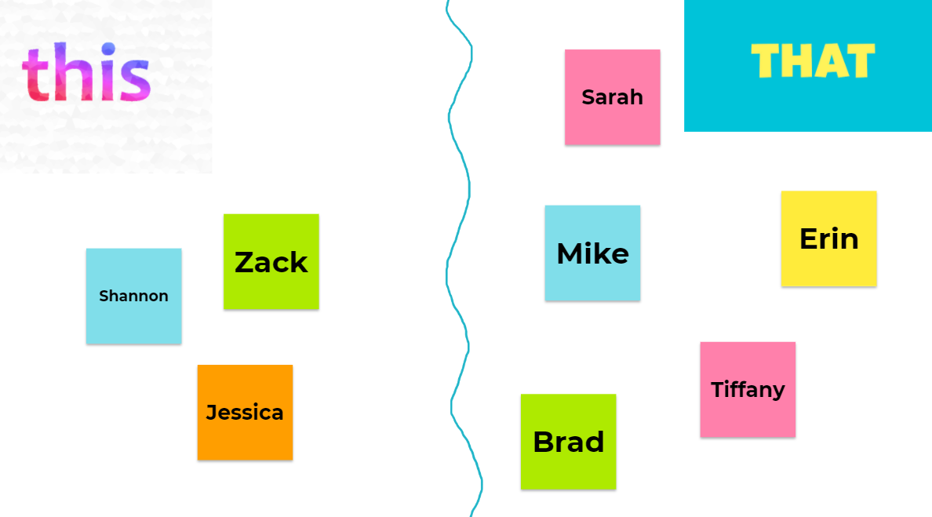
Strategies for Building Community Amongst Peers continued
This or That- Give students a this or that choice such as: Hot Dog or Hamburger. Remote students can do this using a Jamboard and moving their name. In person students could stand and move to different sides of their desk. Partners could also be incorporated to create conversations.
Social Stories and Role Play- This allows students topractice specific social situations in order to learn socially appropriate behaviors.

Slide 15
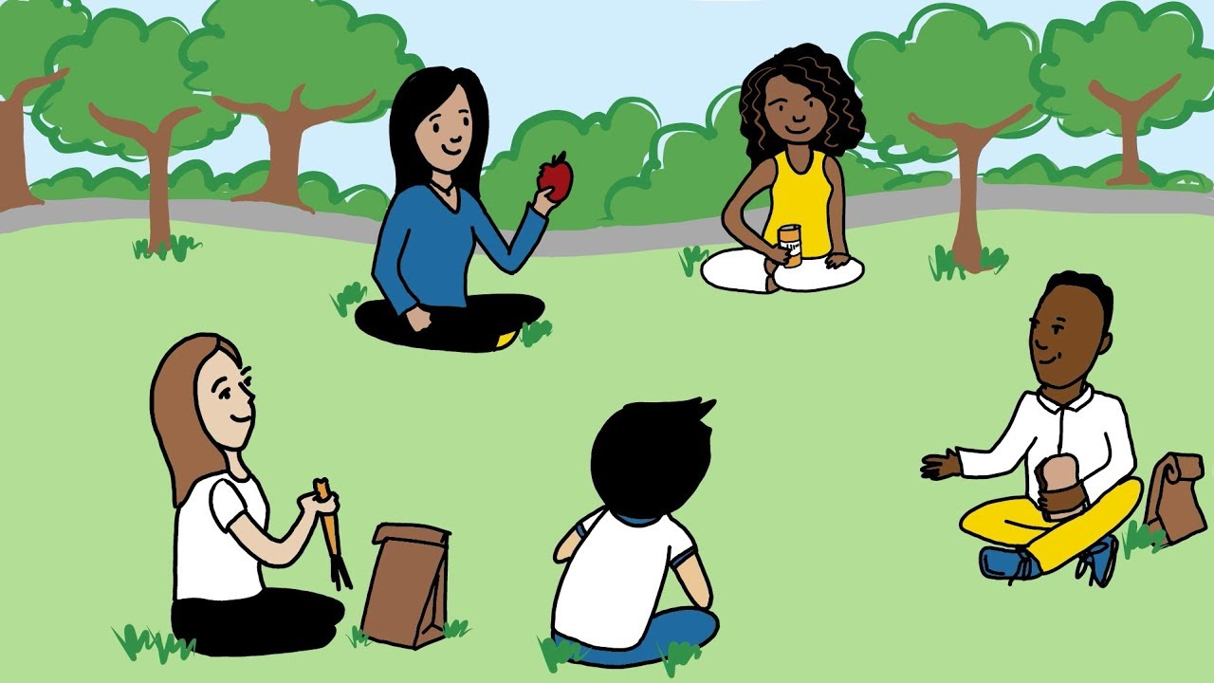
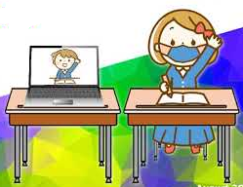
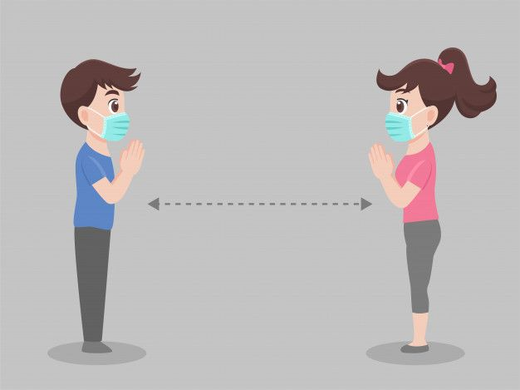
Adapting for the Hybrid/Remote (1/3)
Class building and team building is essential for strong relationships between students. Carve out time in your lessons for students to get to know each other.
Remember: a hybrid class is not an in-person class and a remote class which happens to meet at the same time. It is ONE complete class.
6
4
Notes:
We know academics are an important part of the classroom, but during this shift to hybrid/remote learning (and frequent transitioning between the physical classroom and virtual), relationships and feeling of belonging/connection are the most important. Carving out time from academic instruction to make personal connections with your students and so students can connect with each other will help to ensure that students’ social emotional needs are being met and that there is a sense of community within the class that may seem absent due to lack of in-person proximity. A couple examples from the field are on the next slide.
Always remember to consider individual students’ abilities. Regardless of year in school, some students need additional structures and support when interacting with others. It may be a more relaxed part of the school day, but interacting with peers can be a stressful situation for some, and with the limited ways in which you can safely set students up for peer-peer interaction, it is imperative that norms, agreements, and procedures are put in place. For more information on this topic, please see Part 1 of this learning series.
Note the green circled “4” and purple circled “6” in the corner. The content on this slide aligns with core principles “4” (Teachers provide research-based instructional teaching and learning strategies and supports for students with disabilities) and academic support) and “6” (Schools provide high-quality inclusive programs and activities) of the Blueprint.

Slide 16
Examples from the Field
“We have morning meeting each day where we played a team building zoom game. We also make Flipgrid* videos to interact with each other and reinforce content.”
Amy 4th grade Special Ed
“Once a week we have a class building zoom session. We play bingo, have show and tell, or go on virtual field trips together.”
-Erica 6th grade Special Ed
6
*Flipgid should only be used with district permission
Notes:
These are examples from the field for how to carve out time from academic instruction and get students connecting with each other. Note the purple circled “6” reflecting teachers are providing high quality, inclusive programs and activities in the classroom.

Slide 17
What can high quality peer to peer relationships look like in the virtual learning?
Notes:
Knowing the lists of benefits and challenges in the previous slides, slides 34-41 address how you can foster peer to peer relationships in the virtual classroom.

Slide 18
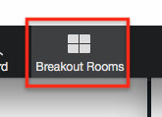
Adapting for the Hybrid/Remote (2/3)
Utilize spaces within your LMS (learning management system) and remote classroom to promote non-content discussion.
Ideas:
Use a discussion board for a class building conversation
Send partners into breakout rooms to discuss a preference
Utilize shared documents to promote collaborative work
6
Notes:
Not all peer to peer communication will be in the synchronous learning situation. There are many educational technology tools out there that can be used to help students engage with each other. First, look into your learning management system (LMS). What features within your LMS offer direct interaction between students? Can O365 or GSuite integrate with your LMS so you can assign partner tasks where students can work together on collaborative documents with secure & monitored messaging? FINISH
This slide provides ways in which a teacher can foster collaboration and relationships using your class’s learning management system or platforms used for collaboration. Note the purple “6” in the corner: core principle 6 (Schools provide high-quality inclusive programs and activities).

Slide 19
More Examples from the Field
“Everyday in class my students use a cooperative learning structure. We have a rotation of structures which creates routine. For example, Wednesdays are Jigsaw day.”
Amy 4th grade Special Ed
“I use the stream in Google Classroom to ask my students getting to know you questions. They like learning new things about each other and many times the conversation keeps going past the initial question!”
-Michelle - 8th and 9th grade Special Ed
6
4
Notes:
These are examples from the field for how to facilitate peer to peer relationships in online collaborative platforms (LMS, video conferencing, collaborative documents). Note the green-circled “4” (Teachers provide research-based instructional teaching and learning strategies and supports for students with disabilities) and purple circled “6” ( Schools provide high-quality inclusive programs and activities) for reference to the 4th and 6th core principles from the Blueprint for Improved Results for Students with Disabilities.

Slide 20
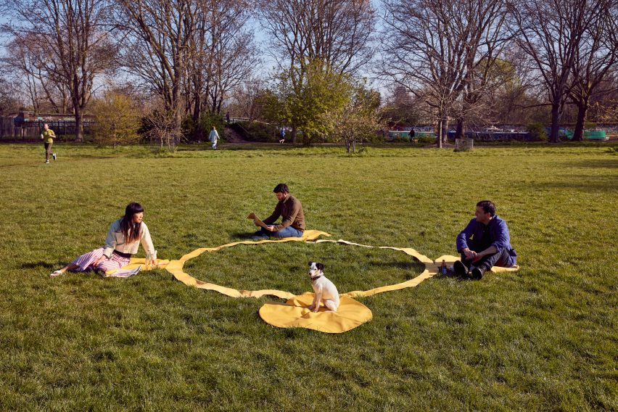
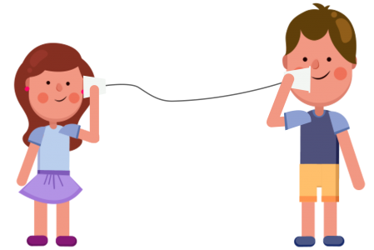
Adapting for the Hybrid/Remote (3/3)
Continue to embed opportunities for students to talk to each other face to face as much as possible.
Socially distanced groups will work with explicitly taught protocol and procedure.
Don’t hesitate to create norms for collaborative student work.
6
Notes:
Think of classroom discussion like a game of pinball - the pinball machine is the classroom, the game is the teaching, discussion, and learning. The goal of pinball is to use the paddles to propel the ball far up into the table for it to bounce back and forth between bumpers and ramps to generate as many points as possible. Think of the teacher as the paddles, the ball as the content, and the bumpers/ramps as the students. As content is delivered (paddles send ball up into the table), conversation is prompted and facilitated between students (ball bounces back and forth between bumpers and ramps. Once in a while the ball returns to the paddles only to be sent back up again. LIke in the game of pinball, having students talk (on task) directly to each other more with less interjection by the teacher is ideal.
However, pinball is a neat, tidy, and contained game. Student discussion starts as anything BUT neat, tidy, and contained, therefore, again, it is essential to put norms, structures, and procedures in place that all students agree to, understand and put into practice. For more information and training for how to put norms, class agreements, and procedures in place in a hybrid/remote learning environment, please participate in the 1st part of this 3-part series. Many considerations for students with disabilities when establishing norms, agreements, and procedures are included in Part 1. Note the purple circled “6” because facilitating opportunities for peers to interact on task aligns with the 6th core principle from the blueprint, “Schools provide high-quality inclusive programs and activities.”

Slide 21
Sample Peer-to-Peer Learning Norms
Be open to spend the time it takes to learn
Be adaptable to your learning and the learning of others
Create safe space
Embrace that learning is food for the mind
Transform learning into action
Understand that learning is a process that requires patience with self and others
6
4
(Fisher, Frey, & Hattie, 2020)
Notes:
This slide provides a sample list of peer-to-peer learning norms. For more information, sign up for Part 1 of this 3-part series of Fine-tuning your Hybrid/Remote Learning Environment.
The core principles attended to in this slide:
4- Teachers provide research-based instructional teaching and learning strategies and supports for students with disabilities.
6- Schools provide high-quality inclusive programs and activities.

Slide 22
What considerations am I making for students with disabilities when building relationships between my students?
Ensure everyone has a voice- embed procedure which ensures everyone has a chance to speak. If the students uses assistive technology or a picture to speak, make sure they have access to that when collaborating with other students.
Considerations for students who typically have an aid- what tools can be added or accessed to help the student interact with other students without an aid
Empower others- Encourage other classmates to assist in ensuring everyone in the group can participate
Practice social interactions- Embed opportunities to practice social interactions and interpreting social cues (this could be as a group or as an individual)
6
4
Notes:
This slide provides additional ideas for fostering relationships with individual students, especially students with disabilities. Both the green circled “4” and purple circled “6” are displayed on this slide because they align with core principles “4” and “6” from the Blueprint. These suggestions are either based in research, result in a more inclusive learning environment, or both!.
For more information about the UDL Framework for planning, please see:https://udlguidelines.cast.org/

Slide 23
Teach, Don’t Preach!
Explain- State the procedure, model, and demonstrate
Rehearse- Practice the procedure
Reinforce- Praise when they do it right! Provide students feedback
4
Notes:
It cannot be reinforced enough. Nothing put in place, no matter how great or revolutionary, will be 100% successful on the first try. This process may have to be explained, rehearsed, reinforced many, many times! It may also need to be adjusted and or modified for individual students as issues or opportunities arise. Note the green circled “4” on the screen. This is because this process of explain, rehearse, reinforce is a research-based strategy to be used with students and reinforces the 4th core principle on the Blueprint for Improved Results for Students with Disabilities.

Slide 24
Questions for Reflection – Peer-to-Peer Relationships
What strategies will you use in a virtual environment to build or maintain peer to peer relationships in the hybrid/remote learning environment?
Be sure to consider strategies that work in both synchronous (“live” video lessons) and asynchronous environments (Learning management systems and other communication platforms like email).
What special considerations must be made for students with disabilities?
Go to your Fine-tuning Planning Chart and complete the norms section
Notes:
At this point, open the Fine Tuning Planning Chart and work in the middle section of the page. Because creating and fostering relationships is a marathon not a sprint, there is space for you to consider strategies to use at specific places leading up to and throughout the school year.

Slide 25
Closure
Notes:
FINAL SECTION: Closure - an important part of learning regardless of environment and situation. In this section, we address receiving feedback about relationships from students and then wrap up reviewing the learning outcomes from the day, and finally offer time for reflecting on the learning during this session and committing to action as a result of the learning.

Slide 26
Explicitly Teaching the Hidden Curriculum
“Hidden Curriculum is an implicit curriculum that expresses and represents attitudes, knowledge, and behaviors, which are conveyed or communicated without aware intent; it is conveyed indirectly by words and actions that are parts of the life of everyone in a society.”
Not all students come to school fully aware or capable of how to act and interact according to what is acceptable in society...
Notes:
Before concluding the 3rd and final part of this learning series, take a moment to reflect on the big picture. Focusing on and continually fine-tuning the learning environment sets the stage properly for the most optimum learning for students. An essential element of any learning environment is the social one - how students act and interact with each other in that space - yet explicit instruction for how to act and interact with others is often absent and only implicitly conveyed. This is true in any learning environment.

Slide 27
Explicitly Teaching the Hidden Curriculum continued
Educators must make the implicit curriculum explicit by weaving it into instruction on a daily basis.
This can be done in any learning environment (in person, hybrid or remote) by:
Establishing norms, agreements, and procedures as a class (Part 1)
Building relationships with students and families, modeling appropriate interactions (Part 2)
Enable the development of peer to peer relationships in a safe space for students (Part 3).
Notes:
Given the drastic shift to hybrid/remote learning environments, teachers, students and students’ families are all having to navigate a completely new learning environment as well as new social constructs. As a result, explicitly teaching, modeling, and engaging in acceptable social behaviors and interactions are that much more important. The typically “hidden” curriculum has to be revealed, explicitly taught, and continually practiced. This can be done by establishing and following mutually agreed upon norms, agreements, and procedures (addressed in Part 1 of this series); building relationships with students and families, being the model of appropriate interactions (addressed in Part 2 of this series), and helping students practice and develop relationships with each other (addressed in Part 3 of this series). Establishing the most optimum learning environment for students is always a work in progress, therefore fine tuning your practice is also an ongoing process. But, continually fine-tuning your environment, regardless of the type of learning environment, will ensure you are putting in place the best conditions for your students to excel academically and social-emotionally, especially for students with disabilities. For more information about the hidden curriculum, use this link: https://files.eric.ed.gov/fulltext/EJ1083566.pdf

Slide 28
Our Learning Revisited
Today’s Outcomes
Describe strategies for students with disabilities when fostering peer relationships in a hybrid and remote learning environment.
Create a plan using the reflection document to ensure students with disabilities are explicitly considered in your learning space.
Notes:
The content in this presentation is focused on teaching in a remote/hybrid learning environment, but the concepts are applicable across any type of learning environment.
We extend focus and consideration to students with disabilities as much as possible throughout. As best practice in any learning environment, our learning outcomes are measurable with expectation of the participant to acquire new knowledge or enhance current knowledge and put into practice what has been learned.

Slide 29
Commitment
Regardless of where you are in the school year, we challenge you to set a reminder 1-2 months from now as a check in point for your commitment.
What strategies will you use to build and sustain positive peer to peer relationships in your classroom?
What will you bring out with your hybrid/remote students more explicitly?
Use the Fine-tuning planning chart to write down your commitment statement.
Notes:
The phrase “fine-tuning” implies that building relationships between students is already in practice in your classroom. However, given the changing times, conditions, and ways in which teaching and learning are being done, it is essential to step back, reflect, and then adopt new or different ideas or adapt what is already in place. Everyone has strengths as well as areas to improve upon. Take what you have gleaned from this presentation to fine-tune your own relationship building strategies to better support your students and yourself as you all continue to navigate hybrid/remote learning. Make a commitment - what is one area you commit to strengthening and why? How will you fine-tune your current strategies to work in a hybrid/remote learning environment? How will you fine-tune your current plan to ensure ALL students feel connected, that they belong and are valued, and are successful in the classroom (whatever that classroom looks like).
There is space in the Fine-tuning Planning Chart to write down your commitment. You are then asked to help yourself be accountable to that commitment. Set a reminder 1-2 months from now (and every 1-2 months after that) to check in on yourself and the commitment you made.

Slide 30
For more information & support
TIES Center: how to use peers and paraprofessionals!
High Leverage Practices: how to implement practices to improve learning for SWD
eteachNY Students with Disabilities

Slide 31
Thank you
“This work is hard, but our kids are worth it.” Thomas C. Murray
Notes:
Thank you for your participation, considerations, reflections, and planning during this presentation. This is the end.

