Slide 1
Teaching in Remote Learning Environments
Introduction

Slide 2
What is eTeachNY?
eTeachNY is a coalition of education partners who have come together to support the implementation of the Teaching in Remote Learning Environments (TRLE) Initiative

Slide 3
NYSED was awarded a grant to implement a Teaching in Remote / Hybrid Learning Environments (TRLE) initiative.
Six applicants were selected to develop resources to support the TRLE initiative

Slide 4
Coalition partners and focus areas
Coalition partners
Areas of focus
Broome-Tioga BOCES
Mohawk Regional Information Center (MORIC)
Eastern Suffolk BOCES
Monroe 2-Orleans BOCES
WSWHE BOCES
Greater Southern Tier BOCES
Students with Disabilities
Families as Partners
Culturally Responsive Education
English Language/Multiple Language Learners
Shifting to Online Learning
Social-Emotional Learning

Slide 5
Our Approach
Develop and curate resources with coalition partners
Deliver turnkey trainings
Trainings will be recorded
Follow up email after training:
Training resources
Exit reflection
Links to eTeachNY website and social media

Slide 6
Your Role
Schedule and publicize trainings
Must be open to all NYS teachers at no cost
Collect registration data
Teacher’s name, district, grade level/content area
Issue CTLE credits
Distribute reflection survey following each training

Slide 7
Questions?

Slide 8
For more information:
Contact Lynne Wells: lynne.wells@neric.org
Visit eTeachNY.org
Follow @eteachny on Twitter

Slide 9
Fine Tuning Your Hybrid/Remote Learning Community
Notes:
This presentation is Part 1 of the Fine-Tuning Your Virtual/Remote Learning Community. Part 2 will focus on Relationships and Part 3 will focus on Teacher Credibility and Social Emotional Learning (SEL), specifically in the virtual/remote learning environment . The presentation was originally made for a “live” session with teachers and has been adapted to be used for asynchronous, self-directed learning. There are some resources referenced in this presentation. When directed, download or print supplemental materials for use throughout the presentation and visit hyperlinked websites for additional resources on the topic.

Slide 10
Our Learning
Today’s Outcomes:
Identify high impact strategies that foster a successful and productive learning environment for all students
Establish classroom norms and expectations for all students (in person and online learning)
Create a plan using the Blueprint for Improved Results for Students with Disabilities to ensure students with disabilities are explicitly considered in your learning space
Notes:
The content in this presentation is for teaching in any type of learning environment. Particular focus has been placed on establishing these essential classroom elements in a hybrid/remote learning environment. Establishing classroom norms and expectations is essential in every learning environment, but may vary because of differing teaching philosophies and the students in the classroom. They are essential yet customizable, and while we establish norms, routines, and procedures, we must consider how they will set all students up for success, not just the majority.
In this presentation, we extend focus to students with disabilities. New York State Education Department’s office of Special Education released the Blueprint for Improved results for Students with disabilities in November of 2015. This document focuses on seven research and evidence-based core principles and practices for all students with disabilities. Improving results for students with disabilities requires a renewed focus on these core principles. Therefore, we have explicitly linked the content in this presentation to some of the appropriate principles in the Blueprint to reinforce that these essential classroom practices are effective for improving results for all students in general, but also for students with disabilities.
By clicking on the “Blueprint for Improved Results for Students with Disabilities” in the third bullet, you will be directed to the actual PDF document for further information. The 7 core principles are also displayed on slide 4 of this presentation. As best practice in any learning environment, our learning outcomes are measurable, with expectation of the participant coming out of this presentation able to acquire new knowledge or enhance current knowledge and put into practice what has been learned.

Slide 11
Agenda
Welcome
Why do we need to think about fine-tuning our learning environment?
What strategies are most effective in establishing our learning environment (Designing a Classroom Management Plan)?
What is my philosophy of teaching and learning in my classroom (face to face, hybrid, or remote)?
What norms do I want students to use as they interact with one another?
What are our class agreements?
What routines and procedures will I have to introduce and teach to my students (given my learning environment)?
What considerations am I making for students with an IEP when creating my classroom environment and community?
What aspects of a hybrid/remote learning environment might you need to be adopt or adapt for student success? Identify Next Steps.
Notes:
The learning focus for this presentation will help us ensure predictability and consistency for our students during this difficult time and beyond. We proceed through this presentation answering the questions listed in this agenda with research-based content and New York State teacher experiences; we also provide space for you to consider your perspective and reflect on your own teaching in the context of the topic at hand. If you are working through this presentation at the start of the school year, there is opportunity for you to think about the year ahead and plan. If you are working through this presentation while school is already in session, you are offered opportunities to reflect and potentially adapt your current perspective and practices. Notice again, that particular emphasis has been placed on considerations for students with disabilities, but we should also always consider other student populations such as English Language or Multilingual Learners as well.

Slide 12
Blueprint for Improved Results for SWDs
1
Look for the numbers throughout the presentation to know when a particular core principle is being addressed!
Items in bold indicate which principles are addressed in this presentation. By Part 3 of this series, all but Principle #7 will be addressed.
Students engage in self-advocacy and are involved in determining their own educational goals and plan.
Parents, and other family members, are engaged as meaningful partners in the special education process and the education of their child.
Teachers design, provide, and assess the effectiveness of specially-designed instruction to provide students with disabilities with access to participate and progress in the general education curriculum.
Teachers provide research-based instructional teaching and learning strategies and supports for students with disabilities.
Schools provide multi-tiered systems of behavioral and academic support.
Schools provide high-quality inclusive programs and activities.
Schools provide appropriate instruction for students with disabilities in career development and opportunities to participate in work-based learning.
2
3
4
5
6
7
Notes:
The Blueprint for Improved Results for Students with Disabilities is made up of 7 core principles:
1- Students engage in self-advocacy and are involved in determining their own educational goals and plan.
2- Parents, and other family members, are engaged as meaningful partners in the special education process and the education of their child.
3- Teachers design, provide, and assess the effectiveness of specially-designed instruction to provide students with disabilities with access to participate and progress in the general education curriculum.
4- Teachers provide research-based instructional teaching and learning strategies and supports for students with disabilities.
5- Schools provide multi-tiered systems of behavioral and academic support.
6- Schools provide high-quality inclusive programs and activities.
7- Schools provide appropriate instruction for students with disabilities in career development and opportunities to participate in work-based learning.
Items in bold indicate which core principles are addressed in this presentation. The numbers in the different colored circles will be found on slides where content is directly aligned to one or more core principles. A special note will also be included in the presentation notes on the slides.

Slide 13
What do I need to fine-tune when it comes to establishing norms and procedures?
When you see an image of this chart on a slide, it is time to use it!
Use the document linked below for your planning. Select the one appropriate for your situation. We will continue to add to this throughout the the next couple of sessions.
Before school starts planning document.
Mid School Year planning document.
Notes:
The document shown on this slide is to be used as a supplemental resource for your learning. It will be used for Parts 1 - 3 of this learning series. If you are participating in this presentation at the start of the school year, click on “Before school starts planning document” and if you are participating after school as has already commenced for the year, click on “Mid School Year planning document.” You will then be prompted to “Make a copy.” Print it out or complete it electronically as you move through the presentation. There are prompts throughout the presentation as to when you should complete particular sections. If you are participating in this presentation with others, you are encouraged to share and discuss!

Slide 14
WHY do we need to think about fine-tuning our learning environment?
Notes:
New Section: Why do we need to think about fine-tuning our learning environment? It may seem to be common sense to establish rules and follow specific classroom management strategies in your classroom. However, to ensure that all students are successful in your learning environment, proper planning must take place, especially as we are having to transition to a remote/hybrid learning model, and sometimes transition back and forth between in person and remote/hybrid learning as we deal locally with the pandemic. We cannot just assume that our students will be able to go with the flow; a lot of times we struggle with going with the flow. We must put structures in place that ensure success for all students regardless of their learning environment. This section dives into the “WHY” behind the work.

Slide 15
Why do we have to fine-tune our learning environment?
“So many New Yorkers are hurting right now. Providing a safe education to our children may be the single most important thing we can do to begin healing.”
Interim Commissioner Dr. Betty A. Rosa

Slide 16
Students come to us with questions….
Whether it is before the school year begins or each day throughout the year, students walk into our classrooms with a variety of questions.
Let’s consider what some of those questions might be.
Notes:
At the start of the school year, we all know students come to school with excitement, anticipation, nerves, and insecurities, full of questions like those listed in the next slide. These questions, if left unanswered, may prevent students from feeling safe and part of the classroom community. They may feel distracted, uncertain, and alienated. As teachers, we typically spend the first days of school answering these questions and putting structures in place to ensure all students feel safe, secure, and included. It is just as, if not more, important to do the same thing in a hybrid/remote learning space. The next two slides present possible questions students come to class thinking about.

Slide 17
What are they thinking at the start of the year?
In Person Learning
Hybrid/Virtual Learning
Am I in the right place?
Where do I sit?
What are the rules of this teacher?
What will I be learning?
How will I be evaluated?
Who are you?
Do you care that I’m here?
Am I in the right place?
Is it the right time?
Can he/she see me?
What are the rules of this teacher?
What will I be learning?
How will I be evaluated?
Who are you?
Do you care that I’m here?
Notes:
Notice that many of the questions are the same regardless of the space in which instruction is delivered. However, there are new questions that are meant to prompt a shift in your thinking. Can you think of other questions that students may have when starting to learn in a hybrid/remote learning environment? Then consider how you can address these questions and use the answers as you develop/reflect on your classroom norms, agreements, and routines later in this presentation.

Slide 18
What are they thinking when school is in session?
In Person Learning
Hybrid/Virtual Learning
Why don’t I get called on?
What are we supposed to be doing right now?
What are we doing next?
What am I supposed to be learning?
Do you care that I am here?
Why don’t I get called on?
What are we supposed to be doing right now?
What are we doing next?
What if my Wi-Fi drops?
What is going on in the other room?
Why can’t I see what is being read?
How do I turn in my work?
Do you care that I am here?
Notes:
At any time while school is in session, students may develop different questions that can have a similar, possibly negative, impact on their learning. This is particularly true if the way in which instruction is delivered changes (i.e.. in-person to hybrid/remote learning). Still, notice that the questions are not completely different between the two styles of instructional delivery. However, the new questions posed in a hybrid/remote learning environment raise the stakes to a new level. As prompted in the previous slide, think of other questions that students may have when starting to learn in a hybrid/remote learning environment? Then consider how you can address these questions and use the answers as you develop/reflect on your classroom norms, agreements, and routines later in this presentation.

Slide 19
What does a safe education look like in a remote/hybrid learning environment?
In a remote/hybrid learning environment, the teacher does not have proximity and other classroom management strategies to ensure safety and equity.
Knowing this, we have to think differently when establishing norms, routines and procedures to ensure that all students feel engaged, safe, and successful learning in the virtual space.
Notes:
When we aren’t able to teach and interact with our students in person, it is even more important that time is spent establishing a classroom structure with norms, routines, and procedures that benefit the entire class. Teachers lose the ability to be physically present and have to connect and engage with their students through computer screens. Therefore, anticipating and adopting (prior to the start of the school year) and then adapting, as necessary (throughout the school year), strategies that directly address how the classroom will operate and the role everyone plays in the environment will set up the classroom and the students within to be successful when learning.

Slide 20
What are the most effective strategies in establishing our learning community/environment?
Notes:
New section: What are the most effective strategies in establishing our learning community/environment? The section will walk you through designing a classroom management plan that can be utilized in any learning environment, but special emphasis is placed on hybrid/remote learning classroom. The following questions will be addressed:
What strategies are most effective in establishing our learning environment (Designing a Classroom Management Plan)?
What is my philosophy of teaching and learning in my classroom (face to face, virtual, or hybrid)?
What norms do I want students to use as they interact with one another?
What are our class agreements?
What routines and procedures will I have to introduce and teach to my students (given my learning environment)?
What considerations am I making for students with an IEP when creating my classroom environment and community?

Slide 21
New Resource: The Distance Learning Playbook
Resources available at https://resources.corwin.com/ distancelearningplaybook
4
Notes:
The Distance Learning Playbook was written by Douglas Fisher, Nancy Frey, and John Hattie to help teachers and administrators navigate the recent interruption of traditional in-person schooling and quick move to hybrid/remote learning for teachers and students. The hyperlink on the screen will take you to Corwin’s website where you will find free video and reproducible forms that accompany the book. The reproducible forms are organized by modules and the content highlighted in this presentation is from Module 2.
The link to the resources is also here: https://resources.corwin.com/distancelearningplaybook
Note the green circled “4” in the bottom right corner of the page. This is indication that the Distance Learning Playbook and the supplemental resources therein meets the fourth core principle in the Blueprint for Improved Results for Students with Disabilities. Utilizing suggested strategies from this book with students in the classroom enables teachers to, “provide research-based instructional teaching and learning strategies and supports for students with disabilities.”

Slide 22
Having a Classroom Management Plan
“A virtual/distance classroom management plan is a teacher-created document that captures the norms, agreements, procedures, and schedules that will be used.”
“Committing a thoughtful and well-constructed plan to paper is a first step in a proactive approach to distance learning…”
(Fisher, Frey, & Hattie, 2020)
Use this Fine-tuning planning chart to help you develop your Classroom Management Plan!
Notes:
These quotes are taken directly from the Distance Learning Playbook text. Though the immediacy of the shift in learning environment has caused many educators to figure things out as they go, taking the time to design a classroom management plan is essential. When there is a plan in place, the stress level of the teacher reduces as well as the students’.

Slide 23
Designing a Classroom Management Plan
What is my philosophy of teaching and learning in my classroom (face to face, hybrid, or remote)?
What norms do I want students to use as they interact with one another?
What are our class agreements?
What routines and procedures will I have to introduce and teach to my students (given my learning environment)?
Notes:
Retrieve the document that was shared in Slide 5 to use with the rest of the presentation. Fisher, Frey, and Hattie stress the importance of intentional planning. These questions are to be asked and answered as you are heading into a new a school year - proactive planning for welcoming a new year and new students.

Slide 24
Reviewing a Classroom Management Plan Mid-year
Has my philosophy of teaching and learning in my classroom changed (face to face, virtual, or hybrid)?
What norms have been followed successfully? Are there norms that need to be revisited or changed given the progress in the school year?
Are our class agreements still appropriate? Are there any that need to be revisited/changed?
Have all the routines and procedures helped ALL my students be successful (given my learning environment)?
Notes:
These questions are for when the school year has already started, regardless of how far into the year you are. As the year progresses, it is essential to check in with how you and your students are doing with the structures you put in place at the start of the year. The last question is especially important to reflect upon. Are all the norms, agreements, routines, and procedures working for ALL students? If not, what may need to be modified? Or, should considerations be made for individual students? This question will be addressed in greater detail later in the presentation.

Slide 25
How does my teaching philosophy impact decisions I make?
As an educator, our teaching philosophy drives the decisions we make on a daily basis. Our teaching philosophy is built upon our individual values and beliefs.
Over the next 5 minutes, reflect on what your beliefs are as a teacher. What do you value as a teacher? What is most important to you? What drives the decisions you make in your classroom?
Notes:
Over the next 5 minutes, reflect on your personal values and beliefs as a teacher.
What are your beliefs about teaching and learning in your classroom? What are your beliefs concerning community and diversity?
Write down every thought you have to the questions on the slide as you will use these answers to construct your teaching philosophy in the next slide. If you are participating in this session with other teachers, take additional time to share some of your thoughts with each other.

Slide 26
What is your philosophy of teaching and learning?
Take two minutes to put your teaching philosophy on paper.
Then, consider...
How will you share your philosophy with your students?
How do all of the norms, expectations, and procedures that you have established in past years align to your philosophy?
Notes:
When it comes to norms and class agreements in a classroom, it is essential to start with yourself as the teacher, taking stock in your own teaching philosophy and critically considering if it remains consistent or changes with the change of your students’ learning environment. Give yourself 2 minutes to write down your philosophy.
Keep your statement short and concise - no more than a few declarative sentences. If you are working through this presentation with someone else, take a couple extra minutes to share with each other.
Then, consider how you will share your philosophy with students and their parents/guardians.

Slide 27
“I value an environment that allows people to take risks and make mistakes. We are all learning new things and are here to help each other.” - 6th grade teacher
Notes:
This is a sample philosophy statement from a 6th grade teacher.

Slide 28
Establishing Classroom Norms
“Norms govern how individuals in the group interact with one another and delineate what will be tolerated and what will not.”
“The norms of the classroom are the beliefs and values you want the collective classroom community to abide by.”
Notes:
Now that you have rooted yourself in your teaching philosophy, turn your focus to establishing classroom norms. This slide defines “norms.” Remember that, for this presentation, you are focused on creating norms in the hybrid/remote classroom. The norms may or may not be similar to those you would use in the physical, in-person classroom. A detailed sequence for how to create norms with your students is detailed in the next slide. Examples of classroom norms are shared on following slides.

Slide 29
How do we create norms with our class?
Explain why you’re going to create them
Elicit Input from All Students
Support students in connecting & summarizing their ideas
Finalize wording together
Ask for everyone’s agreement
Then
Teach, Model, Practice, Give Feedback
Revisit Frequently, Revise as Needed
1
4
Notes:
This is a suggested process for establishing norms with your students. When you do this is a remote setting, use an interactive app such as Google Jamboard or Padlet so students can all contribute their own ideas. Find a platform that offers multiple ways for students to submit ideas. For example, if a student wants to submit text, that is an option, or if they want to record their voice, they can do that too. Whatever way you choose, be sure it is a “live” session with your students so you can facilitate the discussion and support the students in connecting and summarizing their ideas. Once all are in agreement, it is imperative to then teach, model, practice, give feedback to the students. This may need to happen multiple times (and repeated throughout the year) to ensure all students can successfully follow the norms established by the whole class.
Note the red circled “1” in the bottom right corner of the page. This is indication that the act of establishing norms and having students participate in the process supports the first core principle in the Blueprint for Improved Results for Students with Disabilities. Having students contribute their own ideas of how to build a safe and productive learning environment helps them, “engage in self-advocacy” and be “Involved in determining their own educational goals and plan.”. There is also a green circled “4” which is indication that the process “teach, model, practice, give feedback is a “research-based instructional teaching and learning strategy that supports students with disabilities” which is core principle #4 in the Blueprint.
Below are some video examples of establishing norms in the classroom:
Edutopia: https://youtu.be/oRXYc4xmvwg
Expeditionary Learning: https://youtu.be/g_PoAg28TsQ

Slide 30
Sample Learning Community Norms
Take care of yourself
Be fully present (Engage fully and take risks)
Respond thoughtfully to others and embrace differences
Be mindful of other learners
Be fully present
Allow every voice to be heard
Notes:
The norms displayed on the slides were generated by teachers in a synchronous, online version of this training and can be used as a sample list. You will notice they are general statements composed of beliefs and values that are important to the classroom as a community. How you and the students live up to these norms — what they look and sound like in the classroom — are made clear with class agreements.

Slide 31
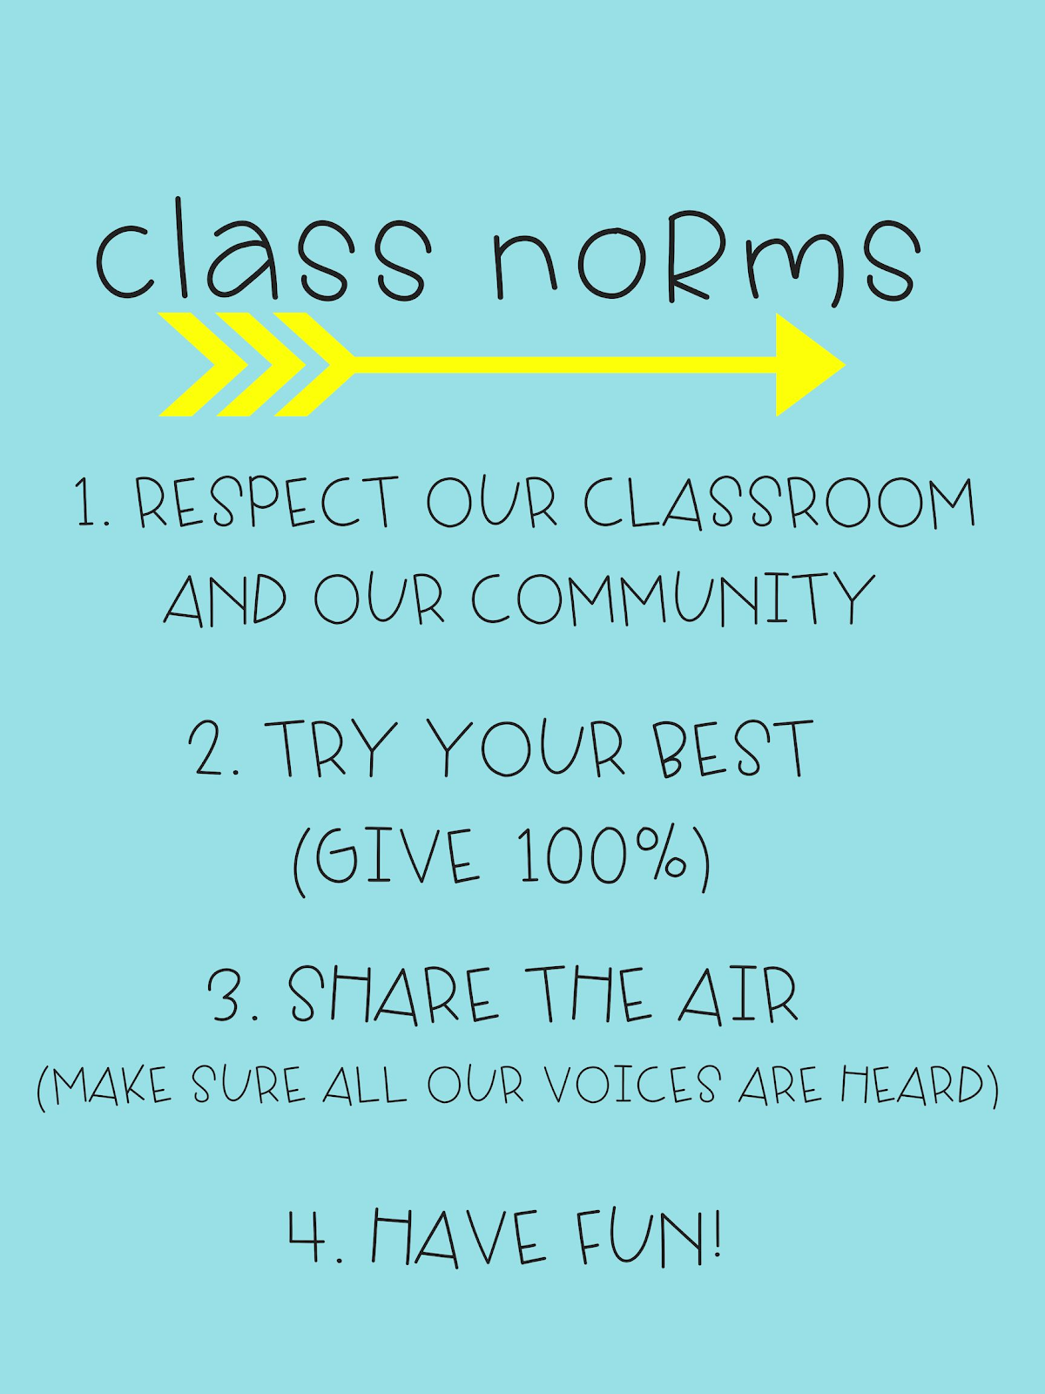
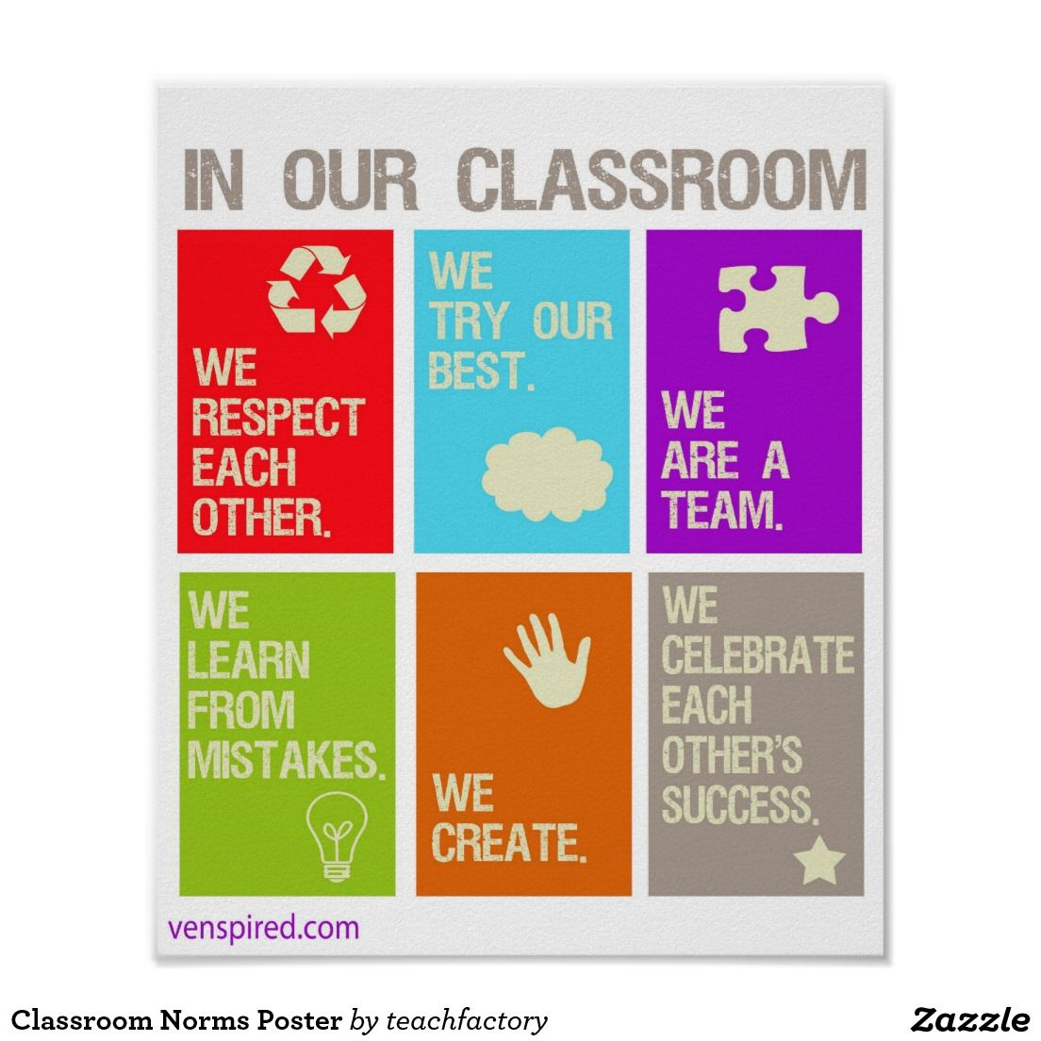
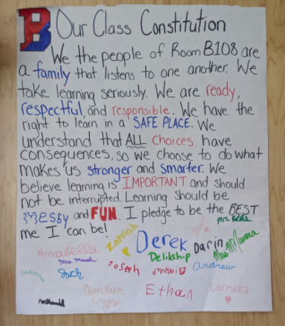
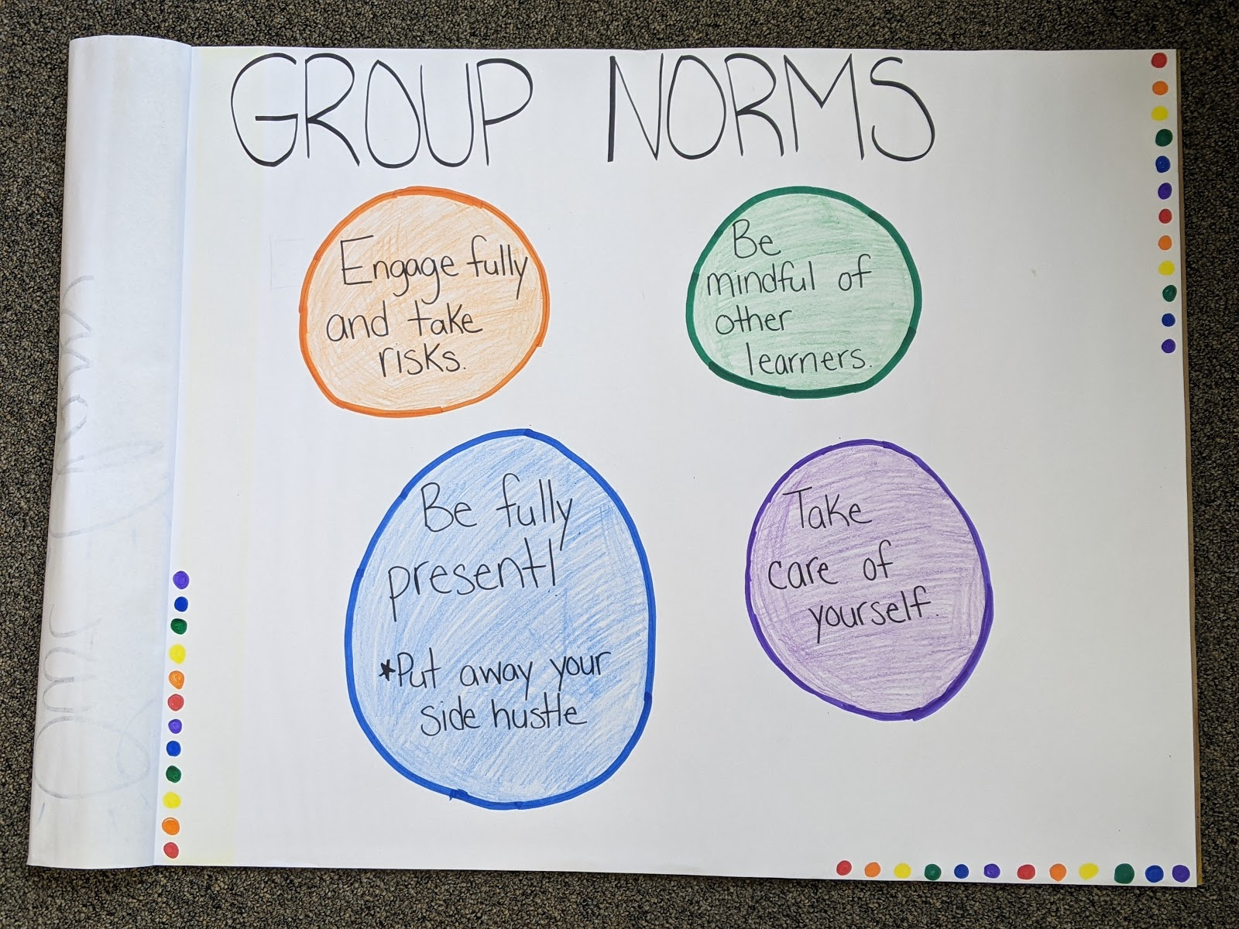
Examples
Notes:
This slide is composed of visual examples from various grade levels and learning environments.
The top left visual:.
“In our classroom:
We respect each other
We try our best
We are a team
We learn from mistakes
We create
We celebrate each other's success”
Top middle visual:
“Classroom norms:
Respect our classroom and our community
Try our best (give 100%),
Share the air (make sure all our voices are heard)
Have fun”
Top right visual:
“Our class Constitution: we the people of room B108 are a family that listens to one another. We take learning seriously. We are ready, respectful, and responsible. We have the right to learn in a safe place. We understand that all choices have consequences, so we choose to do what makes us stronger and smarter. We believe learning is important and should not be interrupted. Learning should be messy and fun. I pledge to be the best me I can be.” All students signed the bottom of the poster.
Bottom left visual:
“Group norms:
Engage fully and take risks.
Be fully present (put away your side hustle)
Take care of yourself,
Be mindful of other learners.”
Again, notice they are general statements composed of beliefs and values that are important to the respective classrooms. We will transition to creating class agreements starting in 2 slides, as these agreements are what bring these norms to life in the classroom.

Slide 32
Questions for Reflection
How do you typically establish norms in your classroom?
What are some new considerations for establishing norms in a hybrid/remote learning environment?
What considerations need to be made for your students with disabilities when establishing norms?
Go to your Fine-tuning Planning Chart and complete the norms section
3
Notes:
Take 5 minutes to think about and jot down your answers to these reflection questions. Then, get out the copy you made of the “Fine Tuning Planning/Reflection Chart and complete the NORMS row only at this point.
With the 3rd question, it is strongly suggested that you take additional time to review your students IEPs and 504 plans before answering this question. Students with IEPs have individualized learning goals that have been crafted to ensure success in the current academic year. It is possible that aspects of their disability could make it difficult for them to participate in upholding the norms in the classroom and that their IEPs have strategies that will help you in creating norms ALL students can follow. The same can be said for students with 504 plans. Be sure to check the nature of their 504s and the strategies that have been included to help support the students in their learning. Some examples of strategies for students with disabilities may be visual, written, verbal, physical prompts or cues or even specialized assistive technology and equipment. Let the IEP and 504 plan help you in your planning.
Note the yellow circle “3” in the bottom right corner of the screen. .This is indication that reflecting on considerations needed for students with disabilities addresses principle #3 in the Blueprint: “Teachers design, provide, and assess the effectiveness of specially-designed instruction to provide students with disabilities with access to participate and progress in the general education curriculum.”

Slide 33
Developing and Utilizing Class Agreements
“Agreements represent the social contract of the classroom community, rather than a narrower set of behavioral guidelines that have been written by the teacher alone.”
A fewer number works better than too many— think 3-5!
Co-construct them with your students
State them positively—what is acceptable, not what they should NOT do
Make them specific
Post the agreements
Teach and rehearse the expectations
1
Notes:
Once your norms are established, the next step is developing and utilizing class agreements. Be sure to link norms to class agreements, as the agreements that they will commit to, should reinforce the norms the class has created together. This slide provides some guidance as to how to construct classroom agreements. An example of class agreements is on the next slide.
Note the red circled “1” in the bottom right corner of the page. This is indication that the act of establishing class agreements and having students participate in the process supports the first core principle in the Blueprint for Improved Results for Students with Disabilities. Having students contribute their own ideas of how to build a safe and productive learning environment helps them, “engage in self-advocacy” and be “Involved in determining their own educational goals and plan.”

Slide 34
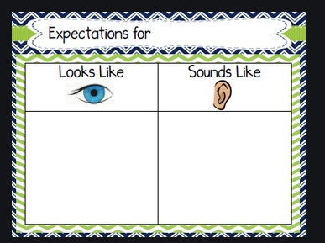
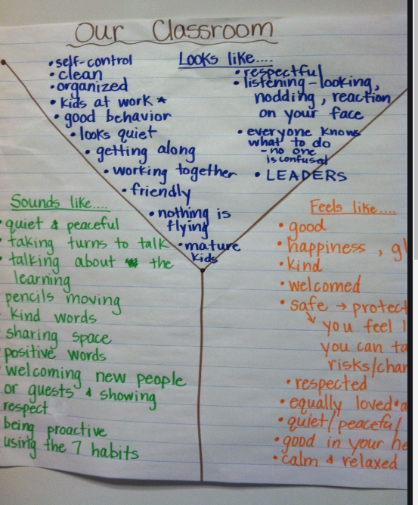
What does the classroom need to look like and sound like for learning to happen for all students?
1
Notes:
It is said that if everyone agrees to the norms that every student will be successful in their learning because the norms establish expectations of a safe and productive learning community. However, remember norms are very general statements that need to be further explained and defined for students. This is especially true in the hybrid/remote learning environment because it can be so unfamiliar and uncomfortable to everyone. Let’s take an example from one of the class norms charts in slide 23: “We respect each other.” What does that mean? It could mean something different to each one of your students and you as well. This is where the class agreements come into play. As a class, everyone needs to understand and agree to what respecting each other looks like and sounds like. Using an example from the poster in the slide, “taking turns to talk” is an example of how to be respectful of each other. And, having the students generate the list gives them ownership of their own agreements and a sense of team comradery that will build a sense of class community. Bottom line is we cannot assume all students understand a very general statement of respect, no matter how much they value the act. This is why class agreements are an essential part of the fine-tuning process.
Note the red circled “1” in the bottom right corner of the page. This is, again, indication that having students participate in the process supports the first core principle in the Blueprint for Improved Results for Students with Disabilities. Having students contribute their own ideas of how to build a safe and productive learning environment helps them, “engage in self-advocacy” and be “Involved in determining their own educational goals and plan.”

Slide 35
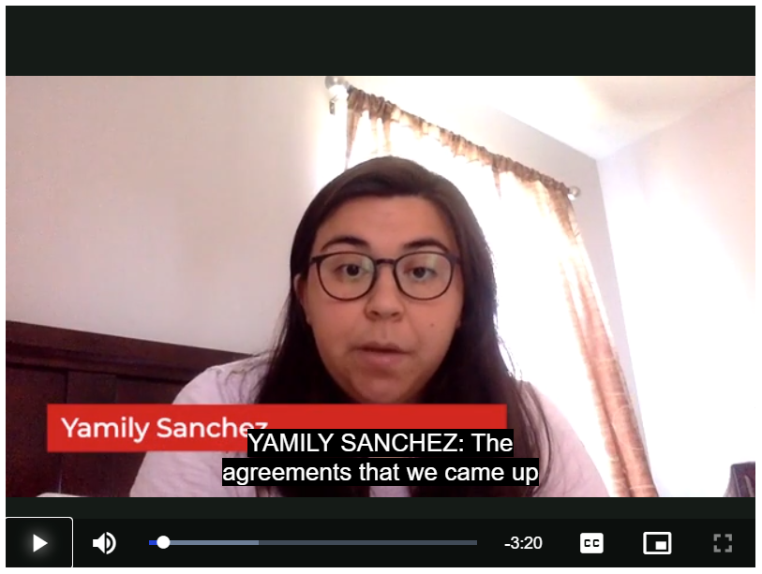
Sample Class Agreements
Middle School Math
Follow the person who is speaking with your eyes
Post respectful reactions to ideas in the chat
Treat members of the class with the care they deserve
1
Notes:
This slide provides you with sample class agreements for a middle school math class. Click on the video link here to take you to the Distance Learning Playbook resources where this video is located: https://resources.corwin.com/distancelearningplaybook/student-resources/videos/module-2

Slide 36
Reflecting on Class Agreements
Before the Start of the School Year Reflections
Mid School Year Reflection
What are the 3-5 agreements that you think would be appropriate for your learning environment?
How might you co-construct agreements with your students?
How have you ensured that your norms are applicable for ALL students?
What adaptations need to be made to your class agreements?
How might you co-construct agreements with your students?
How might you address the need to modify some norms/agreements with your students?
Are all your norms applicable to ALL students? If not, what needs to change?
Go to your Fine-tuning Planning chart and complete the class agreements section
1
3
5
Notes:
Please return to your Fine-tuning chart and complete the CLASS AGREEMENTS row at this point.
As stated previously, depending on when you are participating in this presentation, you may be at the start of your school year or already in session, and you may have had to transition from in person to virtual learning in between. Asking yourself key questions regarding the established norms and class agreements is essential in the planning process. Do not neglect the last question in each box as it prompts you to consider each individual student, the progress they are making in class, and the impact the norms and class agreements are having on their ability to learn successfully in class. If, with any student, you see that they are either struggling to uphold the norms or class agreements it is imperative to consider how to best support that student so they can successfully function in the classroom. This may lead to setting up Multi-tiered systems of support (MTSS) for an individual student. For more information about MTSS, please refer to the presentations on MTSS.
Note the red circled “1” again, speaking to the student involvement in establishing agreements, promoting self advocacy and being involved in establishing goals. A yellow circled “3” is also displayed because of the need for teachers to ensure the agreements are applicable and attainable by all students, and if they aren't, engage in specially designed instruction for students with disabilities. The blue circled “5” in the bottom right corner of the screen indicates that reflecting on performance of all students, especially students with disabilities, and engaging in MTSS when appropriate addresses principle #5 in the Blueprint: “Schools provide multi-tiered systems of behavioral and academic support..”

Slide 37
Develop and Teach Organizational and Procedural Routines
Provide weekly and monthly schedules for students and families so they can organize resources
Furnish a daily schedule at the beginning of each class
Teach students the signals you will use
Identify signals that you would like your students to use or that are designed to use with individual students according to their IEP?
Create procedures for how students will retrieve materials
Create procedures for how students will submit materials
What other routines or procedures might you need when considering your students with IEPs?
3
4
Notes:
Norms? Check. Class agreements? Check. Now we transition from the bigger classroom picture to the day-to-day routines and procedures that will help students access the information they need to be successful academically, especially in the hybrid/remote learning environment. The list on this slide has some procedural routines you can use with your students. An important note here is HOW you will communicate these routines with your students and families. For example, while in the hybrid/virtual teaching, will you post them in a specific place in your learning management system (LMS) so students know exactly where to look every day? Consider individual student needs/requirements. A student may need a daily visual schedule that includes the pull out times for related services. Another student may need modification to how to retrieve, produce, and submit work. If you need assistance in how to make certain procedures work for students, reach out to your consultant teacher colleagues or the CSE Chairperson.
Note the yellow circled “3” and green circled “4” on the screen. The suggested procedural routines are research-based, which align with the Blueprint’s 4th core principle, but also creating student specific procedural routines aligns with the 3rd principle of providing specially designed instruction for students with disabilities.

Slide 38
Classroom Procedures
Face to Face Environment:
Entering the room
Attention signal/ Quieting the class
How to ask for help
Movement of students and paper
End of class period
What is the same in a remote or hybrid environment?
What procedures might you have to add?
3
Notes:
There are examples of typical routines and procedures for the in-person classroom on this slide. What others would you add? Now consider what routines in this list carry over into the hybrid/remote learning environment? What new or different routines need to be added for the hybrid/remote learning environment? Some ideas might include:
how students should ask a question while meeting as a class using Zoom, Google meet, or your designated video conferencing application.
how to interact with the teacher or students in the LMS - especially in regards to discussions and group work.
how to submit work in the LMS.
how parents should contact you with any concerns or questions about the students learning, progress, or attendance.
how you will be in communication with the students and parents while in a remote learning situation.
The yellow circled 3 speaks to engaging in specially designed instruction for students with disabilities. The procedures or routines that has been created for the class in general may require slight modification or complete alteration in order for a student with disability to successfully meet expectations.

Slide 39
Virtual Classroom Procedures
The Hybrid Teacher Survival Guide (Emma Pass)
Here. When students first arrive, I have them write “here” in the chat box so I can easily scroll back through their names and take attendance.
Hall Pass. If a student needs to step away from the computer screen, to go to the bathroom or take care of a family matter, ask them to write “hall pass” in the chat so I know not to call on them or to catch them up when they return.
I’m back. When a student returns, either from the bathroom or completing an assignment on a new tab or window, I ask they type, “I’m back” or “I’m done” in the chat box, so I can see they are back in the Meet, can see my screen, and we can move on.
Clap clap. If a student shares during class, I ask the rest of the classmates to give them virtual applause in the chat box by either typing ”clap clap” or inserting celebratory emojis.
Bye. Finally, I always ask my students to say “goodbye l” before they leave virtual class by either typing in the chat box or unmuting their microphone.
Notes:
The text on the slide is taken from the Hybrid Teacher's Survival Guide, written by Emma Pass in the spring of 2020, and displays examples of procedural routines that she and her students implemented when having to transition to remote learning. The book is available for a free download for a limited time here: https://www.edtechemma.com/the-hybrid-teacher-book

Slide 40
Teach, Not Preach!
Explain – State the procedure, model, and demonstrate
Rehearse – Practice the procedure
Reinforce – Praise when they do it right! Provide students feedback
4
Notes:
It cannot be reinforced enough. Nothing put in place, no matter how great or revolutionary will be 100% successful on the first try. This process may have to be explained, rehearsed, reinforced many, many times! It may also need to be adjusted and or modified for individual students as issues or opportunities arise. Note the green circled “4” on the screen. This is because this process of explain, rehearse, reinforce is a research-based strategy to be used with students and reinforces the 4th core principle on the Blueprint for Improved Results for Students with Disabilities.

Slide 41
What procedures do I need to teach?
What procedures do you need to teach your students?
What strategies will you use to practice the procedures?
How will you reinforce positive behaviors?
What specially designed procedures need to be considered for students with a disability?
Go to your Fine-tuning Planning Chart and complete the procedures and routines section
3
4
Notes:
Now take some time to consider the procedure you already have in place and the additional procedures you have or will implement in the hybrid/remote classroom. Take 5 minutes to answer the questions posed in the slide. If you are struggling to find a place to start, think about your physical classroom and think about how those procedures could translate to the virtual classroom. Think about the ways in which you are interacting with your students — via video, LMS, email — and the assignments/apps you are having the students complete. Remove the uncertainty by putting clear procedures in place. Now, at this point, return to your Fine-tuning planning chart and complete the PROCEDURES and ROUTINES row.
It's important to address reinforcing positive behaviors. Remember that all students come from different home environments. They have varying levels of parental support, internet connectivity, and learning abilities. Be careful not to praise behavior that is actually beyond some students’ control. Everyone is struggling with the transition to hybrid/remote learning. Some just have the proper supports and capabilities in place that others are not able to have. An example is, when in a “live” video session, some students are able to stay connected the entire time. One or two students may have had to reconnect a couple times because their connection was unstable. In the physical classroom, students are “present” the entire time and presumably learned the lesson at hand. Online, if students lose connection, they aren’t present and may miss some of the lesson. Praising the students who stayed connected the entire time might make sense because that is what is expected, but if some students lose connection due to conditions beyond their control, they can quickly feel ostracized, ridiculed, and powerless.
Note the yellow circled “3” and green circled “4” linking to the respective core principles in the Blueprint. The 3rd principle is addressed through considering individuals with disabilities and specially designed instruction, while the 4th principle is met, this time, though the use of research based strategies addressing student behavior.

Slide 42
What is Specially Designed Instruction?
“Adapting, as appropriate to the needs of an eligible student, the content, methodology, or delivery of instruction to address the unique needs that result from the student’s disability; and to ensure access of the students to the general curriculum, so that he or she can meet the educational standards that apply to all students”
NYSED Regulations, 200.1(vv)
In other words…
It is necessary for teachers to review a student’s IEP and specially designed instruction to meet the individual goals of that student.
When establishing routines and procedures, it may be necessary to adapt specific expectations for the students with disabilities to be successful.
3
Notes:
Specially designed instruction (SDI) has already been referenced multiple times in this presentation and defined lightly. Therefore, this and the next few slides are meant to help you better understand SDI so you can better meet the needs of your students with disabilities.
And, since this and the next 3 slides directly address SDI, they also address the 3rd core principle in the Blueprint: “Teachers design, provide, and assess the effectiveness of specially-designed instruction to provide students with disabilities with access to participate and progress in the general education curriculum.” Practicing SDI helps you as a teacher put appropriate procedures in place for students with disabilities, which in turn, gives them greater access to learning.

Slide 43
Specially Designed Instruction
SDI is...
SDI is NOT...
Done by teachers
Addition to regular instruction
Active and ongoing
Teaching specific skills to access and learn curriculum
Unique to the child
Specifically developed for each child’s IEP
Used to help progress and close performance gaps
Done by the student
A replacement for regular instruction
A location. Or placement
Used only to reteach regular curriculum
An alternative schedule
A commercial education program
An excuse for slow progress and low expectations
3
Notes:
This slide gives further explanation of SDI, what it is and is not. This is just scratching the surface on the concept, so for more information and resources, see the presentations targeting SDI.

Slide 44
Supplementary Aids supported through SDI
Specially Designed Instruction (SDI)
Supplementary Aids and Services (SAS)
Instructional practices the teacher uses
Guided practice of listening strategies
Scaffolded instruction, visual, written, verbal, physical, picture prompts and cues
Modeling
Instruction of calming strategies
Grapho-phonic strategies (visual/auditory) including letter/sound knowledge, phonemic awareness, decoding
Explicit instruction on how to use graphic organizer
Aids or services the student uses
Visual prompts
Visual, written, verbal, physical, picture prompts and cues
Self-monitoring checklists
Calming strategies
Graphic organizers
Prompting and cueing
Recorded materials
Extended time
Study guides
Magnifier
3
Notes:
Many Supplementary Aids and Services (SAS) are supported through SDI. For example, in order for a student to access and use a supplementary aid independently, the student will need explicit instruction (SDI) in the use of the specific strategy or device. The intent is to provide levels of support until the student can access a supplementary aid independently. Worth noting here is that many supplementary aids are available for students in the virtual learning environment using accessibility features that technology offers as well as additional assistive technology. To find out what accessibility features are available to you and your students by the devices and applications you use, see the Accessible Technologies presentation offered in this series.

Slide 45
Equity through Specially Designed Instruction
3
Notes:
Fair is not always equal. To ensure equity in learning, individual students will have different supports in place so they can access the same learning as others. This is a visual that reinforces this essential understanding.

Slide 46
Closure
Notes:
LAST SECTION: Closure — an important part of learning regardless of environment and situation. In this section we watch a brief video of Psychologist John Amaechi talking about individual identity and the importance of students learning in a safe environment. We then consider the connection between what he says in the video to our work in this presentation with developing a classroom management plan for the hybrid/remote learning environment. Then we will wrap up with a review of our learning expectations for the presentation and a closing reflection activity — committing to next steps.

Slide 47
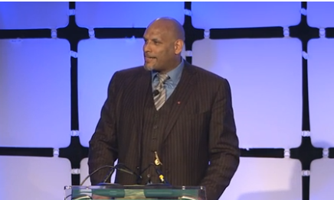
John Amaechi discusses identity and safe environments
What is particularly sticking with you after watching the video?
How do the establishment of norms, agreements, routines, and procedures set up a safe environment to prevent code switching?
Notes:
The picture on this slide links to a video. Click on the picture to begin the video. Closed captioning is available. The link to this video is also here: https://www.facinghistory.org/resource-library/video/john-amaechi-discusses-identity
After watching the video, take 2 minutes to answer the questions posed on the slide. If you are completing this session with others, please take additional time to discuss the video and your answers to the questions.

Slide 48
How do we create that “sweet spot” for our students?
“A lot of people think we need a safe environment because it’s just about this warm and fuzzy experience that young people are supposed to have in education, and it’s not really about that. We need a challenging but safe environment, because there is a very narrow strata, a very narrow bandwidth, where young people can be challenged and high achieve, emotionally. And, when you’re in that sweet spot amazing things can happen. And when you’re outside of it, there’s very little chance of high achievement.”
6
Notes:
Don't lower the bar, but instead lower the barriers. As teachers, we plan, anticipate, implement, execute, and reflect. Much of the heavy lifting happens in the planning and anticipation phases of teaching. Our main goal as teachers is for all students to be academically successful - learn the content we are teaching. But, along with that is the goal for students to be confident, happy, safe, and successful in their own minds. If we consider Maslow’s Hierarchy of Needs, in order for students to meet that “self-actualization” tier, achieving one’s own full potential, the four other tiers, composed of both psychological and basic needs, must be met first. Therefore, we as teachers must plan and anticipate through the lense of both academic AND social-emotional development. Creating and implementing a classroom management plan comprised of norms, class agreements, procedures and routines helps to address the psychological needs of each student, and in turn we can create a learning environment where all students can feel safe and successful in their own ways. In the case that what is put in place for the entire class doesn’t work for some students, like students with disabilities, additional supports may also be necessary through specially designed instruction or multi-tiered systems of support in order for these students to reach the same level of success as fellow students.
Note the purple circled “6” in the bottom corner of this slide. This is indication that what Dr. Amaechi has said addressed core principle “6” in the Blueprint for Improved Results for Students with Disabilities. It is essential for schools, “to provide high-quality inclusive programs and activities” for their students. All students should feel challenged, supported, and included. They should feel like they belong to their classroom community and that their true identity is accepted by their teacher and fellow classmates.
As seen in the video, relationships are also an essential part of the learning community and student success. Teacher and student relationships are the focus of part 2 in this series.

Slide 49
Our Learning
Today’s Outcomes:
Identify high impact strategies that foster a successful and productive learning environment for all students
Establish classroom norms and expectations for all students (in person and online learning)
Create a plan using the Blueprint for Improved Results for Students with Disabilities to ensure students with disabilities are explicitly considered in your learning space
Notes:
Let’s review our learning for this presentation. The content in this presentation was for teaching in any type of learning environment, however, particular focus has been placed on establishing these essential classroom elements in a hybrid/remote learning environment. Establishing classroom norms and expectation is essential in every learning environment but may vary because of differing teaching philosophies and the students in the classroom. They are essential yet customizable, and while we establish norms, routines, and procedures, we must consider how they will set all students up for success, not just the majority.
As best practice in any learning environment, our learning outcomes are measurable, with expectation of the participant coming out of this presentation able to acquire new knowledge or enhance and refine current knowledge/understanding and put into practice what has been learned.
Review the 3 bulleted learning outcomes. Then, move to the next slide where you will be asked to commit to an attainable, personal action plan in regards to implementing a classroom management plan that comprises of the essential strategies that were addressed in this presentation.

Slide 50
Commitment
As you reflect on your practice as it pertains to designing and implementing a classroom management plan as described in this presentation…
What is one area you commit to strengthening and why?
Regardless of where you are in the school year, we challenge you to set a reminder 1-2 months from now as a check in point for your commitment.
Use this Fine-tuning planning chart to write down your commitment statement.
Notes:
The phrase “fine-tuning” implies that a classroom management plan is already in place in your classroom, but given the changing times, conditions, and ways in which teaching and learning are being done, it is essential to step back, reflect, and then adopt new or different ideas or adapt what is already in place. Everyone has strengths as well as areas to improve upon. Take what you have gleaned from this presentation to fine-tune your own classroom management plan to better support your students and yourself as you all continue to navigate hybrid/remote learning. Make a commitment — what is one area you commit to strengthening and why? How will you fine-tune your current plan to work in a hybrid/remote learning environment? How will you fine-tune your current plan to ensure ALL students benefit and are successful in the classroom (whatever that classroom looks like).
There is space in the Fine-tuning Planning Chart to write down your commitment. You are then asked to help yourself be accountable to that commitment. Set a reminder 1-2 months from now (and every 1-2 months after that) to check in on yourself and the commitment you made.

Slide 51
Thank you!
For more learning, join us for part 2!
Notes:
Thank you for your participation, considerations, reflections, and planning during this presentation. Remember, this is only Part 1 of a 3-part series. Look for Fine-tuning your Hybrid/Remote Learning Community Part 2, where the focus is on relationships in the hybrid/remote learning environment. The same Fine-tuning Planning Chart will be used during the other parts of the series as well.
This is the end of the presentation.

