Slide 1
FAMILIES AS PARTNERS
SUPPORTING TEACHING AND LEARNING AT HOME
SESSION ONE
Notes:
Families as Partners: Training Session One.
*Take a moment to introduce yourself, and if you want, have the group introduce themselves as well. Consider using a warm welcome and an activity from the SEL Playbook (https://schoolguide.casel.org/uploads/2018/12/CASEL_SEL-3-Signature-Practices-Playbook-V3.pdf).

Slide 2
Families as Partners Sessions
Session One: Families as Partners Overview
Session Two: Deeper Dive Into Support Structures
Session Three: Celebrating Successful Partnerships
Notes:
Provide an overview of upcoming sessions:
Session One: Families as Partners Overview
Session Two: Deeper Dive Into Support Structures
Session Three: Celebrating Successful Partnerships

Slide 3
Today’s objectives
Address the core components of family partnerships in the educational setting
Discuss the reasons for family partnership transitions
Identify areas of successful transitions and areas for improvement regarding families as partners in a remote/hybrid setting
Notes:
Provide an overview of session objectives:
The first session will address the core components of family partnerships in an educational setting.
Group discussion will focus on the transitions of family partnerships as a result of remote and hybrid learning.
Attendees will use a self-assessment tool to identify areas of success during this transition from face-to-face learning to remote or hybrid learning and discover areas of improvement needed when partnering with families.

Slide 4
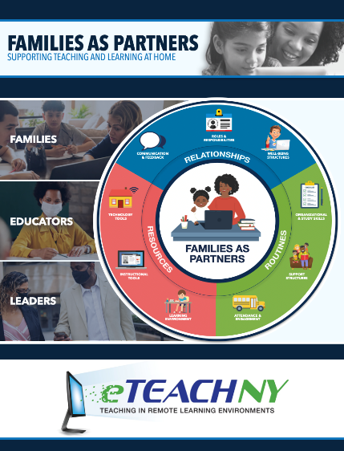
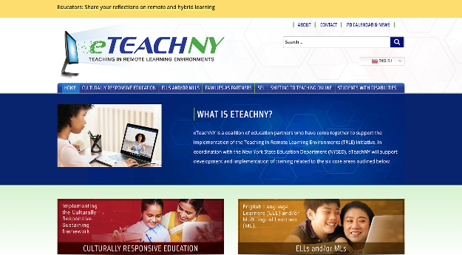
Materials needed
Access to the eTEACHNY Website
Families as Partners Slide Deck
Families as Partners Survey Workbook
Families as Partners Overview Video
Notes:
For today’s training, you will need a copy of this slide deck to guide conversations.
All participants will need a copy of the Families as Partners Workbook (printed or electronic) - this will be the roadmap for today’s session.
You’ll also want to visit eTEACHNY website - https://www.eteachny.org/. All of the resources shared today, plus future resources and resources from the other 5 areas of focus can be found on this website. You will want it in an easy place to return to and use.

Slide 5
Introduction video
Notes:
Kick-off the conversation by playing a quick overview video about Families as Partners.
*Video is hosted on YouTube - please be sure to check internet access and content filter prior to the start of your session.
https://youtu.be/RrJlhu0y3Lc

Slide 6
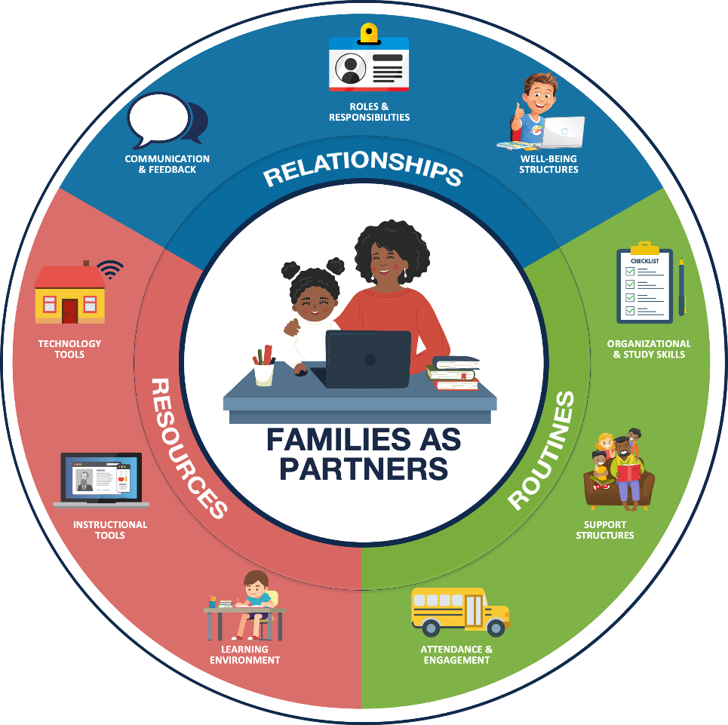
Foundation of partnership with families:
RELATIONSHIPS Positive connections that foster interaction and establish a nurturing environment of trust and support.
ROUTINES Rehearsed and predictable practices that provide structure to support efficient and effective learning.
RESOURCES Materials, Tools, and Supplies to support active learning and skill development.
Notes:
FOUNDATION OF PARTNERSHIP WITH FAMILIES: As teachers and leaders, we have always worked to develop and maintain positive experiences for students and families in our school buildings. We build relationships to foster positive connections and establish a nurturing environment of trust. We have routines in place that provide structure and support efficient and effective learning. Additionally, we ensure students have access to the materials, tools, and supplies needed to support active learning and skill development. Today we’ll look at how the pandemic has changed our approach - and as a result - how some of our newly adopted practices may change how we partner with families even after we return to fully in-person learning.

Slide 7
How has COVID-19 impacted teaching and learning?
FAMILIES
EDUCATORS
LEADERS
The role of families in the learning process has shifted, putting new demands on parents and caregivers.
Parents, siblings, grandparents, daycare providers, and other partners are supporting learners while attending to other responsibilities.
Educators have taken on the challenge of shifting teaching and learning into remote formats.
Teachers are developing relationships, adjusting routines, and leveraging resources to support family partnerships and student learning.
Administrators have fostered the transition of traditional partnering practices into remote/hybrid learning environments.
Leaders are adjusting remote/hybrid learning plans based on feedback from educators and families.
Notes:
HOW COVID HAS IMPACTED FAMILIES, EDUCATORS, AND LEADERS:
FAMILIES: Parents, siblings, grandparents, daycare providers, and other partners are supporting learners while continuing to attend to other responsibilities. (i.e. balancing work, family needs, caring for multiple students at once, etc.)
EDUCATORS: Educators are developing relationships in new ways; adjusting routines and leveraging a variety of new resources to support the family and student learning partnerships.
LEADERS: Educational leaders are transitioning traditional effective partnering practices and adjusting plans based on feedback from educators and families.

Slide 8
Let’s start planning
How to use the families as partners survey workbook
Notes:
The remainder of this training is going to focus on an assessment tool that attendees can utilize to identify the areas of family partnership that they are winning at; as well as review the areas of successful family partnership that could be improved. When answering the prompts remind participants to focus on remote and hybrid learning versus traditional, face-to-face family partnerships.
*Handout or ensure participants have access to the Families as Partners Survey Workbook.

Slide 9
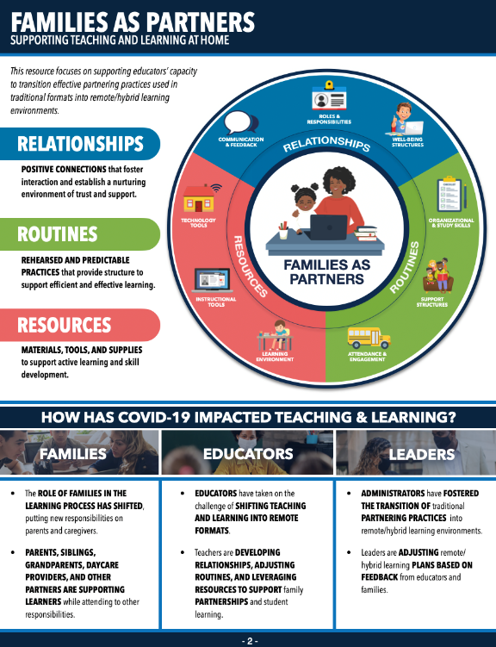
Families as partners overview
Notes:
Page 2 in the Survey Workbook the printed version of the material just covered in the slide deck.

Slide 10
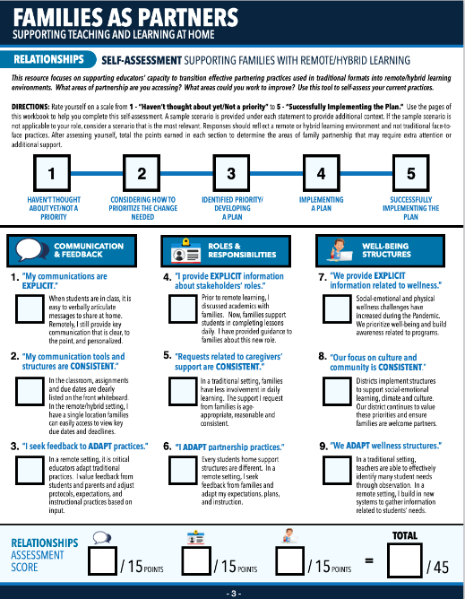
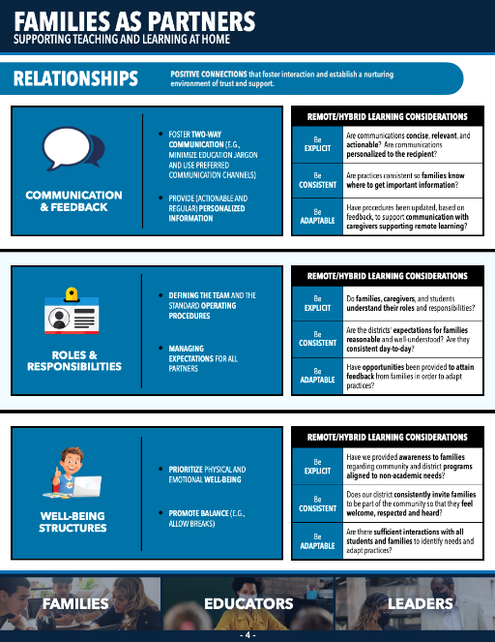
Each section is comprised of two pages
Survey/self-assessment
Informational
Notes:
ABOUT THE SELF-ASSESSMENT WORKBOOK: The assessment tool is broken into 3 sections.
Relationship practices.
Family protocols and routines.
The adaption of instructional resources from face-to-face instructional tools to remote or hybrid learning tools.
Each section of the workbook is comprised of two pages. Let’s look at Pages 3 and 4. The first page is the self-assessment sheet. This is where the self-assessment questions are located and the place where you will record your score…1, 2, 3, 4, 5. The second page is an informational page to support and expand upon the self-assessment question asked on the prior page. Now let’s take a look at the rating system at the top of each survey page.

Slide 11
Self-assessment scale
Haven’t thought about yet/Not a priority
Considering how to prioritize the change needed
Identified priority/Developing a plan
Implementing a plan
Successfully implementing the plan
Remember to respond through the lens of remote or hybrid learning
Notes:
For each question, you will give yourself a score 1 through 5. Remember this is a planning tool to assess what areas of family partnership are easily transitioning to this new environment and which areas could be improved upon.
1: This means that you haven’t thought about the topic yet, or it is not a priority in your school district or building. For example, in the category of routines, maybe study skills have not been a topic of conversation yet. It is not that study skills are not valued, but other priorities have been the focus with regard to family partnerships to date.
2: This means that conversations are being had, but a plan to bring about change has not yet been implemented.
3: This means that a plan to transition practice from face-to-face to remote is being developed.
4: This means a plan is being implemented. For example, in the category of relationships, when addressing student well being, a survey question asks about social-emotional practices. If social-emotional practices are being implemented daily to support student well-being, but maybe the plan of support is being changed and refined as feedback is received, 4 would be the score you would mark.
5: This should be selected if a plan to support partnerships in a remote or hybrid setting is being successfully implemented. Odds are, a 5 is an island you will only visit from time to time and that is totally okay.
This is simply a tool to gauge where energy and efforts should be focused. It is not about having a perfect score. So let’s start the self-assessment.

Slide 12
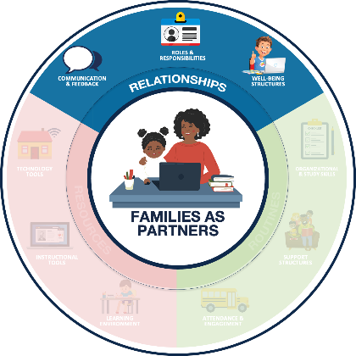
Relationships Positive connections that foster interaction and establish a nurturing environment of trust and support
COMMUNICATION & FEEDBACK
ROLES & RESPONSIBILITIES
WELL-BEING STRUCTURES
Foster two-way communication (e.g., Minimize education jargon and use preferred communication channels)
Provide (actionable and regular) personalized information
Defining the team and the standard operating procedures
Managing expectations for all partners
Prioritize physical and emotional well-being
Promote Balance (e.g., allow breaks)
Notes:
RELATIONSHIPS: (Page 4)
Communications & Feedback: Fostering two way communication and personalizing information for families.
Roles & Responsibilities: Identifying the team and determining how you will work together to successfully manage expectations within the partnership.
Well-being Structures: Prioritization of physical and emotional well-being to promote balance.

Slide 13
Relationships Remote/Hybrid Learning Considerations
COMMUNICATION & FEEDBACK
ROLES & RESPONSIBILITIES
WELL-BEING STRUCTURES
BE EXPLICIT Are communications concise, relevant, and actionable? Are communications personalized to the recipient?
BE CONSISTENT Are practices consistent so families know where to get important information?
BE ADAPTABLE Have procedures been updated, based on feedback, to support communication with caregivers supporting remote learning?
BE EXPLICIT Do families, caregivers, and students understand their roles and responsibilities?
BE CONSISTENT Are the districts’ expectations for families reasonable and well-understood? Are they consistent day-to-day?
BE ADAPTABLE Have opportunities been provided to attain feedback from families in order to adapt practices?
BE EXPLICIT Have we provided awareness to families regarding community and district programs aligned to non-academic needs?
BE CONSISTENT Does our district consistently invite families to be part of the community so that they feel welcome, respected and heard?
BE ADAPTABLE Are there sufficient interactions with all students and families to identify needs and adapt practices?
Notes:
Here are some questions you might ask yourself to help frame in the self-assessment through the perspective of remote or hybrid learning.
Communications & Feedback: Are my communications concise? Do families know where to get important information? Have my communications practices changed with the learning environment?
Roles and Responsibilities: Are expectations understood and consistent? Do all partners know their role in the learning environment? Do families have opportunities to provide feedback so roles can be adapted?
Well-being Structures: Are programs considering non-academic needs of students and families? Do families feel welcome, respected, and heard? And are sufficient interactions with all students and families occurring in the remote or hybrid learning environment?
Consider these questions to establish your mindset for taking the self assessment and let’s do that now.

Slide 14
Relationships Self-assessment
COMMUNICATION & FEEDBACK
“My communications are EXPLICIT.”
When students are in class, it is easy to verbally articulate messages to share at home. Remotely, I still provide key communication that is clear, to the point, and personalized.
Notes:
Return to page 3. Let’s complete the first rating together as a model. Statement 1 reads “My communications are explicit.” Based on that statement, rate yourself on a scale of 1 to 5. Remember, you can use the framing questions on the informational page. Also there is an example scenario to consider. All scenarios will not apply to all educators, but it might help to adjust your point of view to consider how your family partnership practice is transitioning in the remote or hybrid learning environment. Take the next five minutes to complete the remainder of the ratings on this page. If you are not able to complete this survey electronically or print the resource, you can always use a scrap piece of paper to view the survey questions online and then jot down your score for each question.
*Consider setting a timer for participants or giving them a time that the group will reconvene together. Additionally, after the group completes this section of the survey, you might want to consider a share out activity or even a brain break if you notice participants are wearing out. Checkout the engaging strategies and brain break ideas in the SEL Playbook from CASEL (https://schoolguide.casel.org/uploads/2018/12/CASEL_SEL-3-Signature-Practices-Playbook-V3.pdf)

Slide 15
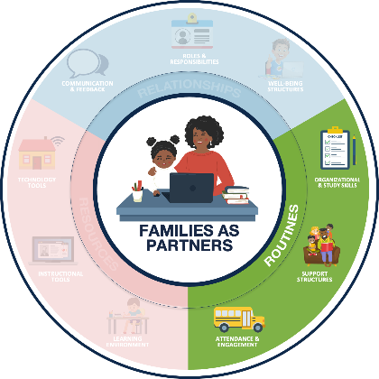
Routines Rehearsed and predictable practices that provide structure to support efficient and effective learning.
ORGANIZATIONAL & STUDY SKILLS
SUPPORT STRUCTURES
ATTENDANCE & ENGAGEMENT
Establish age-appropriate remote learning routines (e.g., setting weekly goals)
Encourage development of study skills (e.g., note taking templates)
Encourage students to reflect, identify needs, and seek help
Establish support routines (e.g., guardian learning office hours)
Foster regular communication about student attendance
Identify learning priorities and offer flexible structures (e.g., manageable and meaningful tasks
Notes:
ROUTINES: (Page 6)
Organizational & Study Skills: Establishing learning routines and developing study skills.
Support Structures: Encouraging students to seek help when needed and establish routines to support those needs.
Attendance & Engagement: Fostering regular communication and flexible structures to promote student attendance and engagement.

Slide 16
Routines Remote/Hybrid Learning Considerations
ORGANIZATIONAL & STUDY SKILLS
SUPPORT STRUCTURES
ATTENDANCE & ENGAGEMENT
BE EXPLICIT Have we modeled strategies, and provided templates, to support families in reinforcing organizational and study skill development?
BE CONSISTENT Are practices consistent across classes to support families in reinforcing the development of organizational/ study skills?
BE ADAPTABLE If students are using increased technology, are we leveraging digital tools that support the application of organizational/study skills?
BE EXPLICIT Do families understand how students can access support from teachers and strategies they can use to support learning?
BE CONSISTENT Are there established office hours or structures students and families can use to seek individualized support?
BE ADAPTABLE Have students and caregivers been provided with suggested strategies to assist them when completing independent work?
BE EXPLICIT Has the district explained remote learning attendance and engagement protocols and expectations to families?
BE CONSISTENT Does the district provide families with regular, timely, and personalized attendance and achievement information?
BE ADAPTABLE Have families’ needs been considered when defining remote learning attendance and engagement expectations and structures?
Notes:
Here are some questions you might ask yourself to help frame in the self-assessment through the perspective of remote or hybrid learning.
Organizational & Study Skills: Do I model strategies and provide templates to support families? Are support practices consistent for families? Am I making use of digital tools for organization and study skills?
Support Structures: Do families know how to access support from you? Have you established office hours or has a structure been implemented for families to seek individualized support? Are students and families aware of strategies for completing work independently?
Attendance & Engagement: Are attendance and engagement expectations established? Do families receive personalized attendance and achievement information? Have families needs been considered when defining expectations and structures related to attendance and engagement?
Consider these questions to establish your mindset for taking the self assessment and let’s do that now.

Slide 17
Routines Self-assessment
ORGANIZATIONAL & STUDY SKILLS
“I am EXPLICIT when teaching organizational/study skills.”
Executive function skills are increasingly important, in a remote setting. I build family awareness of age-appropriate time management, study skills, and organizational strategies.
Notes:
Return to Page 5. Let’s complete the first rating together as a model. Statement 1 reads “I am explicit when teaching organizational/study skills.” Based on that statement, rate yourself on a scale of 1 to 5. Remember, you can use the framing questions on the informational page. Also there is an example scenario to consider. All scenarios will not apply to all educators, but it might help to adjust your point of view to consider how your family partnership practice is transitioning in the remote or hybrid learning environment. Take the next five minutes to complete the remainder of the ratings on this page.
*Consider setting a timer for participants or giving them a time that the group will reconvene together. Additionally, after the group completes this section of the survey, you might want to consider a share out activity or even a brain break if you notice participants are wearing out. Checkout the engaging strategies and brain break ideas in the SEL Playbook from CASEL (https://schoolguide.casel.org/uploads/2018/12/CASEL_SEL-3-Signature-Practices-Playbook-V3.pdf)

Slide 18
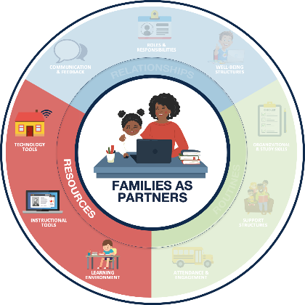
Resources Materials, Tools, and Supplies to support active learning and skill development.
LEARNING ENVIRONMENT
INSTRUCTIONAL TOOLS
TECHNOLOGY TOOLS
Dedicate a space for learning
Maintain an organized learning space
Leverage high-quality digital and print learning resources
Leverage consistent platforms across the district, when possible
Support access to devices and internet
Provide technology support resources and structures
Notes:
RESOURCES: (Page 8)
Learning Environment: A dedicated and organized space for learning.
Instructional Tools: Leveraging consistent platforms and high-quality digital and print resources.
Technology Tools: Access to devices, internet and technology support for these resources.

Slide 19
Resources Remote/Hybrid Learning Considerations
LEARNING ENVIRONMENT
INSTRUCTIONAL TOOLS
TECHNOLOGY TOOLS
BE EXPLICIT Has guidance been provided to families related to setting up and maintaining a remote learning environment?
BE CONSISTENT Do teachers have common expectations related to workspaces and synchronous learning protocols?
BE ADAPTABLE Do teachers assist students and families in making adjustments to the environment based on their individual needs?
BE EXPLICIT Have families been provided with concise, holistic, and specific information related to students’ primary instructional tools?
BE CONSISTENT Have common instructional tools been adopted for use across classrooms and grade levels to foster family involvement?
BE ADAPTABLE Do the district’s instructional tools support students and families’ needs related to remote learning?
BE EXPLICIT Have families been provided with explicit information about support structures to assist with troubleshooting problems?
BE CONSISTENT Have technology tools been standardized to minimize the learning curve for students, families, and caregivers?
BE ADAPTABLE Is there a plan to support students’ device and internet needs? When a technology solution is not possible, is there an alternative?
Notes:
Here are some questions you might ask yourself to help frame in the self-assessment through the perspective of remote or hybrid learning.
Learning Environment: Do families have guidance related to establishing a remote learning environment? Are there expectations related to workspaces? Am I assisting families with making learning environment adjustments to benefit student success?
Instructional Tools: Do families have specifics related to the primary instructional tools being used? Have common instructional tools been adopted? Are the instructional tools implemented meeting families’ needs?
Technology Tools: Are there support structures in place to assist families in troubleshooting problems? Have technology tools been standardized? Is an alternative option available for students when a technology solution is not possible?
Consider these questions to establish your mindset for taking the self assessment and let’s do that now.

Slide 20
Resources Self-assessment
LEARNING ENVIRONMENT
“I provide EXPLICIT suggestions related to students’ work areas.”
In a traditional setting, I establish classroom expectations related to workspace and supplies. I define similar remote expectations and suggestions.
Notes:
Return to Page 7. Let’s complete the first rating together as a model. Statement 1 reads “I provide explicit suggestions related to students’ work areas.” Based on that statement, rate yourself on a scale of 1 to 5. Remember, you can use the framing questions on the informational page. Also there is an example scenario to consider. All scenarios will not apply to all educators, but it might help to adjust your point of view to consider how your family partnership practice is transitioning in the remote or hybrid learning environment. Take the next five minutes to complete the remainder of the ratings on this page.
*Consider setting a timer for participants or giving them a time that the group will reconvene together. Additionally, after the group completes this section of the survey, you might want to consider a share out activity or even a brain break if you notice participants are wearing out. Checkout the engaging strategies and brain break ideas in the SEL Playbook from CASEL (https://schoolguide.casel.org/uploads/2018/12/CASEL_SEL-3-Signature-Practices-Playbook-V3.pdf)

Slide 21
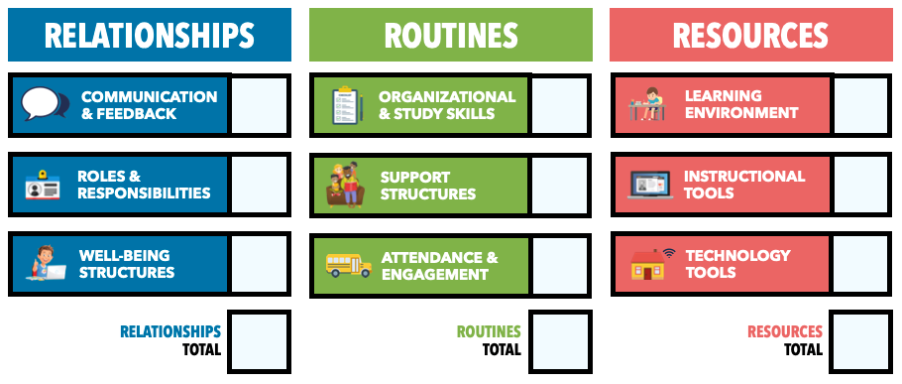
Self-assessment totals
Notes:
On page 9 of the Families as Partners Survey Workbook is a self-assessment totals page. Take a moment to copy your scores from the earlier pages on to one sheet. Give participants 3 minutes to transition their scores to the tools page.
*Consider setting a timer for participants or giving them a time that the group will reconvene together. Additionally, after the group completes the totals, you might want to consider a share out activity or even a brain break if you notice participants are wearing out. Checkout the engaging strategies and brain break ideas in the SEL Playbook from CASEL (https://schoolguide.casel.org/uploads/2018/12/CASEL_SEL-3-Signature-Practices-Playbook-V3.pdf)

Slide 22
Next steps for success
ACT NOW
CHECK OUT
Notes:
To close out this session together, let’s take a look at the survey totals and determine the next steps for success you might consider employing. To do this, review your totals on the top of Page 9. Where are your lowest scores? Suggested examples of actions to take now are provided on pages 10 and 11; as well as additional articles to check out for more research, tips, tricks to engage families as partners.

Slide 23
Next steps for success
ROUTINES
ACT NOW
CHECK OUT
Rehearsed and predictable practices that provide structure to support efficient and effective learning.
ORGANIZATIONAL & STUDY SKILLS
SUPPORT STRUCTURES
ATTENDANCE & ENGAGEMENT
Establish a consistent location and predictable schedule for sharing information
Focus on the implementation of flexible routines rather than rigid schedules.
Share virtual office hours information with students and families
Share expectations for synchronous and asynchronous participation
Encourage students development of reflection, self-awareness, and outreach skills
Edutopia – Engaging Parental Support for Smarter Thinking: https://www.edutopia.org/blog/parental-support-for-smarter-thinking-donna-wilson-marcus-conyers
Edutopia – Establishing Routines for Remote Learning: https://www.edutopia.org/article/establishing-routines-remote-learning
Edutopia – 7 Guiding Principles for Parents Teaching From Home: https://www.edutopia.org/article/7-guiding-principles-parents-teaching-home
Notes:
Let’s look at a sample set of next steps together. (Page 10)
EXAMPLE: When I took the self-assessment, my lowest total score was in the category of routines. What can I do right now to strengthen my partnership with families related to routines, more specifically organizational and study skills, since that is the subcategory I scored lowest in on the self-assessment? In reflecting on the self-assessment results and my current remote learning practice, I know that I can act now by adding a schedule to the home screen of my Google Classroom page. Also, I want to read the second article from Edutopia listed under Check Out and see what other routines for remote learning I might implement to support families as partners in the future.
Now take a few minutes to find the act now actions and check out resources to implement in the coming days. Give participants time to find the act now steps that are best for them and/or open and read some of the articles.

Slide 24
Additional resources
Additional resources to support the development of positive partnerships with families and other remote learning priorities can be found online at www.eteachny.org.
Shifting to Teaching Online
Families as Partners
Students With Disabilities
English Language and Multilingual Learners
Culturally-Responsive Education
Social Emotional Learning
Notes:
(Page 11) If you are looking for more resources related to families as partners or any of the other 5 categories of support, please go to https://www.eteachny.org/ to access countless resources to support educators during the transition to remote and hybrid learning environments.

Slide 25
Questions?
Notes:
This concludes Families as Partners: Training Session One. Questions?
*Consider ending using an optimistic closure from the SEL Playbook (https://schoolguide.casel.org/uploads/2018/12/CASEL_SEL-3-Signature-Practices-Playbook-V3.pdf).

