Slide 1
ACCESSIBILITY FOR ALL IN A VIRTUAL ENVIRONMENT
January 2021
Notes:
It is our students’ rights and our duty to make sure content is accessible, whether students are in person, hybrid or completely remote. This presentation will show how a district can think through the process and make sure they have a ‘toolkit’, or package of tools available to students so they can access the content.

Slide 2
How are you currently helping your students access digital content in a virtual environment?
Notes:
Presenter Note: Establish what your participants already are doing, how are they helping their students access digital content in a virtual environment?
This can be done as a general sharing, post a Jamboard link and have them go in and add to a Jamboard, add to chat, create groups if in person and have them share out.

Slide 3
Outcomes
Learn available accessibility features within Chromebook settings
Articulate a process to identify other apps/extensions that increase accessibility
Create a possible package of tools to maximize accessibility for students
Brainstorm ideas on how to train our students to use these tools in the virtual environment

Slide 4
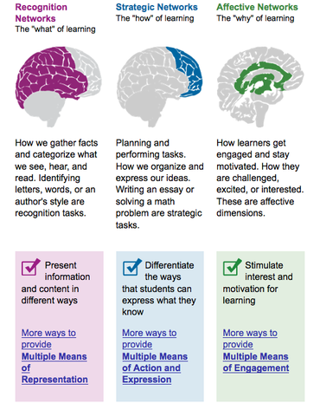
Principles of Universal Design for Learning UDL
Designing lessons that include multiple means of
Representation
Action and Expression
Engagement
Multiple means of representation allows all students to connect with the content. Accessibility features help students access it!
Notes:
When talking about accessing content we have to start with UDL, Universal Design for Learning. By looking at the different networks, recognition (the what), strategic (the how) and affective (the why) we can design lessons that provide students with multiple means of representation, action and expression and engagement. Multiple means of representation allows ALL students to connect with the content, by adding accessibility features (or tools) students can access and engage with the content at their level and pace.

Slide 5
Start with what you have
When thinking of a total package of accessibility tools, start with what you have.
Think about:
Device: Chromebook, laptop, Macbook, iPad
Platforms: Google, Microsoft
Learning Management Platforms: Google Classroom, Schoology, Canvas
Then identify gaps that need filling.
Notes:
When thinking about the total package of accessibility tools, start with what you have. Think about the devices you have in your district, platforms you use, and Learning Management platform. Starting here allows you to have an inventory of what accessibility tools you already have available to your students. For this presentation we will be focusing on the highlighted ones as an example. (Chromebooks, Google, Google Classroom)

Slide 6
Chromebook Updates
Making Chromebooks work for people with disabilities (October 2020 updates)
Say hello to the Chromebook Accessibility hub
Export accessible pdfs in Chrome
Select to speak gets better
Notes:
Google is always updating their features and resources. I’ve included some resources linked to this slide that are especially important to note. These are updates from fall 2020.
Google has created a ‘Chromebook Accessibility Hub’ This hub includes areas of focus depending on your student needs
The October update ‘Making Chromebooks work for people with disabilities’ highlights some of the new updates, including the two linked here
‘Export accessible PDFs in Chrome’ which highlights the update within Chrome. When you export websites and/or articles from Chrome they now have more metadata included, this makes it easier for software programs to process the information in the PDF. Thereby making the pdfs more accessible.
‘Select-to-speak gets better’ highlights the great new feature in this Chromebook accessibility tool. Updates now allow users to select sections to be spoken and shade the background assisting in focusing on the words being read.

Slide 7
Start with Device Features
Notes:
Presenter note: brief pause, then move on to next slide.

Slide 8
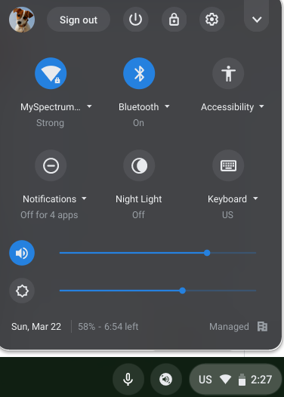
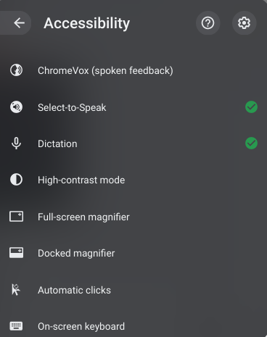
Chromebook Accessibility Features
There are great accessibility features built directly into your Chromebook Settings.
Go to bottom right and click on the clock to open.
Go to ‘Accessibility’.
Select the features you want access to.
If you don’t have this go to next slide
Notes:
So let’s start with the device features, in this case on a Chromebook. The built in accessibility features are numerous and easily accessible. To find them go to the bottom right corner and click on where you see the clock. This opens up the system menu of your Chromebook. In these pictures the user has added Accessibility features to their system menu for easy access. Let’s look at how to set this up.
Presenter Note: the following screenshots were done in fall 2020, as Google is always updating their products and platform it may look different depending on when you are accessing these resources. Best to check and update as needed.

Slide 9
Chromebook Accessibility Features – Full Settings
You can also go to the full settings:
Go to bottom right and click on the clock to open.
Click on the gear to open settings.
Quick Steps for Accessibility (for students and parents)
Notes:
Open up your system menu and click on the ‘Settings’ gear shown here.
Presenter note: The link to ‘Quick Steps for Accessibility (for students and parents)’ will open a forced copy of a document that can be shared with students and parents on how to access and use these features.

Slide 10
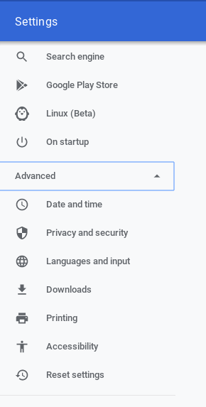
Accessibility Settings
Once in Settings:
Click to open ‘Advanced’ on left side
Select ‘Accessibility’
You can also search for ‘Accessibility’ in the search window at the top.
Select ‘Manage accessibility features’
In these settings you can also turn on to make the accessibility features accessible via the system menu (like in slide 7)
Notes:
Once you have the Chromebook settings opened you will go to the accessibility settings, either go to advanced on the left hand side, or add ‘Accessibility’ to the settings ‘search’ window at the top. From here you can manage your features and most importantly turn on the ‘Always show accessibility options in the system menu’ toggle. This will allow you to have quick access from now on to the features in your System Menu.

Slide 11
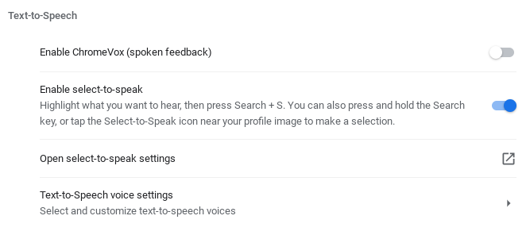
Text-to-Speech
When turned on ‘Enable select-to-speak’ allows you to have text read out loud in any window.
You can also open up settings to change speed and or voice settings.
Once enabled, to use simply click on the ‘select to speak’ icon in the bottom right taskbar.
Notes:
We’re now going to go through some of the main features on the Chromebook. These features would be used by students depending on their individual needs.
The first section is ‘Text to Speech’, this allows students to have the text read out loud to them in any window. The most popular feature used here is ‘Select-to-speak’.
From the ‘manage accessibility’ or your quick access to the accessibility features from the system menu enable ‘Select to Speak’. Once enabled a speaker icon will appear in your taskbar, or shelf of your Chromebook to the right.
Presenter Note: This is where you might want to demonstrate, and then talk participants through enabling it and trying it for themselves. To use open up a window you want read (could be in your LMS, a website or any other document), highlight what you want read and then click on the speaker icon.

Slide 12
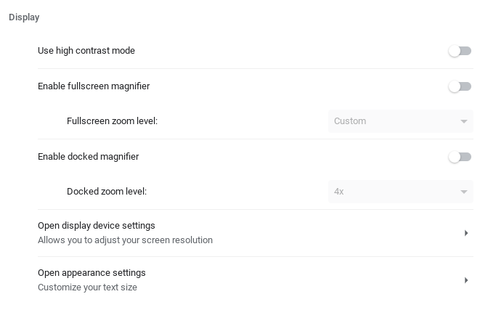
Display
Here you can find the ability to set up a magnifier, as well as set up contrast mode.
Notes:
The next area we will Display, here is where you can find the ability to change the way the user sees the screen, i.e. magnification and contrast mode as just two examples.
Presenter Note: Again, depending on purpose and time you may want to demonstrate these (or allow participants to explore them)

Slide 13
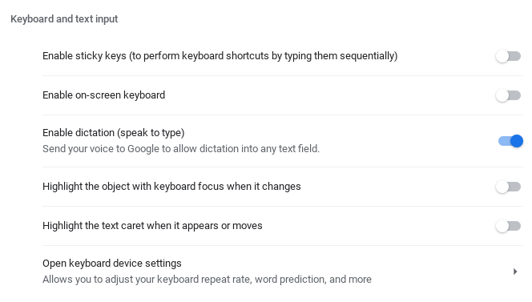
Keyboard and text input
Dictation:
By turning this feature on you can have students speak to type in any text field!
To use simple click on the ‘Dictation’ mic at the bottom right of your taskbar, click in the text box you want to type into and speak your response.
Notes:
Keyboard and text input includes one of the most often used accessibility features and that is dictation or speak to type. When you turn this feature on students are able to dictate (speech to text) into any textbox. Once enabled a microphone will appear in the shelf at the bottom right of the Chromebook. When a student has their cursor in a textbox then can click on this mic and speak. The Chromebook will dictate their speech and add it to the textbox.
Speaker note: Demonstrating this feature helps participants see how easy it is to use, and how well it works!

Slide 14
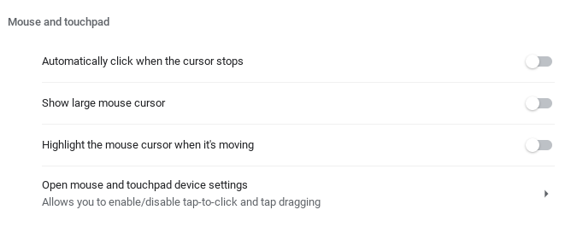
Mouse and touchpad
Use these features when students are having a hard time moving the cursor, or seeing where the cursor is.
Notes:
Mouse and touchpad allows you to adjust the cursor, making it larger or highlighting it, as well as other features.

Slide 15
Audio
Here you can change your audio features or add additional features in the Chrome Web Store.
Notes:
Audio settings are also available.

Slide 16
Student Videos
Using Dictation
Using Select to Speak
Notes:
These two videos are included as a resource for you, and your students/parents. They show how to use the dictation and select to speak features on the Chromebook.
Using Dictation: https://youtu.be/RzSjPxMixjM
Using Select-to-Speak: https://youtu.be/9TxADU4G0CM

Slide 17
Google Accessibility
Google Workspace User Guide to Accessibility for list of accessibility by Google App
Guardian’s Guide to Tools for Children with Disabilities during Distance Learning (updated 8/20)
Did you know?
The filter that appears in the header of Google Classroom and Google Sites is to assure it is ADA Compliant.
Notes:
We looked at accessibility features on the device, in this case a Chromebook, now let’s look at the platform features. Google embeds accessibility features throughout their platform and tools.
The resources on this slide are great for all staff and parents.
Google Workspace User Guide to Accessibility (lists all the accessibility features by Google tool)
Guardian’s Guide to Tools for Children with Disabilities during Distance Learning offers tips to become more familiar with Google tools and how they can help children access digital content.
Did you know: One question that often comes up is the filter that appears when teachers change their Google Classroom and Google Sites headers. These filters are important and can’t be changed (nor should they be) as they assure that the header is ADA compliant. In this case it allows for the contrast between the background and the text to be easier for students to read the text.

Slide 18
Then Look at Platform Features
Notes:
Presenter note: brief pause, then move on to next slide.

Slide 19
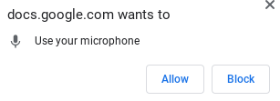
Voice Typing in Google Docs
When using Google Docs you can use dictation by going to ‘Tools’ and selecting ‘Voice typing’.
A mic will appear on the left.
Click to speak, the mic will be red when on.
The first time using you will need to ‘allow microphone’.
Note: Google Slides only has voice typing for speaker notes.
Notes:
Within the Google Tools I want to highlight some of the more used accessibility features.
Google Docs has ‘Voice Typing’ where you can dictate, or voice type within the Google Doc.
Presenter note: This would be a great time to demonstrate this, as it works well for students. (or have participants try it for themselves) One note, voice typing continues to dictate until you click the mic off.

Slide 20
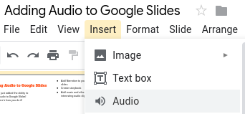
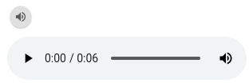
Adding Audio Supports to Google Slides
Open up Google Slides
Go to ‘Insert’, ‘Audio’ and find the audio you want to import from your Google Drive (make sure audio files are available to ‘anyone with the link’)
A speaker will be inserted, when you click on it you can play the audio.
@djainslie 2020
Notes:
In Google Slides they now have the ability to insert audio, this can be especially important for remote learning as the teacher can add in audio directions or listening passages for students directly within the slides.
The embedded video shows detailed directions on how to add audio to your Google Slides. It can also be accessed here: https://youtu.be/l5Z1HX6cOn0

Slide 21
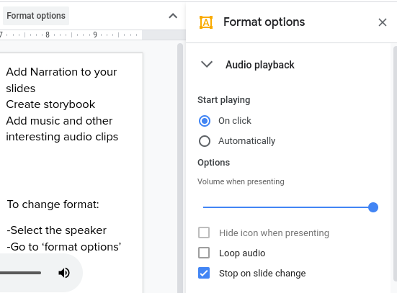
Formatting your Audio
To change format:
Select the audio clip you inserted (the speaker icon)
Go to ‘format options’
On the right hand side open up ‘Audio Playback’ options and select the options that make sense for your project.
@djainslie 2020
Notes:
Once you add audio you will want to make sure the format is correct. Simply select the speaker that is inserted and set the ‘Audio Playback’ format options. Some teachers like the audio to start automatically for students, while others have students click on the speaker for the audio to start. This of course is a teacher preference depending on student needs.

Slide 22
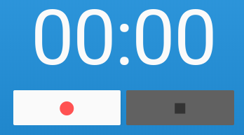
Recording Audio
Record your own narration using the app HablaCloud (ChromeMP3Recorder)
Easy
Opens on Chromebook
Record
Save
Also: Online Voice Recorder (works on all devices)
Notes:
At this point Google Slides doesn’t have the ability to record directly within the slide therefore the audio you insert will need to be already created. Two easy tools to use to record audio are:
ChromeMP3 Recorder: A Chrome App that can be downloaded from the Chrome Webstore.
Online Voice Recorder: A website that can be accessed on any device
Both of these tools are easy to use and don’t require you to sign-in, therefore no personal information is stored. Both also allow easy saving to your Google Drive.

Slide 23
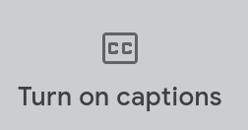
Translation in Google Meet
Translate captions
Translate chat
Step-by-step Tutorial
Notes:
Another tool that has accessibility features is Google Meet. These features allow for students to set the language they need and have both captions and chat translated. For a complete step by step tutorial click on the link.

Slide 24
Look for Other Apps to Fill Gaps
Notes:
Presenter note: brief pause, then move on to next slide.

Slide 25
Data Privacy & Using EdTech Platforms in Your District
New York State passed new regulations that require schools to take additional measures to protect student data privacy (Ed Law 2D Part 121).
Please consult your district administration before using edtech platforms that use students’ Personally Identifiable Information (PII). Each district has its own policy and procedures for platform use and compliance with this law.
Check with your district to determine apps and extensions they support
Notes:
So far we have looked at device and platform features, after you have done a district inventory of these and know what is available you may find that you have some gaps that need filling.
As these next applications are outside of your major platform and devices you will need to make sure they provide compliance for Part 121 Data Privacy Regulations.

Slide 26
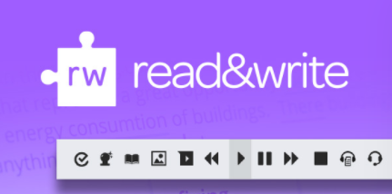
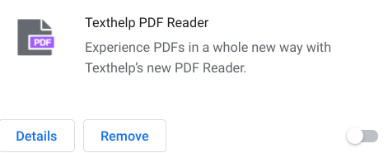
When Looking at Other Accessibility Apps
Questions to Think About
What needs do you have? (depending on gaps and student needs)
Are apps compatible with what you already have? Here’s an example:
OR
OR
Here are some possible additions for your toolkit...
Notes:
Let’s look at some other Accessibility Applications. Some questions to think about
What needs do you have? After looking at what you already have via your devices and platforms, what gaps do you still have. What are some of your student needs that are still not fulfilled?
Once you’ve identified these then do some research to find applications that fill those needs. But, make sure that these apps are compatible with what you already have.
Example- If you are going with Texthelp’s Read and Write for Google, you wouldn’t go with Don Johnston’s tools. You would decide on one or the other as they are not compatible with each other. Another example is if you need a pdf reader you would use Texthelp PDF Reader OR Kami. Having them both on Chromebooks often make accessing them messy as they will need to be defaulted in the extension management.
After you have explored these questions, now let’s look at some possible additions to your toolkit…
Presenter note: These are just two examples, you may want to add your own here, or other ones that you know about to make it relevant to your area/district.

Slide 27
Read Write for Google
Use with web pages, within Google Docs or any pdf.
Prediction
Text to speech
Dictionary
Translator
Highlighter
Vocabulary
Simplify page
And more...
Upgrade Free for teachers
Free version only includes Text to Speech
Works in Google Form Locked Mode!
Notes:
One application that is available that provides a number of tools is Read Write for Google from Texthelp. They have a paid and a free version. The paid version provides a large number of features. They also provide a free upgrade for teachers to have all the features. The free version provides the text to speech, which in and of itself is nice because it comes with more voices and control for the voice. Some students prefer these voices over the Chromebook ‘Select-to-Speak’.
The next slide shows these features in more detail.

Slide 28
Toolbar Features
Notes:
Here are the features in more detail.

Slide 29
Texthelp Tutorials
https://youtu.be/4Bp0to8a9Z0?list=PLvSZbmGbKpCTkk3S93CXtQWNf50f_Ow3D
Notes:
Texthelp also provides a large amount of support on their YouTube channel.

Slide 30
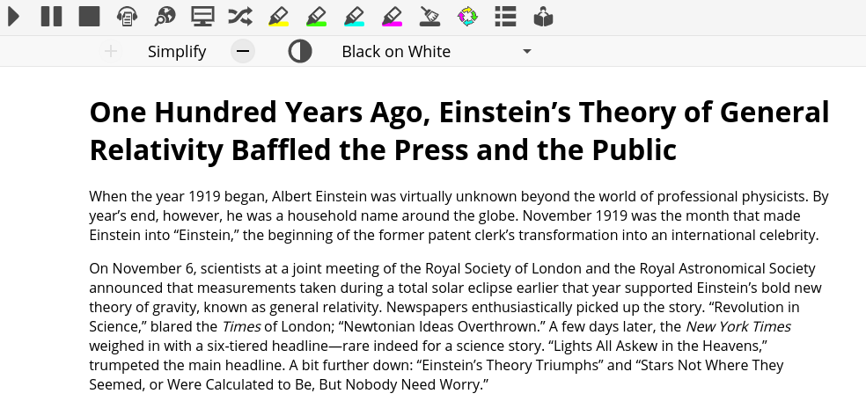
Simplify Page
Cleans up webpage for easier readability
Notes:
One of the features I want to mention on Read Write for Google is the ability to Simplify Webpages. With a click this allows you to take a website and simplify to eliminate distractions for students.
If you like this feature, but don’t want to pay for the full Read Write for Google, there are also some extensions that do this.

Slide 31
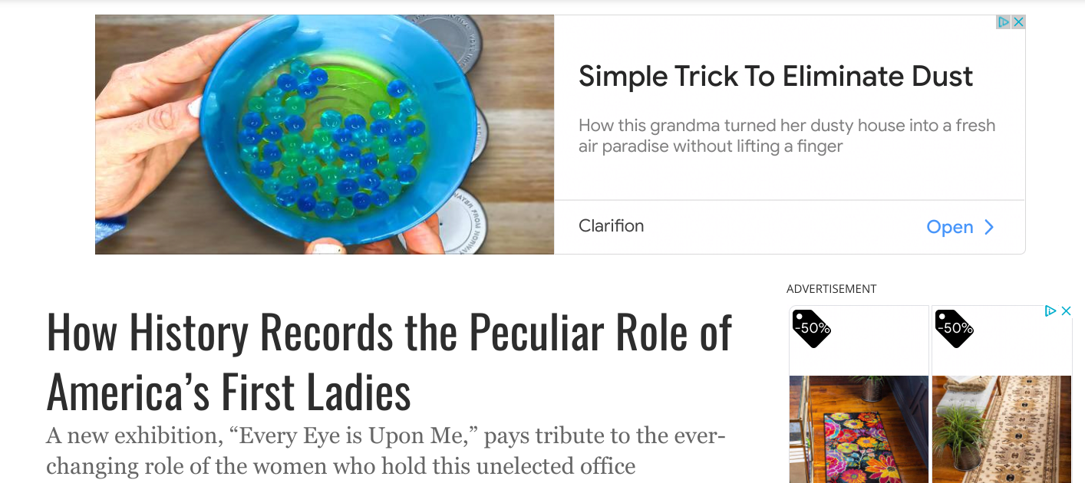
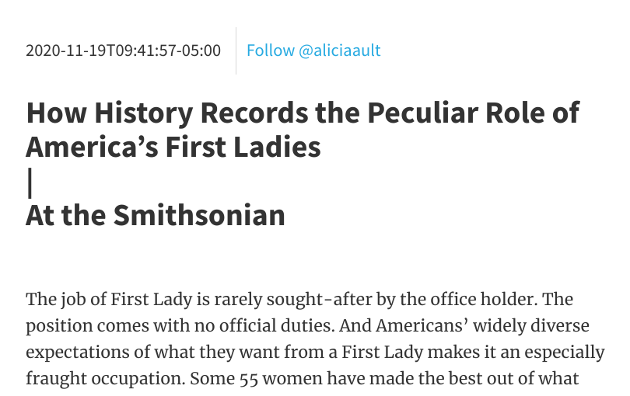
Extension: Just Read
Cleans up webpage for easier readability
Then click ‘print’ and save to pdf, or Google Drive
Notes:
My favorite, at this moment, is the extension Just Read. Open up a website article, click on the extension and it will make it more readability and simplify it. Then you can click ‘print’ and save to pdf or your Google Drive. This makes it super easy to then post the document in your Learning Management System, or otherwise make it available for students.
Presenter note: Another great time to demonstrate this, or have participants try it.

Slide 32
Voice In
Voice Typing Extension
Allows you to Voice Type in any textbox.
Click on extension, allow microphone and speak.
Note: if on Chromebook using dictation accessibility feature works just as well, if not better.
Just one example, there are many extensions out there for this. Good option if students do not all have Chromebooks.
Notes:
Another extension that you might want available is Voice In. This is another way for students to dictate their answers in textboxes. Remember if students have Chromebooks you probably won’t need this as they can use the dictation built right in.

Slide 33
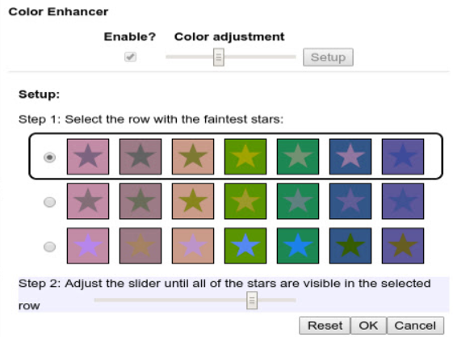
Color Enhancer
Extension
A customizable color filter applied to web pages to improve color perception, for people who are partially color-blind.
Notes:
You may have a need for students to adjust the colors on websites. Color Enhancer is a great extension that allows students, and staff to personally adjust the colors and contrast of windows in Chrome. Once it is set they will be able to access the content easier.

Slide 34
When Looking at Other Learning Apps:
Questions to Think About
What accessibility features are built in?
Are these features user-friendly?
If they aren’t built in will your other accessibility apps work within those apps?
Here are some possible additions...
Notes:
Once you have your package set, and know the features you have in them, now you will further explore additional needs. These needs will probably include learning applications for all. When looking at adding applications for your learning environment it is still important to make sure there are features built in that will help all students access the content, as well as making sure that they are user-friendly and that your existing apps work within them.
Here are some questions to think about:
What accessibility features are built in?
Are these features user-friendly?
If they aren’t built in will your other accessibility apps work within these apps?
Here are some possible additions that will help all students access and engage in content.

Slide 35
Extension: Kami
Annotate pdfs
Annotation Tools
OCR (for scanned documents)
Paid Version adds the following:
Text to Speech (brings in voice pack available on device you are using)
Has languages to read, but no translation
Dictionary
Voice Typing (in textbox)
Audio and Video Comments
Integrates with Google Classroom, Schoology, and Canvas
Free vs. Paid plans
Free 30 day upgrade coupon: herododie
Notes:
Kami isn’t just a tool to annotate documents, but it also allows you to have a digital workflow with feedback loop. I particularly like the built-in accessibility tools that include text to speech, dictionary, voice typing and audio/video commenting. This application also has built in OCR (optical character recognition) software that allows you to open a scanned pdf that comes in as an image, and Kami will ask you if you want to run OCR. If you select yes, it will convert your pdf into a readable pdf, i.e. the text will be recognizable so you can use the text to speech feature in Kami as well as in other applications.

Slide 36
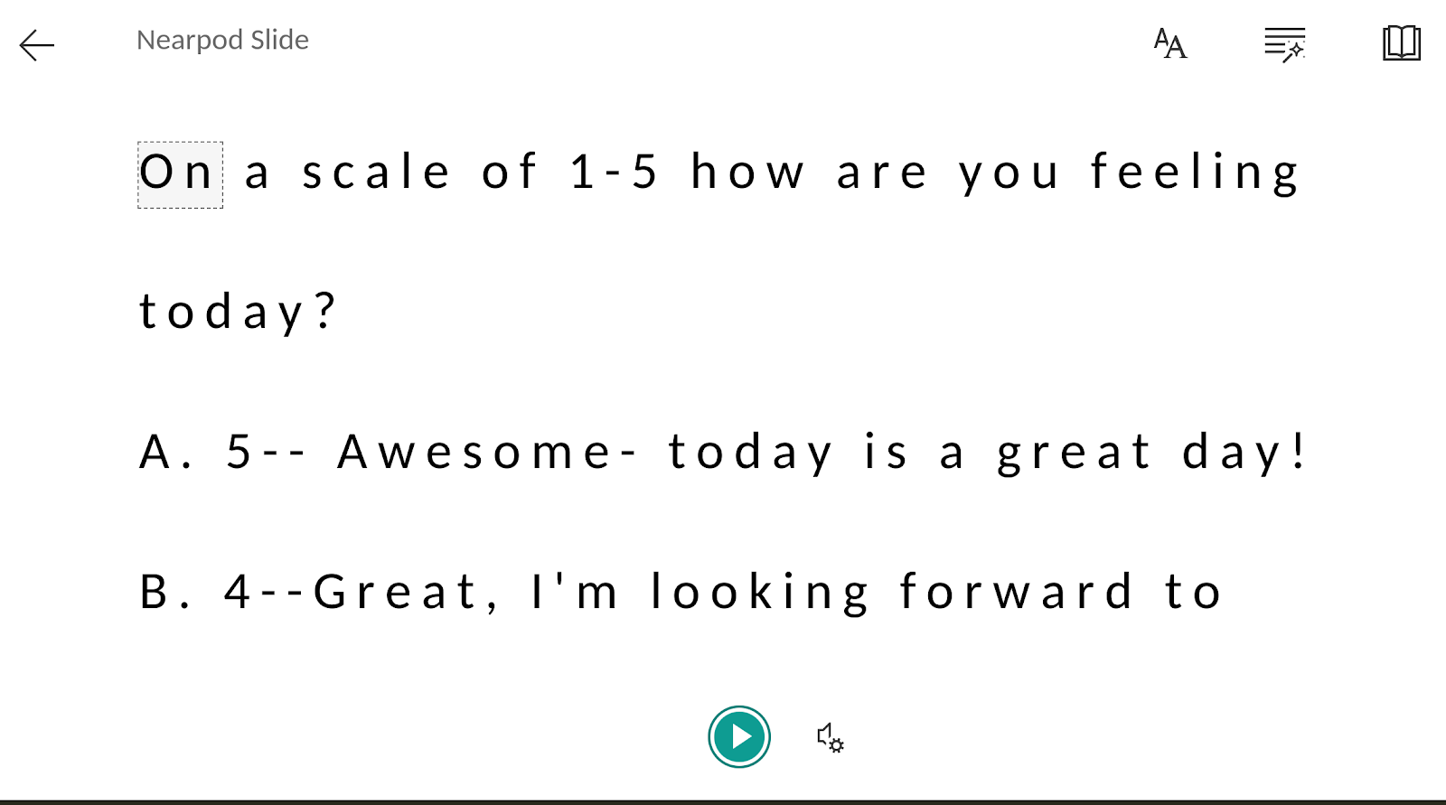
Nearpod
Immersive Reader
Audio resources and responses
In slides with text click on the immersive reader icon and it will open in reader.
Draw-it
Poll
Quiz
Open-ended question
Slides
Translates too!
Notes:
Nearpod is an application that allows you to create an interactive lesson that engages students using multiple means of representation. You can add many different types of media and activities that engage students in the content.
They also have Immersive Reader embedded into their draw-it, poll, quiz, open-ended questions and slides! Immersive Reader allows students to have the text read, but also translates and provides a picture dictionary for visual cues.
Nearpod also allows you to add audio directions and for students to respond using audio instead of typing or drawing their answers.
Presenter note: if you have Nearpod adding an example of an open-ended question here for the participants to click on and explore Immersive reader would help them understand the true power of having an application that has Immersive Reader in it.

Slide 37
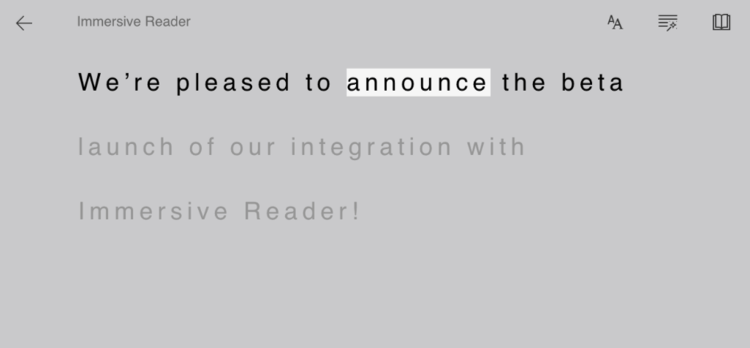
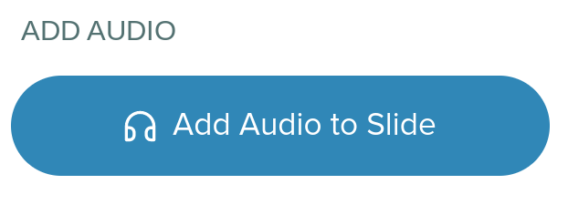
Pear Deck
Immersive Reader
Add Audio
Notes:
If you don’t have Nearpod, you might be looking at Pear Deck. They both provide the ability to create engaging lessons. Pear Deck also has Immersive Reader embedded into the platform.

Slide 38
Immersive Reader
Microsoft Product
Available in many platforms
Flipgrid (flipgrid.com)
Canvas (instructure.com/canvas)
Merge (mergevr.com)
Wonderopolis (wonderopolis.org)
Minecraft Education Edition
Buncee (buncee.com)
Wakelet (wakelet.com)
PowerSchool (powerschool.com)
ThingLink (thinglink.com)
Nearpod (nearpod.com)
Full List
Chrome Extension!
Notes:
As you can see Immersive Reader is available in many different platforms. It is a Microsoft product that is open source. This slide shows just some of the applications that have Immersive Reader in them, a full list is linked.
There is also a Chrome Extension that allows you to use Immersive Reader in any website.

Slide 39
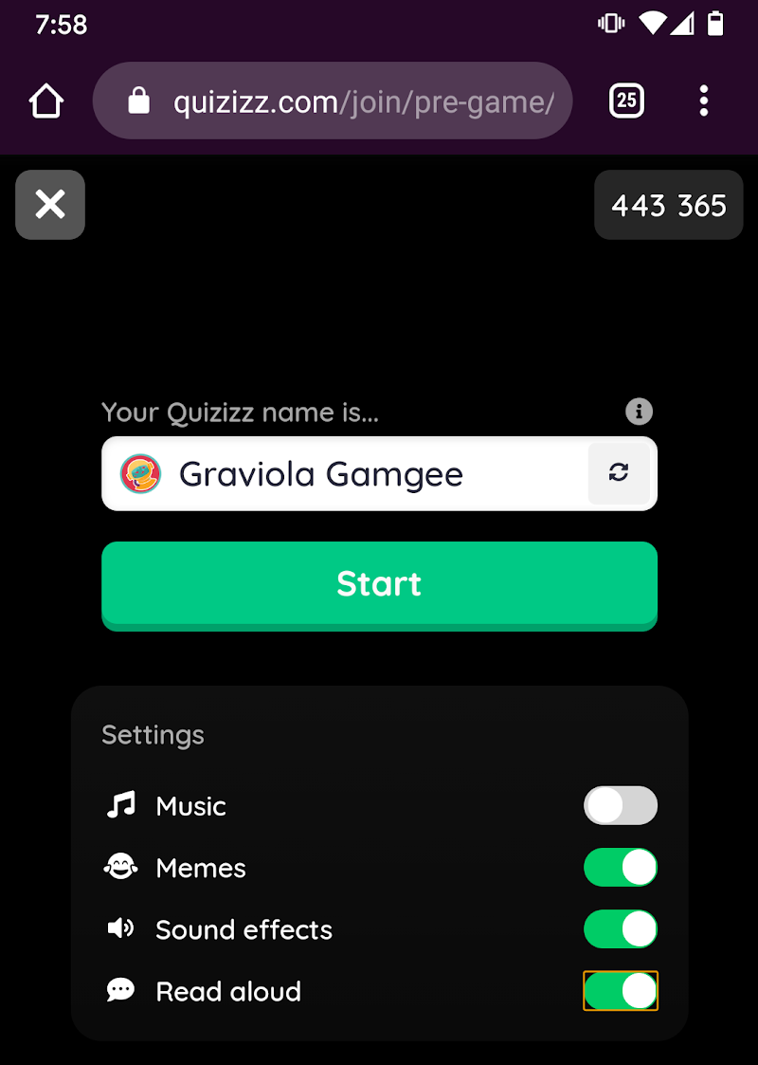
When exploring new apps
Look for accessibility features
Will all of your students be able to use the app to learn?
Example: Quizizz Has read aloud ability
Notes:
The key is when exploring any new app you should be asking yourself ‘Will all of my students be able to use the app to learn?’ An example of this is Quizizz, there are a lot of quiz type applications available. The key is to check to see if students are going to be able to access the quiz/game. In Quizizz students can select ‘Read aloud’ and the app will read the question and answers to them out loud!
Presenter note: This would be a good place to add an example of an application that you particularly want to highlight that has accessibility features built in. The key is to get participants to start thinking about asking this question whenever an application is requested.

Slide 40
Support
How do we support our students to become independent learners who can identify their learning needs and then select the tool that works for them?
Notes:
All these applications are great, but how do we assure our students can become independent learners, identifying their needs in the moment and selecting the tool that will best work for that need?
Presenter note: This may be a moment of brainstorming or having participants add their ideas to a Jamboard, to the chat or other collaborative board.

