Slide 1
FAMILIES AS PARTNERS
A ROUNDTABLE DISCUSSION
SESSION 6
Notes:
Families as Partners: Training Session 6
*Take a moment to introduce yourself, and if you want, have the group introduce themselves as well. Consider using a warm welcome and an activity from the SEL Playbook (https://schoolguide.casel.org/uploads/2018/12/CASEL_SEL-3-Signature-Practices-Playbook-V3.pdf).

Slide 2
Families as Partners Sessions
Session One: Families as Partners Overview
Session Two (2A) and Three (2B): Deeper Dive Into Partnerships
Session Four (3A) and Five (3B): Celebrating Successful Partnerships
Notes:
Provide an overview of upcoming sessions:
Session One: Families as Partners Overview
Session Two (2A) and Three (2B): Deeper Dive Into Support Structures
Session Four (3A) and Five (3B): Celebrating Successful Partnerships

Slide 3
Today’s objectives
Identify attributes of positive relationships, routines, and resources with families as partners.
Discuss successes and challenges as PD professionals when supporting relationships, routines, and resources with families as partners.
Share event agenda and activities for growing relationships, routines, and resources with families as partners connected to National Family Day.
Notes:
Provide an overview of session objectives:
Identify attributes of positive relationships, routines, and resources with families as partners.
Discuss success and challenges as PD professional when supporting relationships, routines, and resources with families as partners.
Share event agenda and activities for growing relationships, routines, and resources with families as partners connected to National Family Day.

Slide 4
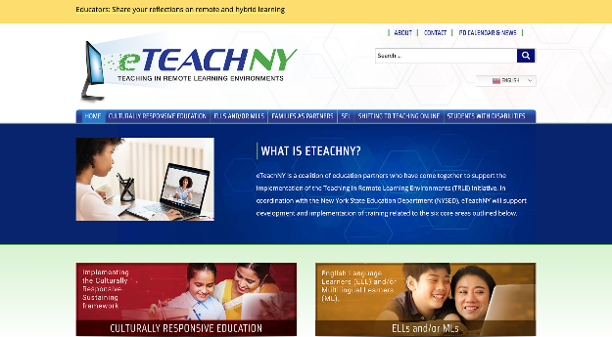
Materials needed
Access to the eTEACHNY Website
Families as Partners Slide Deck
Notes:
For today’s training, you will need a copy of this slide deck to guide conversations.
You’ll also want to visit eTEACHNY website - https://www.eteachny.org/. All of the resources shared today, plus future resources and resources from the other 5 areas of focus can be found on this website. You will want it in an easy place to return to and use.
Participants will benefit from having an electronic or printed version of the Session 6 slide deck and activity resources.

Slide 5
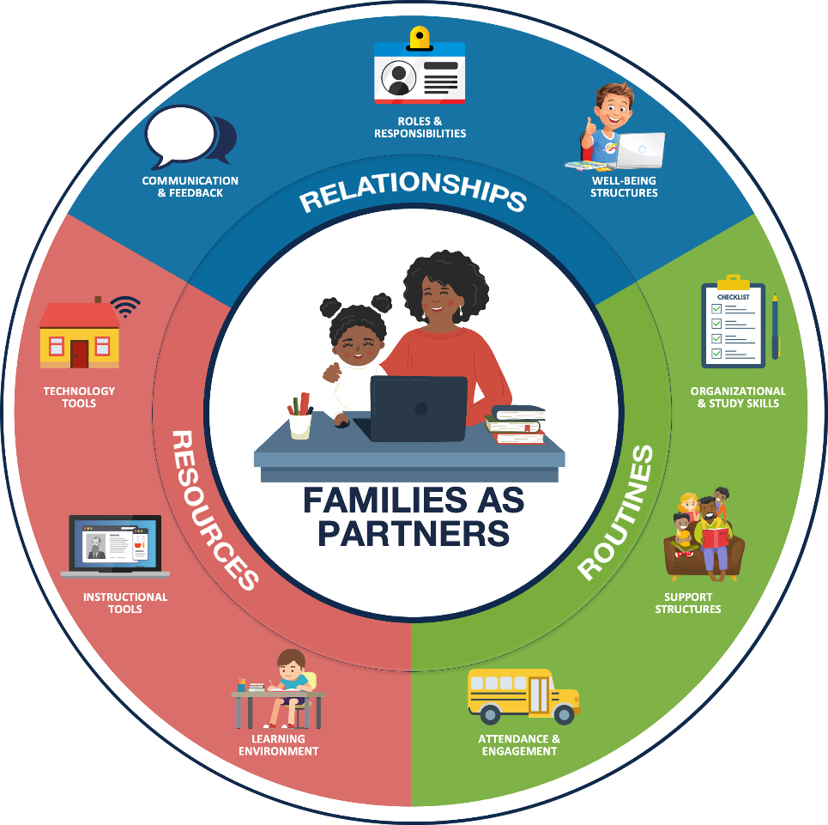
Foundation of partnership with families:
RELATIONSHIPS Positive connections that foster interaction and establish a nurturing environment of trust and support.
ROUTINES Rehearsed and predictable practices that provide structure to support efficient and effective learning.
RESOURCES Materials, Tools, and Supplies to support active learning and skill development.
Notes:
FOUNDATION OF PARTNERSHIP WITH FAMILIES: As teachers and leaders, we have always worked to develop and maintain positive experiences for students and families in our school buildings. We build relationships to foster positive connections and establish a nurturing environment of trust. We have routines in place that provide structure and support efficient and effective learning. Additionally, we ensure students have access to the materials, tools, and supplies needed to support active learning and skill development. Today we’ll look at how the pandemic has changed our approach - and as a result - how some of our newly adopted practices may change how we partner with families even after we return to fully in-person learning.

Slide 6
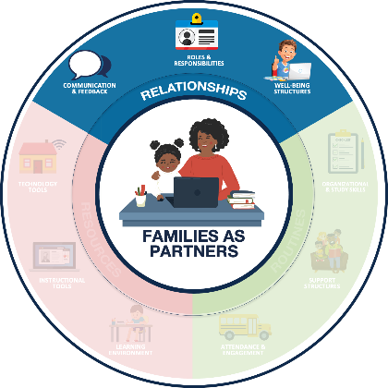
Relationships Positive connections that foster interaction and establish a nurturing environment of trust and support.
COMMUNICATION & FEEDBACK
ROLES & RESPONSIBILITIES
WELL-BEING STRUCTURES
Foster two-way communication (e.g., Minimize education jargon and use preferred communication channels)
Provide (actionable and regular) personalized information
Defining the team and the standard operating procedures
Managing expectations for all partners
Prioritize physical and emotional well-being
Promote Balance (e.g., allow breaks)
Notes:
RELATIONSHIPS:
Communications & Feedback: Fostering two way communication and personalizing information for families.
Roles & Responsibilities: Identifying the team and determining how you will work together to successfully manage expectations within the partnership.
Well-being Structures: Prioritization of physical and emotional well-being to promote balance.

Slide 7
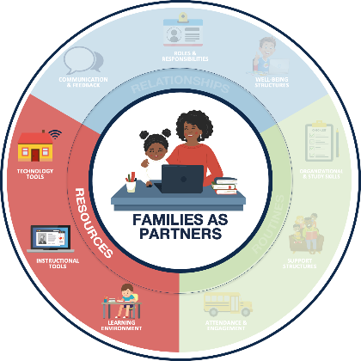
Resources Materials, Tools, and Supplies to support active learning and skill development.
LEARNING ENVIRONMENT
INSTRUCTIONAL TOOLS
TECHNOLOGY TOOLS
Dedicate a space for learning
Maintain an organized learning space
Leverage high-quality digital and print learning resources
Leverage consistent platforms across the district, when possible
Support access to devices and internet
Provide technology support resources and structures
Notes:
RESOURCES:
Learning Environment: A dedicated and organized space for learning.
Instructional Tools: Leveraging consistent platforms and high-quality digital and print resources.
Technology Tools: Access to devices, internet and technology support for these resources.

Slide 8
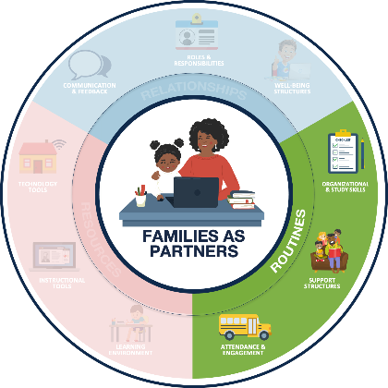
Routines Rehearsed and predictable practices that provide structure to support efficient and effective learning.
ORGANIZATIONAL & STUDY SKILLS
SUPPORT STRUCTURES
ATTENDANCE & ENGAGEMENT
Establish age-appropriate remote learning routines (e.g., setting weekly goals)
Encourage development of study skills (e.g., note taking templates)
Encourage students to reflect, identify needs, and seek help
Establish support routines (e.g., guardian learning office hours)
Foster regular communication about student attendance
Identify learning priorities and offer flexible structures (e.g., manageable and meaningful tasks)
Notes:
ROUTINES:
Organizational & Study Skills: Establishing learning routines and developing study skills.
Support Structures: Encouraging students to seek help when needed and establish routines to support those needs.
Attendance & Engagement: Fostering regular communication and flexible structures to promote student attendance and engagement.

Slide 9
How has COVID-19 impacted teaching and learning?
FAMILIES
EDUCATORS
LEADERS
The role of families in the learning process has shifted, putting new demands on parents and caregivers.
Parents, siblings, grandparents, daycare providers, and other partners are supporting learners while attending to other responsibilities.
Educators have taken on the challenge of shifting teaching and learning into remote formats.
Teachers are developing relationships, adjusting routines, and leveraging resources to support family partnerships and student learning.
Administrators have fostered the transition of traditional partnering practices into remote/hybrid learning environments.
Leaders are adjusting remote/hybrid learning plans based on feedback from educators and families.
Notes:
HOW COVID HAS IMPACTED FAMILIES, EDUCATORS, AND LEADERS:
FAMILIES: Parents, siblings, grandparents, daycare providers, and other partners are supporting learners while continuing to attend to other responsibilities. (i.e. balancing work, family needs, caring for multiple students at once, etc.)
EDUCATORS: Educators are developing relationships in new ways; adjusting routines and leveraging a variety of new resources to support the family and student learning partnerships.
LEADERS: Educational leaders are transitioning traditional effective partnering practices and adjusting plans based on feedback from educators and families.
*After setting the scene, you might consider a share out activity or even a brain break if you notice participants are wearing out. Checkout the engaging strategies and brain break ideas in the SEL Playbook from CASEL (https://schoolguide.casel.org/uploads/2018/12/CASEL_SEL-3-Signature-Practices-Playbook-V3.pdf)

Slide 10
Let’s Review
How to use the families as partners resources

Slide 11
Sessions 1-5 Resources
Overview Video
Assessment Workbook
Resource Outline
Action Toolkit
Action Templates
Reading Resources
Practical Vignettes
Celebrations Spreadsheet
Planning Spreadsheet
Reflection Spreadsheet
https://www.eteachny.org/families-as-partners/
Notes:
Overview of resources provided during TRLE turnkey trainings

Slide 12
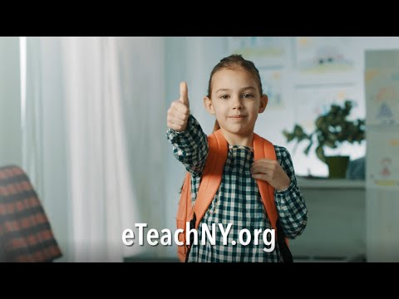
Families as partners Overview Video
https://www.eteachny.org/families-as-partners/
Notes:
Overview Video

Slide 13
Families as partners Assessment Workbook
https://www.eteachny.org/families-as-partners/
Notes:
Assessment Workbook

Slide 14
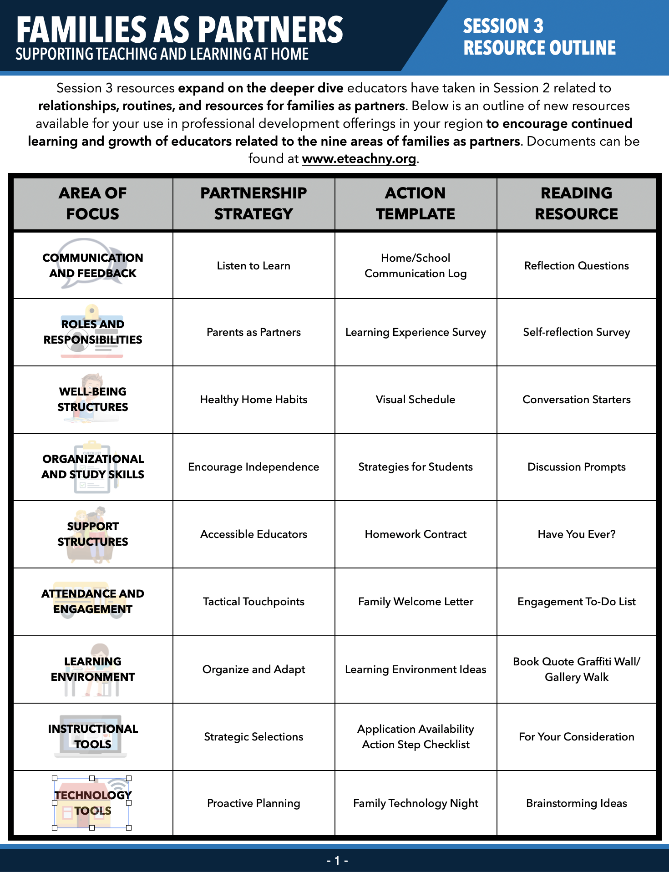
Families as partners Resource Outline
https://www.eteachny.org/families-as-partners/
Notes:
The Session 3 Resource Outline is a pdf document that gives participants a snapshot into the resources they can access to enhance their learning and development related to families as partners.

Slide 15
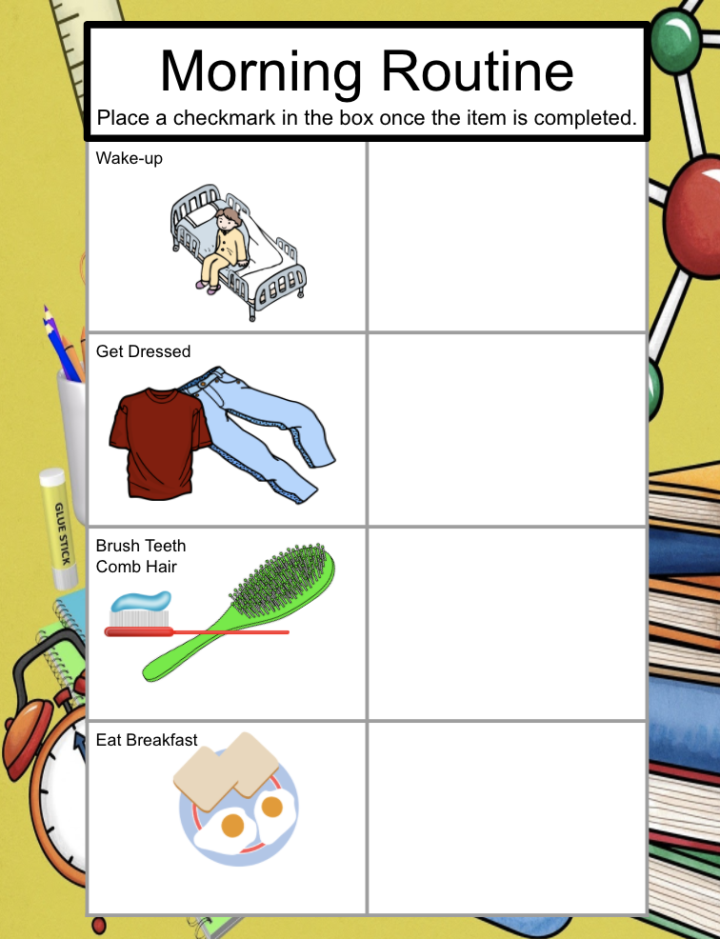
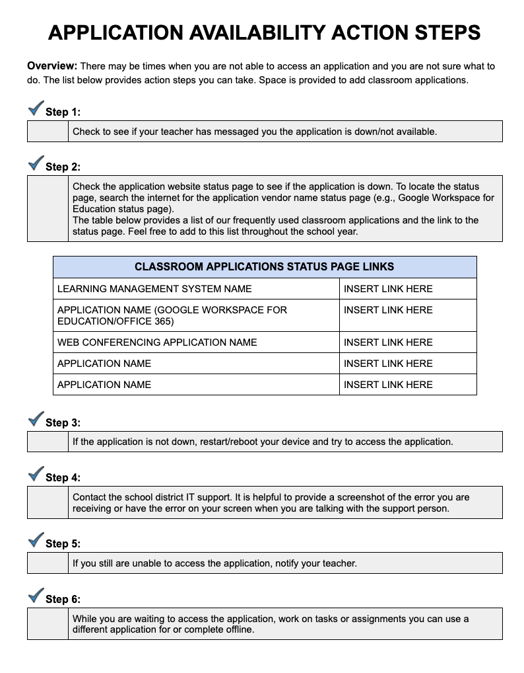
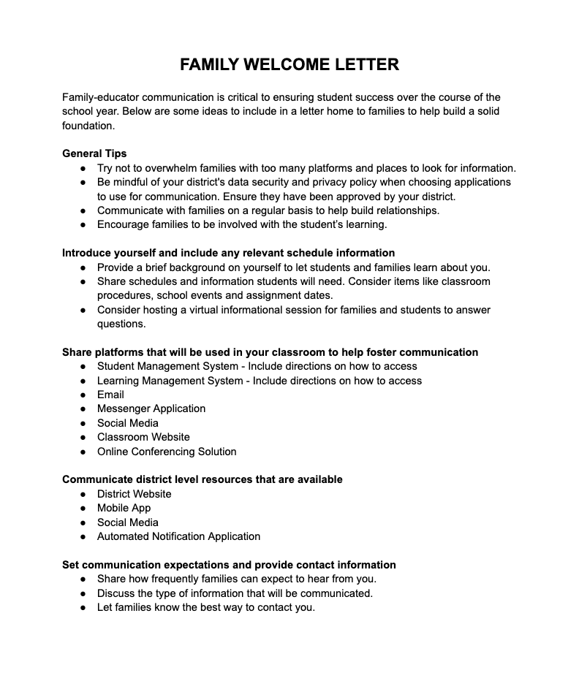
Families as partners Action Templates
https://www.eteachny.org/families-as-partners/
Notes:
A practical action template is a google-based template that can be used to make a best practice actionable. There is a different template for each of the 9 areas of the families as partners circle. These are available in both sessions 2 and 3

Slide 16
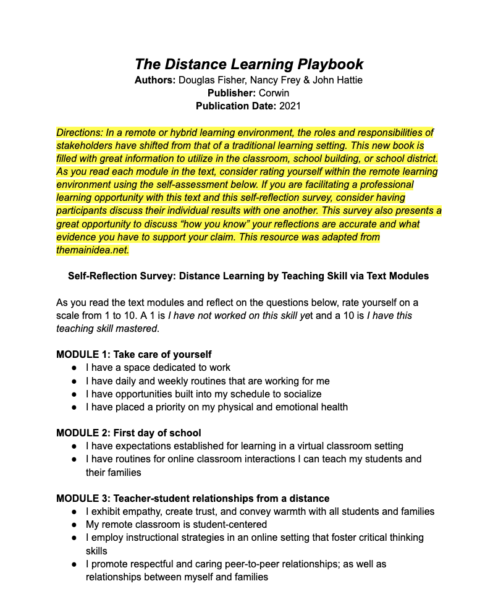
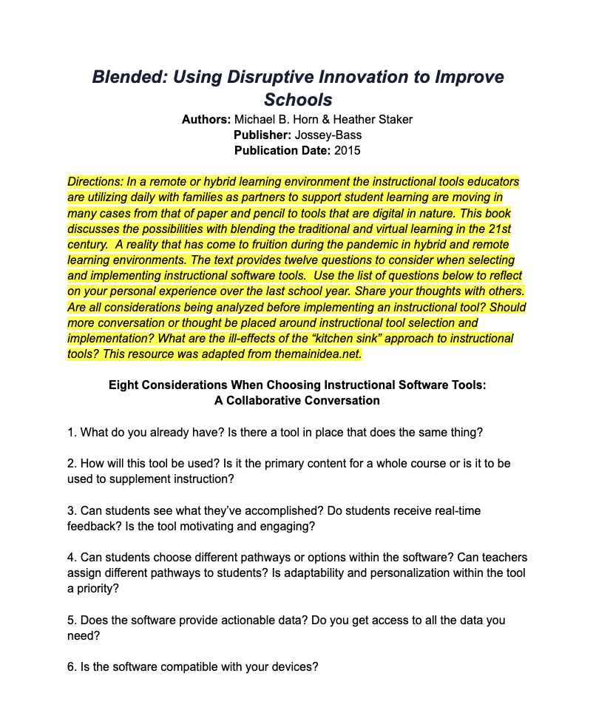
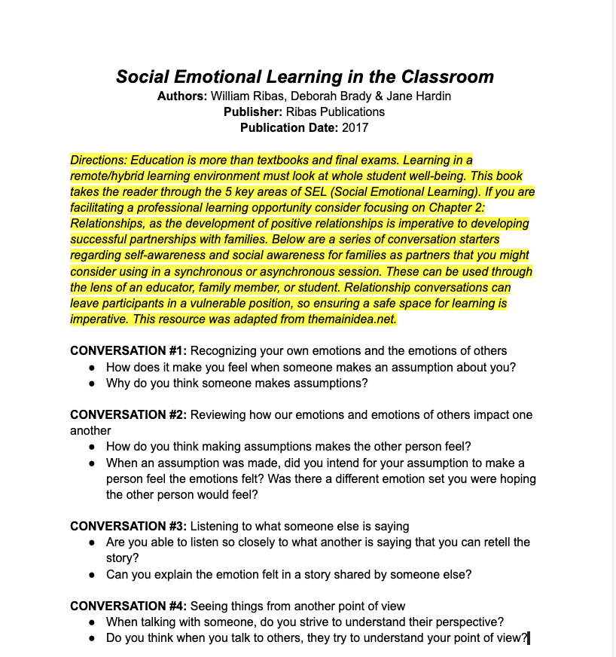
Families as partners Reading Resources
https://www.eteachny.org/families-as-partners/
Notes:
If you like to read, the Action Toolkit from Session 2 provided a book selection to checkout. The reading resource expands upon your interaction with the book in include an activity to do in combination with reading the text.

Slide 17
Families as partners Practical Vignettes
https://www.eteachny.org/families-as-partners/
Notes:
The practical activity vignettes are a tool used to explore practical scenarios educators might be encountering while supporting family partnerships in a remote or hybrid learning environment.

Slide 18
Families as partners Celebrations Spreadsheets
https://www.eteachny.org/families-as-partners/
Notes:
The first spreadsheet resource is Celebrations. In the spreadsheet you will find a column providing a link to a printable story of successful strategies to partner with families in a remote or hybrid learning environment, a description of the article’s content, and which areas of family partnership the celebratory article best aligns too.

Slide 19
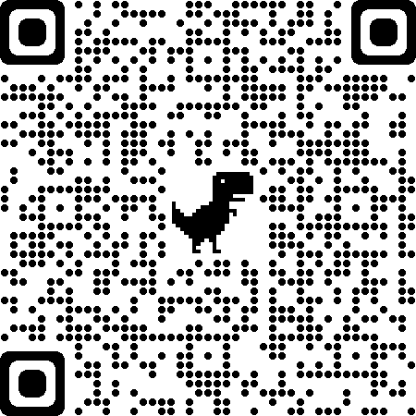
Get Outdoors! (NJ)
Successful Strategy to Celebrate
Learning Outside (Various Ideas)
Notes:
Use the QR code on this slide to view the article described in the title. Also, the area of partnership this article aligns to is highlighted.

Slide 20
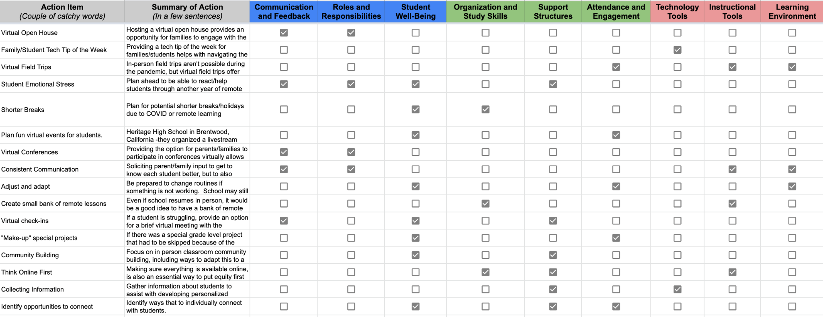
Families as partners Planning Spreadsheets
https://www.eteachny.org/families-as-partners/
Notes:
The second spreadsheet resource is a planning spreadsheet. In the spreadsheet you will find a column providing an action item idea, a summary of the possible planning to consider as the school year begins, and which families and partners category the planning activity best aligns too. Use this spreadsheet as a jumping off point for conversation and planning. Try a reflective exercise on the next slide to help facilitate conversations.

Slide 21
Families as partners Reflective Practices Spreadsheet
https://www.eteachny.org/families-as-partners/
Notes:
The third spreadsheet resource are spreadsheets of Ideas for Reflective Practice. In the spreadsheet you will find a column with a link to a reflective practice item (Website/printable/etc.) and a description of what the activity entails.

Slide 22
We do not learn from experience...we learn from reflecting on experience.
John Dewey
Notes:
Insert this slide as a reflective transition or conversation starter

Slide 23
Families as partners PD Examples
https://www.eteachny.org/families-as-partners/
Notes:
In each Session's slide deck, you will also find examples of how to use the resources from Session 1-5 in a PD format (synchronous, asynchronous, virtual, or face-to-face).

Slide 24
Let’s have a roundtable discussion about the successes and challenges of partnering with families this school year
Notes:
Consider hosting a roundtable discussion in your PD session about the successes and challenges of partnering with families. You might want to drop questions into the chat or move into breakout rooms or into small groups. You might consider brainstorming digitally or on chart paper. This is a great opportunity to bring a close to a year of successes and challenges.

Slide 25
Consider celebrating National Family Day in your region, district, or school building. National Family Day is the fourth Monday in September. This year that is September 27, 2021.
Notes:
Consider celebrating National Family Day in your region, district, or school building. An model agenda of ideas has been created as a jumping off point; as well as a flyer you could use for publicizing your event. You could host a day long event or a short event for a couple of hours. Events could be in person or families could be celebrated virtually.

Slide 26
Let’s dive in
How to use the families as partners resources

Slide 27
Additional resources
Additional resources to support the development of positive partnerships with families and other remote learning priorities can be found online at eTeachny.org.
Shifting to Teaching Online
Families as Partners
Students With Disabilities
English Language and Multilingual Learners
Culturally-Responsive Education
Social Emotional Learning
Notes:
If you are looking for more resources related to families as partners or any of the other 5 categories of support, please go to https://www.eteachny.org/ to access countless resources to support educators during the transition to remote and hybrid learning environments.

Slide 28
Questions?
Notes:
This concludes Families as Partners: Training Session 6. Questions?
*Consider ending using an optimistic closure from the SEL Playbook (https://schoolguide.casel.org/uploads/2018/12/CASEL_SEL-3-Signature-Practices-Playbook-V3.pdf).

